Slide 1
CIT Intern Status Report Clinic
SESSION AGENDA:
Review purpose and scope of Status Reports
Analyze samples
Discuss writing a report for a struggling Intern
Ask questions and get assistance with your own Intern Status Reports
Find all materials here: https://www.rcsdk12.org/Page/50046

Slide 2
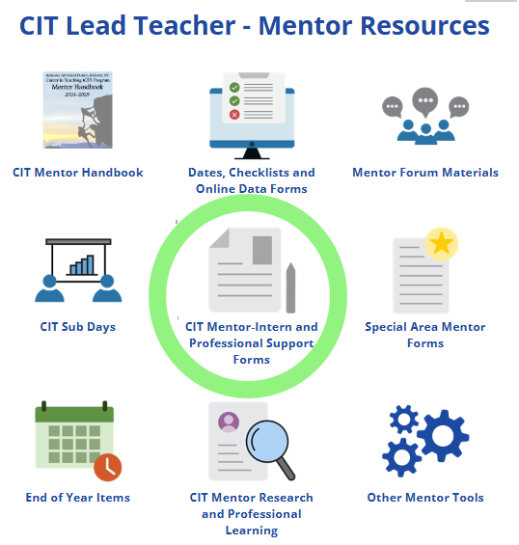
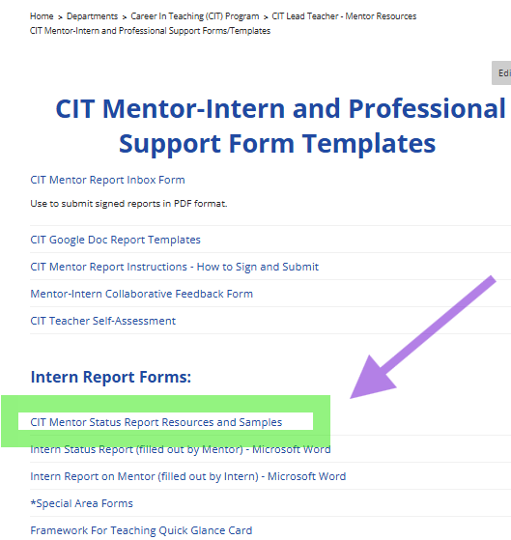
Intern Status Report
www.rcsdk12.org/CIT/Resources

Slide 3
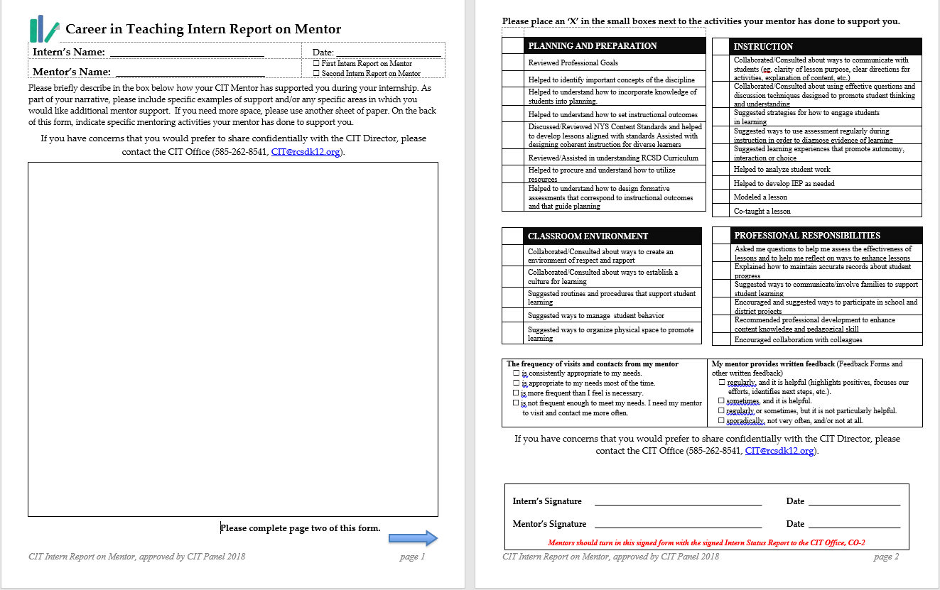
Intern Report on Mentor
The Intern Report on Mentor is also due with the Intern Status Report and should be completed by the Intern and signed by both the Mentor and Intern.

Slide 4
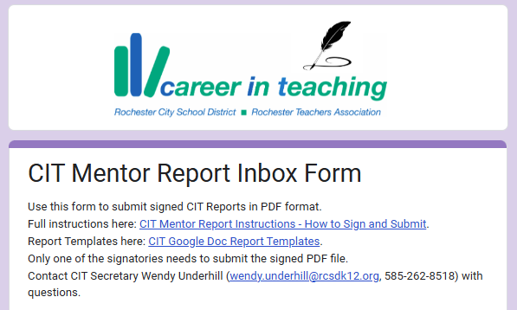
Find, Complete, Sign, & Submit CIT Forms with “CIT Mentor Report Inbox Form”
Full instructions at CIT Mentor Report INSTRUCTIONS
Contact Stefan if you have not had sufficient opportunity to observe your Intern and need a deadline extension, or if you are noticing signs of an Intern in trouble (domains or components that are persistently ineffective).

Slide 5
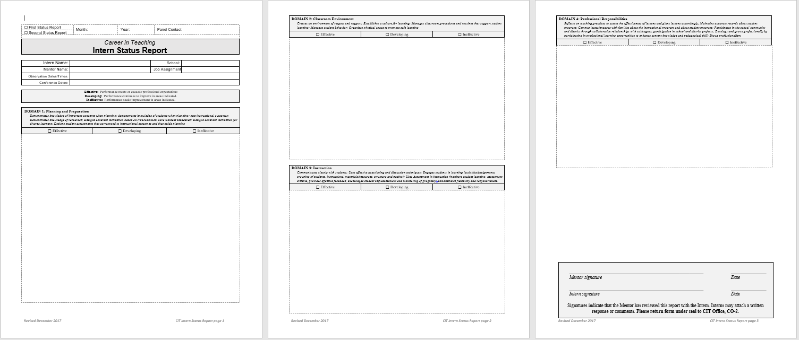
What’s it all for?

Slide 6
STEFAN’s NOTES on WRITING INTERN STATUS REPORTS
Keep in mind the dual purpose of the Intern Status Report:
to reinforce feedback for your Intern about the strengths and challenges you have identified and the aspects of practice that you will focus on in your work together going forward, and
to provide the CIT Governing Panel with evidence of the Intern’s strengths, challenges, and progress.
Intern Status Reports should draw from your notes and feedback with specific examples to illustrate the Intern’s progress. This evidence should align with the four domains in the Danielson Framework for Teaching.

Slide 7
STEFAN’s NOTES on WRITING INTERN STATUS REPORTS
The report should reflect the ongoing work you have done with your Intern—a summation of feedback and goal-setting leading up to the report with no surprises for your Intern. If this is the second Intern Status Report, it should include specific evidence of growth since the first report.
You must provide time to review the Status Report at length with your Intern. You must not simply give the report to your Intern to sign. This learning-focused conversation is essential to effective mentoring. Make sure you both sign the report.

Slide 8
STEFAN’s NOTES on WRITING INTERN STATUS REPORTS
Be honest with your feedback and when you assign ratings. Check rubric language in determining these ratings, and make sure to provide evidence to support the rating you select. Remind the Intern that the Status Report is not and is not part of the Intern’s APPR. We expect our Interns to be “Developing” in some (if not all) domains. An “Effective” rating indicates effective practice in all components of that domain.
The report is an opportunity to provide some relevant context to better understand the Intern’s strengths and challenges, but keep this to a minimum. Clear illustrations of practice are more important.

Slide 9
STEFAN’s NOTES on WRITING INTERN STATUS REPORTS
Ask yourself: if a discussion about this intern is brought to the CIT Governing Panel, does this report include enough information for the Panel to make a recommendation? Does this report clearly demonstrate for the intern his or her strengths and the areas of practice that need additional work?

Slide 10
Sample Status Report #1
Read the sample provided and annotate as you read. Mark it up, highlight, capture questions:
What do you notice? What questions does it raise?
What is problematic about this report?

Slide 11
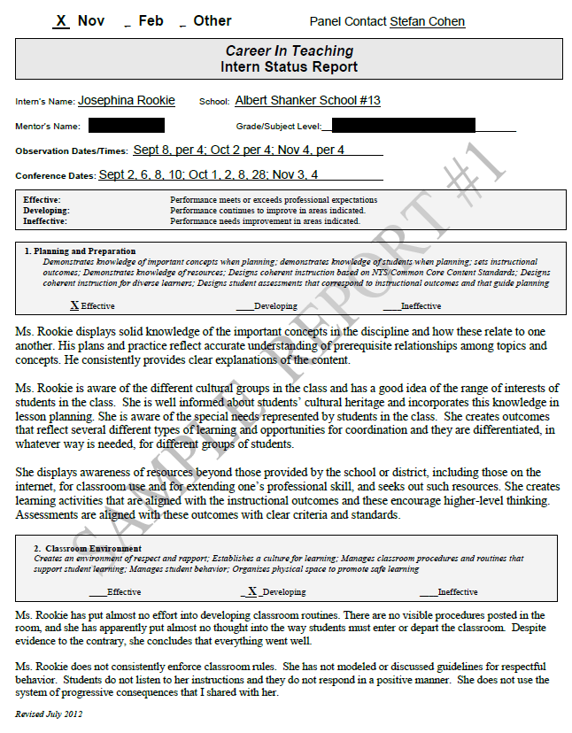

Slide 12
Sample Status Report #2
Read the sample provided and annotate as you read. Mark it up, highlight, capture questions:
What do you notice? What questions does it raise?
What are the strengths of this report?

Slide 13
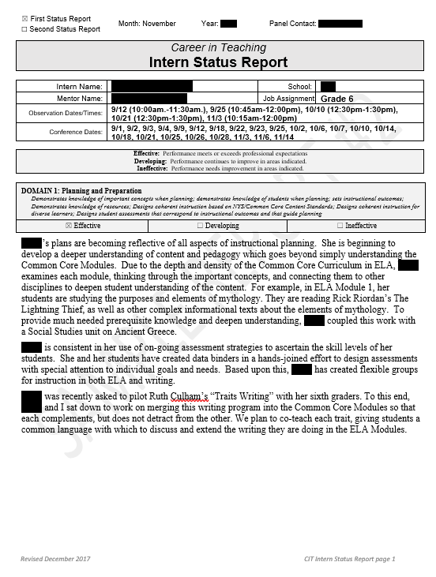

Slide 14
Domain-based Evidence
How does teacher interact typically with kids? Describe.
Do students like being there? Comfort level? Positive?
Expectations clear?
Specific rituals and routines?
Teacher reflective? Open to improvement, growth process?
Examples of family contact? Relationships with colleagues?
Involved in life of school?
Professional learning?
Hard worker? Prepared?
Thoughtful planner? (or “winging it”?)
Clear about Outcomes?
Plans incorporate Student Needs, Interests, Culture?
What’s the Planning “Process”? Collaborative?
Examples of specific lessons.
Purposeful? Instructions clear?
Students engaged? Participating? What are students doing?
How do we know what students are learning? (Assessment?)
Pacing? Closure? Feedback?

Slide 15
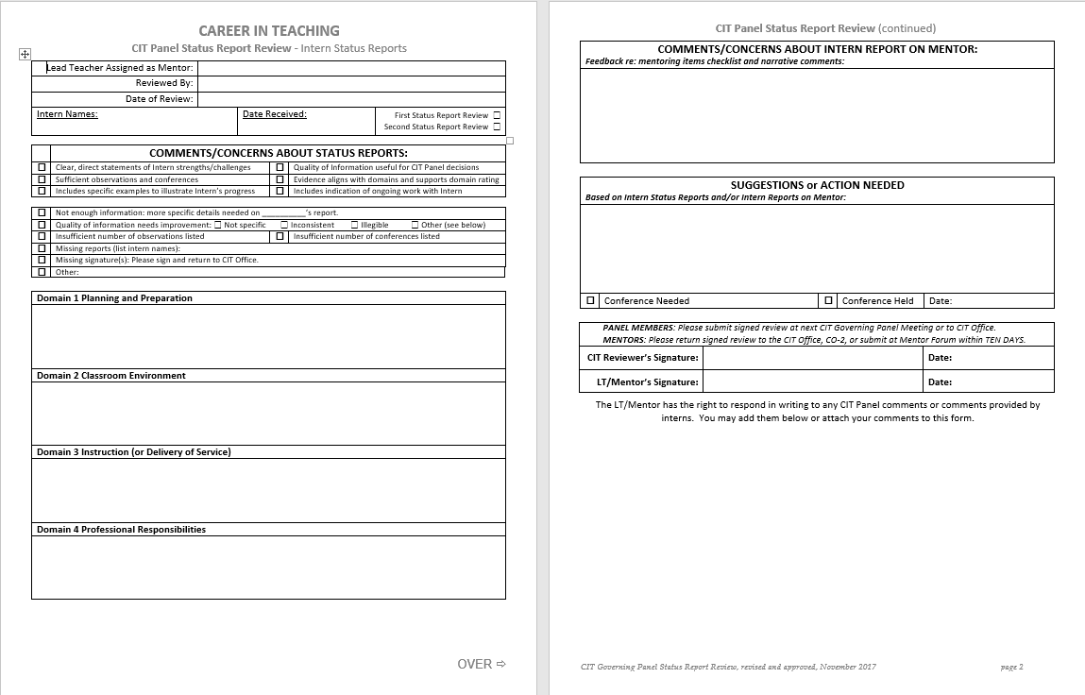
CIT Panel Status Report Review

Slide 16
The Struggling Intern
CIT Intern Status Reports
Stefan Cohen, CIT

Slide 17
When you are writing a Status Report for a Struggling Intern…
Avoid blame
Avoid scolding
Avoid judgmental tone
Avoid assuming you know what the Intern is thinking
Avoid speculating about motivation, effort
Avoid a tone of exasperation or resentment
Avoid generalizations about failure
Avoid piling on (one representative example is enough)
Avoid personal referencing

Slide 18
When you are writing a Status Report for a Struggling Intern…
Frame as ongoing discussion and ongoing work
Frame with goal-setting, next steps
Use positive presupposition: based on assumption that Intern has desire and ability to improve and succeed
Frame struggles as challenges/obstacles to overcome
Discuss the efforts that have been made
Be specific about the problem in the context of working together for improvement.

Slide 19
Resist writing . . .
There is no consistency ….
There are no established expectations for students …
…tries to … but does not succeed…
Classroom management is lacking …
…has not taken my suggestions about…
…doesn’t care about . . .
...has made no effort to…
…has no interest in improving routines…
There is no evidence of any . . .
…has failed to…
There was no instruction given to students
There seem to be no clear expectations for ….
…doesn’t take any suggestions made to . . .
There is no learning taking place
…has not planned lessons …
…does not implement the curriculum correctly…
…knows little about her students’ lives…
Students do not listen to ….
…made poor choices when he ….

Slide 20
Better . . .
… is working to improve her ….
…will need to work on consistently …
…continues to struggle with…
…[aspect of practice] is challenging for . . . .
An area of concern for …. is ….
…will need to be more consistent…
…has made efforts to …., but results are inconsistent…
…has made efforts to ..., but continues to find … challenging
…continues to work on …
… will need to invest additional effort into …
We have been working on…
We have discussed the need to …
We have discussed ways to…
We have made plans to …
We will continue to work on consistently implementing…
We will need to focus on…
I have shared ideas and resources with … to improve …
Going forward, we will work to …
I am hopeful we will see more evidence of…

Slide 21
When you are writing a Status Report for a Struggling Intern…
Be honest, but without judgment.
Don’t avoid identifying problems, but make sure your role is one of support, and that the goal is growth.

Slide 22
In addition, when discussing the Status Report with a Struggling Intern…
Remind Interns that although this is evaluative, this is not APPR.
Use the Danielson Rubric as a THIRD POINT!
Assure Interns that “Developing” is perfectly appropriate for a new teacher.
Emphasize that the goal is to raise “Ineffective” and “Developing” to a higher rating, and …
Have a plan to do so.

Slide 23
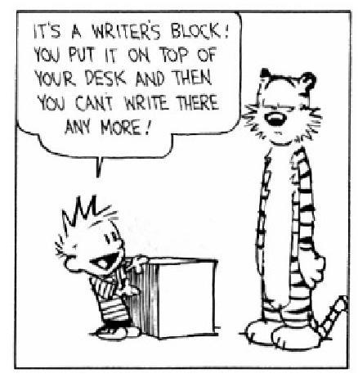
Questions?
Work Time!

