Slide 1
CIT May Mentor Forum & Interns of the Year Celebration
May 20, 2024
Introduce yourself to other Mentors at your assigned table.
Identify the new or nearly-new Mentors at your table.
Experienced Mentors: Ask the Rookies if they have questions.
New (or nearly New) Mentors: Ask the Veterans your questions.

Slide 2
CIT May Mentor Forum & Interns of the Year Celebration
May 20, 2024
AGENDA:
Share Wisdom with a Newbie!
How was Your Year? Rose-Thorn-Bud
What’s New with CIT? Numbers & Changes
Uncertified Teachers, Layoffs, etc.
Wrapping Up. What’s New?
How Might We Help with Transition
Celebrate our CIT Interns of the Year

Slide 3
CIT Forum Ground Rules
Respect (for this work, ideas, time, space, each other)
Participation and Focus (vs. electronics)
Confidentiality
Open Minds
Others?
Notes:
Stefan

Slide 4
Let’s Reflect . . .
Turn to a partner. Share one mentoring ‘Rose,’ one mentoring ‘Thorn,’ and one mentoring ‘Bud.’
MENTORING ROSE A highlight or something that went well. | MENTORING THORN A challenge or something you struggled with. | MENTORING BUD A goal or something you want to work on.

Slide 5
Thanks to your work with your Intern . . .
Your Intern Mastered a New Skill/Strategy
Your Intern Built Positive Relationships with Students
Your Intern Built a Working, Constructive Relationship with a Co-teacher or Administrator
Your Intern Grew to Trust You or Your Intern No Longer Fears Asking for Help
Your Promising Intern Chose to Stay in the RCSD
Your Struggling Intern “turned the corner” and Found Success
Your Intern gave you Positive Verbal Feedback: You are Appreciated!
You were there for your Intern when they really needed you
Others?

Slide 6
Congratulate a Mentor Rookie!!
During Dinner Later . . .
Check in with the new Mentors near you to ask them about their year!

Slide 7
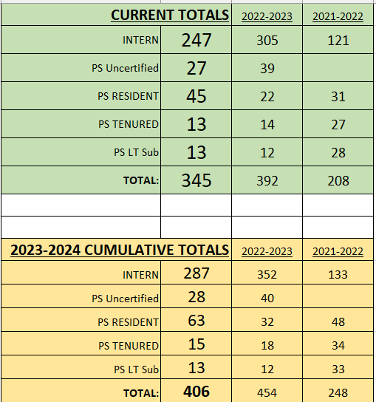
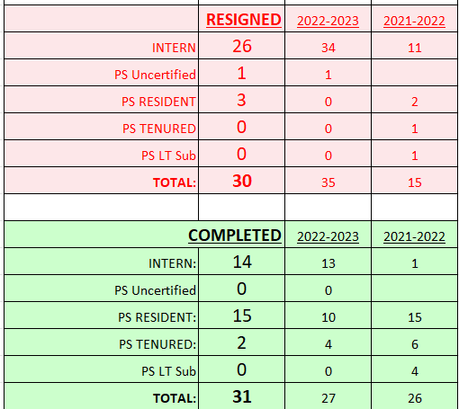
CIT Support Data September 2023-May 2024

Slide 8
Layoffs & Transfers & Bears, oh my!
3:30 PM Check-in Event starts at 4:15 PM
All Middle Schools & Padilla High School
May 20th – Library, Social Work, Counseling, Music, Art, Phys Ed, ESOL/ENL, Reading, Health tenure areas (K-12)
May 22nd – Math, Science, English, Social Studies, Family Consumer Science, Tech, Business/Marketing, Foreign Lang. tenure areas (Core Academic)
May 28th – Special Education tenure area
Receivership week
May 30th – June 5th
Exempt week
May 31st – June 5th
All other Non-Receivership High Schools, Elementaries
June 10th – Library, Social Work, Counseling, Music, Art, Phys Ed, ESOL/ENL, Reading, Health tenure Areas (K-12)
June 12th – Math, Science, English, Social Studies, Family Consumer Science, Tech, Business/Marketing, Foreign Lang. tenure areas (Core Academic) June 13th – Special Education tenure area (Will be held in person TBD location, online okay, too)
June 17th -- Elementary Tenure Area
Mentor Priority: Listening, Validating, Sympathy, & Perspective
Avoid guessing: refer to written instructions from the district and RT
Perspective: once this period of uncertainty wraps up, . . .

Slide 9
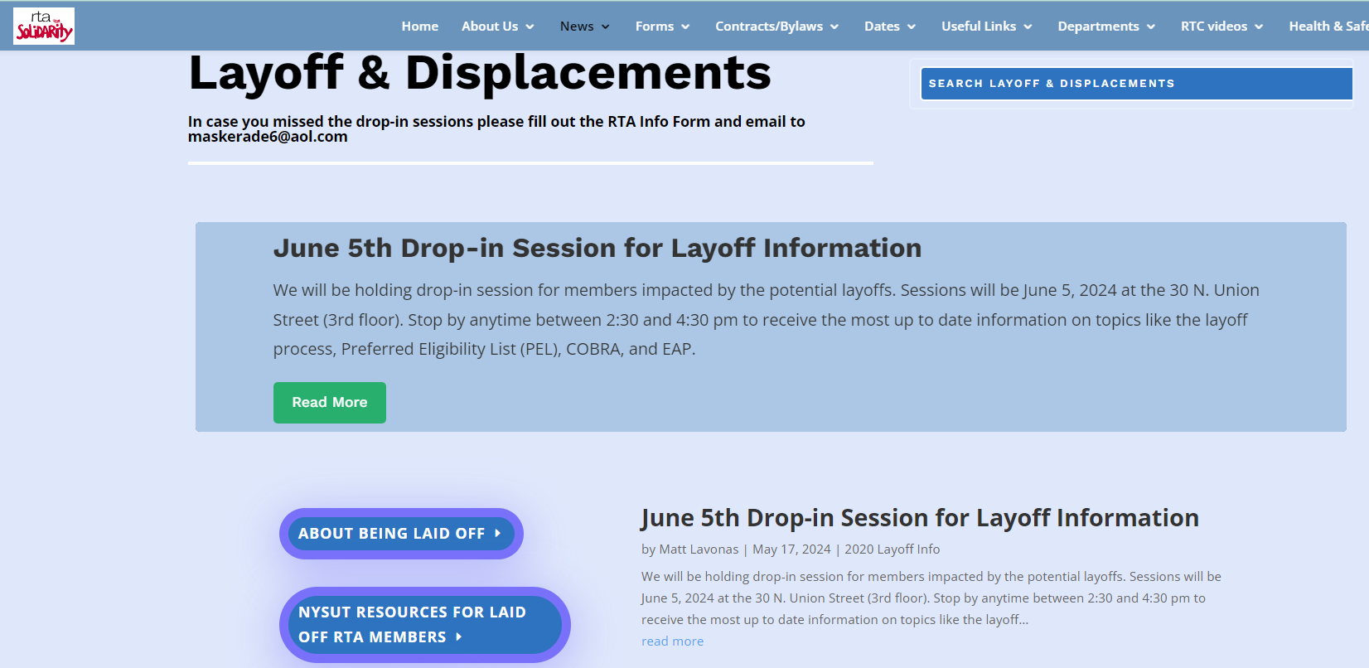
Layoffs
If you are supporting a certified, probationary elementary teacher who received a layoff letter:
Mentor Priority: Listening, Validating, Sympathy, & Perspective
Placed on a "Preferred Eligibility List" (PEL) and recalled from that list in order of seniority.
Benefits continue through August
June 5th Drop-In at RTA Office 2:30-4:30 pm https://rochesterteachers.org/potential-layoffs/
Perspective: district hiring outlook is changing constantly, especially as staffing shifts are made for the fall.
Ask Intern to keep you informed.
www.rcsdk12.org/CIT/Layoff

Slide 10
Uncertified Contract Substitutes
If you are supporting an uncertified teacher/service provider:
Mentor Priority: Listening, Validating, Sympathy, & Perspective
“Contract Substitute” appointments end June 30th.
Benefits continue through August
Displaced for Transfer Day…position becomes a “Vacancy”
Certified teachers must be prioritized in filling vacancies.
If making significant progress on their TCAP, and a vacancy remains, they may be able to return as a contract sub.
Perspective: district hiring outlook is changing constantly, especially as staffing shifts are made for the fall.
Ask your Intern to keep you informed.
www.rcsdk12.org/CIT/Certification

Slide 11
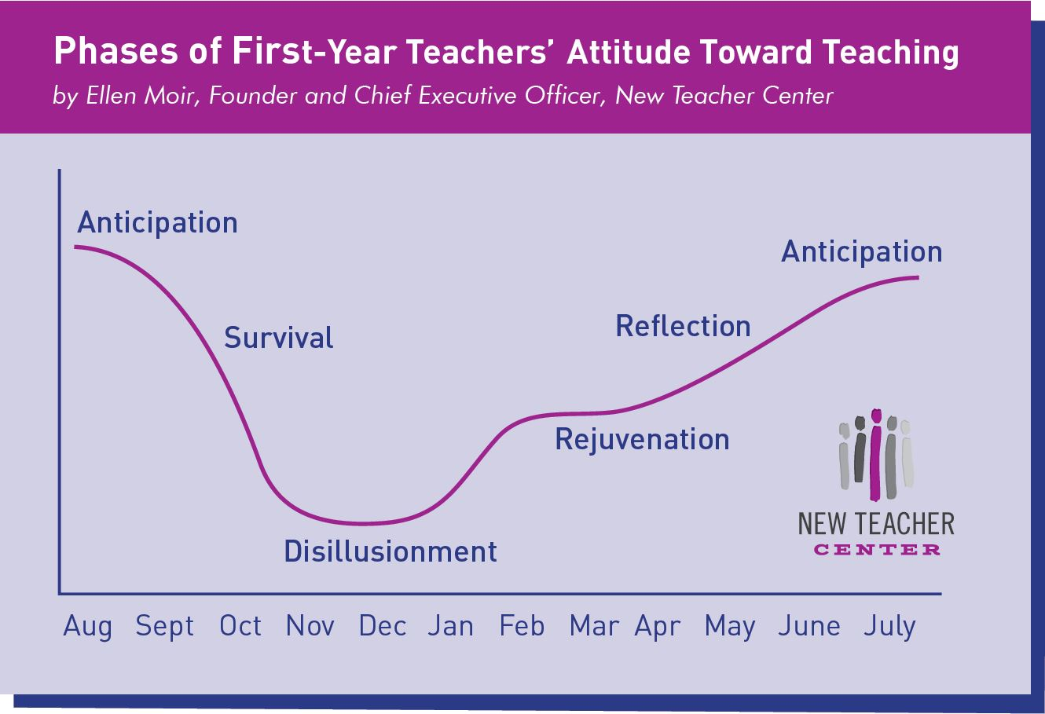
Time for Reflection
Notes:
Mentoring Matters, third edition, page 12.

Slide 12
OFFER SUPPORT by providing information and tips regarding end-of-year events and paperwork. Share your routines for organizing end-of-year tasks. Make a gift pack of colored markers, tape, and stickers for labeling boxes. Start a list of items to order for next year.
CREATE COGNITIVE CHALLENGE Make connections between what was expected, what was desired, and what actually occurred. . . . Structure a learning-focused conversation [to] surface insights, applications, and goals for the coming year.
FACILITATE PROFESSIONAL VISION Explore student successes and mark the specific turning points for them and your [Intern]. Share high points and low points and notice patterns or categories. Collaborate on constructing a professional growth plan for the coming year.
And CELEBRATE!
Mentoring Matters, third edition, page 12.
Notes:
Mentoring Matters, third edition, page 12.

Slide 13
End-of-Year for Interns
End of year evaluation: TEACHBOOST
Your Final Report: Recommendation
End-of-year Survey
New Educator Orientation (August 19-21st)
Professional Support Requests

Slide 14
A New Tool for our 2023-2024 Interns
Was distributed at New Educator Orientation in August
Did you use the text this year as a reference – a “third point?”
Discuss at your table if you found the text useful, or discuss ways you might use it in the coming school year.
Please share any insights on the survey you will receive later tonight.

Slide 15
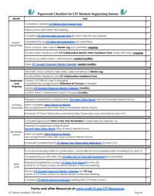
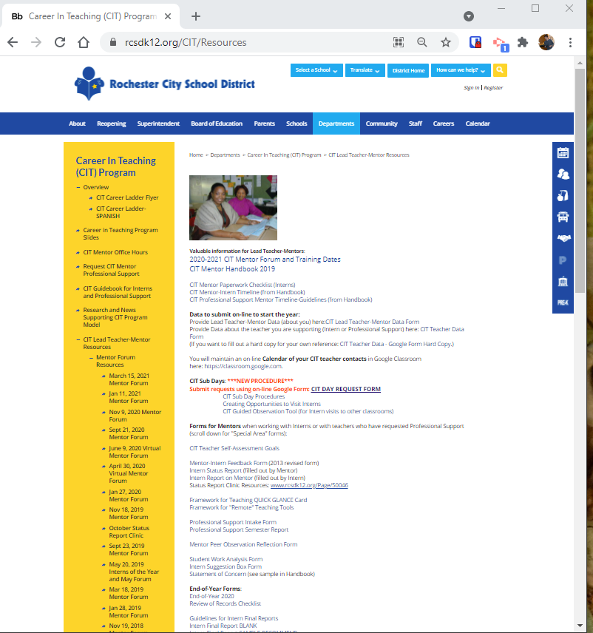
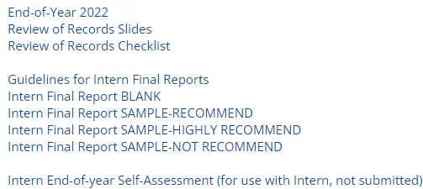
Wrapping up Intern Paperwork
Panel Contact Review of Records
www.rcsdk12.org/CIT/Resources

Slide 16
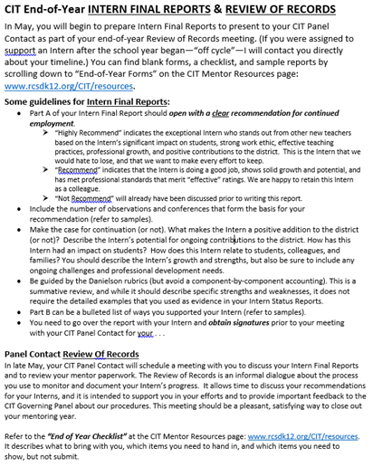
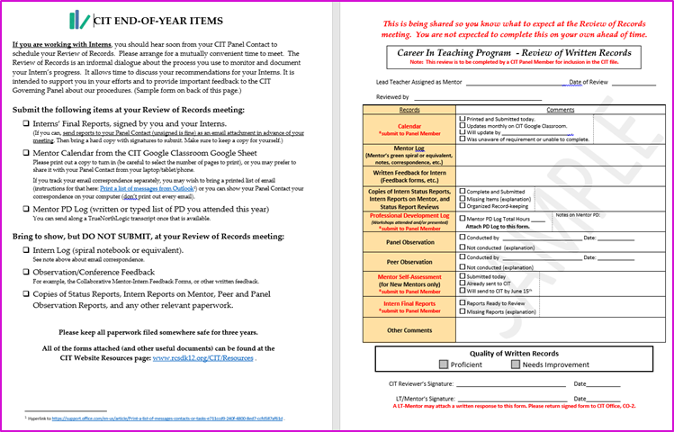
Wrapping up Intern Paperwork
Panel Contact Review of Records
www.rcsdk12.org/CIT/Resources

Slide 17
End-of-Year Tutorial (or “Refresher”)
Tuesday, May 21st at 3:00 PM, and again at 4:15 PM on Microsoft Teams

Slide 18
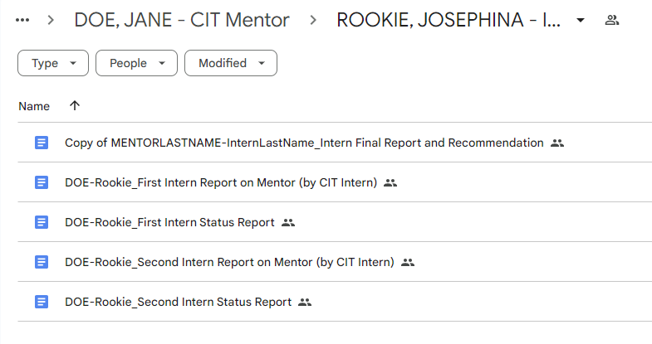
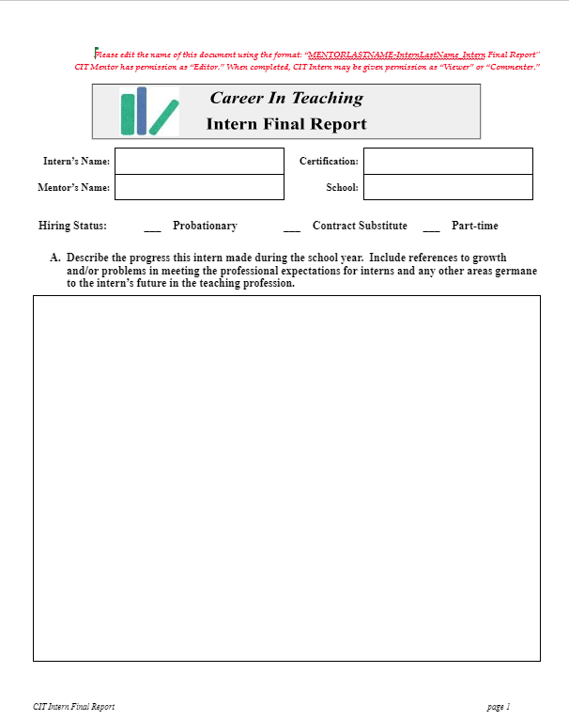
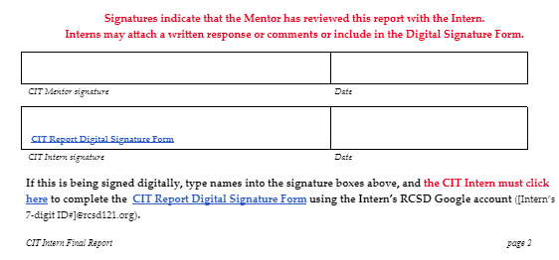
What’s New…Google Department Drive

Slide 19
Meeting the Current Moment: REFLECTION TIME!
2024-2025 School Year
New Superintendent
New Middle Schools
New Principals
New Colleagues
New Assignments
Notes:
Think/Write-Pair-Share

Slide 20
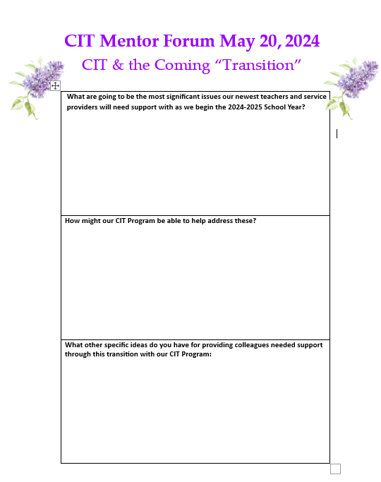
INSIGHTS? Please Discuss and Share
10 minutes

Slide 21
Intermission
We will reconvene to celebrate at 5:15 p.m.

Slide 22
2024 CIT Interns of the Year
Chester Shellman | Fifth Grade | School #22
Alexis Lodico | Science VII-VIII | School #28
Damaris Reinosa Traverso | Bilingual Speech | School #22
Ashley Pheilshifter | High School ENL | East Upper
Sylvia Rooney | First Grade Bilingual | School #12
Andrea Singletary | Third Grade Bilingual | School #33
Jessica Hands | School Psychologist | Edison Tech

Slide 23
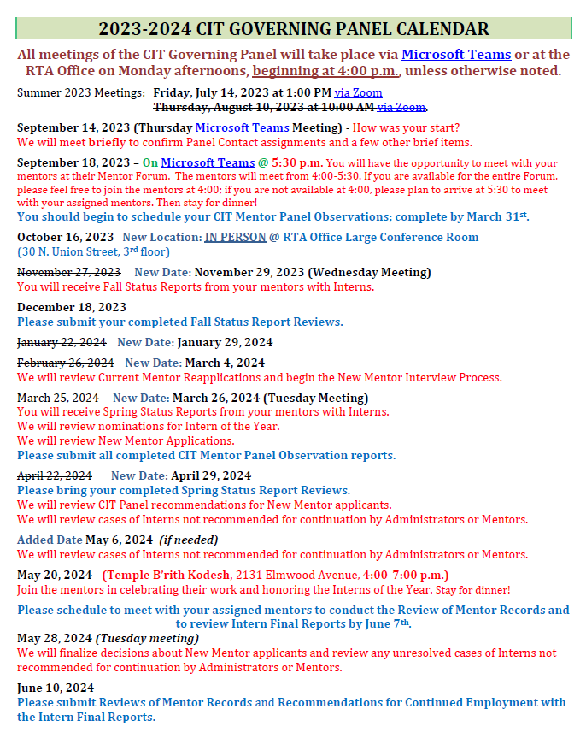
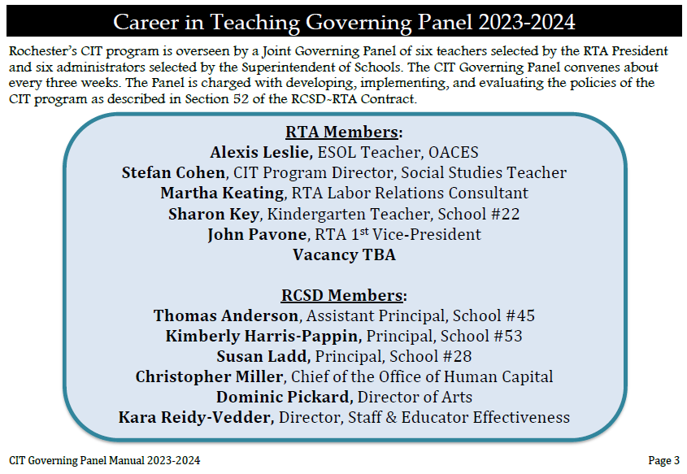
Thank you to our CIT Governing Panel

Slide 24
Fond Farewells to these Retirees . . .
Phil Gauldin
Lisa Tilley

Slide 25
2024 CIT Interns of the Year
Chester Shellman | Fifth Grade | School #22
Alexis Lodico | Science VII-VIII | School #28
Damaris Reinosa Traverso | Bilingual Speech | School #22
Ashley Pheilshifter | High School ENL | East Upper
Sylvia Rooney | First Grade Bilingual | School #12
Andrea Singletary | Third Grade Bilingual | School #33
Jessica Hands | School Psychologist | Edison Tech

