Slide 1
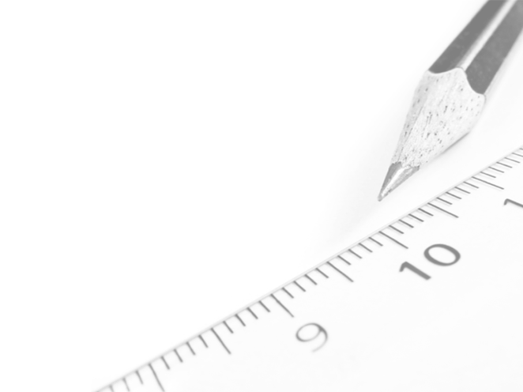
Geometry- Lesson 9
Unknown Angle Proofs- Writing Proofs

Slide 2
Essential Question
Write unknown angle proofs, which does not require any new geometric facts.
String together facts you already know to reveal more information.

Slide 3
Opening Exercise (5 min)
One of the main goals in studying geometry is to develop your ability to reason critically, to draw valid conclusions based upon observations and proven facts. Master detectives do this sort of thing all the time. Take a look as Sherlock Holmes uses seemingly insignificant observations to draw amazing conclusions.
Sherlock Holmes: Master of Deduction!
Could you follow Sherlock Holmes’s reasoning as he described his thought process?
Notes:
-During this example, students will watch a video clip and discuss the connection between Holmes’s process of identifying the attacker and the deduction used in geometry.
-Emphasize that Holmes makes no guesses and that there is a solid piece of evidence behind each conclusion.

Slide 4
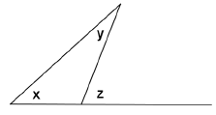
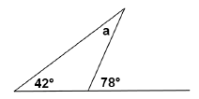
Discussion (10 min)
You needed to figure out the measure of 𝒂, and used the “fact” that an exterior angle of a triangle equals the sum of the measures of the opposite interior angles. The measure of 𝒂 must therefore be 𝟑𝟔°.
Suppose that we rearrange the diagram just a little bit.
Instead of using numbers we’ll use variables to represent angle measures…

Slide 5
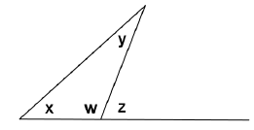
Suppose further that we already have in our arsenal of facts the knowledge that the angles of a triangle sum to 180°. Given the labeled diagram at the right, can we prove that 𝑥 + 𝑦 = 𝑧 (or, in other words, that the exterior angle of a triangle equals the sum of the remote interior angles)?
Proof:
Label ∠𝑤, as shown in the diagram.
∠𝑥 + ∠𝑦 + ∠𝑤 = 180˚ ∠ sum of △
∠𝑤 + ∠𝑧 = 180˚ ∠s on a line
∠𝑥 + ∠𝑦 + ∠𝑤 = ∠𝑤 + ∠𝑧
∴ ∠𝑥 + ∠𝑦 = ∠𝑧

Slide 6
Notice that each step in the proof was justified by a previously known or demonstrated fact.
We ended up with a newly proven fact:
An exterior angle of any triangle is the sum of the remote interior angles of the triangle.
This ability to identify the steps used to reach a conclusion based on known facts is deductive reasoning. The same type of reasoning that Sherlock Holmes used to accurately describe the doctor’s attacker in the video clip!
∠𝑥 + ∠𝑦 = ∠𝑧

Slide 7
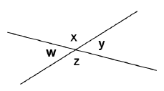
Exercises (25 min)
1. You know that angles on a line sum to 180°.
Prove that vertical angles are congruent.
Make a plan:
What do you know about ∠𝑤 and ∠𝑥 ∠𝑦 and ∠𝑥
They sum to 𝟏𝟖𝟎°.
What conclusion can you draw based on both bits of knowledge?
𝒘 = 𝒚

Slide 8
Write out your proof:
1.)
2.)
3.)
∴
𝒘 + 𝒙 = 𝟏𝟖𝟎°
𝒚 + 𝒙=𝟏𝟖𝟎°
𝒘 + 𝒙= 𝒚 + 𝒙
𝒘= 𝒚

Slide 9
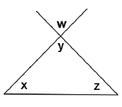
Given the diagram at the right, prove that
𝒘 + 𝒙 + 𝒛 = 𝟏𝟖𝟎°.
(Make a plan first. What do you know about 𝒙, 𝒚, and 𝒛?)
Statement Reason
𝒚 + 𝒙 + 𝒛 = 𝟏𝟖𝟎°
 sum of a △
𝒚 = 𝒘
vert. s
∴ 𝒘 + 𝒙 + 𝒛 = 𝟏𝟖𝟎°

Slide 10
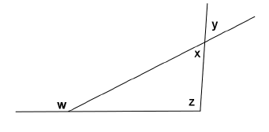
3. Given the diagram at the right, prove that
𝒘 = 𝒚 +𝒛.
Statement Reason
𝒘 = 𝒙 + 𝒛
ext.  of a △
𝒙 + 𝒚
vert. s
∴ 𝒘 = 𝒚 + 𝒛

Slide 11
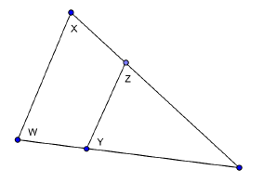
4. In the diagram at the right, prove that
𝒚 + 𝒛 = 𝒘 + 𝒙.
(You will need to write in a label in the diagram that is not labeled yet for this proof.)
Statement Reason
𝒂 + 𝒙 + 𝒘= 𝟏𝟖𝟎°
ext.  of a △
𝒂 + 𝒛 + 𝒚= 𝟏𝟖𝟎°
ext.  of a △
𝒂 + 𝒙 + 𝒘 = 𝒂 = 𝒛 + 𝒚
a
∴ 𝒙 + 𝒘 = 𝒛 + 𝒚

Slide 12
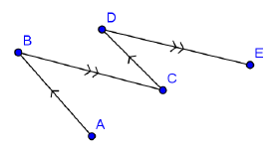
5. In the figure at the right, 𝑨𝑩  𝑪𝑫 and 𝑩𝑪  𝑫𝑬.
Prove that 𝑨𝑩𝑪 = 𝑪𝑫𝑬.
Statement Reason
𝑨𝑩𝑪 = 𝑫𝑪𝑩
alt. s
𝑫𝑪𝑩 = 𝑪𝑫𝑬
alt. s
∴ 𝑨𝑩𝑪 = 𝑪𝑫𝑬

Slide 13
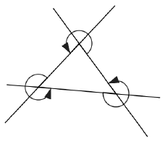
6. In the figure at the right, prove that the sum of the angles marked by arrows is 900°.
(You will need to write in several labels into the diagram for this proof.)
Statement Reason
𝒂 + 𝒃 + 𝒄 + 𝒅 = 𝟑𝟔𝟎°
s at a pt.
f
e
g
𝒆 + 𝒇 + 𝒈 + 𝒉 = 𝟑𝟔𝟎°
s at a pt.
h
a
𝒊 + 𝒋 + 𝒌 + 𝒎 = 𝟑𝟔𝟎°
s at a pt.
d
j
i
b
c
m
k
𝒂+𝒃+𝒄+𝒅+𝒆+𝒇+𝒈+𝒉+𝒊+𝒌+𝒎=𝟏𝟎𝟖𝟎°
𝒅 + 𝒉 + 𝒊 = 𝟏𝟖𝟎°
 sum of a △
∴ 𝒂+𝒃+𝒄+𝒆+𝒇+𝒈+𝒋+𝒌+𝒎 = 𝟗𝟎𝟎°

Slide 14
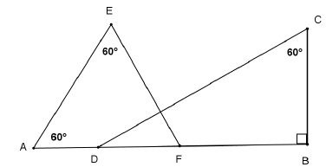
7. In the figure at the right, prove that 𝑫𝑪 ⊥ 𝑬𝑭.
Draw in label 𝒁.
𝒁
Statement Reason
𝑬 + 𝑨 + 𝑬𝑭𝑨 = 𝟏𝟖𝟎°
 sum of a △
𝑬𝑭𝑨 = 𝟔𝟎˚
𝑩 + 𝑪 + C𝑫𝑩 = 𝟏𝟖𝟎°
 sum of a △
𝑪𝑫𝑩 = 𝟑𝟎°
𝑪𝑫𝑩 + 𝑬𝑭𝑨 + 𝑬𝒁𝑪 = 𝟏𝟖𝟎°
 sum of a △
𝑬𝒁𝑪 = 𝟗𝟎˚
𝑫𝑪⊥𝑬𝑭
defn. of perpendicular

Slide 15
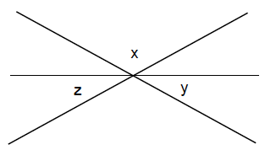
Exit Ticket
In the diagram at the right, prove that the sum of the labeled angles is 180°.
Statement Reason
Label 𝒘 vertical to x
𝒘 = 𝒙 vert. s
𝒛 + 𝒘 + 𝒚 = 𝟏𝟖𝟎° s on a line
𝒛 + 𝒙 + 𝒚 = 𝟏𝟖𝟎°

