Slide 1
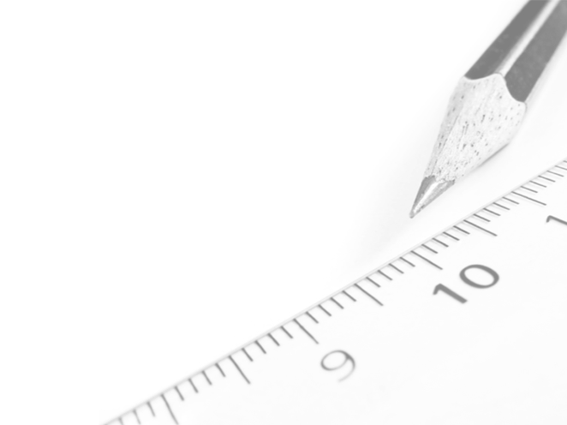
Geometry- Lesson 3
Copy and Bisect an Angle

Slide 2
Essential Question
Learn how to bisect an angle as well as copy an angle
Work on ordering steps of a construction

Slide 3
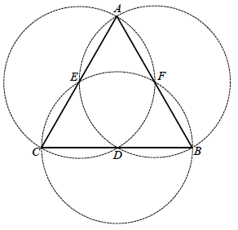
Opening Exercise
In the following figure, circles have been constructed so that the endpoints of the diameter of each circle coincide with the endpoints of each segment of the equilateral triangle.
What is special about points 𝑫, 𝑬, and 𝑭? Explain how this can be confirmed with the use of a compass.
b. Draw DE, EF, and FD. What kind of triangle must △DEF be?
c. What is special about the four triangles within △ABC?
d. How many times greater is the area of △ABC than the area of △CDE?

Slide 4
Opening Exercise
a. What is special about points 𝑫, 𝑬, and 𝑭? Explain how this can be confirmed with the use of a compass.
𝑫, 𝑬, and 𝑭 are midpoints.
b. Draw DE, EF, and FD. What kind of triangle must △DEF be?
△ 𝑫𝑬𝑭 is an equilateral triangle.
c. What is special about the four triangles within △ABC?
All four triangles are equilateral triangles of equal side lengths; they are congruent.
d. How many times greater is the area of △ABC than the area of △CDE?
The area of △ 𝑨𝑩𝑪 is four times greater than the area of △ 𝑪𝑫𝑬.

Slide 5
Discussion (5 min)
Define Angle, Interior of an Angle and Angle Bisector
Angle: An angle is the union of two non-collinear rays with the same endpoint

Slide 6
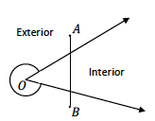
Definitions
Interior of an Angle: The interior of angle ∠𝑩𝑨𝑪 is the set of points in the intersection of the half-plane of 𝑨𝑪 that contains 𝑩 and the half-plane of 𝑨𝑩 that contains 𝑪. The interior is easy to identify because it is always the “smaller” region of the two regions defined by the angle (the region that is convex). The other region is called the exterior of the angle.
Reminder: A subset 𝑅 in the plane is described as convex provided any two points 𝐴 and 𝐵 in 𝑅, the segment 𝐴𝐵 lies completely in 𝑅.
If an angle has a measure of 180˚ or less, it is convex.
If an angle has a measure greater than 180˚ and less than 360˚, it is nonconvex.

Slide 7
Definitions
Angle Bisector: If 𝑪 is in the interior of ∠𝑨𝑶𝑩, and ∠𝐀𝐎𝐂 =∠𝐂𝐎𝐁, then 𝐎𝐂 bisects ∠𝐀𝐎𝐁, and 𝐎𝐂 is called the bisector of ∠𝐀𝐎𝐁.
When we say ∠𝑨𝑶𝑪 =∠𝑪𝑶𝑩, we mean that the angle measures are equal and that ∠𝑨𝑶𝑪 can either refer to the angle itself or its measure when the context is clear.

Slide 8
Geometry Assumptions (8 min)
*Refer to Student Handout
1. To every angle ∠𝑨𝑶𝑩 there corresponds a real number |∠𝑨𝑶𝑩|called the degree or measure of the angle so that 𝟎 < |∠𝑨𝑶𝑩|< 𝟏𝟖𝟎.
2. If 𝑪 is a point in the interior of ∠𝑨𝑶𝑩, then |∠𝑨𝑶𝑪| + |∠𝑪𝑶𝑩| = |∠𝑨𝑶𝑩|. (Abbreviation: ∠𝒔 add.)
3. If two angles ∠𝑩𝑨𝑪 and ∠𝑪𝑨𝑫 form a linear pair, then they are supplementary, i.e., |∠𝑩𝑨𝑪| + |∠𝑪𝑨𝑫| = 𝟏𝟖𝟎. (Abbreviation: ∠𝒔 on a line.)
4. Let 𝑶𝑩 be a ray on the edge of the half-plane H. For every 𝒓 such that 𝟎 < 𝒓 < 𝟏𝟖𝟎, there is exactly one ray 𝑶𝑨 with 𝑨 in 𝑯 such that |∠𝑨𝑶𝑩| = 𝒓.

Slide 9
Example 1 (12 min) Investigate How to Bisect an Angle

Slide 10
Before you Begin!
Watch Video on Angles and Trim
*keep the steps in the video in mind as you read the scenarios following the video!!
Q. Did you notice an error in the speakers speech?
The speaker misspeaks in the clip by using the word ‘protractor’ instead of the word ‘compass’

Slide 11
Ideas to consider:
Are angles the only geometric figures that can be bisected?
No, i.e., segments.
What determines whether a figure can be bisected? What kinds of figures cannot be bisected?
A line of reflection must exist so that when the figure is folded along this line, each point on one side of the line maps to a corresponding point on the other side of the line. A ray cannot be bisected.

Slide 12
Example 1
You will need a compass and a straightedge.
Joey and his brother, Jimmy, are working on making a picture frame as a birthday gift for their mother. Although they have the wooden pieces for the frame, they need to find the angle bisector to accurately fit the edges of the pieces together. Using your compass and straightedge, show how the boys bisected the corner angles of the wooden pieces below to create the finished frame on the right.

Slide 13
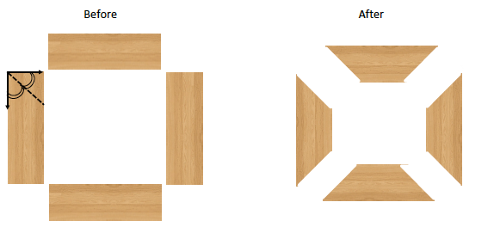
Joey and his brother, Jimmy, are working on making a picture frame as a birthday gift for their mother. Although they have the wooden pieces for the frame, they need to find the angle bisector to accurately fit the edges of the pieces together. Using your compass and straightedge, show how the boys bisected the corner angles of the wooden pieces below to create the finished frame on the right.
Consider how the use of circles aids the construction of an angle bisector. Be sure to label the construction as it progresses and to include the labels in your steps. Experiment with the angles below to determine the correct steps for the construction.

Slide 14
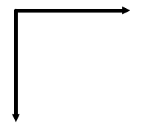
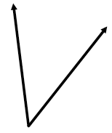
What steps did you take to bisect an angle?
List the steps below:
1.
2.
3.
4.
5.
6.
7.
Label vertex of angle as 𝑨.
Draw circle CA: center 𝑨, any size radius.
Label intersections of circle 𝑨 with rays of angle as 𝑩 and 𝑪.
Draw circle CB: center 𝑩, radius 𝑩𝑪.
Draw circle CC: center 𝑪, radius 𝑪𝑩.
At least one of the two intersection points of CB and CC lie in the angle. Label that intersection point 𝑫.
Draw ray 𝑨𝑫.

Slide 15
Example 1- Reflection
How does the video’s method of the angle bisector construction differ from the class’s method?
Are there fundamental differences or is the video’s method simply an expedited form of the class method?
Yes, the video’s method is an expedited version with no fundamental difference from the class’s method.
Symmetry in the Construction
The same procedure is done to both sides of the angle, so the line constructed bears the same relationships to each side.

Slide 16
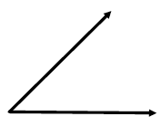
Example 2 (12 min) Investigate How to Copy an Angle
*You will need a compass and a straightedge.
You and your partner will be provided with a list of steps (in random order) needed to copy an angle using a compass and straightedge. Your task is to place the steps in the correct order, and then follow the steps to copy the angle below.
Steps needed (in correct order)…

Slide 17
1.
2.
3.
4.
5.
6.
7.
8.
9.
Label the vertex of the original angle as 𝑩.
Draw a ray 𝑬𝑮 as one side of the angle to be drawn.
Draw circle C_{B}: center 𝑩, any radius.
Label the intersections of C_{B} with the sides of the angle as 𝑨 and 𝑪.
Draw circle C_{E}: center 𝑬, radius 𝑩𝑨.
Label intersection of C_{E} with 𝑬𝑮 as 𝑭.
Draw circle C_{F}: center 𝑭, radius 𝑪𝑨.
Label either intersection of C_{E} and C_{F} as 𝑫.
Draw ray 𝑬𝑫.

Slide 18
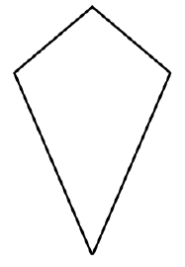
Exit Ticket
Later that day, Jimmy and Joey were working together to build a kite with sticks, newspapers, tape, and string. After they fastened the sticks together in the overall shape of the kite, Jimmy looked at the position of the sticks and said that each of the four corners of the kite is bisected; Joey said that they would only be able to bisect the top and bottom angles of the kite. Who is correct? Explain.
Joey is correct. The diagonal that joins the vertices of the angles between the two pairs of congruent sides of a kite also bisects those angles. The diagonal that joins the vertices of the angles created by a pair of the sides of uneven lengths does not bisect those angles.

