Slide 1
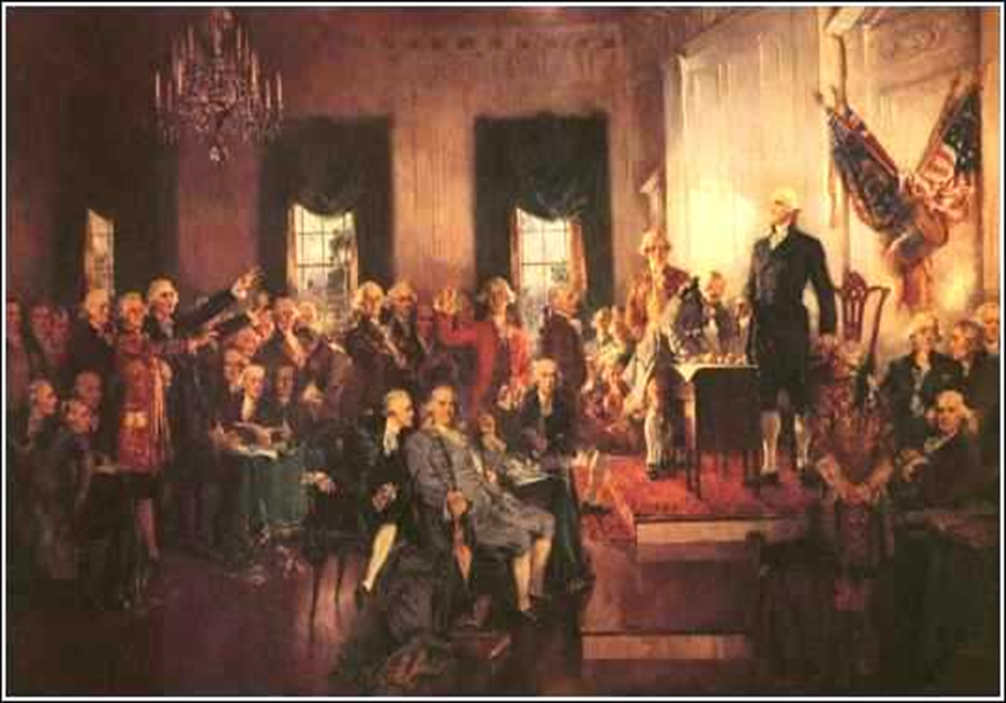
Compromises and the Constitution

Slide 2
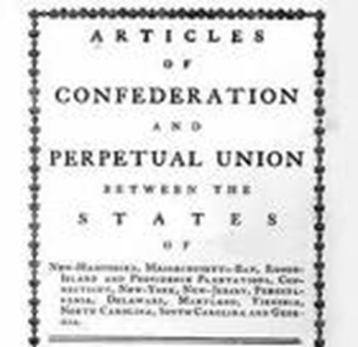
Articles of Confederation
Weak union of states
Kept most power in the hands of the states
Problems:
No Chief Executive to enforce laws
No Judiciary to settle disputes between states
Could not tax
Could not regulate interstate trade
Needed supermajority to pass laws (9 of 13)
Needed unanimous vote to amend Articles

Slide 3
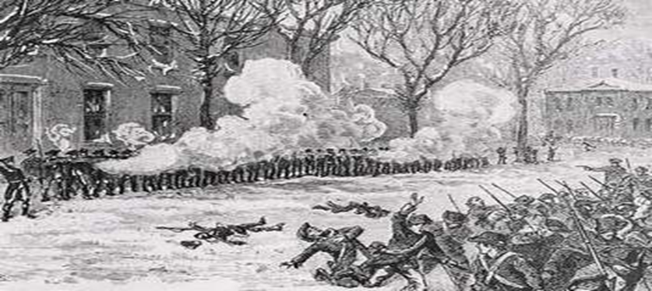
Shays’s Rebellion
Farmers revolt against state taxes. Government could not enforce laws. Inability of the National government to act showed the need to reform the Articles of Confederation.

Slide 4
CONSTITUTIONAL CONVENTION
May 1787, 55 delegates (representatives) met in Philadelphia to figure out how to improve Articles of Confederation.
In a secret meeting they decided to write a new Constitution.

Slide 5
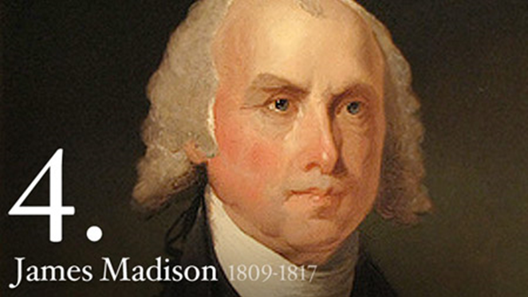
James Madison
“Father of the Constitution”
Took notes during the convention
Authored the “Virginia Plan” which set the basic structure of the government
Authored majority of the Bill of Rights
Eventually elected 4th president of the U.S.

Slide 6
“Bundle of Compromises”
Many different interests at the convention had to compromise to create a working government that all interests could support.
Compromises dealt with the issues of representation and commerce.

Slide 7
Virginia Plan: (Large State Plan)
Create a 3 branch government (Leg. Exec. Jud.)
Bi-cameral (2 house) legislature
Lower house elected, upper chosen by the lower and state legislatures
Representation based on POPULATION. Small states would have as few as 1 representatives, while large would have more than a dozen!

Slide 8
New Jersey Plan (Small-State Plan)
Strengthen the Articles of Confederation
Enable the power to tax and regulate commerce
Uni-cameral legislature (one house) with equal representation for states (1 vote).

Slide 9
The Great Compromise
Bi-Cameral Legislature
Lower House: House of Representatives
Representation based on Population, though all states had at least 1 representative
Popularly elected every 2 years. Called “the people’s house” because most responsive to the people
All revenue bills (taxes) must begin here, as it is closest to the people
Upper House: Senate
Equal representation (2 per state)
Chosen by state legislatures every 6 years
Changed to popular election by 17th Amendment

Slide 10
Slavery and the Constitution
Debate over apportionment of seats in the House for slaves
South wanted slaves to count towards representation but not taxation
Wanted protection from northern majorities which would pass economic laws (import tariffs, export taxes) which would hurt the south.
North wanted slaves to count toward taxation as they were a part of the southern economy but not representation because did not have rights.

Slide 11
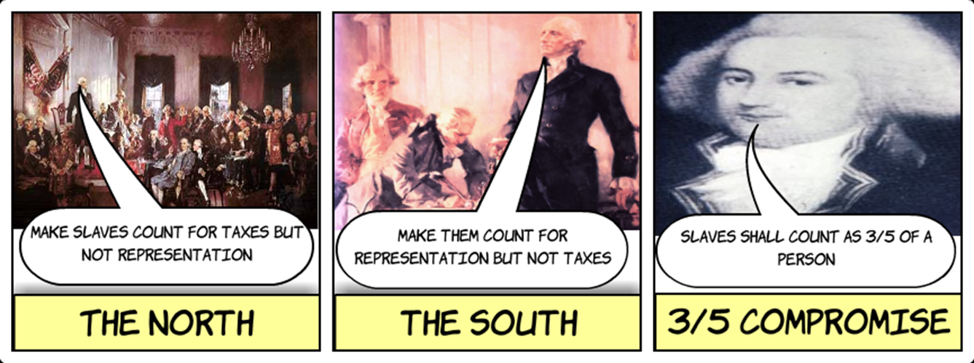
3/5 Compromise
Slaves counted as 3/5 of a person for both taxation and representation
Congress could not pass laws banning the slave trade until 1808
Congress could tax imports (tariffs) but not exports

Slide 12
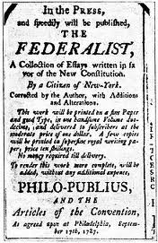
Ratification!!
Debate over the Constitution raged. Both the Federalists (pro-ratification) and Anti-federalists (against) wrote pamphlets supporting their arguments to get the 9 states necessary to ratify.

Slide 14
The Law of Unintended Consequences
Outcomes that are not the ones intended by a purposeful action!
Read document and write your answer on the back:
What unintended consequence did the Great Compromise have in regards to slavery?

