Slide 1
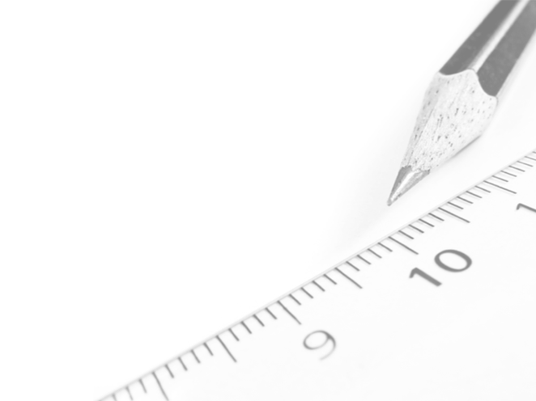
Geometry- Lesson 4
Construct a Perpendicular Bisector

Slide 2
Essential Question
Learn how to construct a perpendicular bisector.
Learn about the relationship between symmetry with respect to a line and a perpendicular bisector.
Apply perpendicular construction to problems.
Continue to learn how to write precise step-by-step instructions for constructions.
*For this lesson you may need a Compass, String, Patty Paper and a Straight Edge

Slide 3
Opening Exercise (5 min)
Choose one method below to check your homework:
Trace your copied angles and bisectors onto patty paper (wax paper), then fold the paper along the bisector you constructed. Did one ray exactly overlap the other?
*For option 1 wax paper is needed. If not available plain paper will do
Work with your partner. Hold one partner’s work over another’s. Did your angles and bisectors coincide perfectly?
Use the following rubric to evaluate your homework:

Slide 4
Grading Rubric for Homework

Slide 5
Discussion (38 min)
Imagine a segment that joins any pair of points that map onto each other when the original angle is folded along the bisector. The following figure illustrates two such segments:
When the angle is folded along ray 𝑨𝑱, 𝑬 coincides with 𝑮.
folding the angle demonstrates that 𝑬 is the same distance from 𝑭 as 𝑮 is from 𝑭; 𝑬𝑭 = 𝑭𝑮
The point that separates these equal halves of 𝑬𝑮 is 𝑭, which is in fact the midpoint of the segment and lies on the bisector 𝑨𝑱.
We can also show that the angles formed by the segment and the angle bisector are right angles…

Slide 6
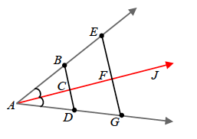
Discussion
By folding, we can show that ∠𝑬𝑭𝑱 and ∠𝑮𝑭𝑱 coincide and must have the same measure.
The two angles also lie on a straight line, which means they sum to 180˚
Since they are equal in measure and they sum to 180˚ they each have a measure of 90˚
Two points are symmetric with respect to a line 𝒍 if and only if 𝒍 is the perpendicular bisector of the segment that joins the two points.
A perpendicular bisector of a segment passes through the _________ of the segment and forms ___________with the segment.
Midpoint
Right Angles

Slide 7
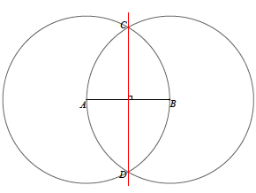
Construct a perpendicular bisector of a line segment using a compass and a straightedge.
Using what you know about the construction of an angle bisector, experiment with your construction tools and the following line segment to establish the steps that determine this construction.

Slide 8
Precisely describe the steps you took to bisect the segment.
1.
2.
3.
4.
Label the endpoints of the segment 𝑨 and 𝑩.
Draw circle C_{A}: center A, radius AB and circle C_{B}: center B, radius BA.
Label the points of intersections as 𝑪 and 𝑫.
Draw line 𝑪𝑫.

Slide 9
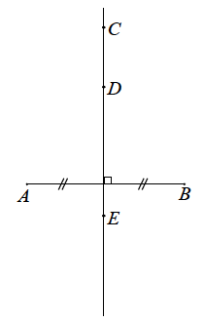
Now that you are familiar with the construction of a perpendicular bisector, we must make one last observation. Using your compass, string, or patty paper, examine the following pairs of segments:
I. 𝐴𝐶, 𝐵𝐶
II. 𝐴𝐷, 𝐵𝐷
III. 𝐴𝐸, 𝐵𝐸
Based on your findings, fill in the observation below.
Observation:
Any point on the perpendicular bisector of a line segment is ___________ from the endpoints of the line segment.
Equidistant

Slide 10
Mathematical Modeling Exercise
You know how to construct the perpendicular bisector of a segment. Now you will investigate how to construct a perpendicular to a line 𝓵 from a point 𝑨 not on 𝓵.
The first step of the instructions has been provided for you. Discover the construction and write the remaining steps.

Slide 11
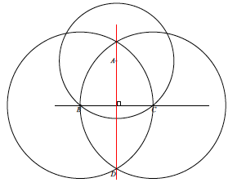
Mathematical Modeling Exercise
Step 1:
Step 2:
Step 3:
Step 4:
Step 5:
Step 6:
Draw circle C_{A}: center A, with radius so that C_{A} intersects line 𝓵 in two points.
Label the two points of intersection as 𝑩 and 𝑪.
Draw circle C_{B}: center B, radius BC.
Draw circle C_{C}: center C, radius CB.
Label the unlabeled intersection of circle C_{B} and C_{C} as 𝑫.
Draw line 𝑨𝑫.

Slide 12
Relevant Vocabulary
Right Angle: An angle is called a right angle if its measure is 90˚.
Perpendicular: Two lines are perpendicular if they intersect in one point, and any of the angles formed by the intersection of the lines is a 90˚ angle. Two segments or rays are perpendicular if the lines containing them are perpendicular lines.
Equidistant: A point 𝐴 is said to be equidistant from two different points 𝐵 and 𝐶 if 𝐴𝐵=𝐴𝐶. A point 𝐴 is said to be equidistant from a point 𝐵 and a line 𝐿 if the distance between 𝐴 and 𝐿 is equal to 𝐴𝐵.

Slide 13
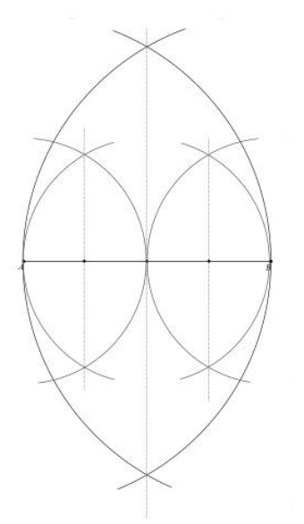
Exit Ticket
Divide the following segment 𝐴𝐵 into 4 segments of equal length.
Don’t Forget Problem Set!!!

