Slide 1
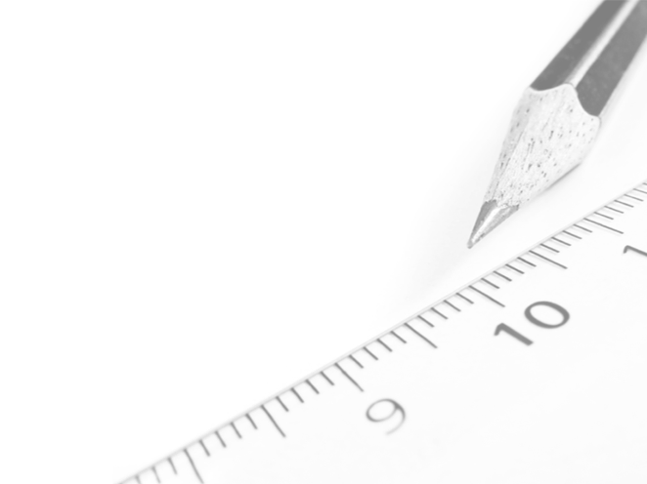
Geometry- Lesson 8
Solve for Unknown Angles- Angles in a Triangle

Slide 2
Essential Question
Review of previously learned Geometry Facts
Practice citing the geometric justifications for future work with unknown angle proofs

Slide 3
You Should Now Know How to Solve for Unknown Angles Involving …
Lines
Angles at a point
Transversals
Angles in triangles
We are now going to use this to expand to a variety of diagrams involving one or more of these things.

Slide 4
Answers to Lesson 7 Problem Set
1. ∠𝒂 = 𝟒𝟎°, int. s, alt. s
2. ∠𝒃 = 𝟒𝟖°, corr. s
∠𝒄 = 𝟒𝟔°, vert. s, corr. s
3. ∠𝒅 = 𝟓𝟎°, alt. s
∠𝒆 = 𝟓𝟎°, alt. s
4. ∠𝒇 = 𝟖𝟐°, int. s, vert. s

Slide 5
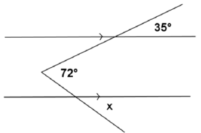
Opening Exercise (5 min)
Find 𝑥 in the figure to the right. Explain your calculations. (Hint: Draw an auxiliary line segment.)
𝒙= 𝟑𝟐°

Slide 6
Discussion (5 min)
Facts about angles in a triangle review
180°
The sum of the 3 angle measures of any triangle is ______ . Abbreviation: ∠ sum of a △
In any triangle, the measure of the exterior angle is equal to the sum of the measures of the _______________ angles.
Abbreviation: ext. ∠ of a △
Base angles of an __________ triangle are equal.
Abbreviation: base ∠s of isos. △
Each angle of an ___________ triangle has a measure equal to 60°. Abbreviation: equilat. △
opposite interior
isosceles
equilateral

Slide 7
Relevant Vocabulary
Isosceles Triangle: An isosceles triangle is a triangle with at least two sides of equal length.
Angles of a Triangle: Every triangle △𝑨𝑩𝑪 determines three angles, namely, ∠𝑩𝑨𝑪, ∠𝑨𝑩𝑪, and ∠𝑨𝑪𝑩. These are called the angles of △𝑨𝑩𝑪.
Interior of a Triangle: A point lies in the interior of a triangle if it lies in the interior of each of the angles of the triangle.
Exterior Angle of a Triangle: Let angle ∠𝑨𝑩𝑪 be an interior angle of a triangle △𝑨𝑩𝑪, and let 𝑫 be a point on line 𝑳𝑨𝑩 such that 𝑩 is between 𝑨 and 𝑫. Then angle ∠𝑪𝑩𝑫 is an exterior angle of the triangle △𝑨𝑩𝑪.

Slide 8
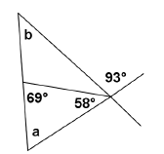
Exercises (30 min)
Try these exercises on your own and we will review as a class. We will do the first one together.
1.) Find the values of 𝒂 and 𝒃 in the figure to the right. Justify your results.
53˚
∠𝑎 = _____
40˚
∠b = _____

Slide 9
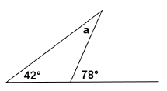
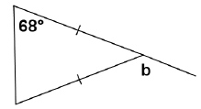
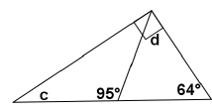
For each figure in 2-11, determine the measures of the unknown (labeled) angles. Give reasons for your calculations
2.)
𝒂 = 𝟑𝟔°, ext.  of a △
3.)
𝒃 = 𝟏𝟑𝟔°, base s of isos. △,
 sum of a △, s on a line
4.)
𝒄= 𝟐𝟔°,  sum of a △
𝒅 = 𝟑𝟏°, s on a line,
 sum of a △

Slide 10
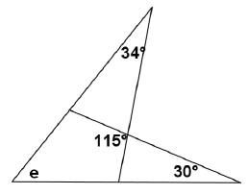
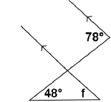
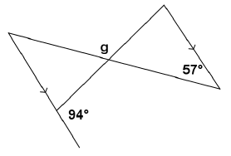
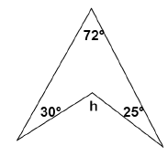
5.)
𝒆 = 𝟓𝟏°, s on a line,
sum of a △
6.)
𝒇 = 𝟑𝟎°, corr. s, s on a line,
 sum of a △
𝒈 = 𝟏𝟒𝟑°, alt. s, s on a line,
 sum of a △, s on a line
7.)
𝒉 = 𝟏𝟐𝟕°, use an auxiliary line,
s on a line, s on a line,
 sum of a △, s on a line
8.)

Slide 11
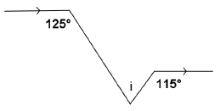
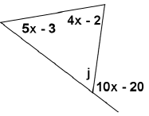
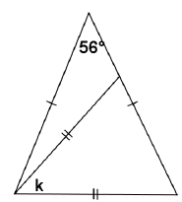
9.)
𝒊 = 𝟔𝟎°, alt. s,
s on a line,
s on a line,
 sum of a △
10.)
𝒋 = 𝟓𝟎°, alt. s,
s on a line e
11.)
𝒌 = 𝟓𝟔°, base s of isos. △,
 sum of a △

Slide 12
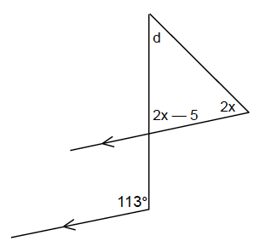
Exit Ticket
Find d and x
d = ________
𝑥 = ________
36˚
41˚
Do Problem Set for Lesson 8!

