Slide 1
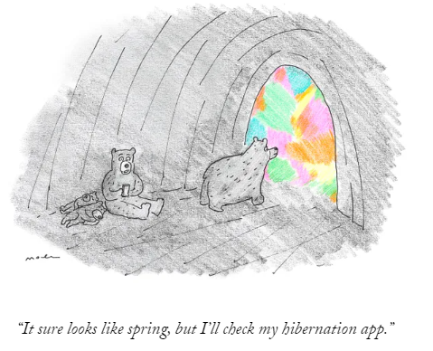
Welcome to our CIT March Mentor Forum March 18, 2024 (last one before the Eclipse)
Share in “Chat:”
For our CIT Interns,
teaching/providing student services in the RCSD is like a Solar Eclipse because . . .*
We will share the responses (with names removed) after today’s meeting.
This Photo by Unknown Author is licensed under CC BY-SA
*Using a critical thinking strategy, sometimes called “synectics,” or “reasoning by analogy.” Additional info here: https://johndabell.com/2018/02/11/the-synectic-model-of-teaching; and more here: https://mcblogs.montgomerycollege.edu/thehub/fundamentals-of-teaching/instructor_resources/synectics-a-creative-thinking-process-to-anchor-learning.
Tech issues with Microsoft Teams? Please email Anna.Leone-Tobar@rcsdk12.org .

Slide 2
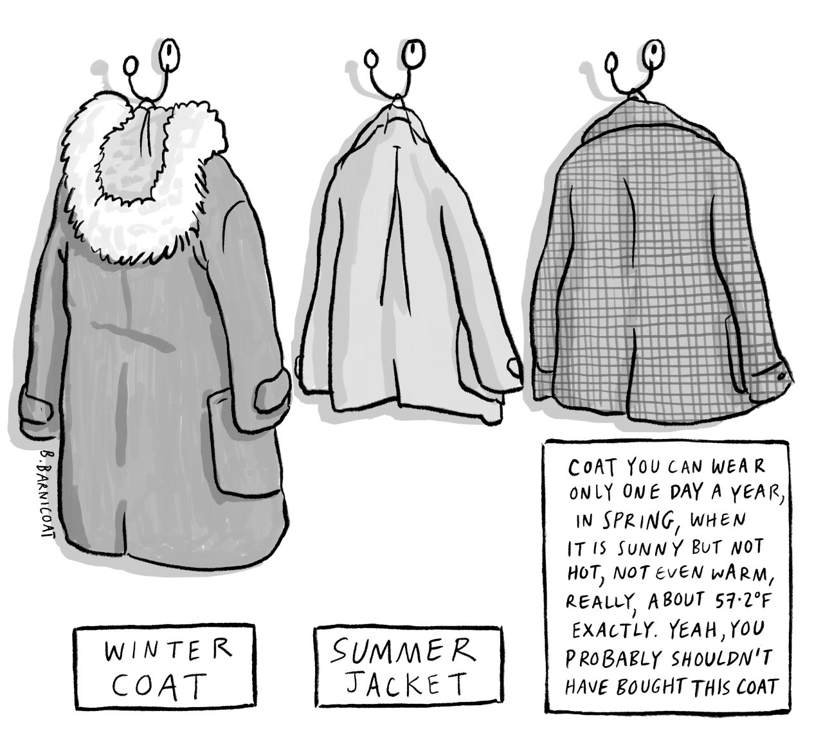
Tentative March 18th Mentor Forum AGENDA:
Critical Thinking in the Chat
CIT Numbers, Reminders, & Announcements
“Rejuvenation” & Reflection in Uncertain Times
Breakout Rooms Round One: Randomly Assigned Challenging Mentor-Administrator Scenarios Debrief and Some CIT Guidance
Breakout Rooms Round Two: Grade/Content Problem-Solving Support from Colleagues
Debrief, Goodbye, & Survey Time
Share in “Chat:”
For our CIT Interns,
teaching/providing student services in the RCSD is like a Solar Eclipse because . . .*
We will share the responses (with names removed) after today’s meeting.
Tech issues with Microsoft Teams? Please email Anna.Leone-Tobar@rcsdk12.org .
*Using a critical thinking strategy, sometimes called “synectics,” or “reasoning by analogy.” Additional info here: https://johndabell.com/2018/02/11/the-synectic-model-of-teaching; and more here: https://mcblogs.montgomerycollege.edu/thehub/fundamentals-of-teaching/instructor_resources/synectics-a-creative-thinking-process-to-anchor-learning.

Slide 3
CIT Support Numbers as of 3/15/2024
CIT Lead Teacher Support Cumulative Totals (includes completed or resigned) | 2023-2024 (as of 3/15/2024) | 2022-2023 | 2021-2022 | 2020-2021 | 2019-2020 | 2018- 2019
INTERNS TOTAL | 285 | 349 | 129 | 37 | 218 | 372
Prof Support RESIDENT | 56 | 32 | 50 | 55 | 91 | 83
Prof Support TENURED | 15 | 19 | 31 | 51 | 33 | 22
Prof Support Uncertified & LT Sub | 37 | 56 | 29 | 14 | 20 | 37
Teachers needing Mentor Support | 393 | 456 | 239 | 157 | 362 | 514
Teachers Receiving Independent Evaluation | 38 | 52 | 55 | 81 | 123 | 136
Lead Teacher-Mentors Activated (as of Sept 14, 2023) | 169 (91.8%) | 158 (98.1%) | 102 (67.1%) | 74 (44.0%) | 142 (72.8%) | 188 (94%)
Resigned: 24
Completed: 28

Slide 4
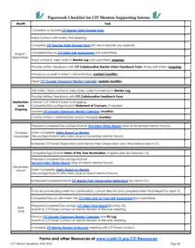
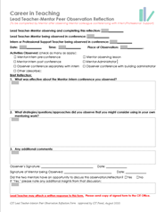
🏀Mad March Reminders
If activated, have you . . .
Updated your CIT Google Classroom Calendar (monthly)
Completed your CIT Panel Observation (due after April recess)
Arranged your Mentor Peer Reflection (due after April recess)
If supporting Interns . . .
Reviewed the Intern Status Report with your Intern
Submitted the Intern Status Report & the Intern Report on Mentor
Made your Monthly Administrator Contact
www.rcsdk12.org/CIT/Resources

Slide 5
From January 8, 2024 CIT Mentor Forum
Link to Whiteboard: https://drive.google.com/file/d/1A5MDUkjgfnsau-ppT2bd4Q7Pp1FYzjed/view?usp=sharing
Possible CIT Intern Status Report Checklist for Mentors and Panel

Slide 6
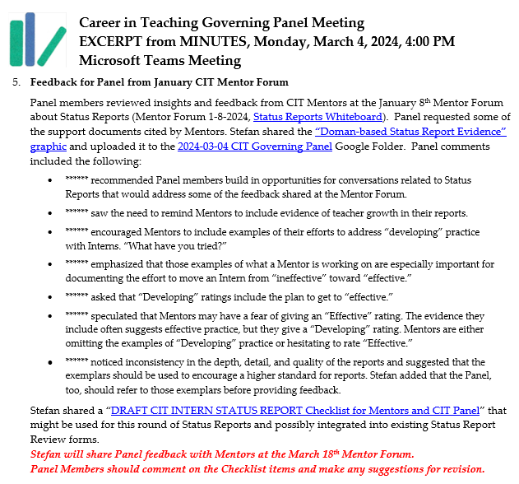
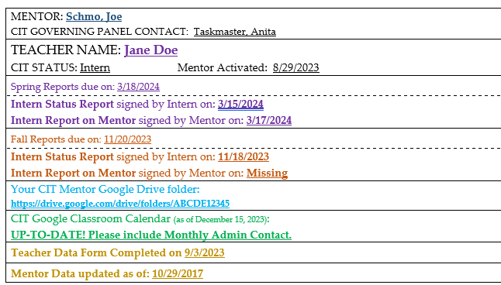
CIT Intern Status Reports
Thank you!
CIT Panel Feedback
Issues with Drafts in CIT Department Google Drive
Paperwork Update Coming Soon
https://docs.google.com/document/d/1TJ4blB0j-1jQuR_dKJw9ZXM9zUCQx2o5/edit

Slide 7
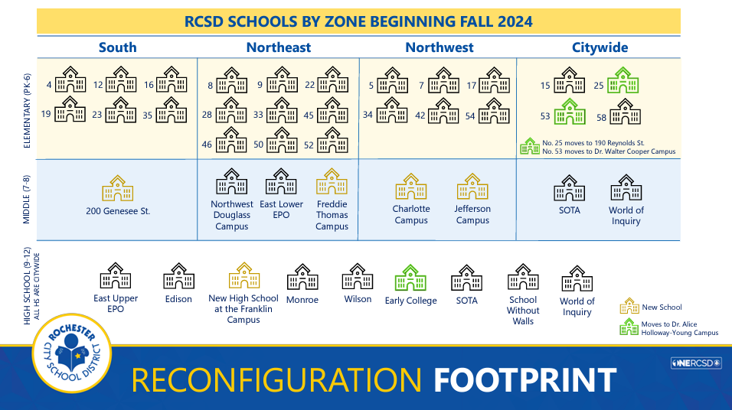
Uncertainties Abound

Slide 8
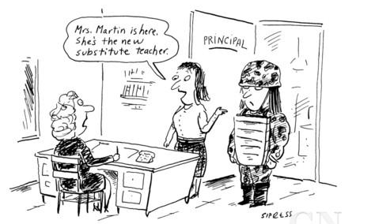
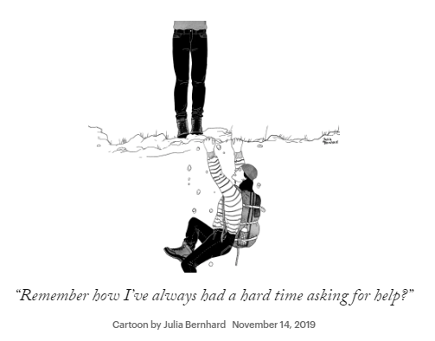
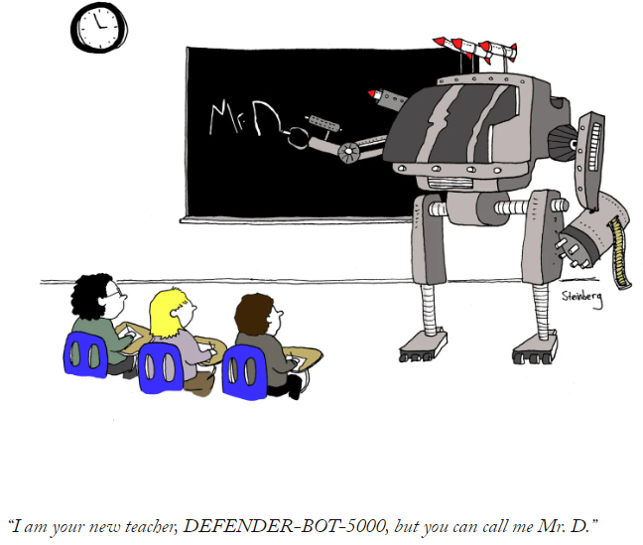
Challenges Abound
“I am your new teacher, DEFENDER-BOT_5000, but you can call me Mr. D.”

Slide 9
For our CIT Interns, teaching/providing student services in the RCSD is like Charlie Brown because . . .

Slide 10
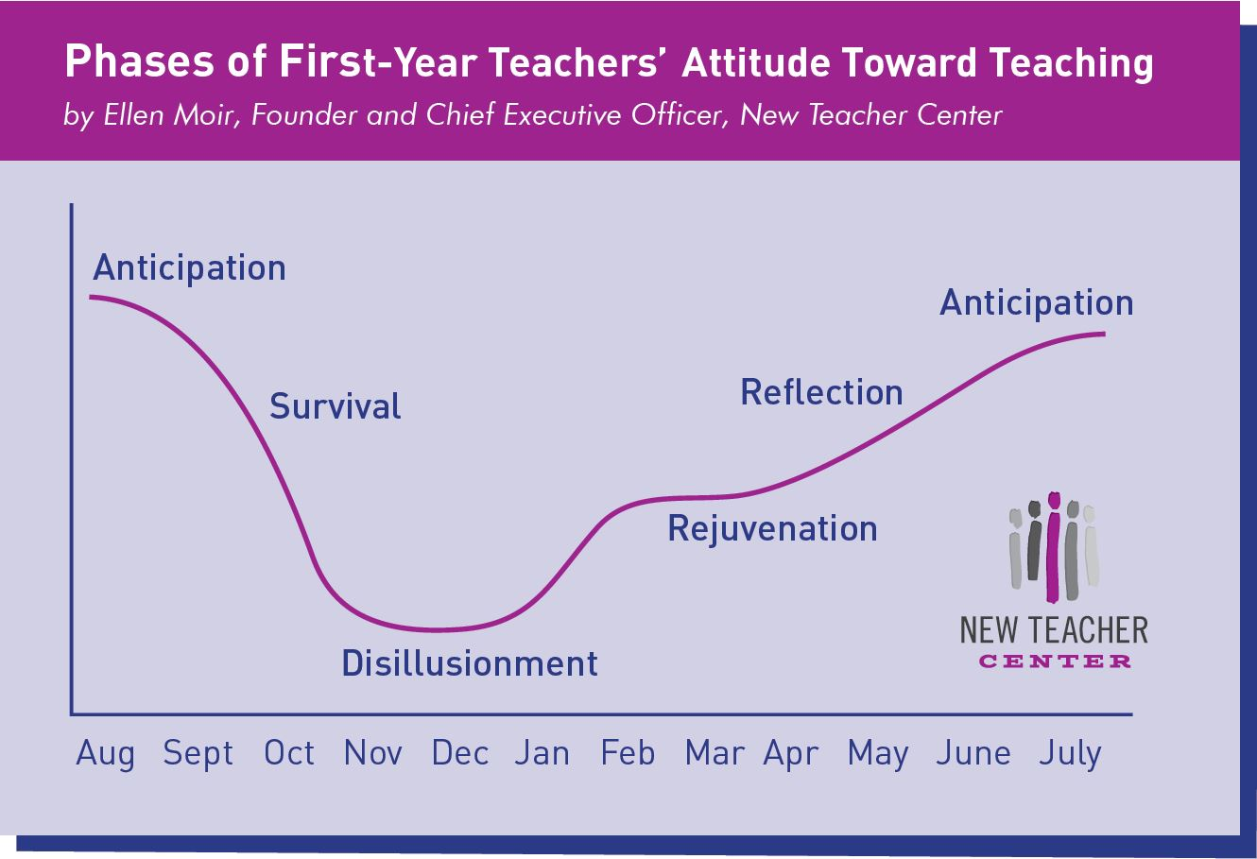
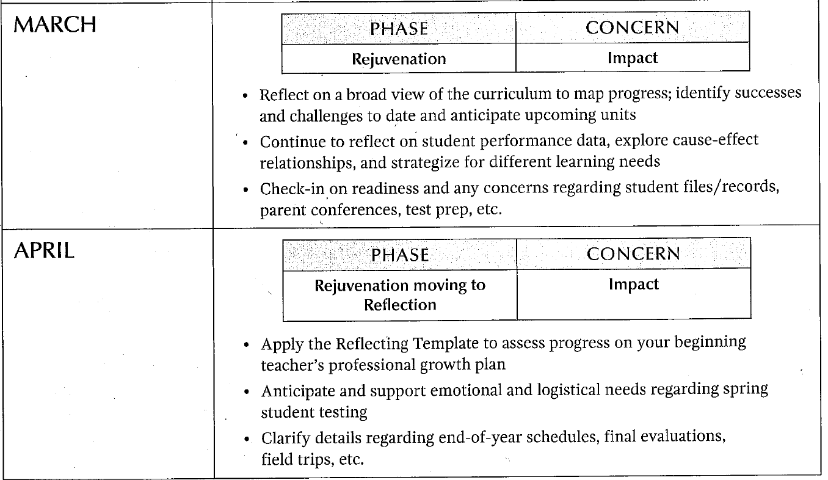
Try not to let uncertainty and challenges “eclipse” opportunities for “Rejuvenation”
Bottom of page 15
Visit our training on “Structured Conversations” from March 2023.
www.rcsdk12.org/Page/58061
Taking Care of Ourselves:
CIT Slide and Self-care Info

Slide 11
https://sharemylesson.com/community/vc2024

Slide 12
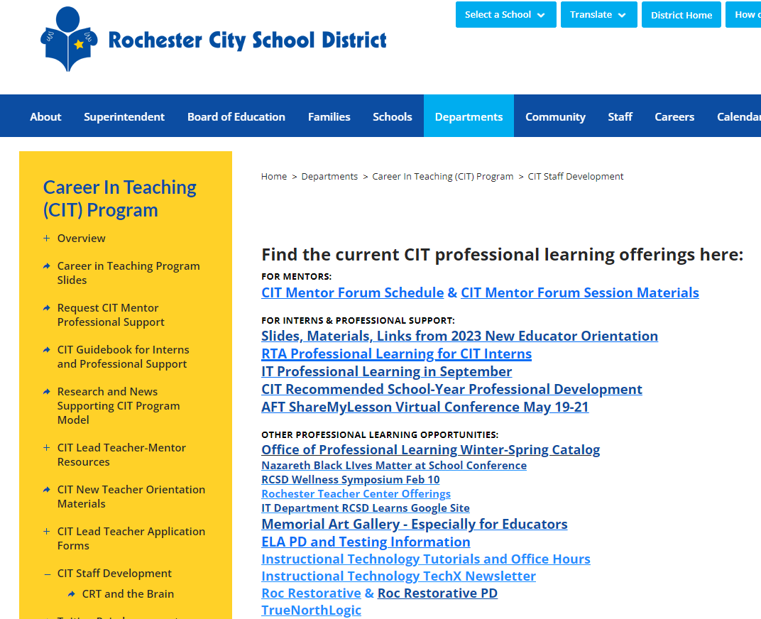
CIT Staff Development: www.rcsdk12.org/CIT/StaffDevelopment

Slide 13
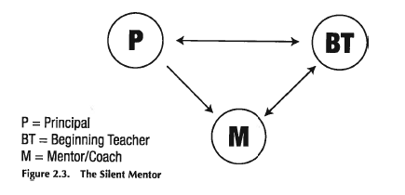
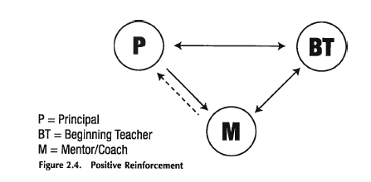
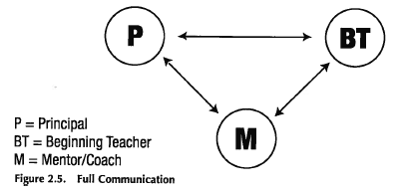
Multiple Choice: Which model of mentoring best represents what we do in the CIT Program?
A
B
C
D

Slide 14
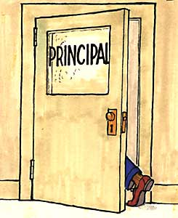
Working with Administrators
Introduce yourself immediately to your intern’s principal. Find out who is responsible for the intern’s evaluation and make contact with that administrator as well.
Check in monthly with your intern’s administrator to share positive news and to inquire if there are any areas of concern. Many problems and misunderstandings can be avoided by keeping lines of communication open.
Do not share information or concerns with the administrator without informing your intern.
You must preserve the confidentiality of the mentor-intern relationship in your dealings with administration.
Take every opportunity to coach your intern in dealing with administrators. Don’t take it upon yourself to solve any problems without your intern’s participation.
Call Stefan when a problem arises with an administrator (or when a problem is anticipated).

Slide 15
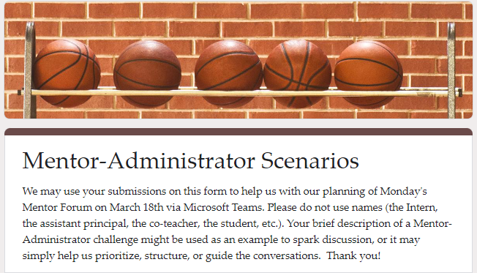
Mentor-Intern-Administrator Scenarios
The vast majority of our Mentor interactions with Administrators are respectful and constructive.
But sometimes . . .

Slide 16
Some challenges you might be encountering
Challenges to Mentor-Intern Confidentiality
Expectations that you will “fix” the Intern
The Absentee Administrator
Administrator-Intern Conflict
Administrator-Mentor Disagreement
Administrator Targeting the Intern

Slide 17
Mentor-Intern-Administrator Scenarios
Please review the Breakout Room Instructions here: Breakout Room Instructions #1
Take one minute to get acquainted. Then …
Read over the scenarios, and also think about challenges that as a Mentor you have encountered with Administrators.
Come to consensus about one or two scenarios to discuss in your Breakout Room (can be one that is listed, or one provided by a mentor in the Breakout Room). Select additional scenarios to discuss if you have time.
Identify the core issues in each scenario and discuss how a Mentor might address those issues.
Generate sentence stems that Mentors might use if faced with this scenario, and add them to our CIT Mentor Padlet: https://rcsdk12.padlet.org/1266650/CITMENTORADMIN.
Be sure to give everyone an opportunity to speak and to listen.
Only share what you feel comfortable sharing, you always have the option to pass.
Please respect the privacy of the others in your Breakout Room.
You are welcome to leave the Breakout Room to return to the main room at any time.
Notes:
https://rcsdk12-my.sharepoint.com/:wb:/g/personal/1266650_rcsdk12_org/EfrT2KvaKTxJsSmg91AfR8MBat7dQFWsJvz7EKnpTYjbsg?e=4V0ZM7

Slide 18
Brief Discussion Debrief
How was the discussion process for you?
Did you gain some helpful ideas?
Any themes emerge? Any surprises?
Please “raise your hand” or drop your comments into the ‘Chat’.
Notes:
Paste in Chat:
How was the discussion process for you? Did you find common issues? Consensus? Any surprises?

Slide 19
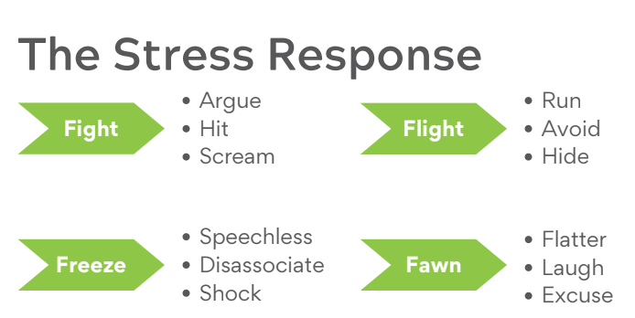
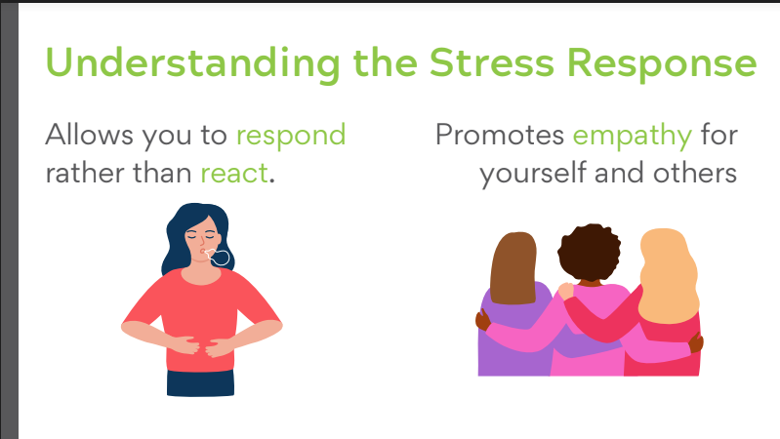
Mentor-Intern-Administrator Scenarios
The vast majority of our Mentor interactions with Administrators are respectful and constructive.
When they don’t, and when we are “in the moment,” . . .

Slide 20
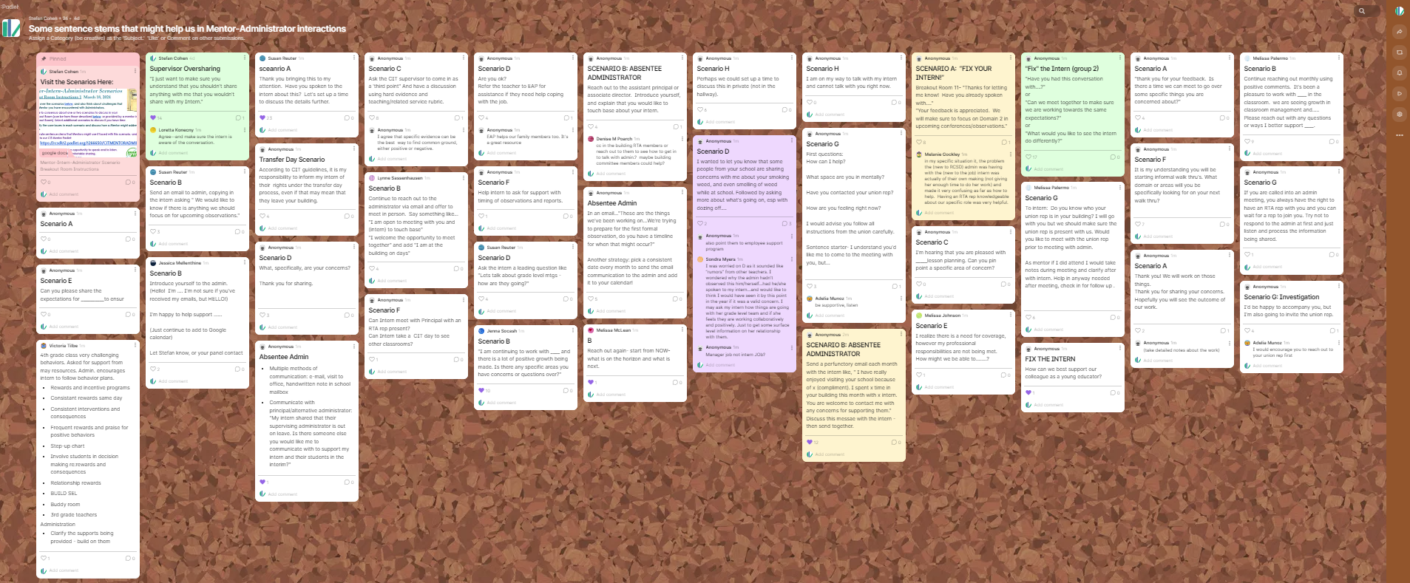
Check out the Padlet an Take a Break!
Visit the CIT Mentor-Admin Scenarios Padlet.
“Like” (💙) postings that you feel are valuable, and Add Comments with additional concrete actions or insights!
Back at 5:27 PM

Slide 21
General Notes…
GENERAL NOTES on Mentor-Admin situations:
The vast majority of our Mentor interactions with are respectful, constructive.
Very important to make the monthly contact/email to Admin to keep communications open.
Don’t do anything that, if your Intern found out about it, would make your Intern feel that you betrayed your Intern’s trust.
Share with the Intern that you will be communicating with the Admin; share the reason, the limitations, and the content of any additional communication with Admin.
Avoid discussing Admin with your Intern via email or text.
Try to include Interns in meeting with Admin if at all possible. Your first role in those settings is as a listener, maybe taking notes when appropriate.
Focus on the legitimate classroom practice issue raised by Admin. Don’t try to strategize how to “satisfy” the Admin. Meet the student or instructional need.
Full document here: NOTES and TIPS FOR THE Mentor-Intern-Administrator Scenarios

Slide 22
When the Admin …
When Admin tells you to “fix” the Intern:
Avoid “Defending” the Intern.
“Thank you for sharing this. I will address it with [the Intern].”
“Have you shared this concern with [the Intern]?
When Admin asks you to share information.
“I am required to maintain confidentiality in my work with my Intern.”
“I am obligated to address any concerns you share with my Intern, but I also must preserve confidentiality with my Intern.”
Full document here: NOTES and TIPS FOR THE Mentor-Intern-Administrator Scenarios

Slide 23
When the Admin . . .
When Admin wants to share information with you “off the record,” not to be shared with your Intern:
Remind Admin (immediately!) that anything shared with you must be shared with your Intern.
If something is shared with you inappropriately, the goal should be to restore full transparency. If unsure, consult with the Director or an experienced mentor colleague.
When Admin should tell Intern directly:
“Have you shared this with [the Intern]?”
“You may wish to share this directly with [the Intern].”
“It would be helpful for you to share this with [the Intern]. It would be valuable for [the Intern] to hear it from you.”
“It would be more appropriate for you to share that directly with [the Intern].”
“I would be happy to sit with you and [the Intern] to discuss this further.”
Full document here: NOTES and TIPS FOR THE Mentor-Intern-Administrator Scenarios

Slide 24
When the Admin . . .
When Admin addresses issues that may not be appropriate (interpersonal, social, “fitting in”):
“Do you feel this is affecting the Intern’s performance in the classroom? How so? I can focus on that.”
“I can address any concerns related to classroom performance or work with students.”
When to get RTA involved:
Contract issue, building safety, conditions issue, discipline/evaluation issue.
Keep “intern” out of “line of fire.”
Never discourage Intern from contacting RTA. Try to avoid Intern being the “lightning rod.”
Some ideas for proactive communication with Admin:
Again, very important to make the monthly contact/email to Admin to keep communications open.
In monthly email, using “we” and “us” to frame interactions.
Be clear that in order to meet your obligation to maintain trust and confidentiality with your Intern, anything the Admin shares must be shared with the Intern.
Full document here: NOTES and TIPS FOR THE Mentor-Intern-Administrator Scenarios

Slide 25
When the Admin . . .
When dealing with Admin, we will not always react “perfectly” in the moment …
Understand the Stress Response.
Hindsight/Regret/Self-incrimination is less important than Reflection.
You have earned some Grace. You’re human.
It may be necessary to repair a breach of confidentiality. Reach out for help with this when needed.
Full document here: NOTES and TIPS FOR THE Mentor-Intern-Administrator Scenarios

Slide 26
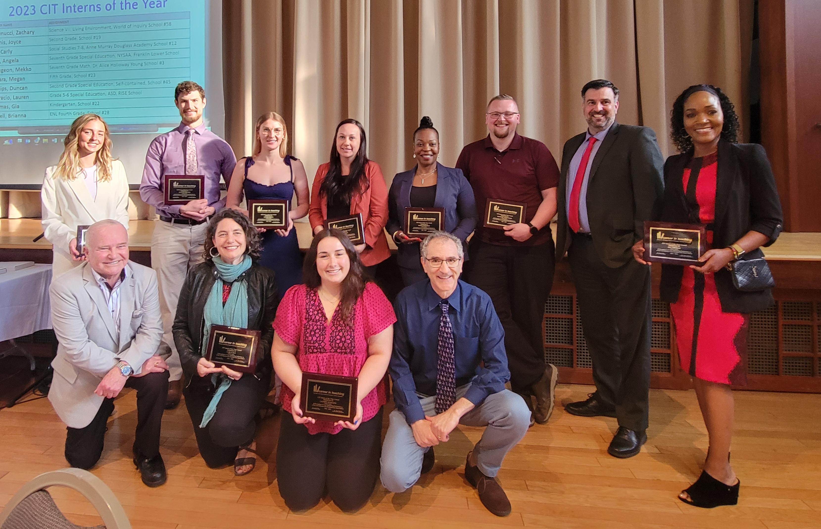
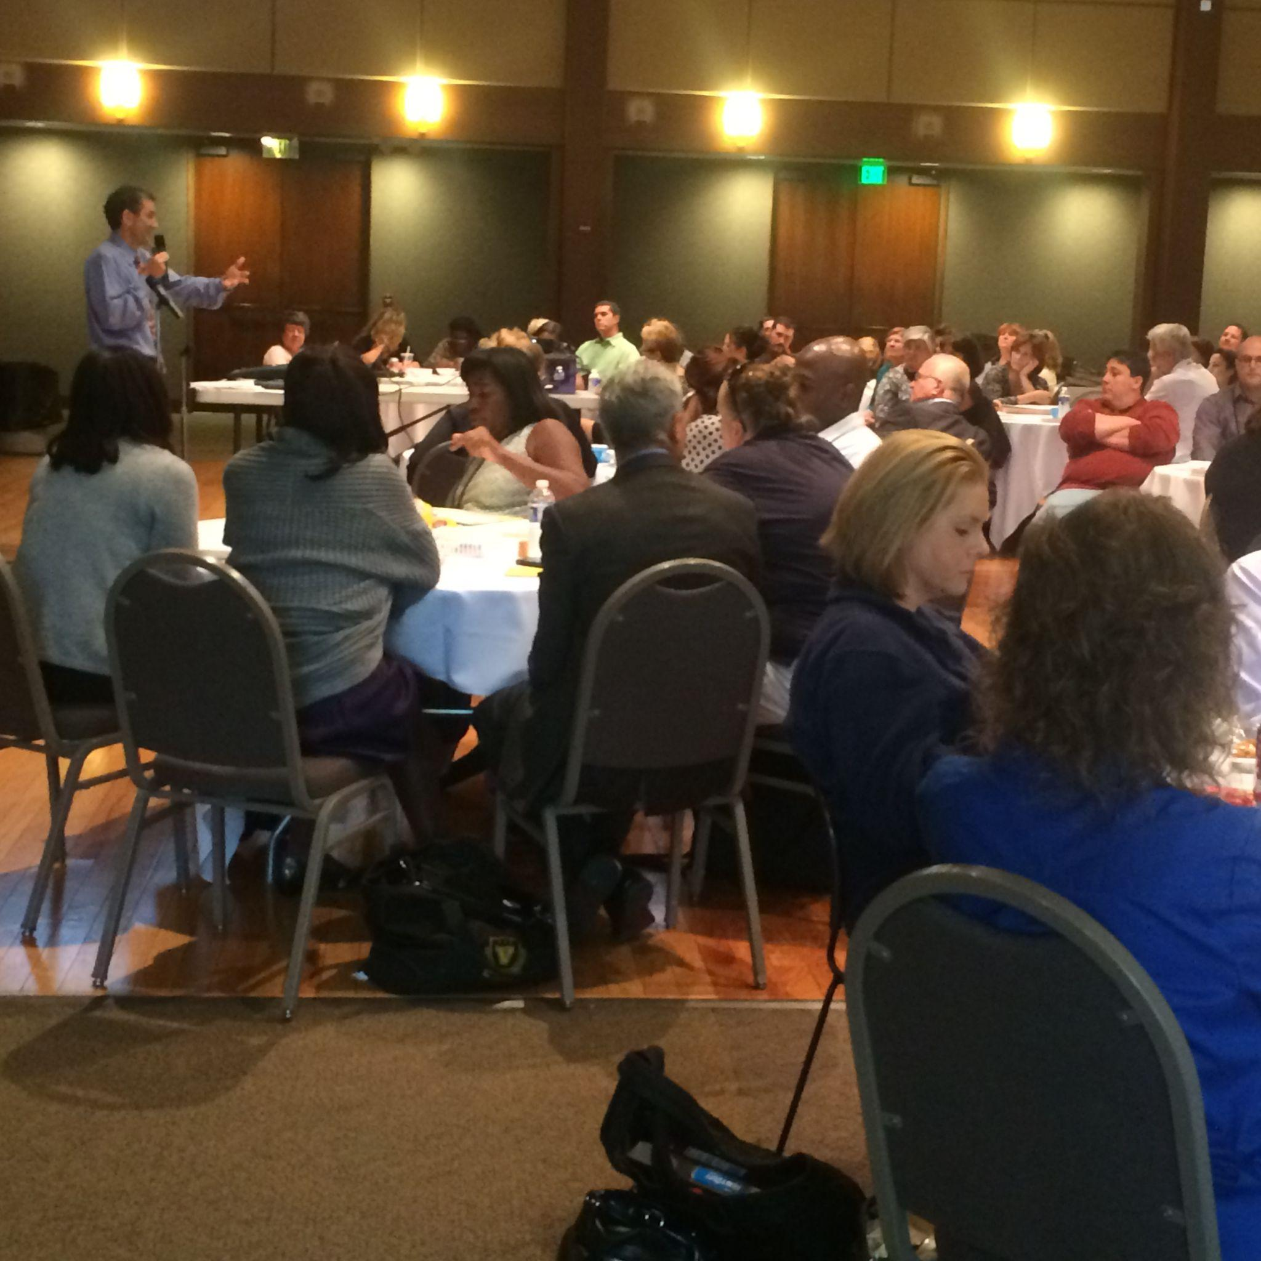
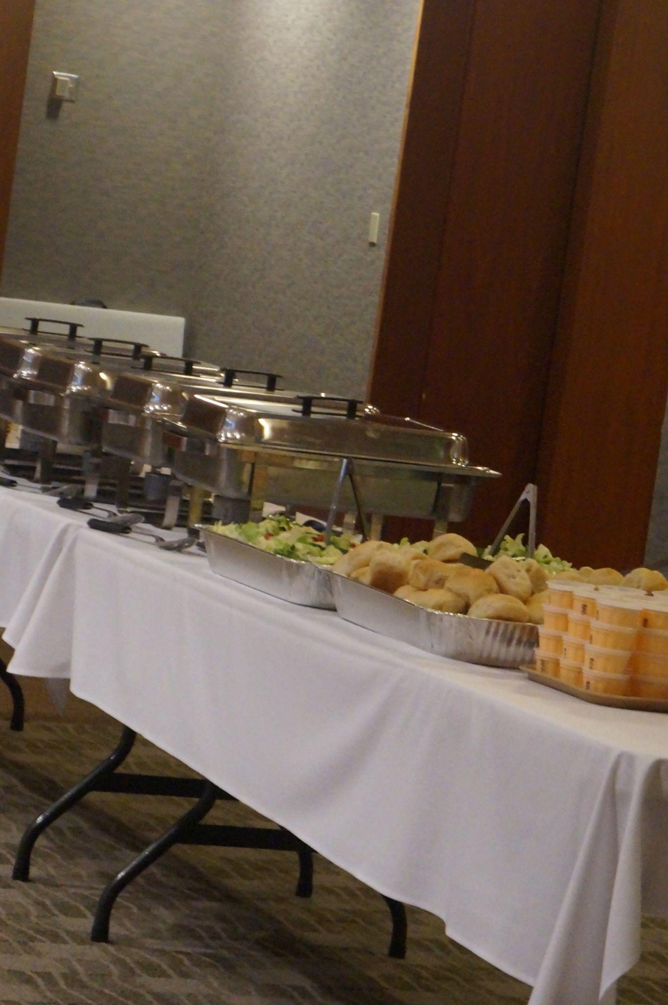
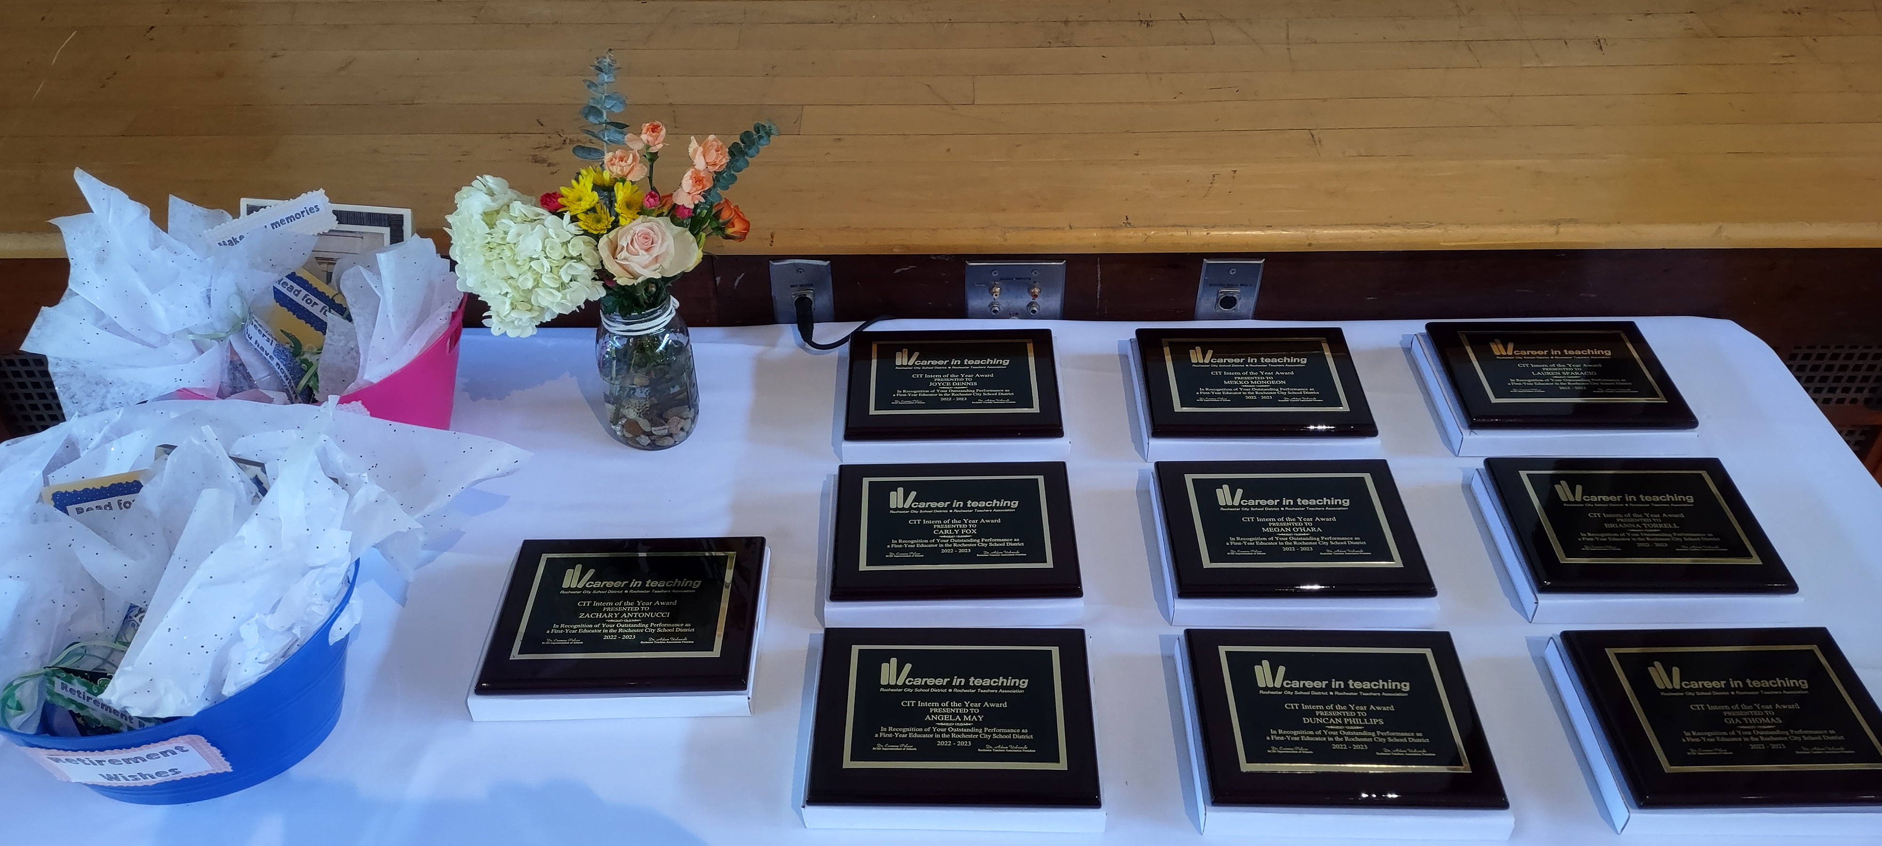
May Mentor Forum in Person
May 20, 2024, 4:00-7:00 pm
at Temple B’rith Kodesh,2131 Elmwood Avenue
Wrap-up, Interns of the Year& Dinner! (Thanks, RTA!)

Slide 27
Breakout Room Topics – Round Two or (even better!) Discuss One of Your Own
Creating Opportunities to Visit my Intern with Students
My Intern Fears “Getting Caught” Falling Behind or not Teaching Grade Level Curriculum
Intern is Effective. What now?
Mediating my Intern’s Relationships with Colleagues
Handling my Intern’s Work Ethic (It’s not strong.)
How to Ask Questions to Deepen Thinking & Encourage Intern Independence
My Intern is not Connecting with Students/Not Planning Sufficiently/Not Consistently Following Through . . .
My Intern is Getting Bad Advice from School Colleagues
Need Clear Roles for Co-teachers or for Support Staff
It is Never my Intern’s Fault (according to my Intern)
Addressing my Intern about Cultural Bias or Favoritism
Intern’s Challenges are due to School Environment or School Leadership
Full Breakout Room Instructions_03.18.2024
Visit your insights on some of these topics on pp. 12-13 of the January Forum Evaluation here: www.rcsdk12.org/Page/58855
Notes:
https://www.rcsdk12.org/site/handlers/filedownload.ashx?moduleinstanceid=85464&dataid=97571&FileName=Breakout%20Rooms%20and%20Instructions%201.8.2024.docx

Slide 28
Breakout Room Problem Solving
Please . . .
Take one minute to make brief introductions.
Poll each Mentor in the Breakout room about a topic/challenge they most want to address (relevant to Mentoring and to the Mentors in that Breakout Room).
Be sure to give everyone an opportunity to speak and to listen.
Only share what you feel comfortable sharing, you always have the option to pass.
Please respect the privacy of the others in your Breakout Room.
You are welcome to leave the Breakout Room to return to the main room at any time.
Notes:
https://www.rcsdk12.org/site/handlers/filedownload.ashx?moduleinstanceid=85464&dataid=97571&FileName=Breakout%20Rooms%20and%20Instructions%201.8.2024.docx

Slide 29
Brief Discussion Debrief
How was the discussion process for you?
Did you gain some helpful ideas?
Any themes emerge? Any surprises?
Please “raise your hand” or drop your comments into the ‘Chat’.
(We can share comments with the group after the Forum.)
You will be invited to share reactions and insights in the Survey after the session.
Notes:
Paste in Chat:
How was the discussion process for you? Did you find common issues? Consensus? Any surprises?

Slide 30
May Mentor Forum in Person
May 20, 2024, 4:00-7:00 pm
at Temple B’rith Kodesh,2131 Elmwood Avenue
Wrap-up, Interns of the Year& Dinner! (Thanks, RTA!)

Slide 31
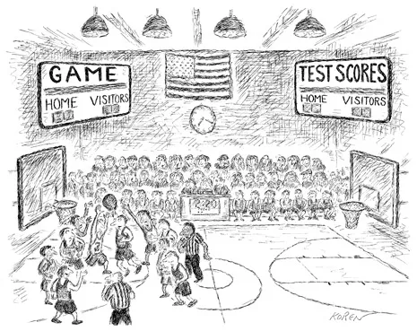
Thanks for enduring Mentor March Madness!
Please complete the Program Evaluation Survey after today’s Forum. Your input is needed to help us plan future sessions.

