Slide 1
Geometry- Lesson 2
Construct an Equilateral
Triangle II

Slide 2
Essential Question
Students apply the equilateral triangle construction to more challenging problems.
Students communicate mathematical concepts clearly and concisely.
Become more familiar with vocabulary as well as how to use it.

Slide 3
Opening Exercise
You will need a compass, a straightedge, and another student’s homework.
Directions:
Follow the directions from another student’s homework write-up to construct an equilateral triangle.
What kinds of problems did you have as you followed your classmate’s directions?
Think about ways to avoid these problems. What criteria or expectations for writing steps in constructions should be included in a rubric for evaluating your writing? List at least three criteria below:

Slide 4
Discussion (5 min)
What are common errors?
What are concrete suggestions to help improve the instruction-writing process?
Correct use of vocabulary, simple and concise steps (making sure each step involves just one instruction), and clear use of labels.
It is important to describe objects using correct terminology instead of pronouns. Instead of “it” or “they” perhaps “the center” or “the sides” should be used.

Slide 5
Problem Set 1, #1
Write a clear set of steps for the construction of an equilateral triangle. Use Euclid’s Proposition 1 as a guide.
1. Draw circle CJ: center J, radius JS.
2. Draw circle CS: center S, radius SJ.
3. Label the intersection as M.
4. Join S, J, M.
M
C
J
S
C

Slide 6
Exploratory Challenge 1 (15 min)
You will need your handout, a compass and a straightedge.
Using the skills you have practiced, construct three equilateral triangles, where the first and second triangles share a common side, and the second and third triangles share a common side. Clearly and precisely list the steps needed to accomplish this construction.
Switch your list of steps with a partner, and complete the construction according to your partner’s steps. Revise your drawing and/or list of steps as needed.
Construct 3 equilateral triangles on your paper in the space provided

Slide 7
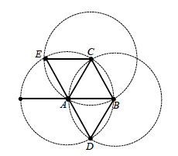
Exploratory Challenge 1
Construct three equilateral triangles
Steps
Draw a segment AB.
1.
2.
3.
4.
5.
6.
7.
Draw circle CA: center A, radius AB.
Draw circle CB: center B, radius BA
Label one intersection as C; label the other intersection as D.
Draw circle CC: center C, radius CA.
Label the unlabeled intersection of circle CC with circle CA (or the unlabeled intersection of circle CC with circle CB) as E.
Draw all segments that are congruent to AB between the labeled points.

Slide 8
Exploratory Challenge 2 (16 min)
Materials needed: Piece of paper, compass and a straight edge
On a separate piece of paper, use the skills you have developed in this lesson construct a regular hexagon. Clearly and precisely list the steps needed to accomplish this construction. Compare your results with a partner and revise your drawing and/or list of steps as needed.
Can you repeat the construction of a hexagon until the entire sheet is covered in hexagons (except the edges will be partial hexagons)?

Slide 9
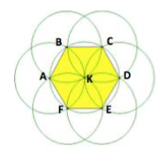
Exploratory Challenge 2
Steps
Draw circle C_{K}: center K, any radius.
1.
2.
3.
4.
5.
6.
7.
8.
Pick a point on the circle; label this point A.
Draw circle C_{A}: center A, radius AK.
Label the intersections of circle C_{A} with circle C_{K} as B and F.
Draw circle C_{B}: center B, radius BK.
Label the intersection of circle C_{B} with circle C_{K} as C.
Continue to treat the intersection of each new circle with circle C_{K} as the center of a new circle until the next circle to be drawn is circle C_{A}.
Draw AB, BC, CD, DE, EF, FA.

Slide 10
Exploratory Challenge 2
Can you repeat the construction of a hexagon until the entire sheet is covered in hexagons (except the edges will be partial hexagons)?
Wallpaper, tile patterns, etc.

Slide 11
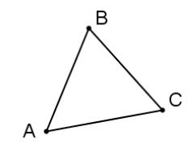
Exit Ticket
△𝐴𝐵𝐶 is shown below. Is it an equilateral triangle? Justify your response.
Don’t Forget Problem Set!

