Slide 1
CIT Mentor Forum
September 18, 2023
How’s it going so far? Complete the poll using either the poll notification pop-up or in the Chat window.
Welcome and
Welcome Back!
But I just figured out Zoom!
Tech issues during this Microsoft Teams meeting? Please email Anna.Leone-Tobar@rcsdk12.org .
Notes:
Launch Poll #1

Slide 2
CIT Mentor Forum - September 18, 2023
TODAY’S AGENDA:
Checking in via . . . Microsoft Teams?!?
Connect with a Mentor - Rose & Thorn
CIT Data & Reminders
Certified? Or Certifiable? FAQ Info & Resources
Navigating Reconfiguration Repercussions
How’d we do? Insights from 2023 CIT Program Evaluation Survey
Supporting Each Other: Advice for the Rookies and Problem-Solving
CIT Paperwork Pilot in Google Shared Drive
Meet the Panel!
How’s it going so far? Complete the poll using either the poll notification pop-up or in the Chat window.
But I just figured out Zoom!
Tech issues during this Microsoft Teams meeting? Please email Anna.Leone-Tobar@rcsdk12.org .

Slide 3
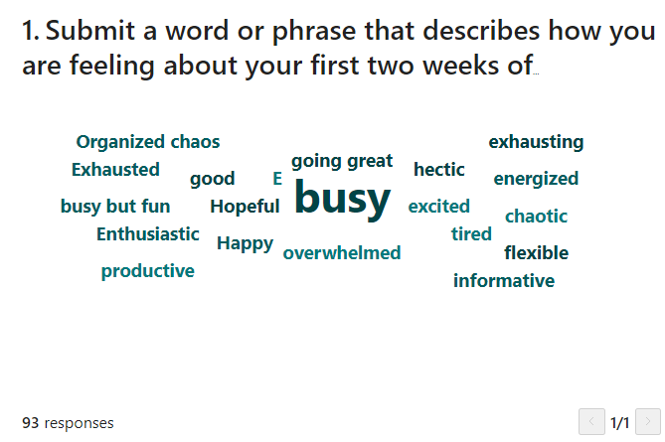

Slide 4
Let’s Reflect . . .
In Breakout Rooms, reflect with a partner about your experience of this new school year. Take 5 minutes to share.
ROSE Share a highlight | THORN Share a struggle | BUD Share a Goal

Slide 5
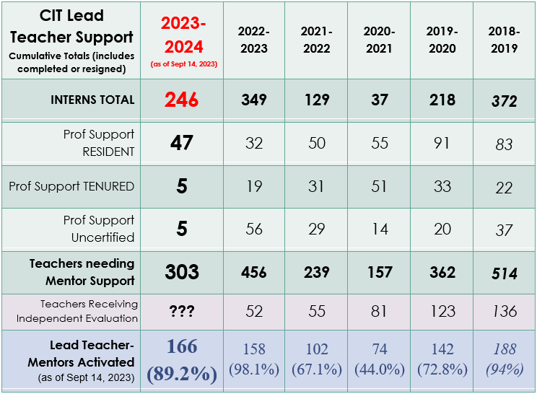

Slide 6
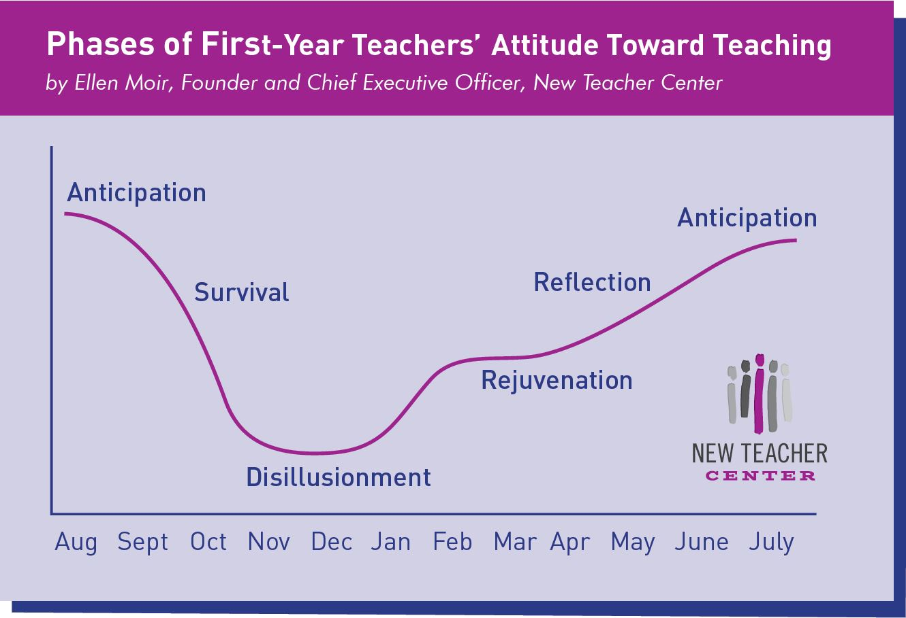
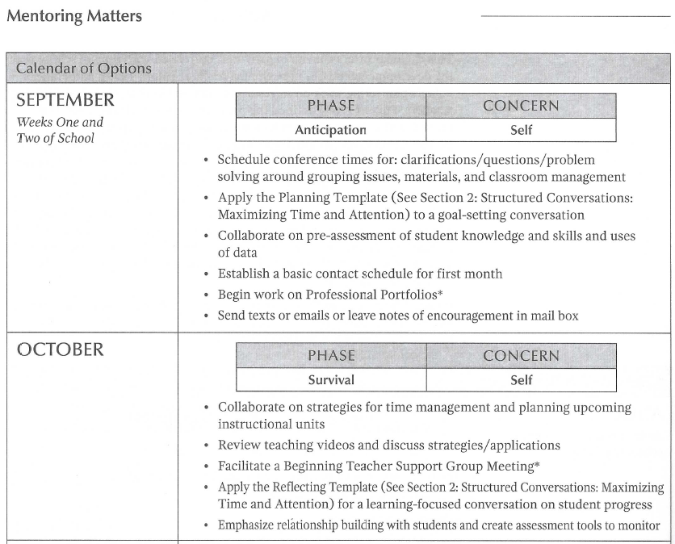
As we start the year supporting a colleague, remember . . .
Page 14

Slide 7
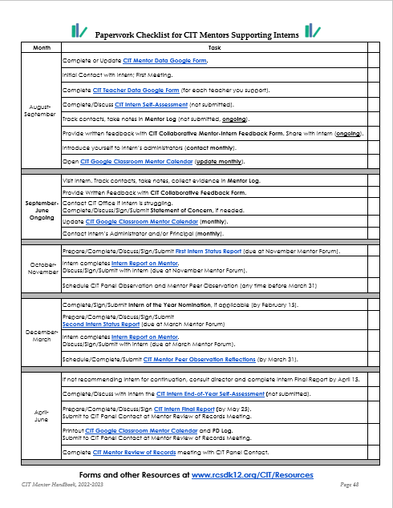
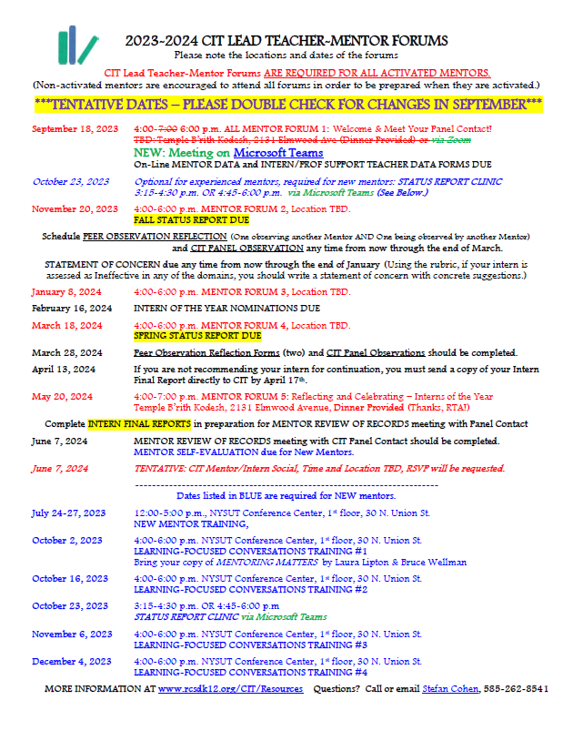
At the back of the Mentor Handbook

Slide 8
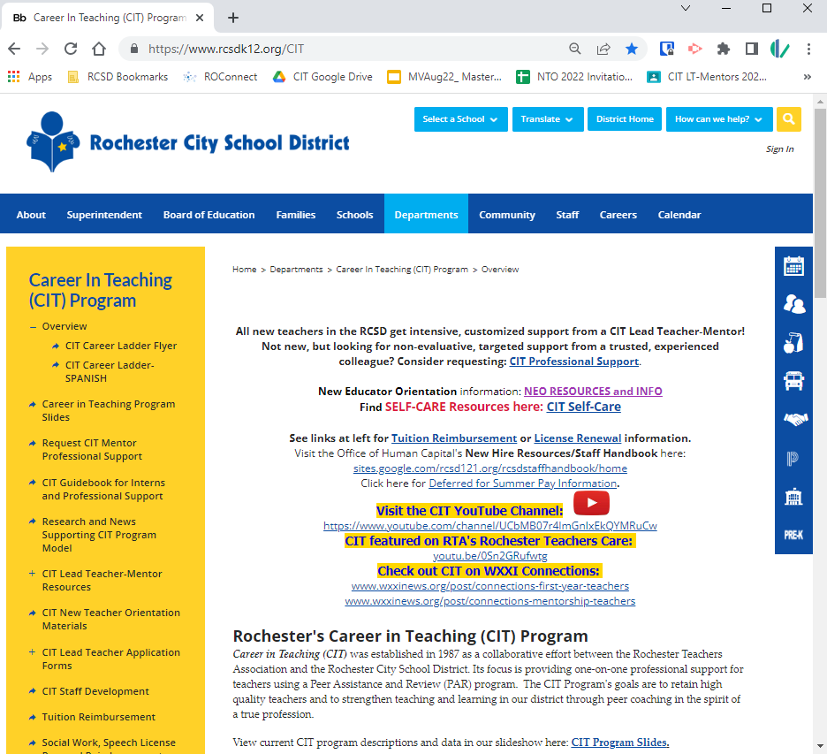
So when you have questions . . .
Start with the CIT Website: www.rcsdk12.org/CIT.
Tuition Reimbursement
APPR Evaluation Process Info
Teacher Evaluation Guide
Staff Development (PD Recommendations)
Intern & Prof Support Guidebook
Links for Teacher Certification
Links for PD Incentive and NYS PD Requirements
Self-care Resources

Slide 9
Calendars, Forms, and More
@ www.rcsdk12.org/CIT/Resources

Slide 10
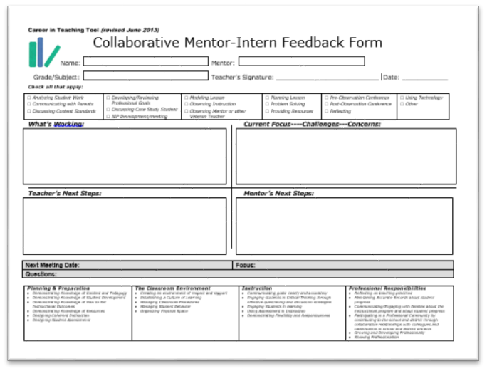
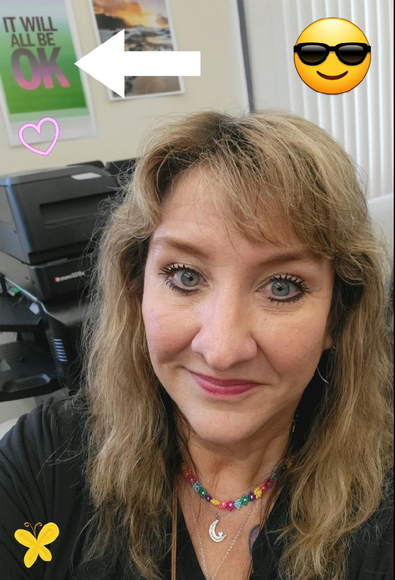
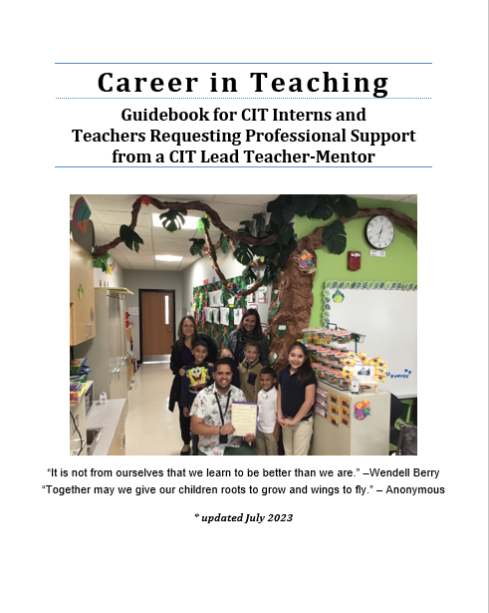
At the CIT Office . . .
Ready to help!
These forms are available in modified versions for Counselors, Librarians, Psychologists, Social Workers, and Speech Language Therapists.

Slide 11
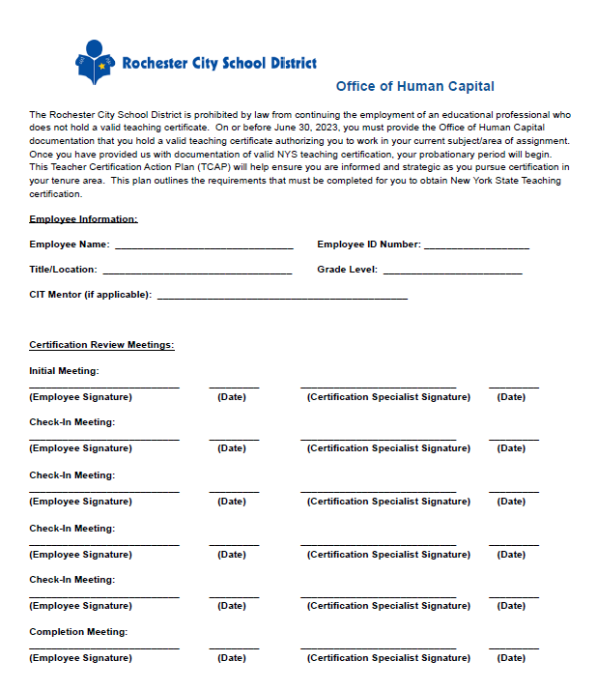
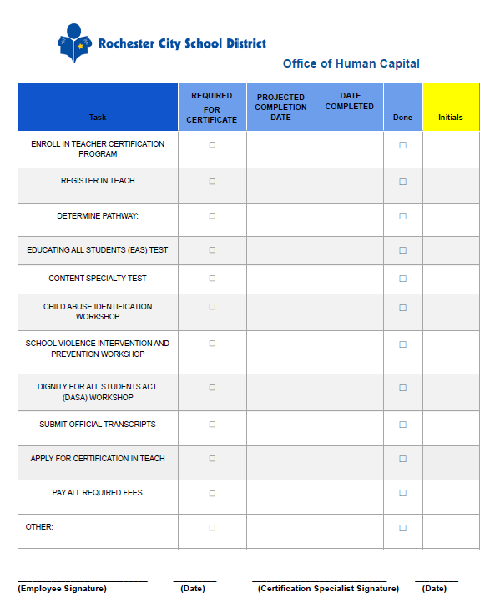
FAQ #1: What happens when an Intern is Uncertified?
Most uncertified hires have a “Teacher Certification Action Plan” or “TCAP”
Most uncertified hires are in PeopleSoft as “Contract Substitute” (code “REGS or“REGU”)
Office of Human Capital’s Director of Staff & Educator Effectiveness Kara Reidy-Vedder
Tuition Reimbursement only through December 2023 toward “Initial Certificate.” TR will continue to be available toward “Professional Certificate.”
Info at CIT Website: www.rcsdk12.org/CIT/Certification
Notes:
Launch Poll #2

Slide 12
“CIT Intern” or “PS Uncertified?”
Certified or Almost Certified | Won’t be Certified by Sept 2024
“Intern” Support Intern Status Reports & Intern Final Report | “PS Uncertified” or “PS Per Diem” Intake Form & Semester Reports (January, June)
Comprehensive formative feedback | Address Immediate Needs Support (Time) same as Intern.
Support with completing Certification process (if needed) | Support with Certification process.
Monthly Admin Contact | Monthly Admin Contact (same as CIT Intern)
DEFAULT to CIT Intern to start

Slide 13
Other Significant Info
Teacher Evaluation
Should be completed by Supervisor
Important for reducing Probationary Period once certified
What happens in June?
Goal is to support, grow, and retain promising teachers.
TCAPs for Contract Subs revisited in June before rehiring
CIT Office will check in with mentors supporting “uncertified” folks in a few weeks to confirm status.
www.rcsdk12.org/CIT/Certification

Slide 14
FAQ #2: What if the “CIT Intern” already has significant teaching experience elsewhere?
Almost always starts as “CIT Intern,” even if experienced prior to coming to RCSD.
CIT Mentor needs to observe work with students.
If Intern has prior experience and demonstrates “effective” practice in all domains, collaborate on setting goals and providing support for continuing growth.
If first “Intern Status Report” shows Intern to be “Effective” in all domains, you may wish to reach out to CIT Director to discuss shifting level of CIT support.

Slide 15
FAQ #3: What’s the deal with the “New Educator Orientation Requirement?”
The August “New Educator Orientation” program meets a contractual requirement for all teacher hires per RTA-RCSD Contract Section 15.2 for “up to five days . . . of orientation and in-services.”
Total Attendance | 196
Incomplete (missed sessions) | 52
New Educators missed NEO | 70
(NOT to be confused with the Office of Human Capital’s “Onboarding” or monthly Friday “New Hire Sessions.”)
CIT will be sending out information about meeting the contractual requirement by the end of September.
http://www.rcsdk12.org/CIT/NTO

Slide 16
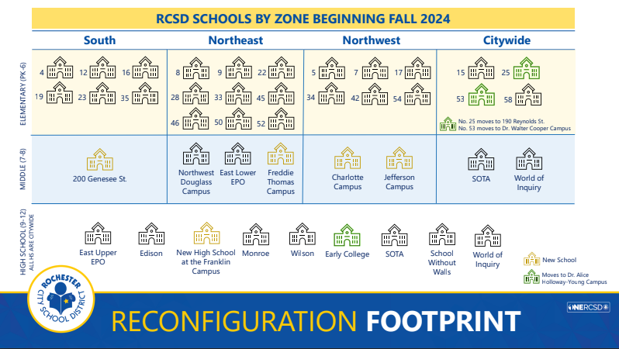
FAQ #4: What’s going to happen with this dramatic district reconfiguration?
What’s the buzz?
How to approach?
Model Calm
Acknowledge and validate feelings
Avoid speculation
Provide perspective
Don’t lose focus on students
Don’t dismiss your own valid emotional response.
Notes:
Launch Poll #3

Slide 17
FAQ #5: Show me the Money?
If you are activated, the CIT Mentor Stipend will typically appear in your paychecks in mid-October, with retroactive pay appearing in the subsequent paycheck.

Slide 18
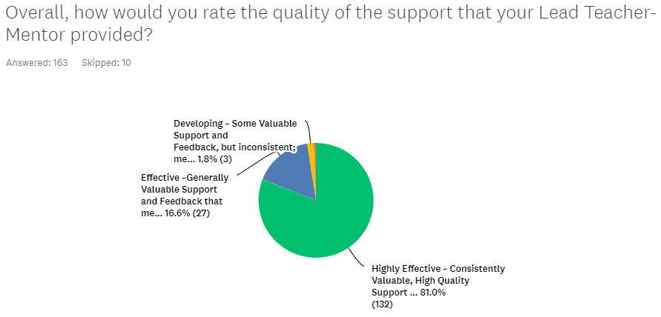
2023 CIT Program Evaluation Survey
Compare to 2022

Slide 19
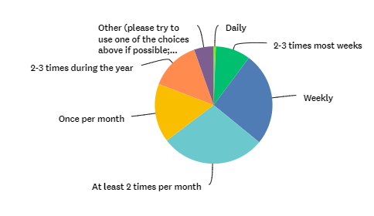
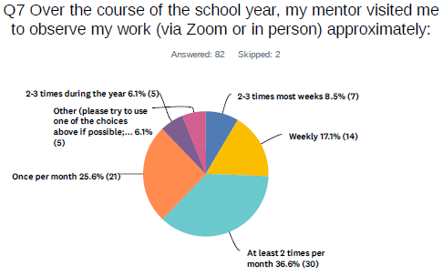
2023 CIT Program Evaluation Survey
Over the course of the school year, my mentor visited me to observe my work (via Zoom or in person) approximately:
OBSERVATIONS
Compare to 2022

Slide 20
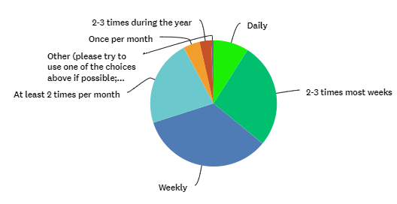
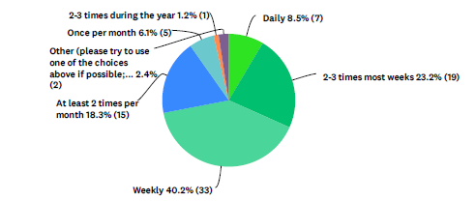
2023 CIT Program Evaluation Survey
My mentor was in contact with me approximately (include classroom/office visits, Zoom visits, phone calls, emails, texts, meetings outside of classroom)
CONTACT
Compare to 2022

Slide 21
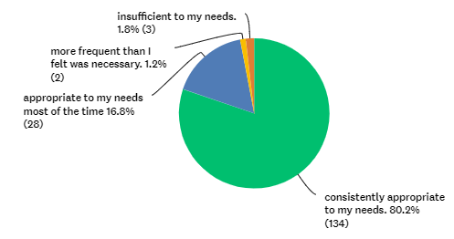
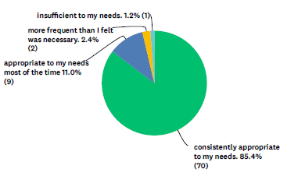
2023 CIT Program Evaluation Survey
The frequency of contact with my mentor was
FREQUENCY of CONTACT
Compare to 2022

Slide 22
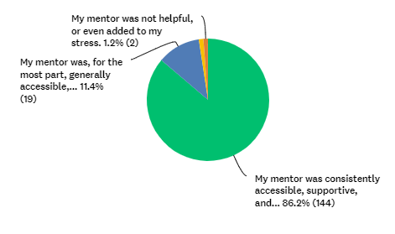
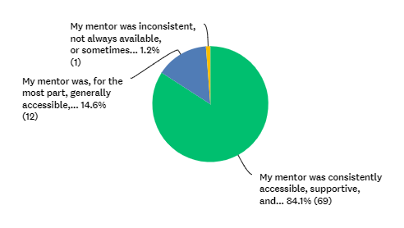
2023 CIT Program Evaluation Survey
Which of the following best describes your relationship with your assigned Lead Teacher-Mentor?
RELATIONSHIP with MENTOR
Compare to 2022

Slide 23
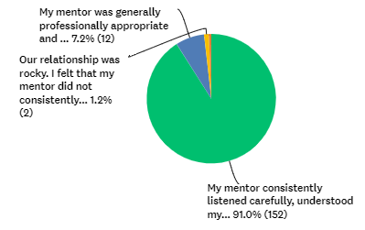
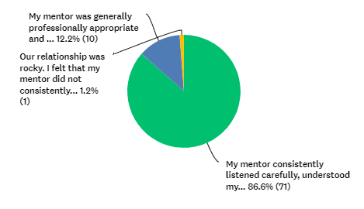
2023 CIT Program Evaluation Survey
Which of the following best describes your interactions with your assigned Lead Teacher-Mentor?
INTERACTIONS with MENTOR
Compare to 2022

Slide 24
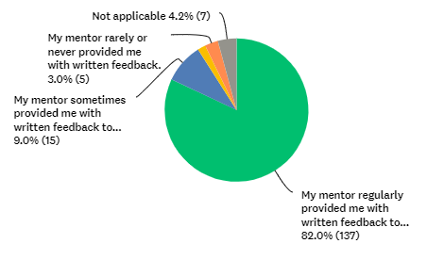
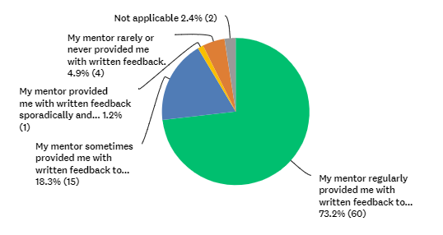
2023 CIT Program Evaluation Survey
Which of the following describes your use of written feedback?
WRITTEN FEEDBACK
Compare to 2022

Slide 25
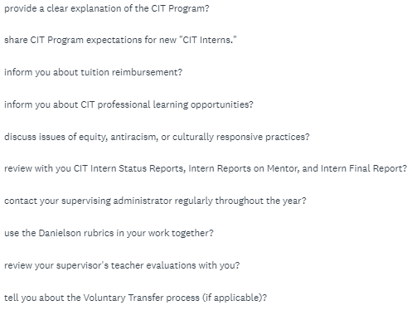
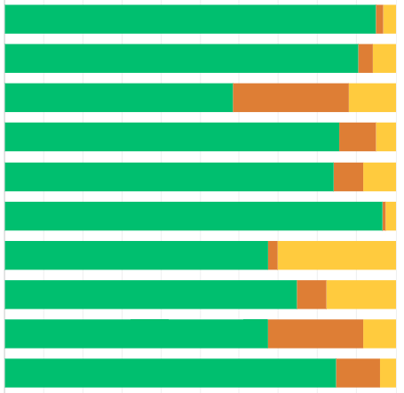
2023 CIT Program Evaluation Survey
Did your Mentor . . .

Slide 26
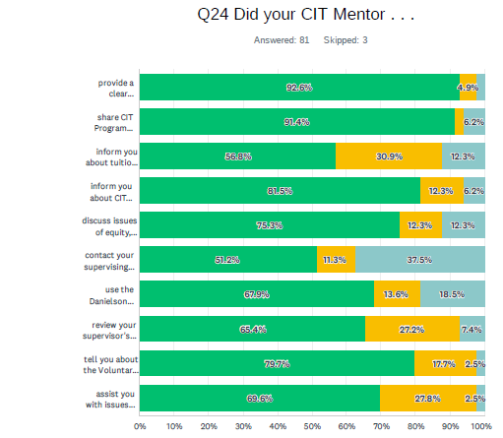
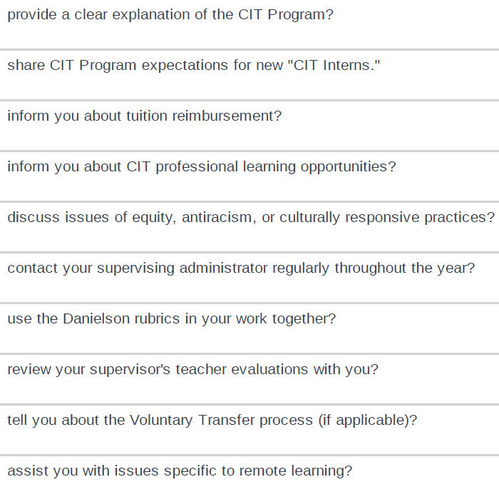
2022 CIT Program Evaluation Survey

Slide 27
Review the Comments in the CIT Program Evaluation Survey: 2023_CIT_Intern_Program_Evaluation Survey
Pages of comments to review | Survey Questions | Start here if your last name begins with . . .
PAGES 1-12 | Frequency & Quality of Contacts; Additional Comments | A through D
PAGES 13-19 PAGES 20-24 | Overall Quality of Support; How CIT Mentor Helped You Most What Could Be Improved-CIT? | E through L
PAGES 25-29 PAGES 30-35 | What Helped you Most Besides Mentor What Could Be Improved-District? | L through P
PAGES 36-42 PAGES 43-44 PAGES 45-65 | Considered resigning? Reasons Did your Mentor . . . ? Planning; Environment; Instruction; Prof Resp; Cult Resp Practices | R through Z
What confirmed, challenged, or extended your thinking about our Mentoring work? What surprised you? What questions were raised? Add your comments on the following slides
Find Link here and in Chat for CIT Program Evaluation Survey Analysis PADLET

Slide 28
Instructions
Once you are in your Breakout Rooms:
Please select one person in your Breakout Room to copy and open the Breakout Room Instructions (dropped into the ‘Chat’) with detailed instructions, and then “Share Screen” with the rest of the group. You will have 20 minutes to:
Introduce yourselves. (~4 minutes)
Share some experience, questions, and challenges.
New Mentors First:
Share about your experience as a CIT Mentor so far AND/OR
Share a question about mentoring work that you would like to have answered, or share a current mentoring challenge that you would like some help addressing.
Then Experienced Mentors
Share what you enjoy most about being a Mentor AND
Share the advice you wish you had received when you first started as a Mentor (“If I knew then what I know now . . .“).
Please . . . Be sure to give everyone an opportunity to speak and to listen. Only share what you feel comfortable sharing, you always have the option to pass. Please respect the privacy of the others in your Breakout Room. You are welcome to leave the Breakout Room to return to the main room at any time.

Slide 29
Brief Discussion Debrief
How was the discussion process for you?
Did you gain some helpful ideas?
Any themes emerge? Any surprises?
Please “raise your hand” or drop your comments into the ‘Chat’.
(We can share comments with the group after the Forum.)
You will be invited to share reactions and insights in the Survey after the session.
Notes:
Paste in Chat:
How was the discussion process for you? Did you find common issues? Consensus? Any surprises?

Slide 30
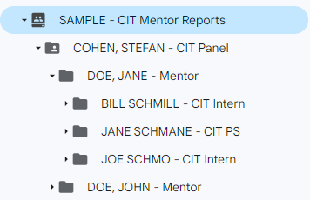
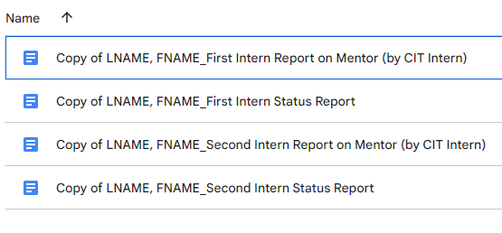
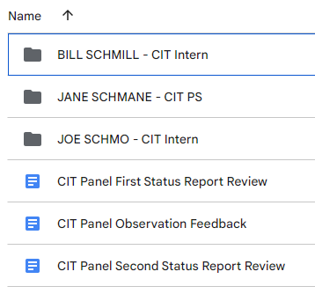
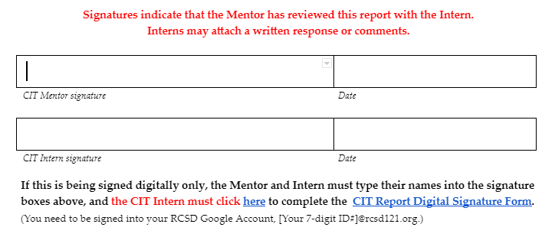
CIT Forms on Google Shared Drive
Visit the Google Shared Drive: SAMPLE – CIT Mentor Reports
Stay tuned!

Slide 31
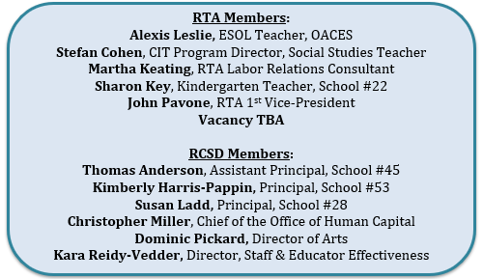
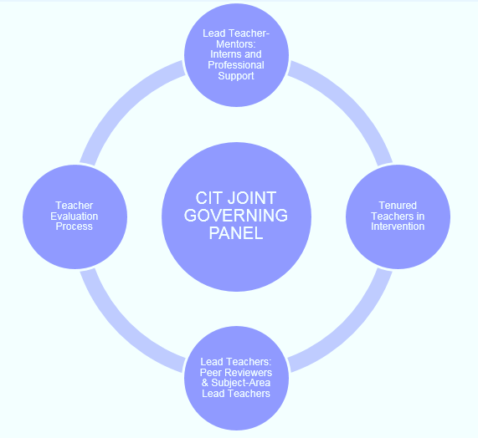
Our CIT Joint Governing Panel

Slide 32
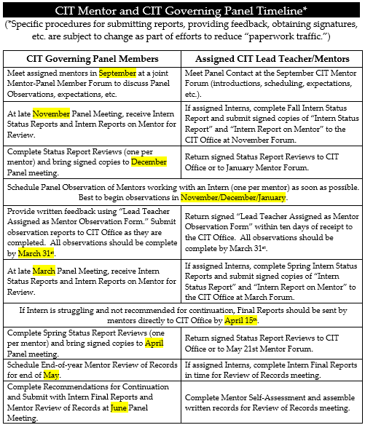
CIT Governing Panel
JOIN YOUR PANEL MEMBER’s BREAKOUT ROOM to . . .
Make Introductions
Review the Role of the CIT Governing Panel
Review Expectations and Procedures for Activated Mentors
Discuss Whatever Might Seem Relevant or Helpful

