Slide 1
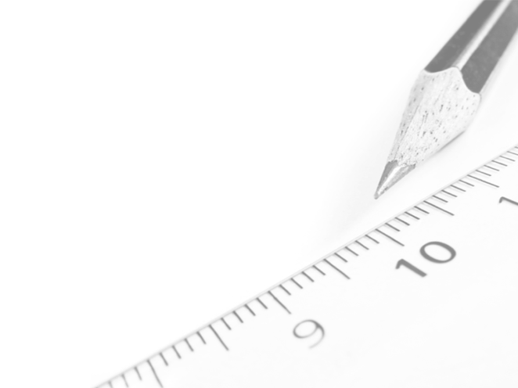
Geometry- Lesson 7
Solve for Unknown Angles- Transversals

Slide 2
Essential Question
Review of previously learned Geometry Facts
Practice citing the geometric justifications for future work with unknown angle proofs
This lesson focuses on Transversals. What have you learned previously about transversals?

Slide 3
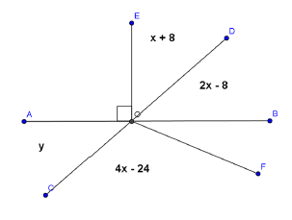
Opening Exercise
Use the diagram at the right to determine 𝑥 and 𝑦. 𝐴𝐵 and 𝐶𝐷 are straight lines.
𝑥 = ________
𝑦 = ________
30˚
52˚
Name a pair of vertical angles:
_____________________
Find the measure of ∠𝐵𝑂𝐹. Justify your calculation.
___________________________
___________________________
∠𝑨𝑶𝑪, ∠𝑫𝑶𝑩
∠𝑩𝑶𝑭= 𝟑𝟐°
s on a line

Slide 4
Discussion (5 min)
Angle Facts
If two lines are cut by a transversal and corresponding angles are equal, then the lines are parallel.
If parallel lines are cut by a transversal, corresponding angles are equal. (This second part is often called the Parallel Postulate. It tells us a property that parallel lines have. The property cannot be deduced from the definition of parallel lines.)

Slide 5
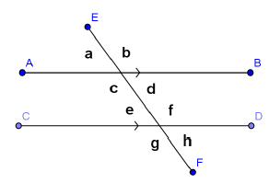
Given a pair of lines 𝐴𝐵 and 𝐶𝐷 in a plane (see the diagram below), a third line 𝐸𝐹 is called a transversal if it intersects 𝐴𝐵 at a single point and intersects 𝐶𝐷 at a single but different point. The two lines 𝐴𝐵 and 𝐶𝐷 are parallel if and only if the following types of angle pairs are congruent or supplementary

Slide 6
Corresponding Angles are equal in measure
Abbreviation: ________
__________________________
Alternate Interior Angles are equal in measure
Abbreviation: ________ __________________________
Same Side Interior Angles are supplementary
Abbreviation: ________ ___________________________
corr. s
a and e , d and h, etc.
alt. s
c and f , d and e.
int. s
c and e , d and f.

Slide 7
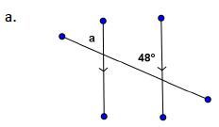
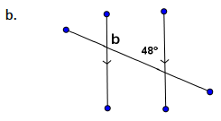
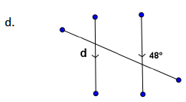
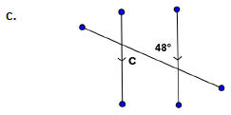
Examples (8 min)
Do Examples on your own
48˚
132˚
∠𝑎 = _____
∠b = _____
48˚
48˚
∠c = _____
∠d = _____

Slide 8
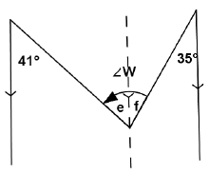
e. An ________________ is sometimes useful when solving for unknown angles.
In this figure, we can use the auxiliary line to find the measures of ∠𝑒 and ∠𝑓 (how?), then add the two measures together to find the measure of ∠𝑊.
What is the measure of ∠𝑊?
auxiliary line
𝒆= 𝟒𝟏°
𝒇= 𝟑𝟓°
∠𝑾 = ______
𝟕𝟔°

Slide 9
Relevant Vocabulary
Alternate Interior Angles: Let line 𝑇 be a transversal to lines 𝐿 and 𝑀 such that 𝑇 intersects 𝐿 at point 𝑃 and intersects 𝑀 at point 𝑄. Let 𝑅 be a point on 𝐿, and 𝑆 be a point on 𝑀 such that the points 𝑅 and 𝑆 lie in opposite half-planes of 𝑇. Then the angle ∠𝑅𝑃𝑄 and the angle ∠𝑃𝑄𝑆 are called alternate interior angles of the transversal 𝑇 with respect to 𝑀 and 𝐿.
Corresponding Angles: Let line 𝑇 be a transversal to lines 𝐿 and 𝑀. If ∠𝑥 and ∠𝑦 are alternate interior angles, and ∠𝑦 and ∠𝑧 are vertical angles, then ∠𝑥 and ∠𝑧 are corresponding angles.

Slide 10
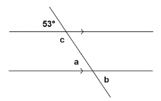
Exercises
Spend some time on your own or with a partner working on the following exercises.
1.
53°
corr. s
∠𝑎 = ______ , ____________
53°
vert. s
∠b = ______ , ____________
127°
int. s
∠c = ______ , ____________

Slide 11
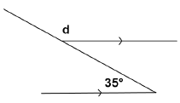
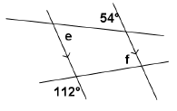
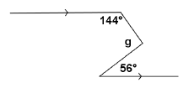
2.
145°
s on a line
alt. s
∠d = ______ , ____________
3.
∠e = ______ , ____________
54°
alt. s
∠f = ______ , ____________
68°
vert. s
int. s
4.
92°
vert. s
∠g = ______ , ____________
int. s

Slide 12
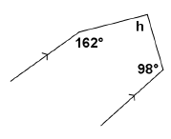
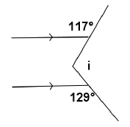
5.
100°
int. s
∠h = ______ , ____________
6.
∠i = ______ , ____________
114°
s on a line
alt. s

Slide 13
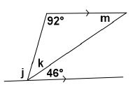
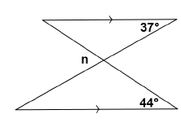
7.
92°
∠j = ______ , ____________
alt. s
∠k = ______ , ____________
42°
s on a line
46°
alt. s
∠m = ______ , ____________
8.
∠n = ______ , ____________
81°
corr. s

Slide 14
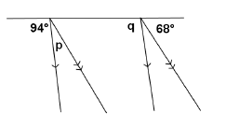
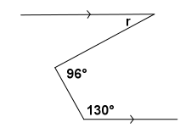
9.
∠p = ______ , ____________
18°
s on a line
94°
corr. s
∠q = ______ , ____________
10.
46°
int. s
∠r = ______ , ____________
alt. s

Slide 15
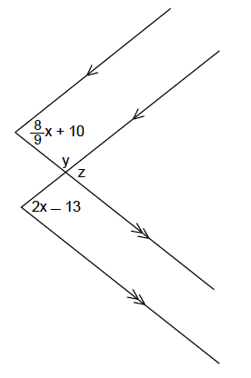
Exit Ticket
Find x, y and z
𝑥 = ______
𝑦 = ______
z = ________
40°
113°
67°
Don’t Forget Problem Set!!!

