Slide 1
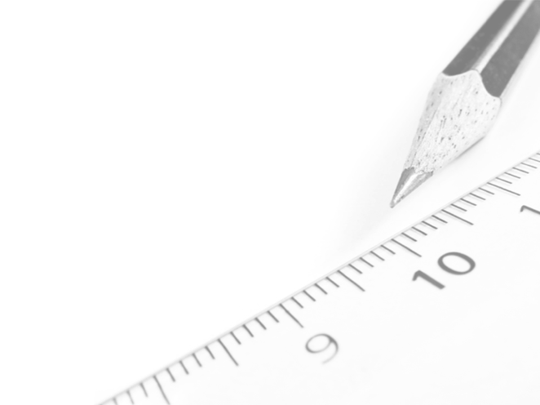
Geometry- Lesson 6
Solve for Unknown Angles- Angles and Lines at a Point

Slide 2
Essential Question
Review of previously learned Geometry Facts
Practice citing the geometric justifications for future work with unknown angle proofs

Slide 3
In The Next Three Lessons You should Be Able To…
Solve for unknown angles in diagrams
Justify each step or decision in the proof- writing process of unknown angle solutions.

Slide 4
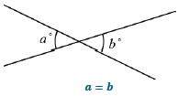
Opening Exercise
Review Chart from Lesson 5 Problem Set
* Make sure all your answers and diagrams are correct!!

Slide 5
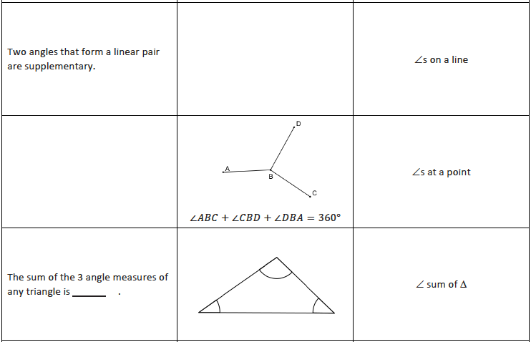
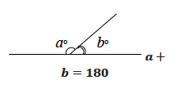
The sum the measures of all angles formed by three or more rays with the same vertex is 360°
The sum of the 3 angle measures of any triangle is ________.
180°

Slide 6
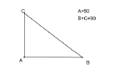
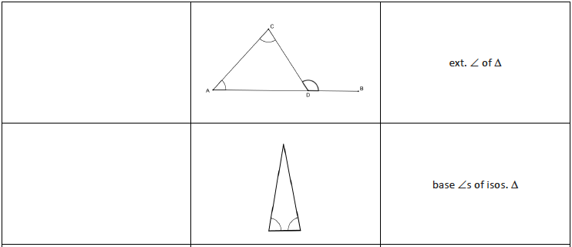
The sum of the measures of two angles of a triangle equals the measure of the opposite exterior angle.
Base angles of an isosceles triangle are congruent.

Slide 7
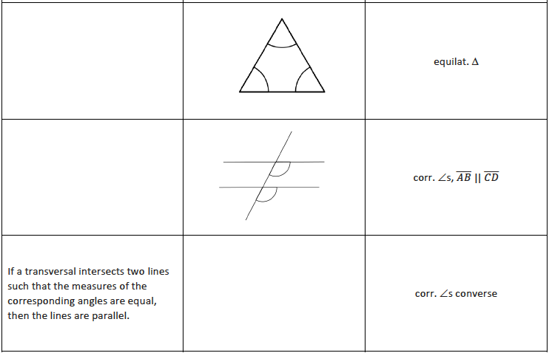
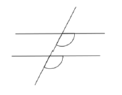
All angles in an equilateral triangle have equal measure.
If a transversal intersects two parallel lines then the measures of the corresponding angles are equal.

Slide 8
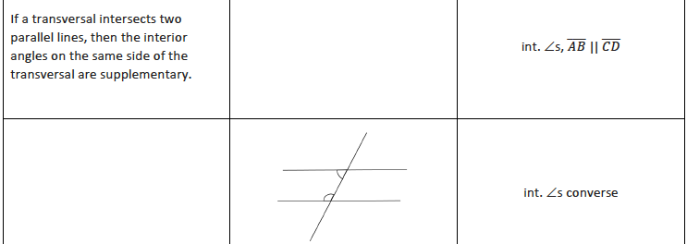
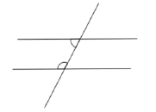
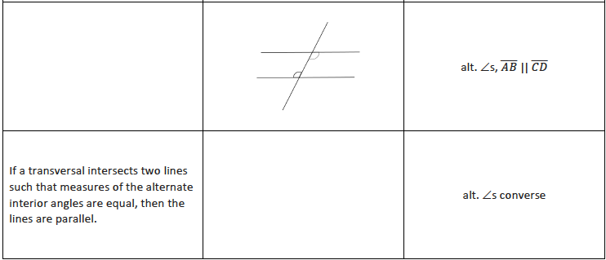
If a transversal intersects two lines such that the same side interior angles are supplementary, then the lines are parallel.
If a transversal intersects two parallel lines, then the measures of alternate interior angles are equal

Slide 9
Discussion (2 min)
Two angles ∠𝐴𝑂𝐶 and ∠𝐶𝑂𝐵, with a common side 𝑂𝐶, are _____________ if 𝐶 belongs to the interior of ∠𝐴𝑂𝐵. The sum of angles on a straight line is 180°. Two angles are called supplementary if the sum of their measures is ______ ; two angles are called complementary if the sum of their measures is _____. Describing angles as supplementary or complementary refers only to the measures of their angles; the positions of the angles or whether the pair of angles is adjacent to each other is not part of the definition.
adjacent angles
180˚
90˚

Slide 10
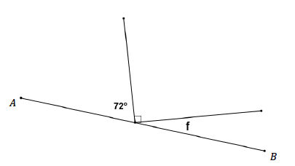
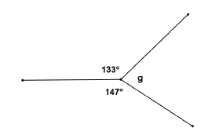
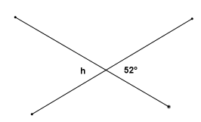
In the figure, 𝐴𝐵 is a straight line. Find the measure of ∠𝑓.
∠𝑓 = ______
18˚
The total measure of adjacent angles around a point is ______.
Find the measure of ∠𝑔.
360˚
80˚
∠𝑔 = _______
Vertical angles have _______ measure.
Find the measure of ∠ℎ.
Equal
52˚
∠ℎ = _______

Slide 11
Example 1 (30 min)
Find the measures of each labeled angle. Give a reason for your solution.
35˚
s on a line
140˚
s on a line
40˚
vertical s
140˚
s on a line or vertical s
238˚
s at a point

Slide 12
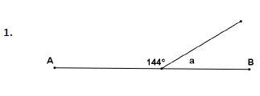
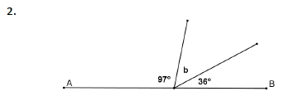
Exercises
In the figures below, 𝐴𝐵, 𝐶𝐷, and 𝐸𝐹 are straight lines. Find the measure of each marked angle or find the unknown numbers labeled by the variables in the diagrams. Give reasons for your calculations. Show all the steps to your solution.
36˚
∠a = ______________
Reason: _______________
s on a line
47˚
∠b = ______________
Reason: _______________
s on a line

Slide 13
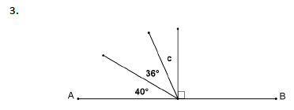
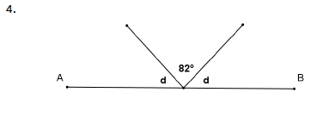
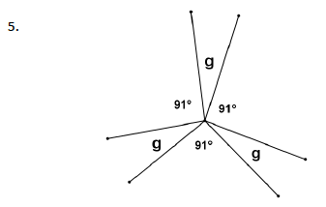
14˚
∠c = ______________
Reason: _______________
s on a line
49˚
∠d = ______________
Reason: _______________
s on a line
29˚
∠g = ______________
Reason: _______________
s at a point

Slide 14
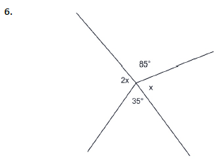
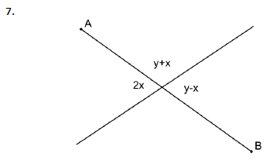
80˚
∠x = ______________
Reason: _______________
s at a point
30˚
90˚
∠x = _______ y = ________
Reason: _______________
s at a point and vert. s

Slide 15
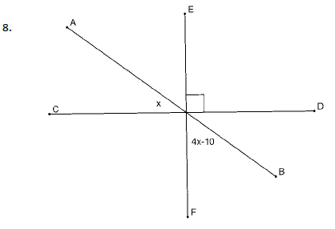
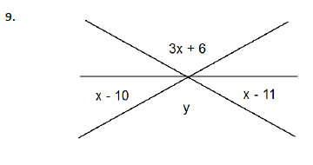
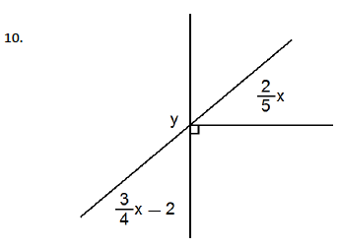
20˚
∠x = ______________
Reason: _______________
vert. s and s on a line
39˚
123˚
∠x = _______ y = ________
Reason: _______________
vert. s and s at a point
80˚
122˚
∠x = _______ y = ________
Reason: _______________
s on a line

Slide 16
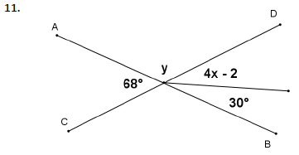
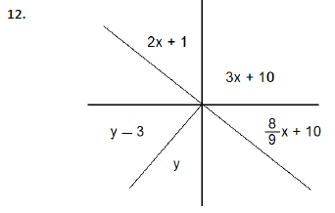
For Problems 11–12, find the values of 𝑥 and 𝑦. Show all the steps to your solution.
10˚
x = ____________
y = ____________
112˚
27˚
x = ____________
y = ____________
47˚

Slide 17
Vocabulary
Straight Angle: If two rays with the same vertex are distinct and collinear (i.e., they form a line), then each of the angles formed by the line is called a straight angle.
Vertical Angles: Two angles are vertical angles (or vertically opposite angles) if their sides form two pairs of opposite rays.

Slide 18
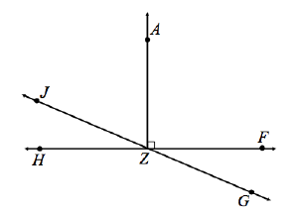
Exit Ticket
Use the following diagram to answer the questions below:
1.
Name an angle supplementary to ∠𝐻𝑍𝐽 and provide the reason for your calculation
Name an angle complementary to ∠𝐻𝑍𝐽 and provide the reason for your calculation.
∠𝑱𝒁𝑭 or ∠𝑯𝒁𝑮
∠𝑱𝒁𝑨
2. If ∠𝐻𝑍𝐽 = 38°, what is the measure of each of the following angles? Provide reasons for your calculations.
a. ∠𝐹𝑍𝐺 _______ b. ∠𝐻𝑍𝐺 _______ c. ∠𝐴𝑍𝐽 ______
38˚
142˚
52˚

