Slide 1
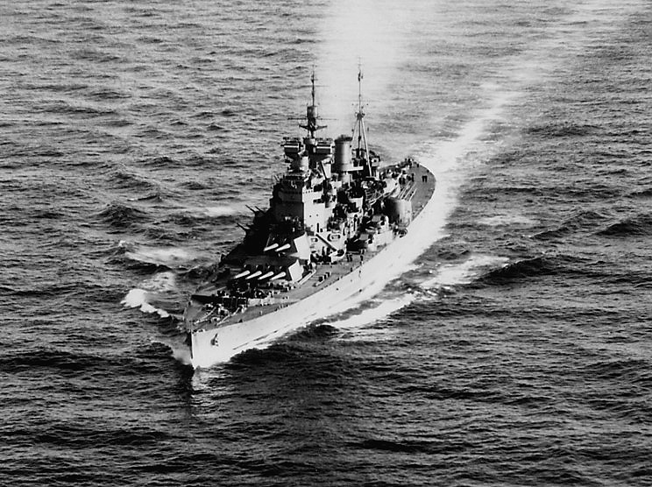

Slide 2
Washington Naval Agreements 1921-22
Four Power Agreement
- Respect territory in Far East or Asia
Five Power Agreement
- Naval forces ration for US Britain and Japan 5:5:3
France and Italy 1//2 the size Japanese navy
Concern China instability
Nine Power Agreement
- Reaffirmed territory in China

Slide 3
GB, USA, France & Japan agreed to respect each other’s Pacific possessions & guarantee China’s independence.
Japan would restore Kias-Chow & Shantung to China. Japan to withdraw from Siberia, in Russia.
There would be a ten year stoppage in the building of capital ships (more than 10,000 tons with guns larger than 8"). A ratio of USA:5, GB:5, Japan:3, France:1.75 and Italy:1.75 was to be maintained in the building of capital ships

Slide 4
Effects- Washington Disarmament
Lessened possibility of naval war in the Far East where Japan & USSR had ideas about expanding into China.
The alliance of First World War victors was reaffirmed, despite USA’s isolation policy.
Though better international relations resulted, the USSR was not invited to the talks, despite her extensive Far Eastern interests. (USSR was, as yet, not recognized.)
Treaty of Rapallo (April 1922) – Signed, 2 months after the Washington Treaty, by Germany and Soviet Russia. They said they would not attack each other and trade links were opened. Both powers were no longer isolated.

Slide 5
London Naval Agreement (1930)
o Further steps in naval disarmament o Most nations economic hardship, GD
o The Treaty for the Limitation;
Reduction of Naval Armament
Modified the naval ratio between the US, Brit, and Japan- 5:5:3→10:10:7,
- France and Italy excluded themselves from the ratio changes

Slide 6
Results London
“Limits” set above current capacity of powers involved
US worried limitations would inhibit defense of territories

Slide 7
Geneva Disarmament Conferences 1932-34
Reduction and Limitation of Armaments
Extension of Washington Conference
Goal to achieve lowest disarmament
Difficulty defining offensive vs defensive weapons
France and Germany disagree;

Slide 8
Results of Geneva Conference
France reluctant to disarm, security more important
Germany demanded other nations disarm or be allowed to rearm
Jan 1933 Hitler withdraws from conference and LON
No significant results
Japan and Germany aggressive tactics

Slide 9
London Conference 1936
France, GB, US (Japan and Italy out)
Failure
Did agree on limits of size of navy but collapsed
Conflicts around world

