Slide 1
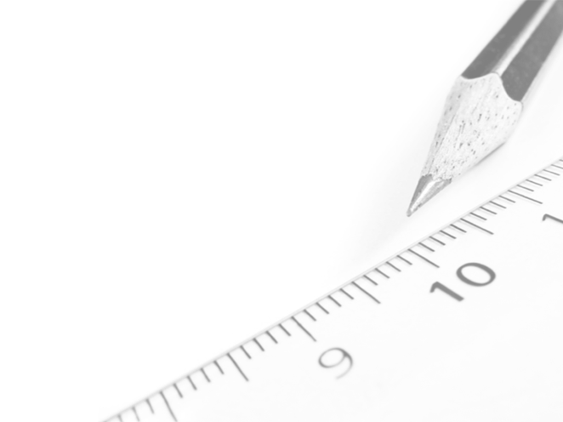
Geometry- Lesson 11
Unknown Angle Proofs- Proofs of Known Facts

Slide 2
Essential Question
Write unknown angle proofs involving known facts

Slide 3
Answers to Lesson 10 Problem Set
1. In the figure at the right, 𝑨𝑩 || 𝑫𝑬 and 𝑩𝑪 || 𝑬𝑭.
Prove that ∠ABC = ∠DEF.
Extend DE through BC, and mark the intersection with BC as Z.
∠𝑨𝑩𝑪 = ∠𝑬𝒁𝑪 corr. ∠s
∠𝑬𝒁𝑪 = ∠𝑫𝑬𝑭 corr. ∠s
∠𝑨𝑩𝑪 = ∠𝑫𝑬𝑭 Trans Prop
2. In the figure at the right, 𝑨𝑩 || 𝑪𝑫.
Prove that ∠AEC = a + c.
Draw in line through E parallel to AB and CD; add point F.
∠𝑩𝑨𝑬 = ∠𝑨𝑬𝑭 alt. ∠s
∠𝑫𝑪𝑬 = ∠𝑭𝑬𝑪 alt. ∠s
∠𝑨𝑬𝑪=𝒂+𝒄

Slide 4
Opening Exercise
A proof of a mathematical statement is a detailed explanation of how that statement follows logically from other statements already accepted as true.
A theorem is a mathematical statement with a proof.
* A theorem is often stated as an “If-then” as:
If “hypothesis,” then “conclusion.”
Theorems can be stated without reference to any specific, labeled diagram.
However, we cannot take steps to prove a statement without a way of referring to parts.

Slide 5
Opening Exercise
What known facts have we gone over up till now?
The sum of angles of a triangle is 180°
Vertical angles are congruent
Known Fact: “opposite angles of parallelograms are equal in measure.”
How do we prove that?

Slide 6
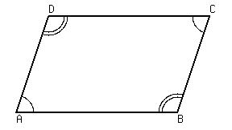
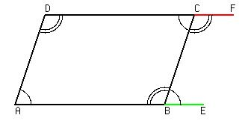
Prove “opposite angles of parallelograms are equal in measure.”
Hint: Extend 2 of the lines
Alternate interior angles are congruent when parallel lines are cut by a transversal.
It is possible using one basic fact to build to the next.

Slide 7
Discussion
Once a theorem has been proved, it can be added to our list of known facts and used in proofs of other theorems.
For example, in Lesson 9 we proved that vertical angles are of equal measure, and we know (from earlier grades and by paper cutting and folding) that if a transversal intersects two parallel lines, alternate interior angles are of equal measure.
How do these facts help us prove that corresponding angles are congruent?

Slide 8
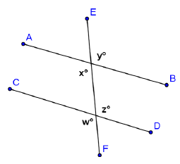
In the diagram at the right, if you are given that 𝑨𝑩∥𝑪𝑫
How can you use your knowledge of the congruence of vertical angles and alternate interior angles to prove that 𝒙=𝒘?
𝒘=𝒛 (vert. ∠s)
𝒛=𝒙 (alt. ∠s)
𝒙=𝒘 (Trans. Prop.)
You now have available the following facts:
▪ Vertical angles are equal in measure.(vert. ∠s)
▪ Alternate interior angles are equal in measure. (alt. ∠s, 𝑨𝑩∥𝑪𝑫)
▪ Corresponding angles are equal in measure. (corr. ∠s, 𝑨𝑩∥𝑪𝑫)

Slide 9
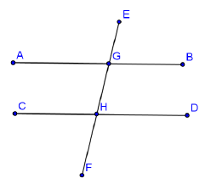
Use any or all of these facts to prove that interior angles on the same side of the transversal are supplementary. Add any necessary labels to the diagram below, then write out a proof including given facts and a statement of what needs to be proved.
𝑨𝑩∥𝑪𝑫, transversal 𝑬𝑭
Given: ________________________
∠𝑩𝑮𝑯 + ∠𝑫𝑯𝑮 = 𝟏𝟖𝟎°
Prove: ________________________
Statement Reason
∠𝑩𝑮𝑯 + ∠𝑨𝑮𝑯 = 𝟏𝟖𝟎° ∠s on a line
∠𝑨𝑮𝑯 = ∠𝑫𝑯𝑮 alt. ∠s
∠𝑩𝑮𝑯 + ∠𝑫𝑯𝑮 = 𝟏𝟖𝟎° Sub. Prop.

Slide 10
Now that you have proved this, you may add this theorem to your available facts.
▪ Interior angles on the same side of the transversal that intersects parallel lines sums to 180°. (int. ∠s, 𝑨𝑩∥𝑪𝑫)
Previous Facts:
▪ Vertical angles are equal in measure.(vert. ∠s)
Alternate interior angles are equal in measure. (alt. ∠s, 𝑨𝑩∥𝑪𝑫)
Corresponding angles are equal in measure. (corr. ∠s, 𝑨𝑩∥𝑪𝑫)

Slide 11
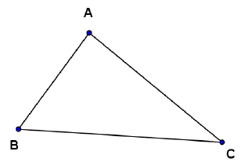
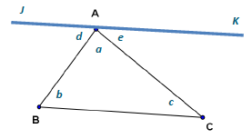
Use any of these four facts to prove that the three angles of a triangle sum to 180°. For this proof, you will need to draw an auxiliary line parallel to one of the triangle’s sides and passing through the vertex opposite that side. Add any necessary labels, and write out your proof.
Draw in auxiliary line 𝑱𝑲 so that 𝑱𝑲∥𝑬𝑭.
Statement Reason
𝒅+𝒂+𝒆=𝟏𝟖𝟎° ∠s on a line
𝒅=𝒃 alt. ∠s
𝒆=𝒄 alt. ∠s
𝒂+𝒃+𝒄=𝟏𝟖𝟎° Sub. Prop.

Slide 12
Let’s review the theorems we have now proved:
Vertical angles are equal in measure.
A transversal intersects a pair of lines. The pair of lines is parallel if and only if,
Alternate interior angles are equal in measure. (alt. int. ∠s, 𝑨𝑩 ∥ 𝑪𝑫)
Corresponding angles are equal in measure. (corr. ∠s,
𝑨𝑩 ∥ 𝑪𝑫)
Interior angles on the same side of the transversal add to 180°. (int. ∠s, 𝑨𝑩 ∥ 𝑪𝑫)
The sum of the degree measures of the angles of a triangle is 180°.
* What is the absolute shortest list of facts from which all other facts can be derived?
Notes:
The basics

Slide 13
Side Trip
Take a moment to take a look at one of those really famous Greek guys we hear so much about in geometry – Eratosthenes. Over 2,000 years ago, Eratosthenes used the geometry we have just been working with to find the diameter of Earth. He did not have cell towers, satellites, or any other advanced instruments available to scientists today. The only things Eratosthenes used were his eyes, his feet, and perhaps the ancient Greek equivalent to a protractor.
Watch this video to see how he did it, and try to spot the geometry we have been using throughout this lesson.
Eratosthenes solves a puzzle

Slide 14
Example 1
Construct a proof designed to demonstrate the following:
“If two lines are perpendicular to the same line,
they are parallel to each other.”
Draw and label a diagram,
State the given facts and the conjecture to be proved,
Write out a clear statement of your reasoning to justify each step.
Given: 𝑨𝑩 ⊥ 𝑬𝑭, 𝑪𝑫 ⊥ 𝑬𝑭
Prove: 𝑨𝑩 ∥ 𝑪𝑫

Slide 15
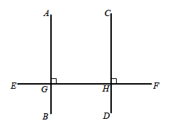
𝑨𝑩 ⊥ 𝑬𝑭, 𝑪𝑫 ⊥ 𝑬𝑭
Given: ________________________
𝑨𝑩 ∥ 𝑪𝑫
Prove: ________________________
Statement Reason
∠𝑨𝑮𝑯 = 𝟗𝟎°; ∠𝑪𝑯𝑭 = 𝟗𝟎° defn. of perpendicular
∠𝑨𝑮𝑯 = ∠𝑪𝑯𝑭 perp ∠s are equal
∠𝑨𝑮𝑯 = ∠𝑪𝑯𝑭 corr. ∠s
𝑨𝑩 ∥ 𝑪𝑫 since corr. ∠s are equal

Slide 16
Discussion
Each of the three parallel line theorems has a converse (or reversing) theorem as follows:
Original | Converse
If two parallel lines are cut by a transversal, then alternate interior angles are congruent. (alt. ∠s) | If two lines are cut by a transversal such that alternate interior angles are congruent, then the lines are parallel. (alt. ∠s converse)
If two parallel lines are cut by a transversal, then corresponding angles are congruent. (corr. ∠s) | If two lines are cut by a transversal such that corresponding angles are congruent, then the lines are parallel. (corr. ∠s converse)
If two parallel lines are cut by a transversal, then interior angles on the same side of the transversal add to 180°. (int. ∠s) | If two lines are cut by a transversal such that interior angles on the same side of the transversal add to 180°, then the lines are parallel. (int. ∠s converse)

Slide 17
Example of Converse Usage
First Parallel Line Theorem:
If two parallel lines are cut by a transversal,
then alternate interior angles are congruent. (alt. ∠s )
Converse:
If two lines are cut by a transversal such that alternate interior angles are congruent, then the lines are parallel. (alt. ∠s converse)
Have a student hold 2 rulers parallel and another student hold 1 up as a transversal and test the first parallel line theorem with them

Slide 18
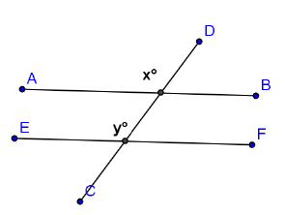
Example 2
In the figure at the right, 𝒙=𝒚.
Prove that 𝑨𝑩∥𝑬𝑭.
Statement Reason
𝒙=𝒚 Given
𝑨𝑩∥𝑬𝑭 corr. ∠s converse

Slide 19
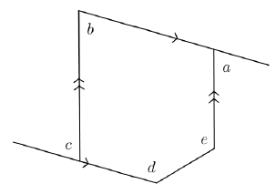
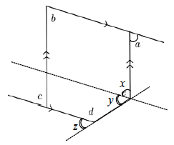
Exit Ticket
In the diagram at the right, prove that
∠𝒅 + ∠𝒆 − ∠𝒂 = 𝟏𝟖𝟎˚.
Draw auxiliary lines, and label ∠s.
∠𝒂 = ∠𝒙 alt. ∠s
∠𝒚 = ∠𝒆 − ∠𝒙 ∠s add
∠𝒚 = ∠𝒛 corr. ∠s
∠𝒅 + ∠𝒛 = 𝟏𝟖𝟎˚ ∠s on a line
∠𝒅 + ∠𝒆 − ∠𝒂 = 𝟏𝟖𝟎˚

