Slide 1
Geometry- Lesson 10
Unknown Angle Proofs- Proofs With Constructions

Slide 2
Essential Question
Write unknown angle proofs involving auxiliary lines.

Slide 3
Answers to Problem Set 9
1. In the figure at the right, prove that 𝒎║𝒏.
𝒂 + 𝟏𝟑𝟖° = 𝟏𝟖𝟎° s on a line
𝒂 = 𝟒𝟐°
𝒂 = 𝒃
∴ 𝒎║𝒏 corr. s converse
2. In the diagram at the right, prove that the sum of the angles marked by arrows is 𝟑𝟔𝟎°.
𝒂 + 𝒃 = 𝟏𝟖𝟎° s on a line
𝒄 + 𝒅 = 𝟏𝟖𝟎° s on a line
𝒆 + 𝒇 = 𝟏𝟖𝟎° s on a line 𝒂 + 𝒃 + 𝒄 + 𝒅 + 𝒆 + 𝒇 = 𝟓𝟒𝟎°
𝒃 + 𝒅 + 𝒇 = 𝟏𝟖𝟎°  sum of a △
∴ 𝒂 + 𝒄 + 𝒆 = 𝟑𝟔𝟎°
3. In the diagram at the right, prove that 𝒂 + 𝒅 −𝒃 = 𝟏𝟖𝟎°.
𝒂 = 𝒃 + 𝒄 alt. int. s, s add
𝒄 + 𝒅 = 𝟏𝟖𝟎° int. s
𝒂 + 𝒅 − 𝒃 = 𝟏𝟖𝟎°

Slide 4
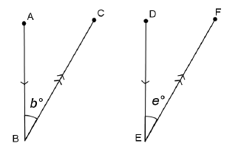
Opening Exercise
In the figure to the right, 𝑨𝑩 || 𝑫𝑬 and 𝑩𝑪 || 𝑬𝑭. Prove that 𝒃=𝒆. (Hint: Extend 𝑩𝑪 and 𝑬𝑫.)
z
𝒃=𝒛 alt. s
𝒛=𝒆 alt. s
𝒃=𝒆

Slide 5
Proof:
In the previous lesson, you used deductive reasoning with labeled diagrams to prove specific conjectures. What is different about the proof above?
Adding or extending segments, lines, or rays (referred to as auxiliary lines) is frequently useful in demonstrating steps in the deductive reasoning process. Once 𝑩𝑪 and 𝑬𝑫 were extended, it was relatively simple to prove the two angles congruent based on our knowledge of alternate interior angles. Sometimes there are several possible extensions or additional lines that would work equally well.

Slide 6
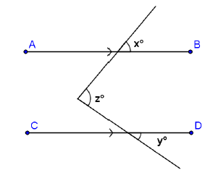
For example, in this diagram, there are at least two possibilities for auxiliary lines. Can you spot them both?
Given: 𝑨𝑩 || 𝑪𝑫.
Prove: 𝒛 = 𝒙 + 𝒚.

Slide 7
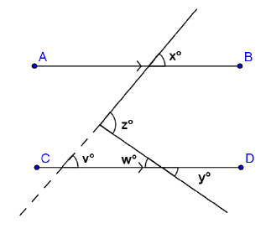
Discussion (7 min)
Here is one possibility:
Given: 𝑨𝑩 || 𝑪𝑫.
Prove: 𝒛 = 𝒙 + 𝒚.
Extend the transversal as shown by the dotted line in the diagram.
Label angles 𝒗 and 𝒘, as shown.
What do you know about 𝒗 and 𝒙
About angles 𝒘 and 𝒚 How does this help you?
Write a proof using the auxiliary segment drawn in the diagram to the right.

Slide 8
Proof:
Statement Reason
𝒛 = 𝒗 + 𝒘 ext.  of a △
𝒙 = 𝒗 corr. s
𝒚 = 𝒘 vert. s
𝒛 = 𝒙 + 𝒚

Slide 9
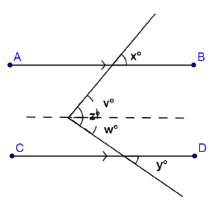
Another possibility appears here:
Given: 𝑨𝑩 || 𝑪𝑫.
Prove: 𝒛=𝒙+𝒚.
Draw a segment parallel to 𝑨𝑩 through
the vertex of angle 𝒛. This divides 𝒛
Into angles 𝒗 and 𝒘, as shown.
What do you know about angles 𝒗 and 𝒙?
They are equal in measure since they are corresponding angles of parallel lines crossed by a transversal.
About angles 𝒘 and 𝒚 How does this help you?
They are also equal in measure since they are corresponding angles of parallel lines crossed by a transversal.

Slide 10
Write a proof using the auxiliary segment drawn in this diagram. Notice how this proof differs from the one above.
Statement Reason
𝒙 = 𝒗 corr. s
𝒚 = 𝒘 corr. s
𝒛 = 𝒗+ 𝒘
𝒛= 𝒙 + 𝒚

Slide 11
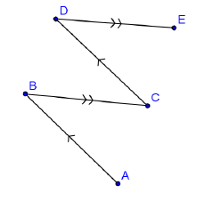
Examples (25 min)
Work on the examples on your own or with a partner
In the figure at the right, 𝑨𝑩 || 𝑪𝑫 and 𝑩𝑪 || 𝑫𝑬.
Prove that 𝑨𝑩𝑪 = 𝑪𝑫𝑬.
(Where will you draw an auxiliary segment?)
Statement Reason
𝑨𝑩𝑪 = 𝑩𝑪𝑫 alt. s
𝑩𝑪𝑫 = 𝑪𝑫𝑬 alt. s
𝑨𝑩𝑪 = 𝑪𝑫𝑬

Slide 12
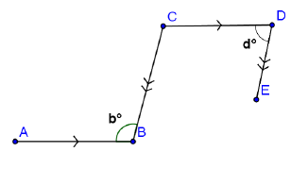
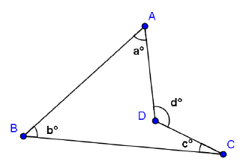
In the figure, 𝐴𝐵 || 𝐶𝐷 and 𝐵𝐶 || 𝐷𝐸.
Prove that 𝑏 + 𝑑 = 180.
c
Statement Reason
Label 𝒄.
𝒃=𝒄 alt. s
𝒄+𝒅=𝟏𝟖𝟎° int. s
𝒃+𝒅=𝟏𝟖𝟎°
3. In the figure, prove that 𝑑 = 𝑎 + 𝑏 + 𝑐.
Statement Reason
Z
Label 𝒁 and 𝒛.
𝒛=𝒃+𝒄 ext.  of a △
𝒅=𝒛+𝒂 ext.  of a △
𝒅=𝒂+𝒃+𝒄
z

Slide 13
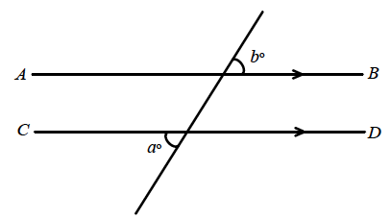
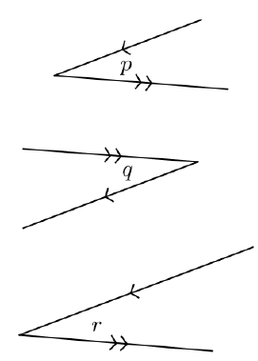
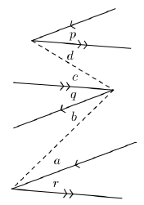
Exit Ticket
Write a proof for each question.
In the figure at the right, 𝐴𝐵̅̅̅̅ ∥ 𝐶𝐷̅̅̅̅.
Prove that 𝑎 = 𝑏.
Write in angles 𝒄 and 𝒅.
𝒂 = 𝒄 vert. s
𝒄 = 𝒅 alt. s
𝒅 = 𝒃 vert. s
𝒂 = 𝒃
2. Prove 𝑝 ≅ 𝑟.
Mark angles a, b, c, and d.
𝒑 + 𝒅 ≅ 𝒄 + 𝒒 alt. s
𝒅 ≅ 𝒄 alt. s
𝒑 ≅ 𝒒
𝒒 + 𝒃 ≅ 𝒂 + 𝒓 alt. s
𝒂 ≅ 𝒃 alt. s
𝒒 ≅ 𝒓
𝒑 ≅ 𝒓

