Slide 1
Geometry- Lesson 5
Points of Concurrency

Slide 2
Essential Question
Become familiar with vocabulary regarding two points of concurrencies
Understand why the points are concurrent.
*Materials needed: String, Pencil and Straightedge
*Incorporate geometry software?

Slide 3
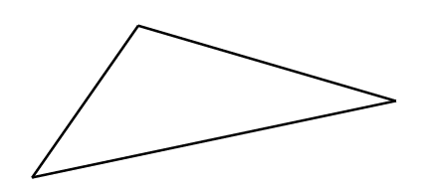
Opening Exercise (7 min)
* You will need a make-shift compass made from string and pencil
Use these materials to construct the perpendicular bisectors of the three sides of the triangle below (like you did with Problem Set # 2).
How did using this tool differ from using a compass and straightedge? Compare your construction with that of your partner. Did you obtain the same results?

Slide 4
Discussion (38 min)
When three or more lines intersect in a single point, they are _____________, and the point of intersection is the _____________________.
concurrent
point of concurrency
You saw an example of a point of concurrency in yesterday’s problem set (and in the Opening Exercise above) when all three perpendicular bisectors passed through a common point.
The point of concurrency of the three perpendicular bisectors is the __________________________.
circumcenter of the triangle
The circumcenter of △𝑨𝑩𝑪 is shown next as point 𝑷.

Slide 5
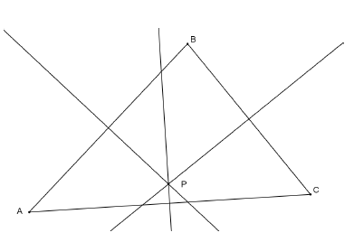
Mark the right angles and congruent segments (defined by midpoints) on the triangle.
The question that arises here is WHY are the three perpendicular bisectors concurrent? Will these bisectors be concurrent in all triangles?
1.
2.
3.
𝑃 is equidistant from 𝐴 and 𝐵 since it lies on the _____________________ of 𝐴𝐵.
perpendicular bisector
𝑃 is also ___________ from 𝐵 and 𝐶 since it lies on the perpendicular bisector of 𝐵𝐶.
equidistant
Therefore, 𝑃 must also be equidistant from 𝐴 and 𝐶.

Slide 6
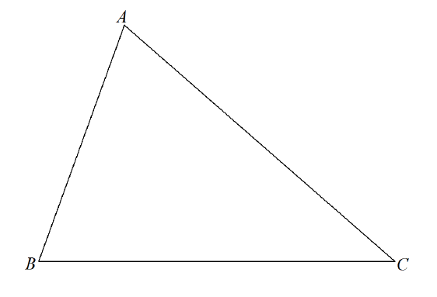
Hence, 𝐴𝑃=𝐵𝑃=𝐶𝑃, which suggests that 𝑃 is the point of _____________ of all three perpendicular bisectors.
concurrency
You have also worked with angles bisectors. The construction of the three angle bisectors of a triangle also results in a point of concurrency, which we call the ___________.
incenter
Use the triangle below to construct the angle bisectors of each angle in the triangel to locate the triangle’s
* label the congruent angles formed by the angle bisectors.
Q

Slide 7
1. State precisely the steps in your construction:
* Note: You do not need to re-explain constructions you have established before this current construction.
1.
2.
Construct the angle bisectors of  𝑨, 𝑩, and  𝑪.
Label the point of intersection 𝑸.
Q

Slide 8
2. Earlier in this lesson, we explained why the perpendicular bisectors are always concurrent. Using similar reasoning, explain clearly why the angle bisectors are always concurrent at the incenter.
Any point on the angle bisector is equidistant from the rays forming the angle. Therefore, since point 𝑸 is on the angle bisector of  𝑨𝑩𝑪, it is equidistant from 𝑩𝑨 and 𝑩𝑪. Similarly, since point 𝑸 is on the angle bisector of  𝑩𝑪𝑨, it is equidistant from 𝑪𝑩 and 𝑪𝑨. Therefore, 𝑸 must also be equidistant from 𝑨𝑩 and 𝑨𝑪, since it lies on the angle bisector of  𝑩𝑨𝑪. So 𝑸 is a point of concurrency of all three angle bisectors.

Slide 9
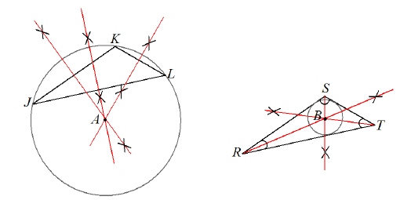
circumcenter
3. Observe the constructions below. Point 𝐴 is the _____________ of triangle △𝐽𝐾𝐿 (notice that it can fall outside of the triangle). Point 𝐵 is the __________ of triangle △𝑅𝑆𝑇. The circumcenter of a triangle is the center of the circle that circumscribes that triangle. The incenter of the triangle is the center of the circle that is inscribed in that triangle.
incenter
On a separate piece of paper, draw two triangles of your own below and demonstrate how the circumcenter and incenter have these special relationships.

Slide 10
4. How can you use what you have learned in Problem 3 to find the center of a circle if the center is not shown?
Inscribe a triangle into the circle and construct the perpendicular bisectors of at least two sides. Where the bisectors intersect is the center of the circle.

Slide 11
No Exit Ticket
There is going to be a topic shift to unknown angle problems and proofs for the next six lessons.
The Lesson 5 Problem Set is a preview for Lessons 6–11, but is based on previously taught geometry facts.

