Slide 1
Russia: Industrialization and Revolution (1750-1914)
AP World History: Chapter 18

Slide 2
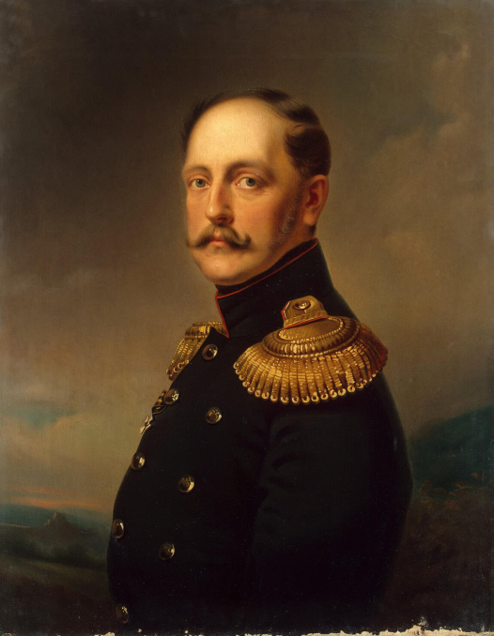
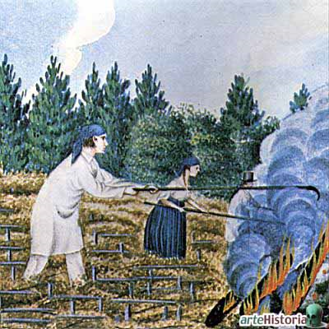
Russia During the 19th Century
STILL had an absolute monarchy (the tsar)
No national parliament
No political parties
No nationwide elections
Russian society = dominated by titled nobility
Until 1861 = most Russians were serfs
Bound to their masters’ estates; subject to sale; greatly exploited
Tsar Nicholas I (1825-1855)

Slide 3
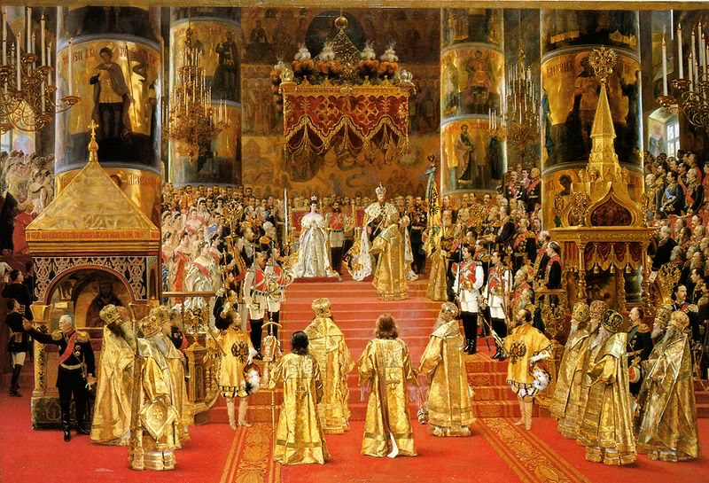
Russia: “Transformation from Above”
In the U.S. = social and economic change has always come from society as people sought new opportunities and rights
In Russia = change was initiated by the state/government itself
Done to catch up with the more powerful and innovative states of western Europe

Slide 4
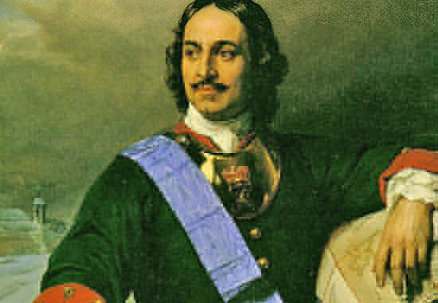
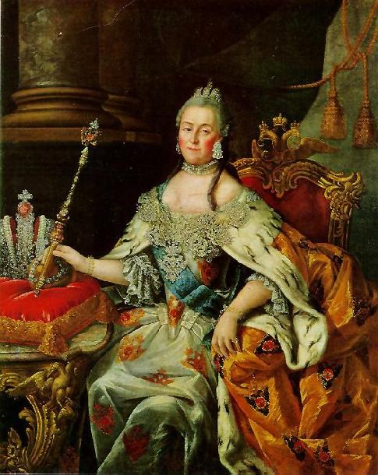
Russia: “Transformation from Above”
Peter the Great (1689-1725)
Enlarged and modernized the military
Created new educational system for sons of nobles
Supported new manufacturing enterprises
Nobles had to dress in European styles
New capital = St. Petersburg = “window on the West”
Catherine the Great (1762-1796)
Russia’s “heir to the Enlightenment”

Slide 5
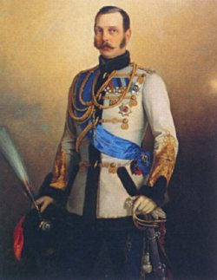
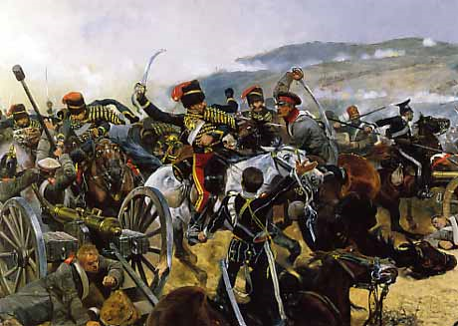
Russia: “Transformation from Above”
1861 = Russian state abolished serfdom (by Alexander II)
Stimulated by its defeat in the Crimean War (1854-1856)
Lost to British and French forces
War was over influence in territories of the declining Ottoman Empire
Tsar Alexander II saw the defeat of Russia’s serf-army at the hands of FREE British and French troops as a sign to end serfdom
After the abolition of serfdom = Russia began a program of industrial development

Slide 6
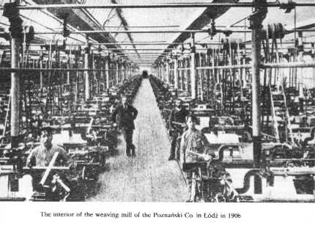
Russia’s Industrial Revolution
1890s = industrialization under way and growing rapidly
Focused on railroads and heavy industry
By 1900 = Russia ranked 4th in the world in steel production
Had major industries in: coal, textiles, and oil

Slide 7
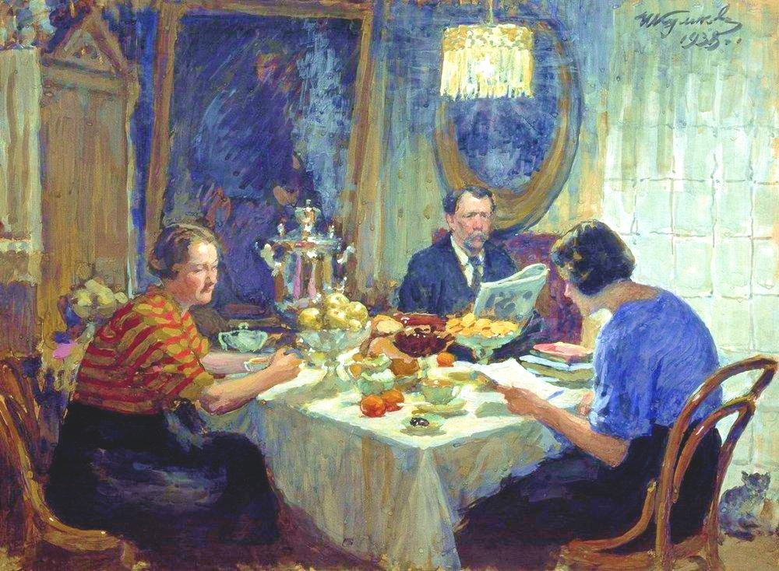
Social Outcomes: The Middle Class
Growing middle class = comprised of businessmen and professionals
Many objected to tsarist Russia and wanted a greater role in political life
But, the middle class was also dependent on the state for: contracts, jobs, and suppressing the growing radicalism of the workers
A Family at Table, 1938
Painting of a Middle-Class Russian Family

Slide 8
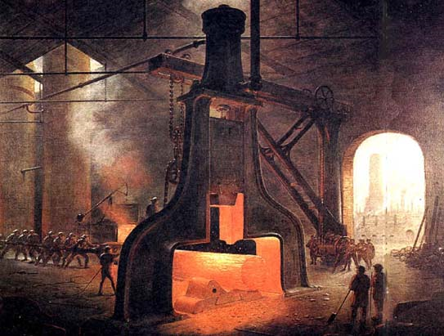
Social Outcomes: The Working Class
Factory workers = about 5% of total Russian population
Harsh work conditions
13-hour work day
Ruthless discipline and constant disrespect from supervisors
Most lived in large, unsanitary barracks
Unions and political parties = illegal
Only way to protest was through large-scale strikes

Slide 9
Social Outcomes: The Working Class
Many workers and educated Russians turned to Marxist socialism
1898 = illegal Russian Social-Democratic Labor Party created
Got involved in: workers’ education, union organizing, and revolutionary action
1905 = a revolution in Russia erupted

Slide 10
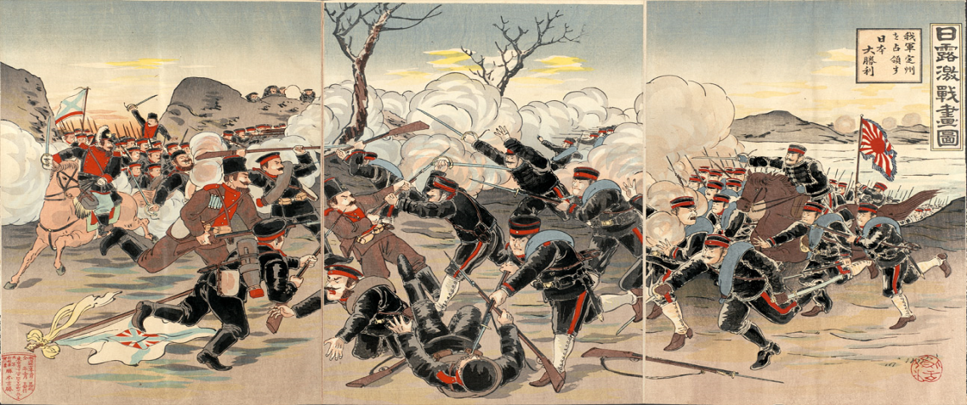
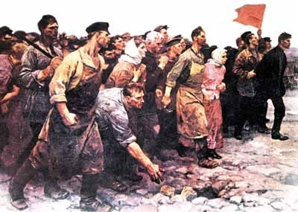
Russian Revolution of 1905
Erupted following a Russian defeat in a naval war with Japan
Workers went on strike and created their own representative councils called soviets
Revolution also included: peasant uprisings, mutinies in the military, student demonstrations, and revolts of non-Russian nationalities
The Russo-Japanese War (1905) occurred as a result of imperialist competition over Manchuria and Korea

Slide 11
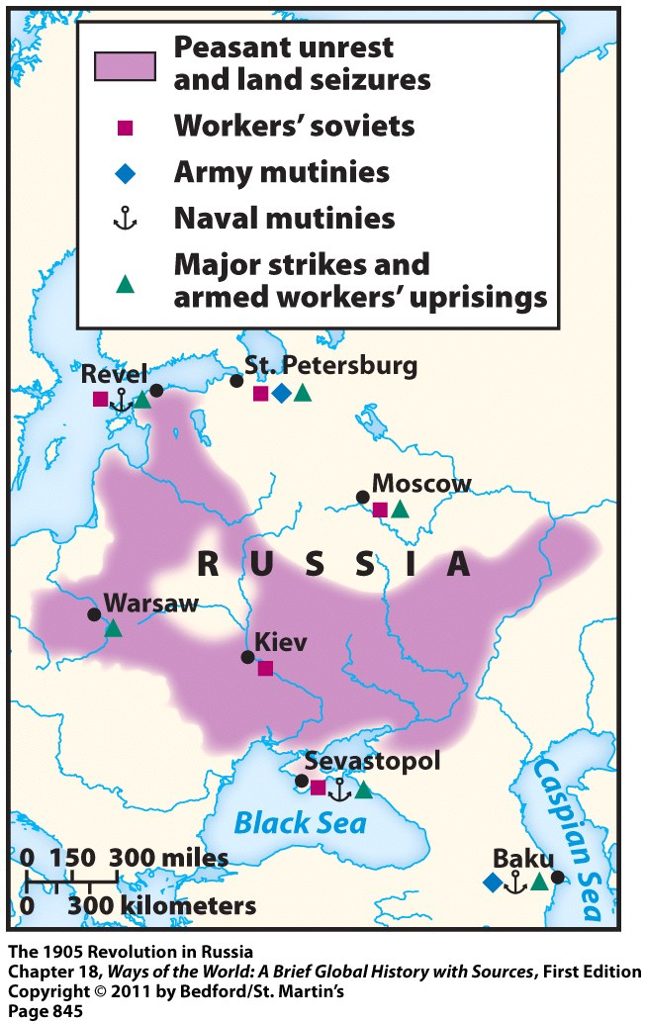
Russian Revolution of 1905

Slide 12
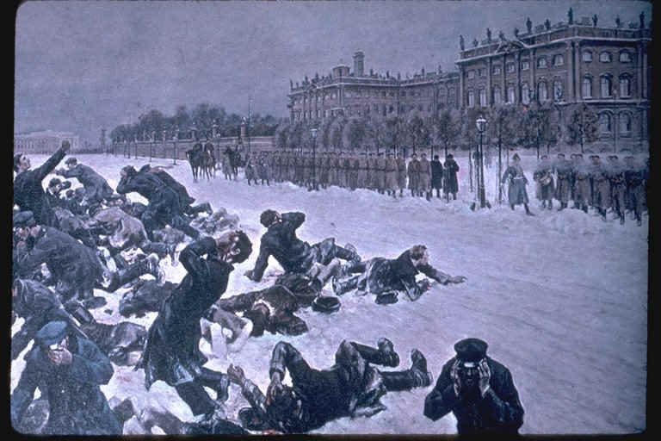
Russian Revolution of 1905
Revolution was brutally suppressed and pretty unsuccessful
As a result of the revolution, the tsar’s regime implemented some reluctant and halfhearted reforms (most of which weren’t actually carried out)
Granted a constitution
Legalized trade unions and political parties
Permitted election of a national assembly (the Duma)
Censorship eased
Plans for universal primary education
Continued industrial development

Slide 13
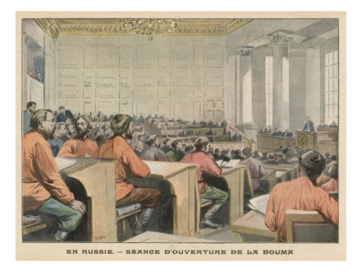
After the 1905 Revolution
These limited reforms did not tame the radical working class or bring social stability to Russia
1907 = Tsar Nicholas II dissolved the Duma
Limited political voice even for the privileged classes
Many felt that revolution was inevitable and necessary if real changes were going to happen
Russian Duma in 1906

Slide 14
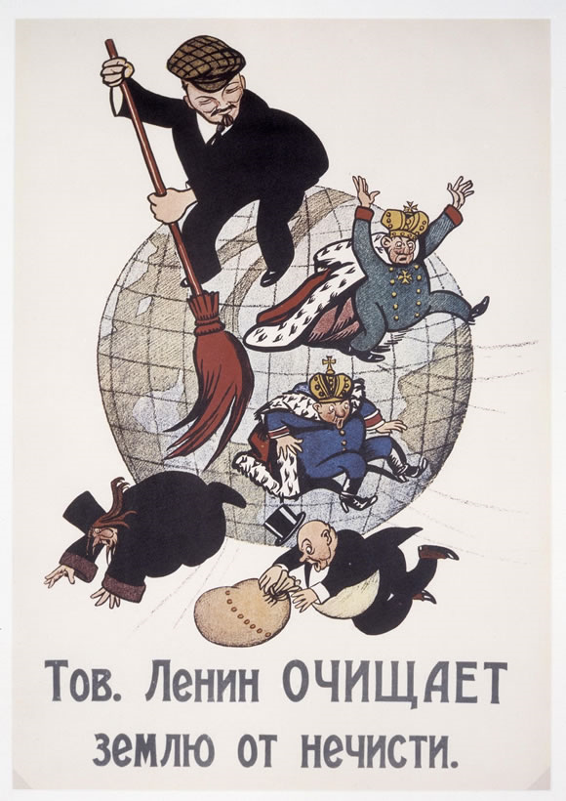
Growth of Revolutionary Groups
Most of these groups were socialist
Most effective in the cities
Published pamphlets and newspapers
Organized trade unions
Spread their messages among workers and peasants
Furnished leaders who were able to act when the revolutionary moment arrived

Slide 15
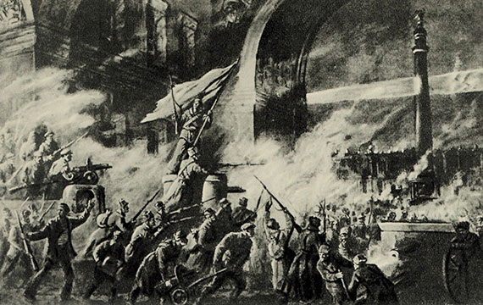
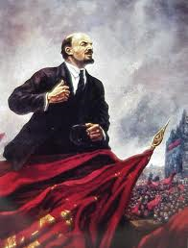
The Revolutionary Moment
Key catalyst = World War I
Russian Revolution of 1917 sparked by:
Hardships of WWI
Social tensions of industrialization
Autocratic tsarist regime
This revolution brought to power the Bolsheviks = radical socialist group
Led by Vladimir Lenin

Slide 16
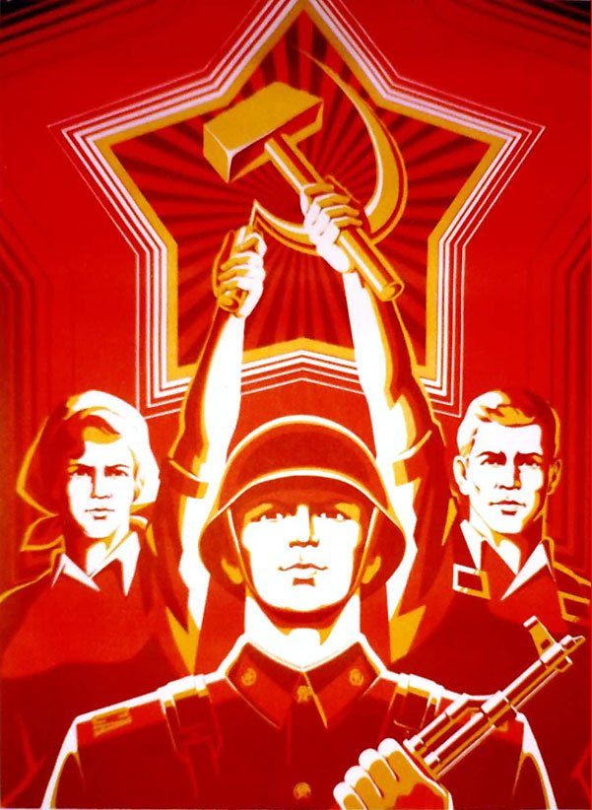
Only in Russia…
Industrialization caused violent social revolution
A socialist party, inspired by Karl Marx, was able to seize power
Modern world’s first socialist society

