Slide 1

Rochester City School District Retirees

Slide 2

Topics
What is Medicare
What are the different types of plans offered
What changes are there to the prescription drug coverage
What should I do and when
2

Slide 3
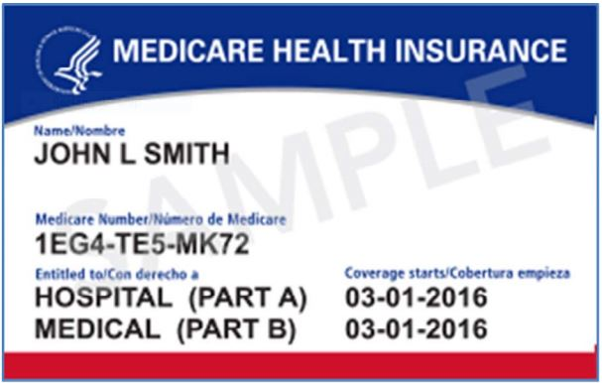


Original Medicare
Federal Health Insurance Program administered by CMS
(Centers for Medicare and Medicaid Services)
Medicare Claim Number
Hospital (Part A) Effective Date
Medical (Part B) Effective Date
Medicare Part B Premium for 2025 is projected at $185 per month (deducted from SS)
3

Slide 4


How Do I Sign Up
● Sign up for Parts A & B three months before your 65th Birthday
● If Collecting Social Security A & B are automatic. If not:
  Call SS 1-800-772-1213
  Visit your local SS office
  Go online to SSA.gov
  ● Visit the Rochester Social Security office at 200 E Main St 2nd Floor Rochester NY 14604

Slide 5
RCSD Types of Plans
HMO – POS The HMO component covers you in the service area
The POS component can be used outside the area - $2,000 Limit
EPO Covers you anywhere in the country
Basic Acts like a supplement

Slide 6
RCSD Plan Offerings

Slide 7


Part D Changes
Inflation Recovery Act NEW 2025
○ Cap on medications is now $2,000
○ Elimination of the Coverage Gap
  Deductible
  Initial Coverage
  Catastrophic
○ Medicare Prescription Payment Plan M3P

Slide 8

Part D | Fast Facts
Formulary
○ List of drugs that the insurance plan covers.
Excellus is 25%. MVP uses tiers.
○ Generally, the lower the tier, the lower your copay.
Tiered Formulary
Tier 1 Preferred Generic
Tier 2 Generic
Tier 3 Preferred Brand
Tier 4 Non-Preferred Brand
Tier 5 Specialty Medication
( NOT available on MVP Plans)
Abbreviations and Definitions
○ Prior Authorization (PA)
○ Quantity Limits (QL)
○ Step Therapy (ST)

Slide 9

Making Informed Decisions – Exhibit A
What does Original Medicare cover?
What
should I do and when?
9

Slide 10
Making Informed Decisions – Exhibit B
What does Original Medicare cover?
What
should I do and when?
10

Slide 11

Meet Your Team!
John
Weatherby
Medicare & Individual Health Consultant
Office 716.849.8299
Call 716.290.3905
Fax 716.849.8291
jweatherby@lawleyinsurance.com
5350 Main St.
Williamsville, NY 14221

Slide 12





When am
I eligible for Medicare?
How do
these additional Medicare plans work?
What if
I am still working?
What does Original Medicare cover?
Do I need additional coverage?
What
should I do and when?

