Slide 1



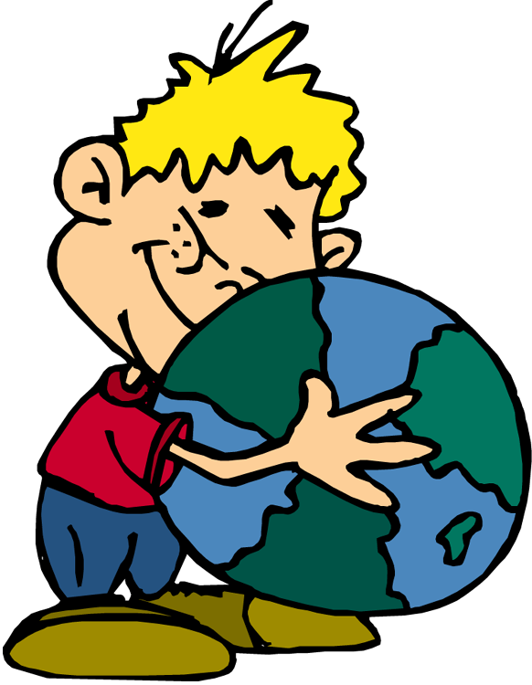


RCSD, School #7
What is Earth Day?

Slide 2
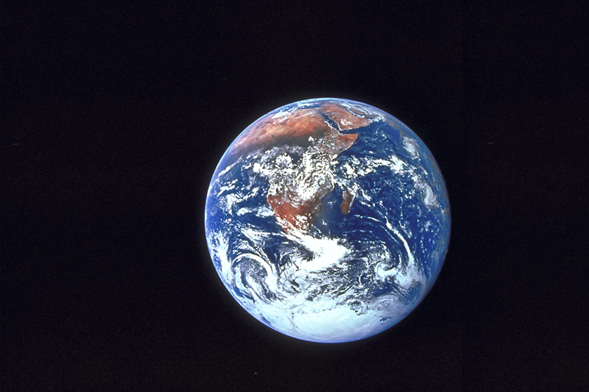
Earth Day is a global event.
Activities and events are held each year as a show of support for Earth’s environment.

Slide 3


Earth Day is celebrated each year on April 22.

Slide 4

3 R’s
The Three R’s
Reuse:
Try not to buy a new product. Try and use the one you already have.
Reduce:
Only take the amount you will use. Try to use stuff so you have trash to get rid of later.
Recycle:
Use products that can be reused. Place recyclable in the recycling bin.

Slide 5

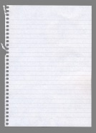

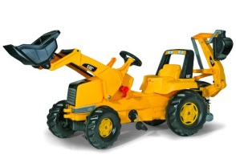

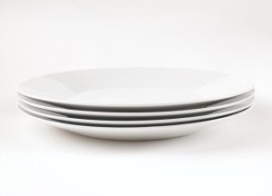
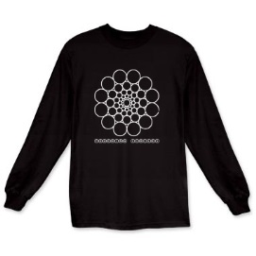

Reduce and Reuse
How can we reuse items?
How can we reduce trash?
Bring your lunch to school in a lunchbox or bag.
Reuse plastic and paper grocery bags.
Take reusable grocery bags to the store.
Sell or donate unwanted clothes.
Use both sides of pieces of paper.
Repair broken items instead of throwing them away.
Use washable dishes instead of paper plates.
Buy groceries in big sizes or bulk to reduce packaging.

Slide 6
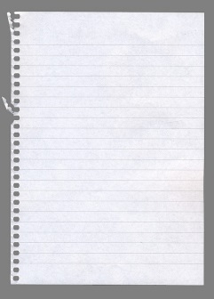


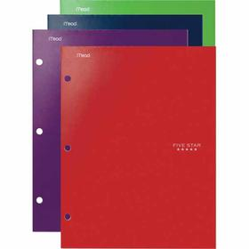
How can we recycle at school?
Put paper and cardboard in the recycle box
Put empty milk cartons in the rolling recycle bin.

Slide 7
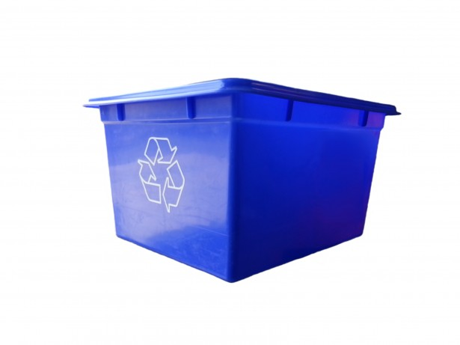


How can we recycle at home?
Make sure your family has a recycle bin
Find out what day collection is
Know what goes in the bin (plastic, glass, paper, cardboard)

Slide 8

Check your knowledge:
Kindergarten, 1st grade, and 2nd grade:
Reuse a sheet of paper
Draw a picture of how you can reuse, reduce, or recycle
3rd through 6th:
Reuse a sheet of paper
Write 3 complete sentences telling how you can help the Earth.
School #7 Challenge:
Take a section of the area surrounding our school. Make a plan to make it cleaner and greener. Share your plan and progress with us all!
The 3 classes with the most correct answers will win prizes!!!!! Ki

