Slide 1

Using Naviance at Rochester City School District

Slide 2



What Will We Accomplish Today?
RCSD Back to School Training
Logging in: Naviance and Naviance Student
Naviance CCLR & the Comprehensive Plan
Implementation Resources for RCSD

Slide 3

Student Log In Process

Slide 4
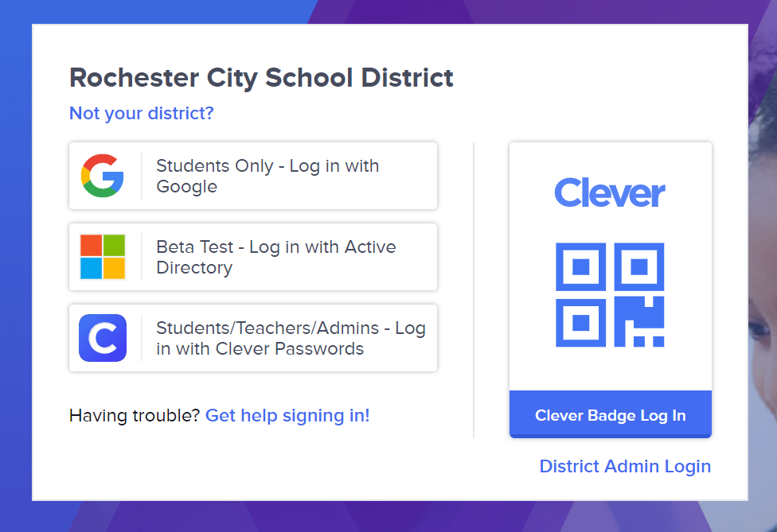
Go to Clever Website
Students will navigate to
clever.com/in/rochestercsd

Slide 5
Log in through Google RCSD Credentials
Click box titled “Students Only- Log in with Google”
RCSD Google Credentials:
Username:890_____@rcsd121.org
Password: Google password

Slide 6

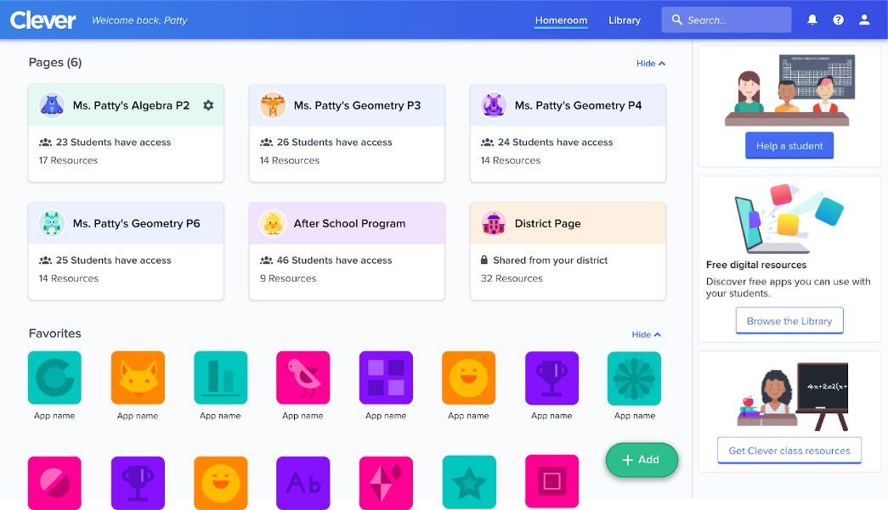
Click on Naviance Student Icon
Locate and click the Naviance Student icon to complete the log in process

Slide 7

Staff Log In Process
Notes:
Protocols are tools. Tools make the job at hand easier to do. Protocols help keep the discussions focused, their time used efficiently, and their actions purposeful and impactful. They keep us on track so that we talk about the stuff that matters and do so in a structured, safe way that promotes depth and honesty of discourse. They also take the pressure
Source: http://www.ascd.org/publications/books/114007/chapters/Data-Meeting-1@-Reviewing-Existing-Data-and-Asking-Questions.aspx

Slide 8
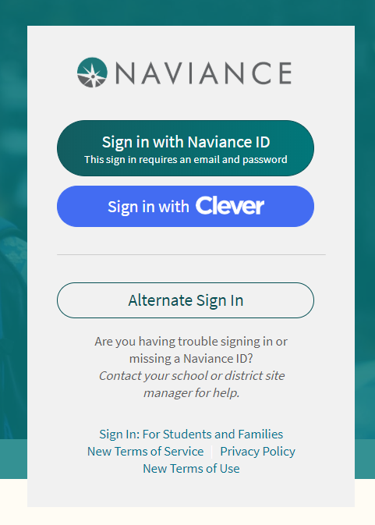
Go to Naviance Staff Website
Staff should navigate to id.naviance.com
Click “Sign in with Naviance ID”

Slide 9
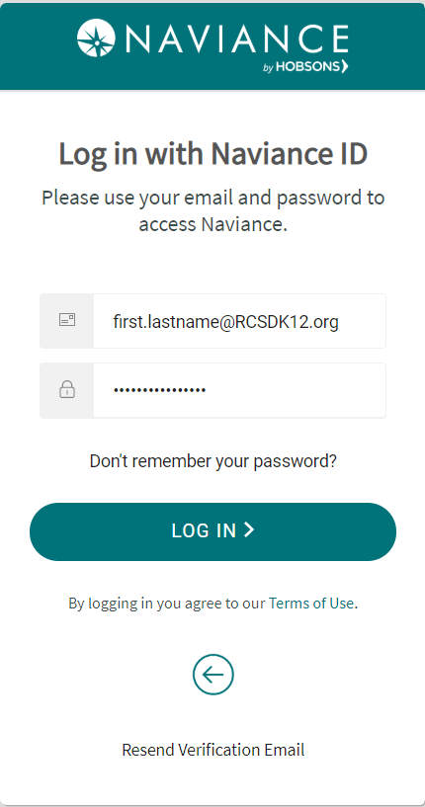
Log in through Google RCSD Credentials
Use your RCSD Credentials
Username:RCSD Email
Password: Created password
Notes:
**The password is what the RCSD employee created and NOT necessarily the RCSD generated password

Slide 10

Integrating the Naviance CCLR Guide
Notes:
Protocols are tools. Tools make the job at hand easier to do. Protocols help keep the discussions focused, their time used efficiently, and their actions purposeful and impactful. They keep us on track so that we talk about the stuff that matters and do so in a structured, safe way that promotes depth and honesty of discourse. They also take the pressure
Source: http://www.ascd.org/publications/books/114007/chapters/Data-Meeting-1@-Reviewing-Existing-Data-and-Asking-Questions.aspx

Slide 11
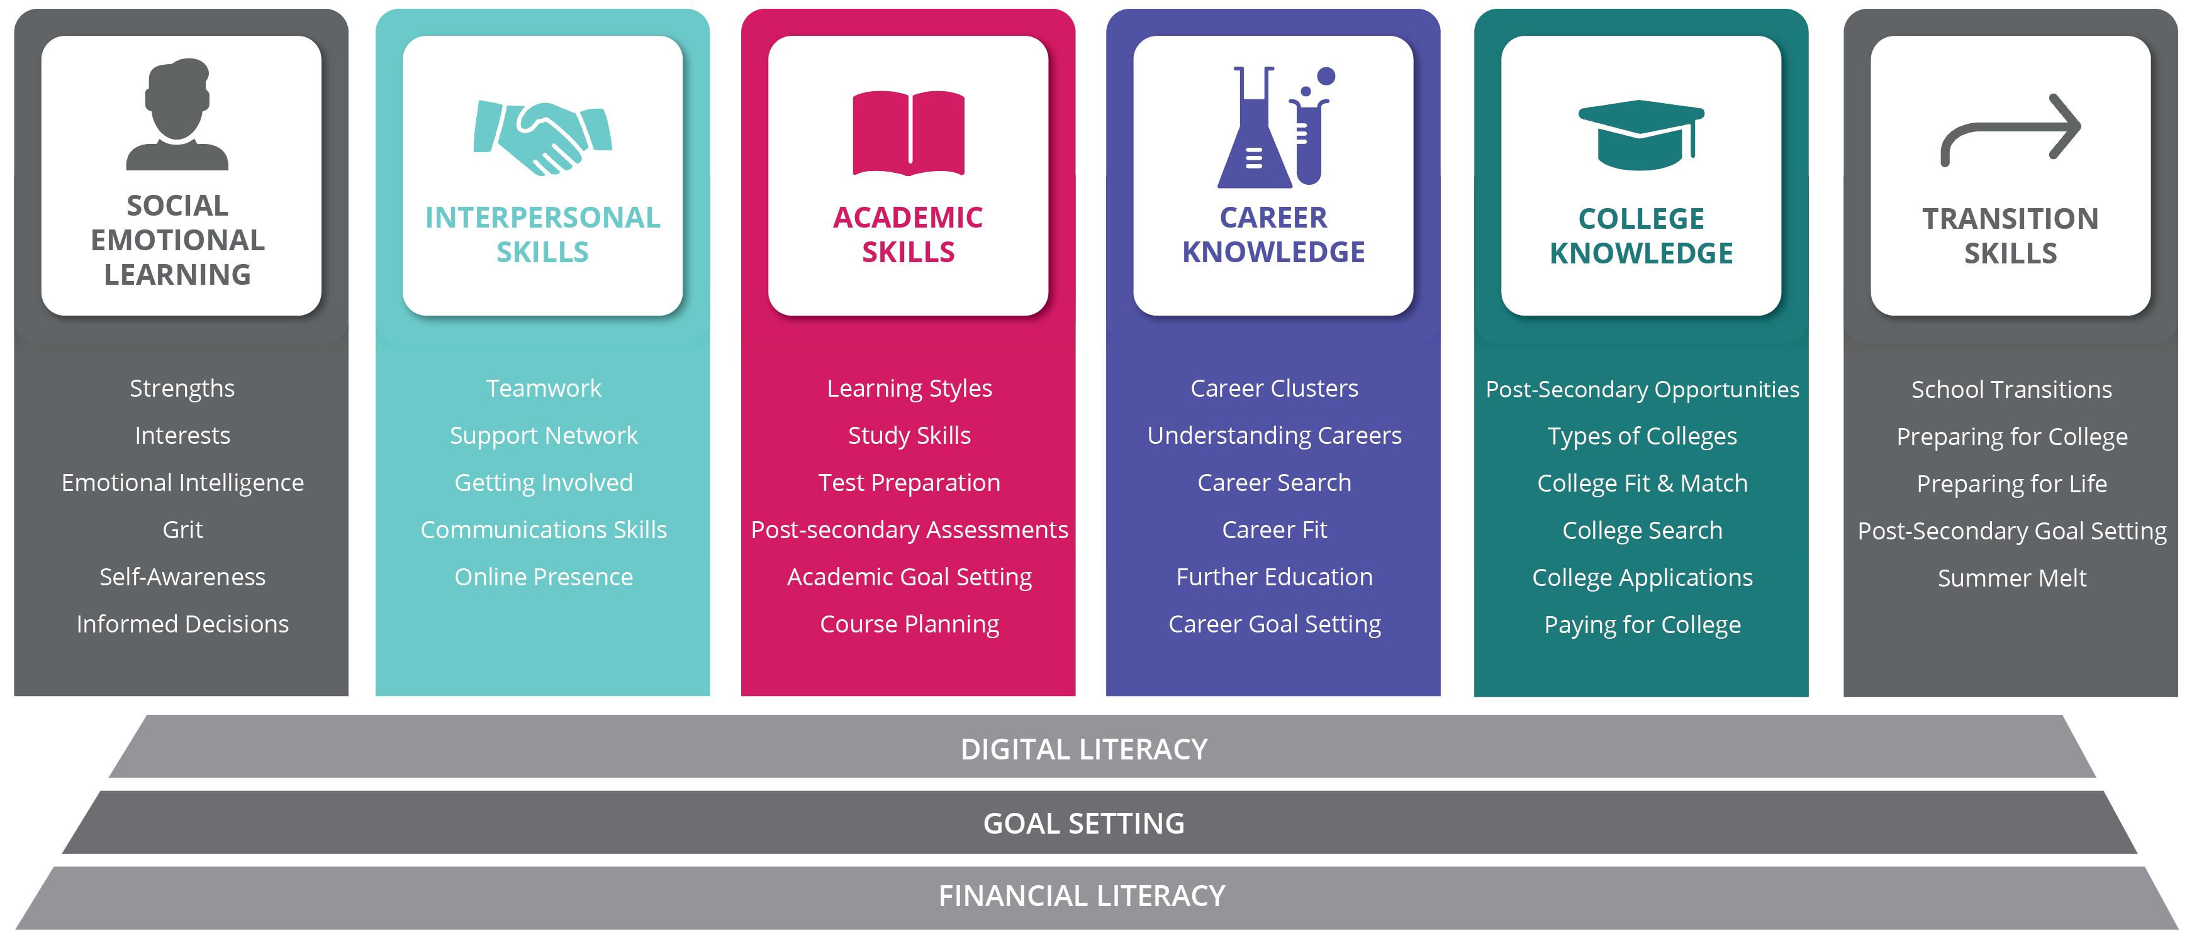
CCLR Framework
Competencies + Themes
Notes:
No longer can we rely on the traditional definition of college and career readiness. Students need to be socially, emotionally, and technically ready for life after high school, no matter the path they take.
The research-backed model outlines six competencies that students in grades 6-12 must achieve to become college, career and life ready. Each competency outlines themes and objectives to further define success, as well as grade-specific activities to achieve each the grade-specific objectives. The model provides guidance on key the metrics to track related to each competency.
The College, Career, and Life Readiness Framework provides a blueprint to prepare middle and high school students for success after graduation.

Slide 12
Assessment
Objectives
Essential Objectives
Activities
Track
CCLR Framework
CCLR Framework Journey
Competencies
Themes
What is my current CCLR status?
Where could my program be improved?
What defines CCLR success in my school?
How should I set my school’s (district’s) long- term goals?
What short-term objectives should I prioritize?
Which CCLR competencies support my short-term objectives
What activities and tools will help me achieve my objectives?
How do I measure progress toward my objectives and goals?
What are the most valuable metrics?

Slide 13

Putting it Together
Now that you know more about what Naviance does and how we hope to integrate the Career, College, and Life Readiness (CCLR) Guide into your Naviance usage, it is time to plan for next steps.
Rochester City School District leadership used their main goals and the goals outlined in the NY Comprehensive Plan to outline key performance indicators (KPIs) for each grade level. Those KPIs and the Naviance CCLR Framework have been used to align Naviance Student tasks to reach the goals you have set for your students, for each grade level. This has created the RCSD NY Comprehensive Plan.

Slide 14
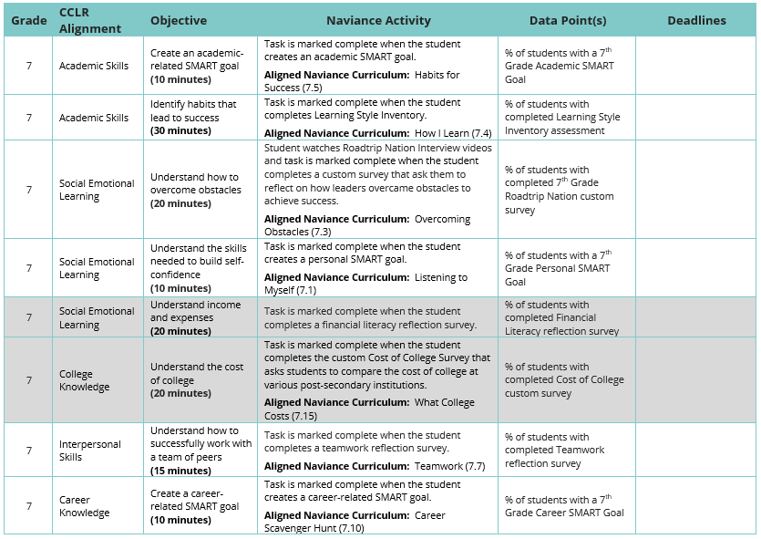
Seventh Grade
RCSD NY Comprehensive Plan

Slide 15
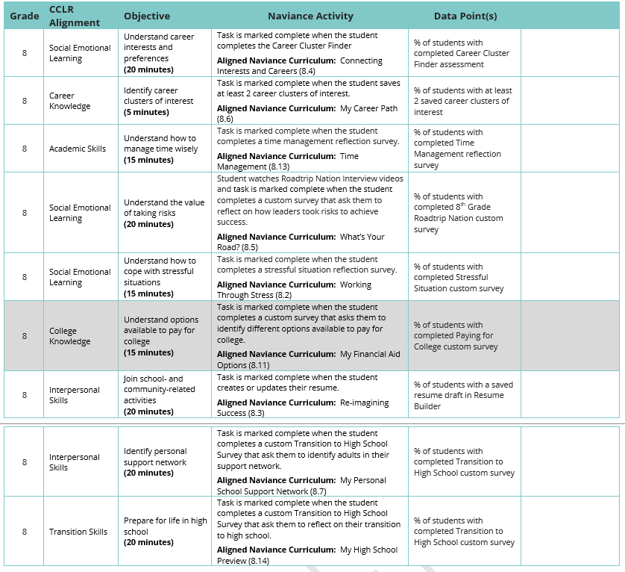
Eighth Grade
RCSD NY Comprehensive Plan

Slide 16
Eighth Grade Continued
RCSD NY Comprehensive Plan

Slide 17
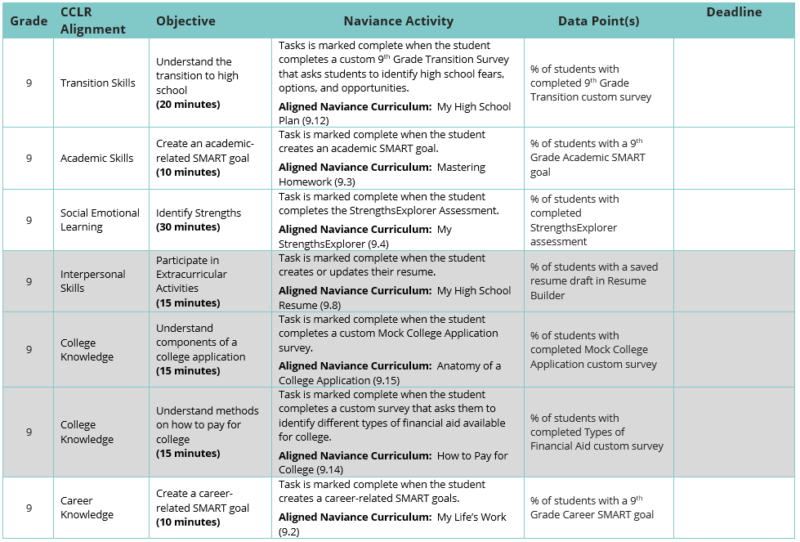
Ninth Grade
RCSD NY Comprehensive Plan

Slide 18
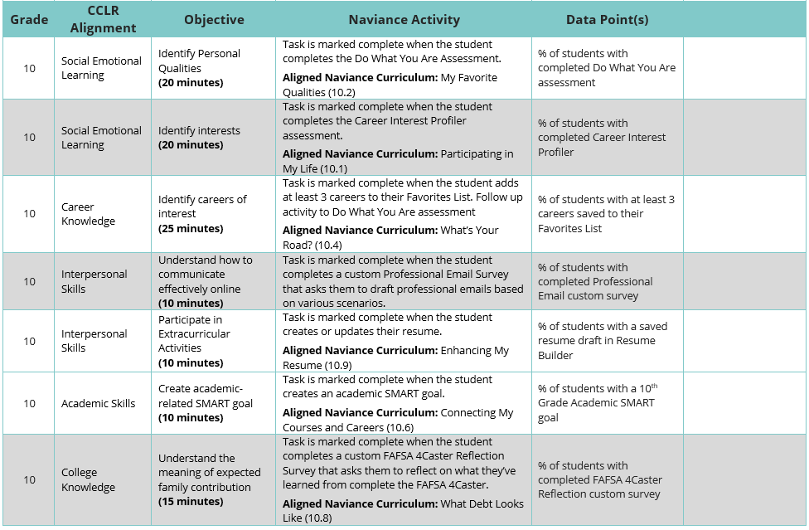
Tenth Grade
RCSD NY Comprehensive Plan

Slide 19
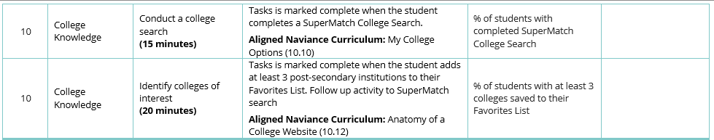
Tenth Grade Continued
RCSD NY Comprehensive Plan

Slide 20
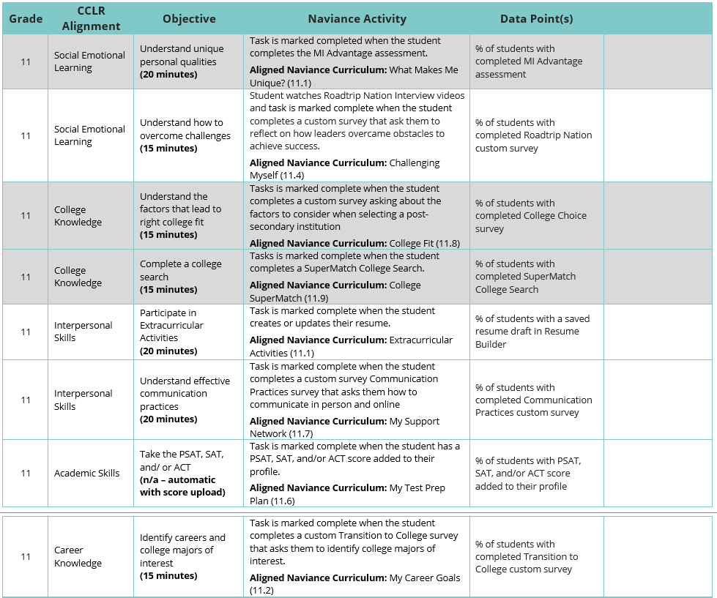
Eleventh Grade
RCSD NY Comprehensive Plan

Slide 21
Eleventh Grade Continued
RCSD NY Comprehensive Plan

Slide 22
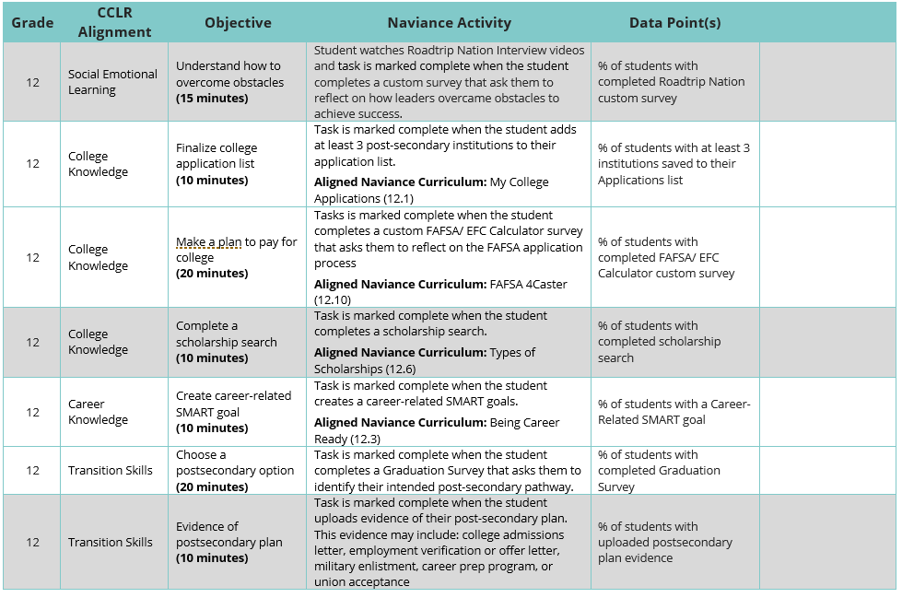
Twelfth Grade
RCSD NY Comprehensive Plan

Slide 23
Naviance Engagement and Student Outcomes
Why Is This Important?
% Students Applied to at Least 1 College by # of Tasks Completed
% Students Applied to at Least 1 College by # of Naviance Visit

Slide 24
Resources for Completing Naviance
Notes:
Protocols are tools. Tools make the job at hand easier to do. Protocols help keep the discussions focused, their time used efficiently, and their actions purposeful and impactful. They keep us on track so that we talk about the stuff that matters and do so in a structured, safe way that promotes depth and honesty of discourse. They also take the pressure
Source: http://www.ascd.org/publications/books/114007/chapters/Data-Meeting-1@-Reviewing-Existing-Data-and-Asking-Questions.aspx

Slide 25
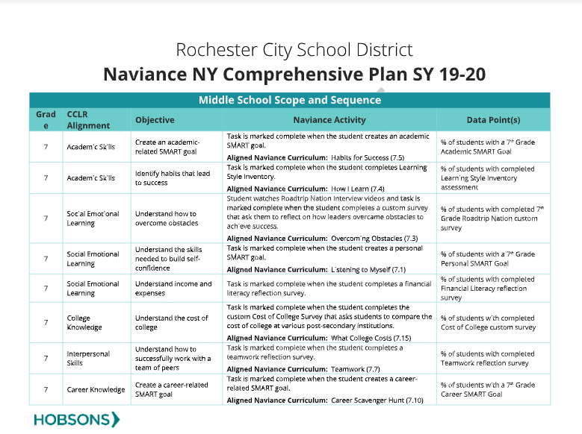
RCSD NY Comprehensive Plan
As we just reviewed, the RCSD NY Comprehensive Plan document will be used to demonstrate what tasks need to be completed and when.
Use the comprehensive plan document to see which tasks are required, when they are due, and what marks the task complete.

Slide 26
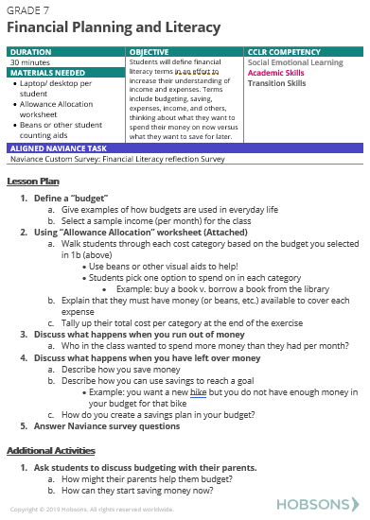
Comprehensive Plan Companion Guide
The companion guide outlines a lesson plan for every task and activity in the comprehensive plan.
Use these lessons as you push into classrooms, give to your advisory teachers (if applicable), or review with your content teachers as needed.

Slide 27
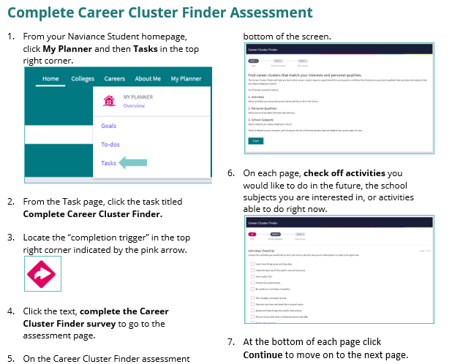
Quick Guides
Quick guides are student facing, showing students exactly how to log in and where to click to complete each task in the comprehensive plan.
Use these guides digitally or print for students to use with their Naviance Student access.

Slide 28
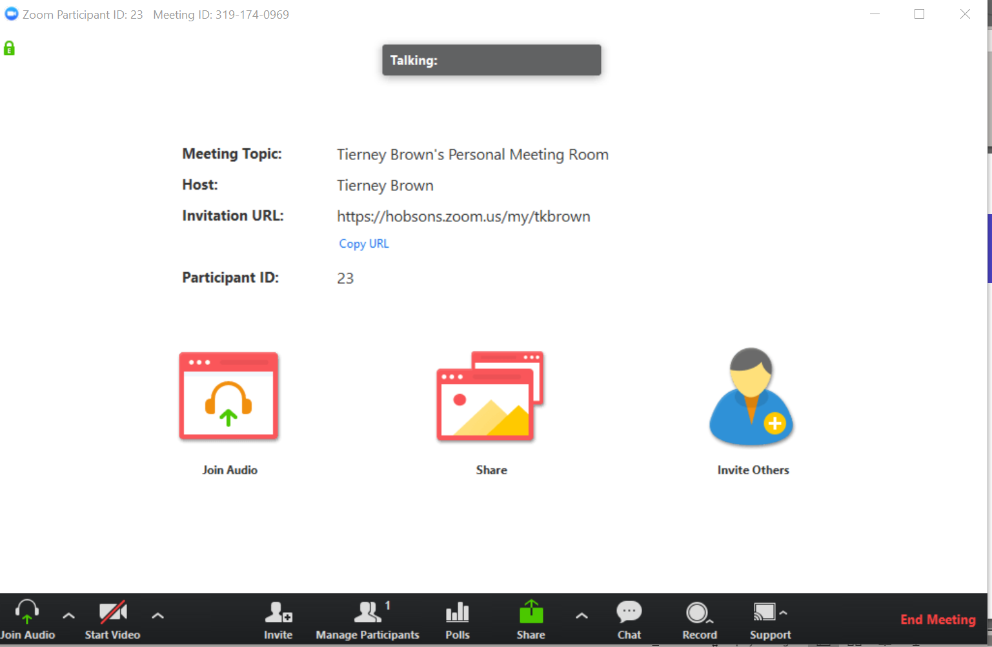
Naviance Office Hours
Starting in September, Tierney Brown (RCSD’s Naviance Project Consultant) will hold office hours for 1.5 hours, monthly.
Use this time to drop-in as you have time available, ask your questions, and get answers throughout the school year.
All meetings will be held virtually through Zoom meeting room. Crystal Clark will send log in information and calendar holds soon!

Slide 29

Demonstration Time!
Notes:
Logging in through Clever (staff and students)

Slide 30

Additional Resources
Contact Support Services
Help Library
Naviance Contact
Email: support@naviance.com
Phone: 866.337.0080, option#2
Hours: M-F, 8 AM-7 PM EST
Read help articles written by Naviance Experts
Tierney Brown
Tierney.Brown@Hobsons.com

Slide 31


Thank you | Questions

