Slide 1
First in Math
Review of the Webinar on October 24th

Slide 2
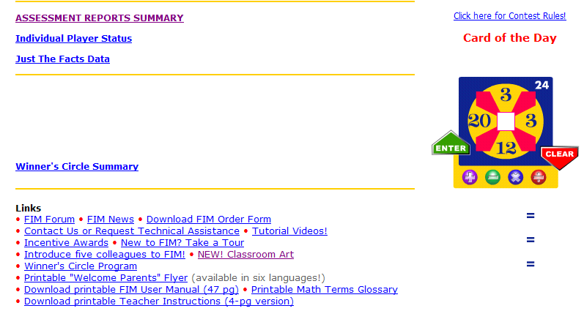
Overview – What is New? Classroom Art

Slide 3
Use the Classroom Art Link for Bulletin Boards to Promote First in Math

Slide 4
Promote!!!!!!!!!

Slide 5
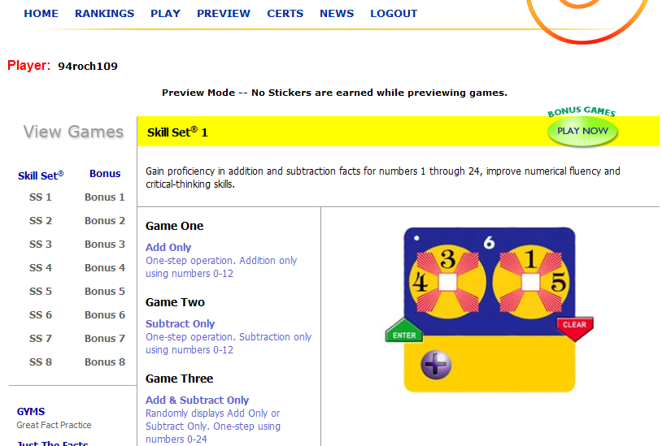
Click Preview to find out what each Skill Set tests

Slide 6
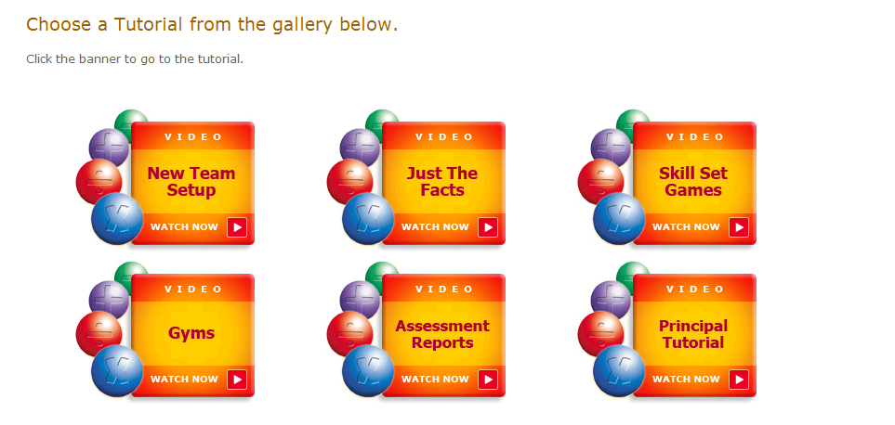
Click on Tutorial Videos to use for Professional Development or Parent Nights

Slide 7
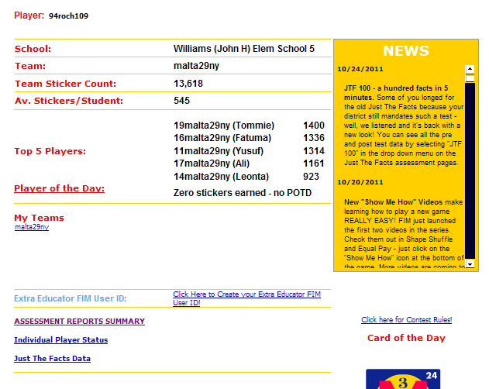
Click Assessment Report Summary – Progress Check

Slide 8
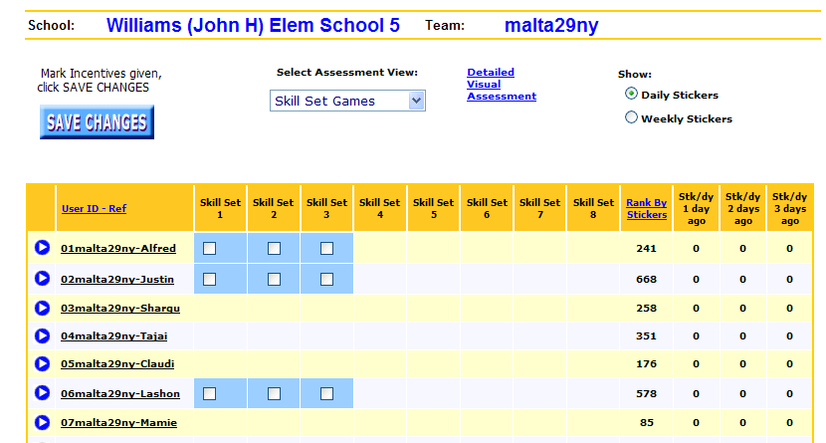
Click Assessment View for different reports – How is Alfredo doing in the skill sets?

Slide 9
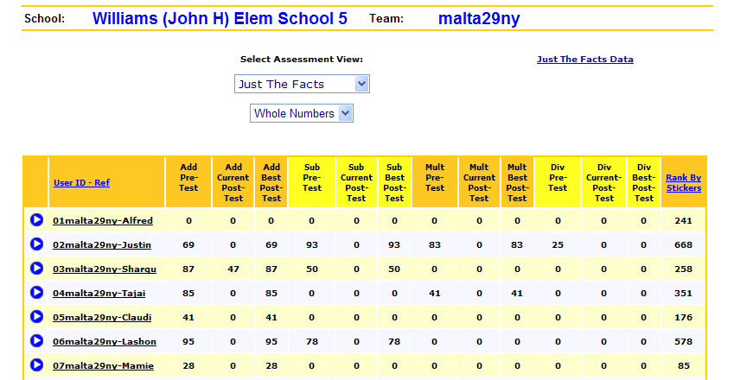
How is Alfredo doing with Just the Facts?

Slide 10
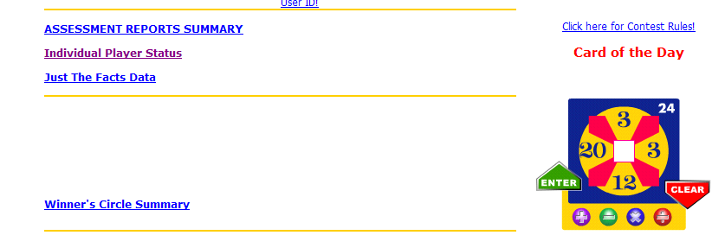
New! Click on Individual Player Status

Slide 11
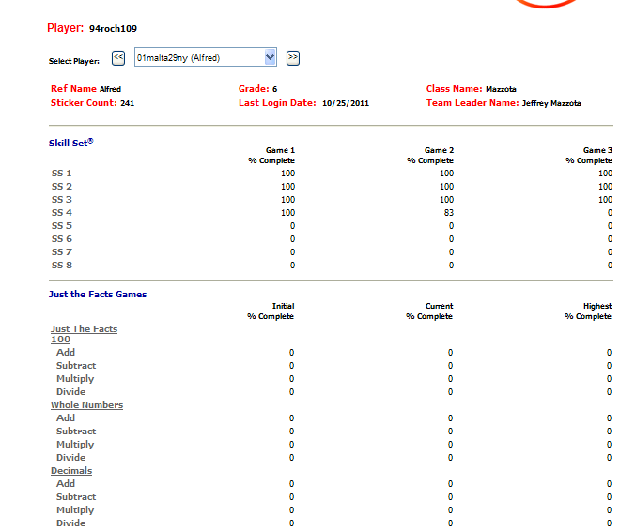

Slide 12
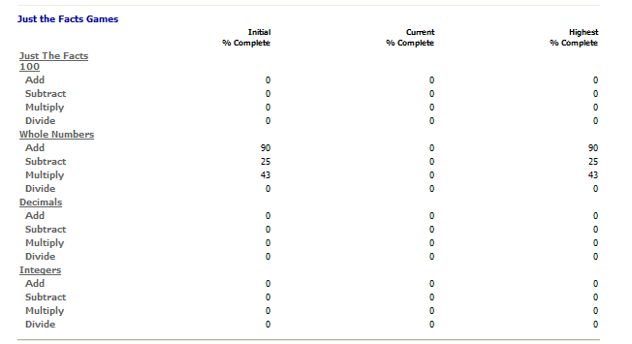
Individual Reports are useful for RtI & Parent Conferences This particular student only received 25% correct in subtraction so he needs practice to become more fluent – Use the Gyms

Slide 14
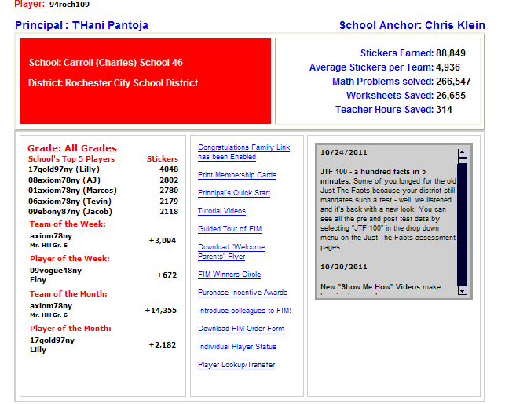
Don’t forget to announce your Top Players and Player of the week

