Slide 1
Types of Rock
Liz LaRosa http://www.middleschoolscience.com 2010
Images from Geology.com unless otherwise noted

Slide 2
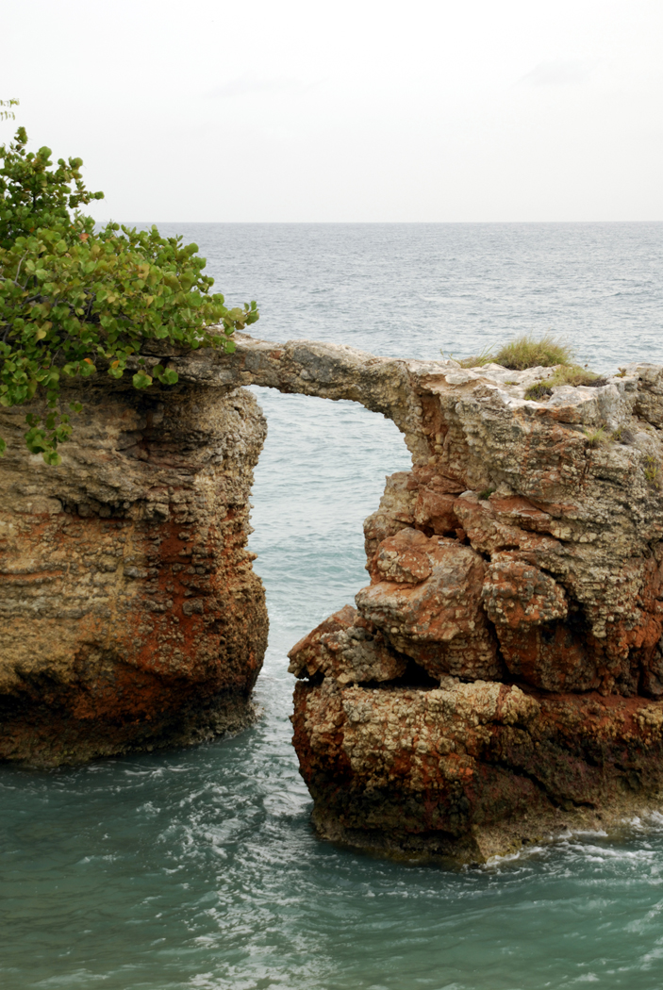
What are Rocks?
A rock is a naturally occurring solid mixture of one or more minerals, or organic matter
Rocks are classified by how they are formed, their composition, and texture
Rocks change over time through the rock cycle

Slide 3
Igneous Rocks
Igneous rock begins as magma.
Magma can form:
    When rock is heated
    When pressure is released
    When rock changes composition
Magma freezes between
  700 °C and 1,250 °C
Magma is a mixture of
many minerals
http://www.fi.edu/fellows/payton/rocks/create/igneous.htm

Slide 4
ESRT p.6

Slide 5
Igneous Rocks
Felsic: light colored rocks that are rich in elements such as silicon, aluminum, potassium, and sodium
Mafic: dark colored rocks that are rich in iron, magnesium, and calcium, poor in silicon
Coarse-grained: takes longer to cool, giving mineral crystals more time to grow
Fine-grained: cools quickly with small to microscopic crystals

Slide 6
ESRT p.6

Slide 7
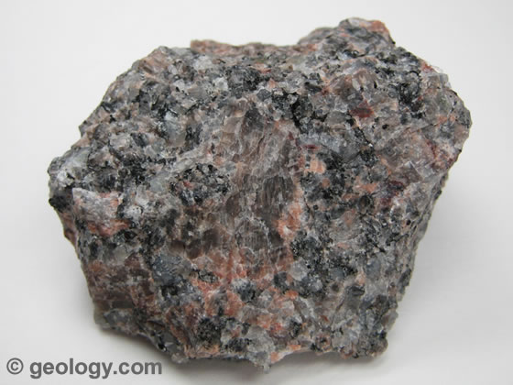
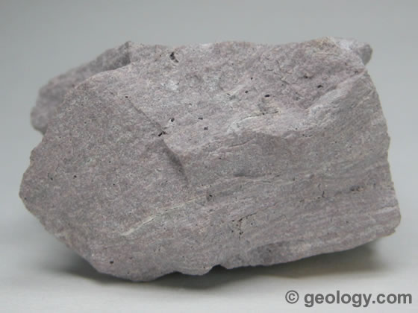
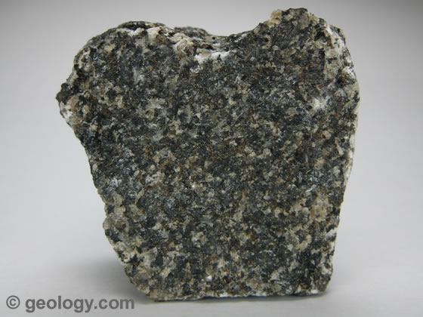
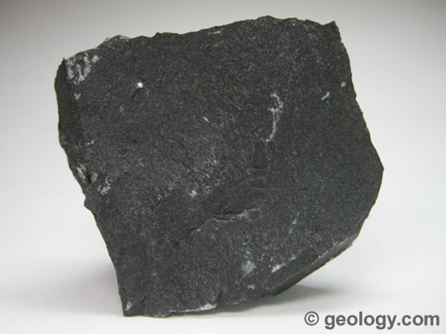
Igneous Rocks
Coarse-Grained
Fine-Grained
Felsic
Granite
Rhyolite
Mafic
Gabbro
Basalt

Slide 8
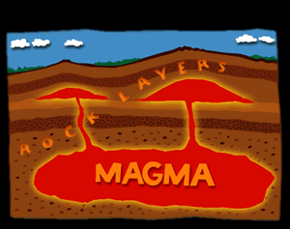
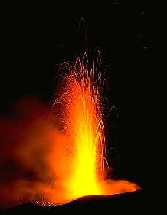
Igneous Rocks
Intrusive Igneous Rocks (plutonic): magma pushes into surrounding rock below the Earth’s surface
Extrusive Rocks (volcanic): forms when magma erupts onto the Earth’s surface (lava), cools quickly with very small or no crystals formed
http://www.windows.ucar.edu/tour/link=/earth/geology/ig_intrusive.html&edu=high&fr=t

Slide 9
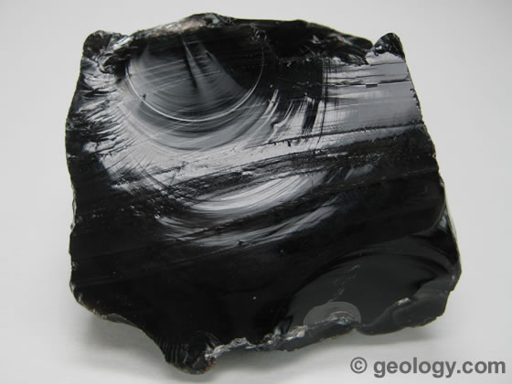
Igneous Rocks
Obsidian
What is Obsidian?
Obsidian is a dark-colored volcanic glass that forms from the very rapid cooling of molten rock material. It cools so rapidly that crystals do not form.
Obsidian is a dark-colored volcanic glass that forms from the very rapid cooling of molten rock material. It cools so rapidly that crystals do not form.
Is this rock Felsic or Mafic?
Is it fine-grained or coarse-grained?
Is this rock Intrusive or Extrusive?
Felsic, glassy, extrusive

Slide 10
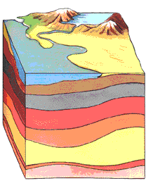
Sedimentary Rocks
Sedimentary rock is formed by erosion
Sediments are moved from one place to another
Sediments are deposited in layers, with the older ones
on the bottom
The layers become compacted and cemented together
http://www.fi.edu/fellows/payton/rocks/create/sediment.htm

Slide 11
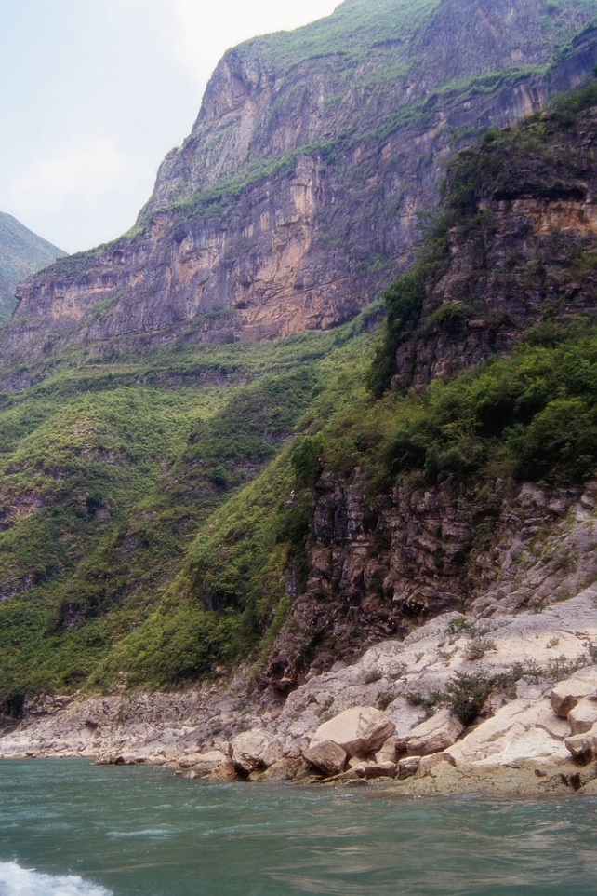
Sedimentary Rock
Sedimentary Rocks are formed at or near the Earth’s surface
No heat and pressure involved
Strata – layers of rock
Stratification – the process in which sedimentary rocks are arranged in layers

Slide 12
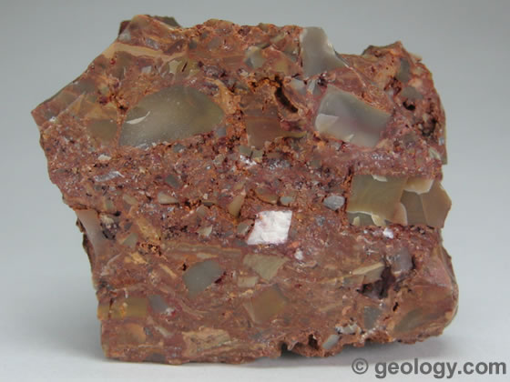
Sedimentary Rock
Clastic – made of fragments of rock cemented together with calcite or quartz
Breccia is a term most often used for clastic sedimentary rocks that are composed of large angular fragments (over two millimeters in diameter).
The spaces between the large angular fragments can be filled with a matrix of smaller particles or a mineral cement that binds the rock together.

Slide 13
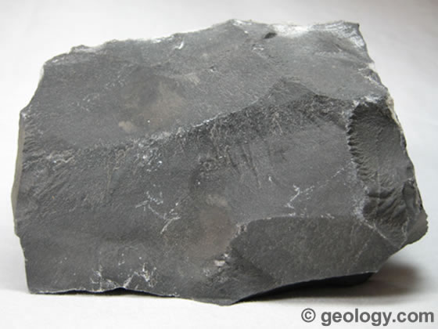
Sedimentary Rock
Chemical sedimentary – minerals crystallize out of solution to become rock
Limestone is a sedimentary rock composed primarily of calcium carbonate (CaCO₃) in the form of the mineral calcite. It most commonly forms in clear, warm, shallow marine waters.
It is usually an organic sedimentary rock that forms from the accumulation of shell, coral, algal and fecal debris.

Slide 14
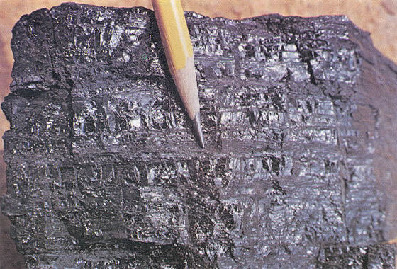
Sedimentary Rock
Organic sedimentary – remains of plants and animals
Coal is an organic sedimentary rock that forms from the accumulation and preservation of plant materials, usually in a swamp environment.
Coal is a combustible rock and along with oil and natural gas it is one of the three most important fossil fuels.

Slide 15
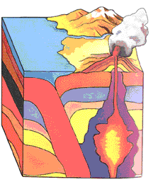
Metamorphic Rock
Meaning to change shape
Changes with temperature
and pressure, but remains
solid
Usually takes place deep in
the Earth
http://www.fi.edu/fellows/payton/rocks/create/metamorph.htm

Slide 16
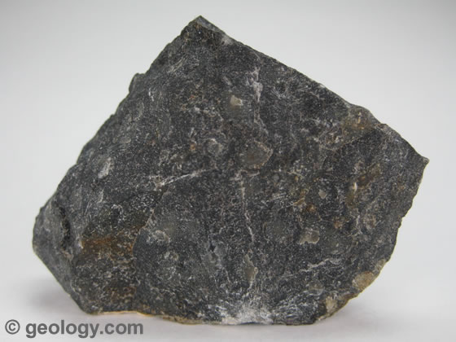
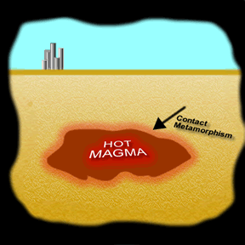
Metamorphic Rocks
Contact Metamorphism – heated by nearby magma
Increased temperature changes the composition of the rock, minerals are changed into new minerals
Hornfels is a fine-grained non-foliated metamorphic rock produced by contact metamorphism
http://www.windows.ucar.edu/tour/link=/earth/geology/meta_contact.html&edu=h igh&fr=t

Slide 17
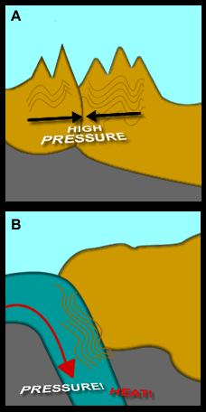
Metamorphic Rocks
Regional Metamorphism – pressure builds up in rocks that is deep within the Earth
Large pieces of the Earth’s crust collide and the rock is deformed and chemically changed by heat and pressure
http://www.windows.ucar.edu/tour/link=/earth/geology/meta_regional.html&edu=high&fr=t

Slide 18
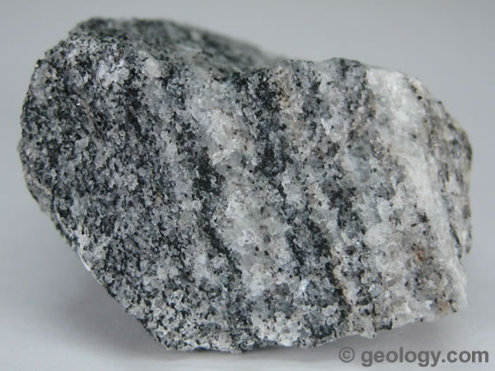
Metamorphic Rock
Foliated - contain aligned grains of flat minerals
Gneiss is foliated metamorphic rock that has a banded appearance and is made up of granular mineral grains.
It typically contains abundant quartz or feldspar minerals.

Slide 19
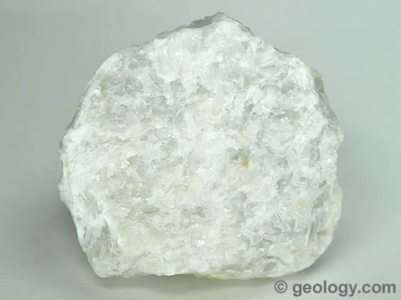
Metamorphic Rock
Non-Foliated – mineral grains are not arranged in plains or bands
Marble is a non-foliated metamorphic rock that is produced from the metamorphism of limestone.
It is composed primarily of calcium carbonate.

Slide 20
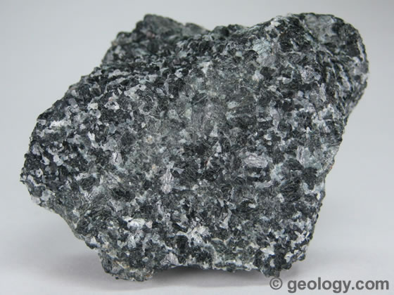
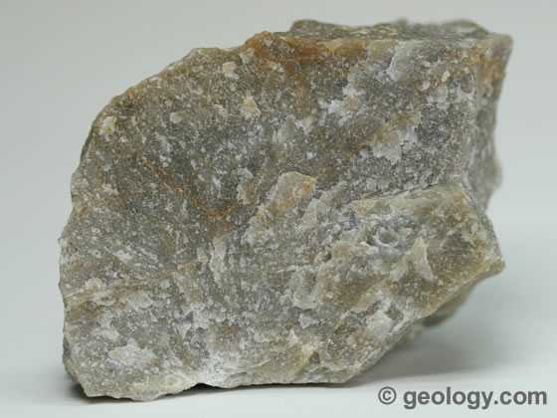
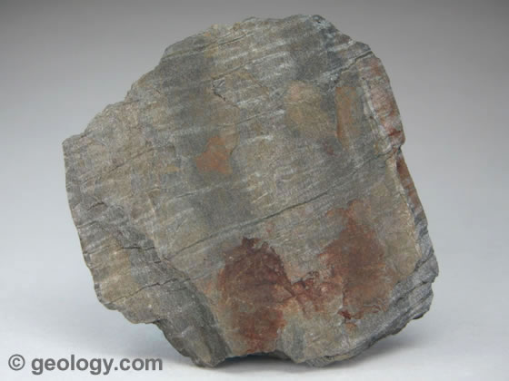
Metamorphic Rock
Determine if the following rock samples are foliated or non-foliated:
Amphibolite
Quartzite
Phyllite
Foliated

Slide 21
End of Types of Rocks PPT
Be sure to complete your “Types of Rocks” notes as you view this presentation.

