Slide 1
Enzymes

Slide 2
Structure
Proteins→ made of strings of amino acids→ through the process of dehydration synthesis

Slide 3
Shape
Determined by the order of amino acids and the interaction of the R groups

Slide 4
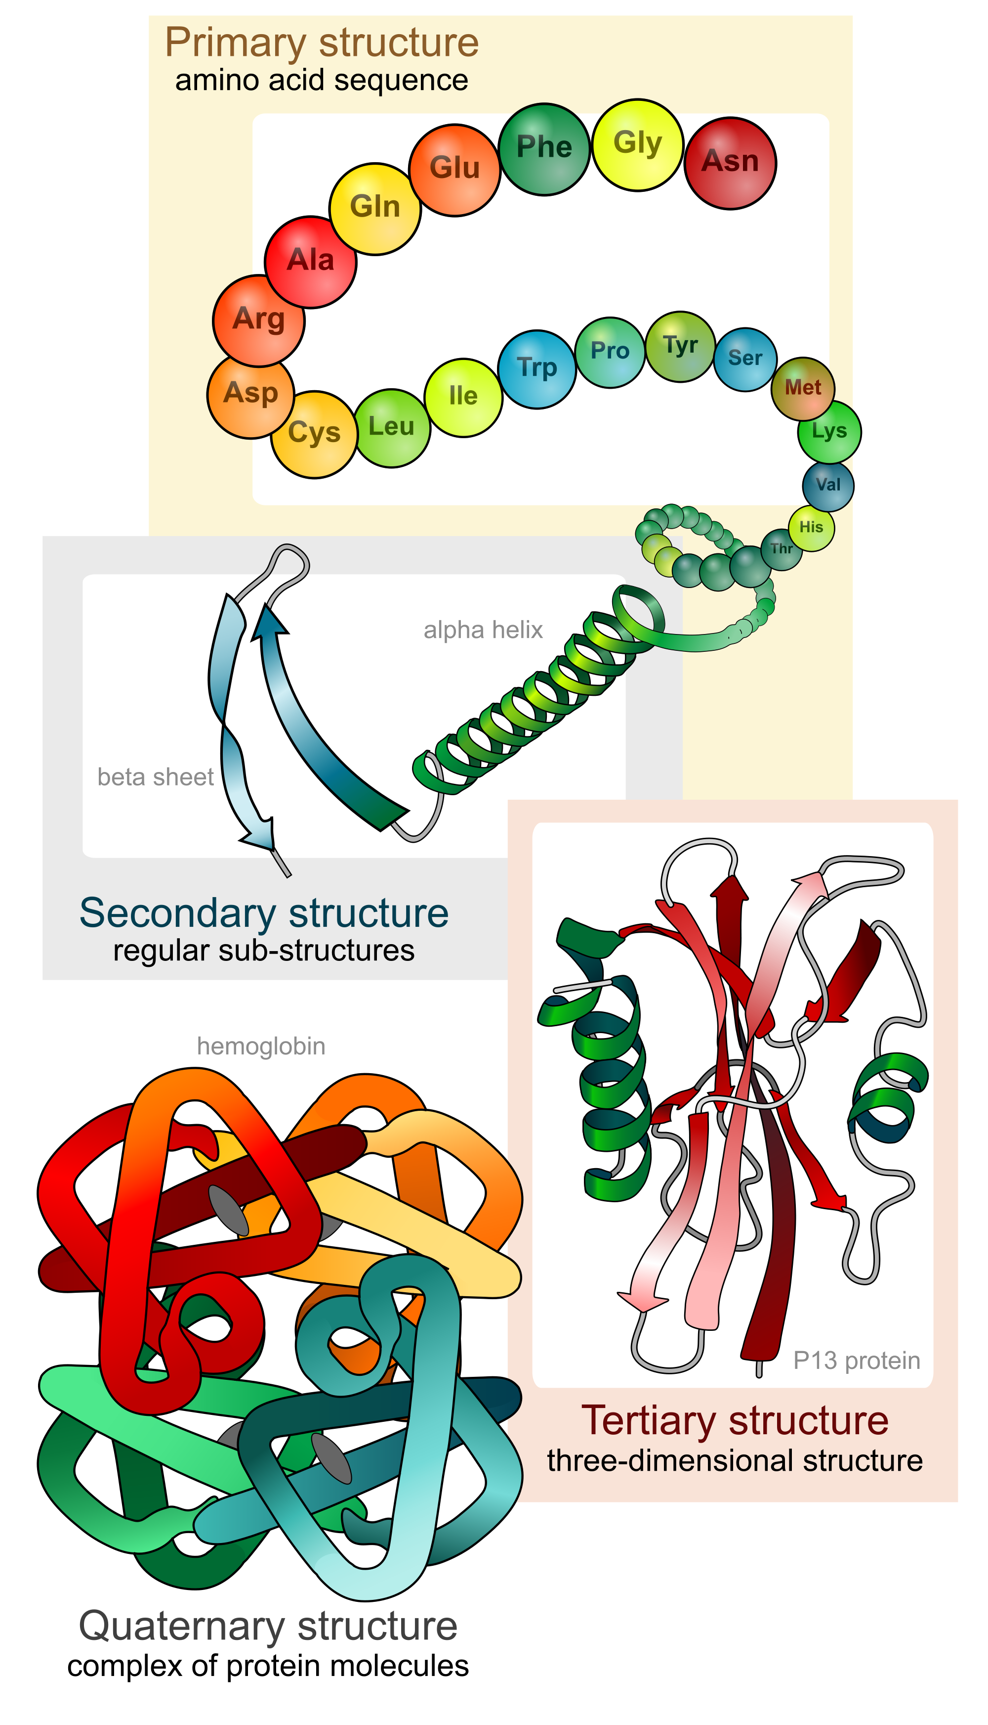

Slide 5
Regulation
enzymes speed up metabolic reactions by lowering energy barriers

Slide 6
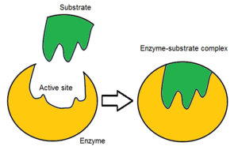
Substrate Specific
Enzymes have specifically shaped active sites and shape

Slide 7
Rate of Reaction
The physical and chemical environment affect enzyme activity.

Slide 8
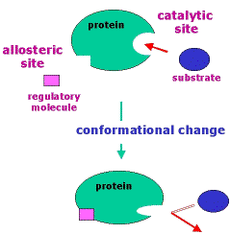
Allosteric Regulation
Enzymes change shape (allosteric) in order to regulate activity, turning on and off function.

Slide 9
Temp. and pH Regulation
localization of enzymes within a cell helps order metabolism

Slide 10
Competitive Inhibition
Something fits into the active site and blocks it from operating

Slide 11
Non Competitive inhibition
Something bonds to a non-active site and causes an allosteric shape change preventing it from operating.

Slide 12
Co Enzyme
A substance bonds to non active site of enzyme causing changes in the shape turning it on

Slide 13
Vocab.
Denature- Change of shape and rendering it useless due to temp. and/ or pH
Conformational change- Shape change

