Slide 1

Monday, 2 / 13/ 12
1 Attendance
2 Review for test
3 Unit Test 7
4 Grade Sheets
5 Time 4 make-up work

Slide 2
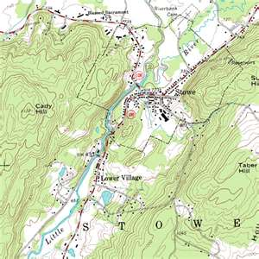
A real topographic map.

Slide 3
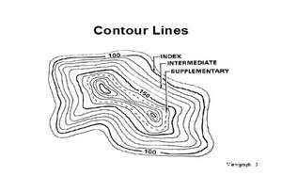

Slide 4
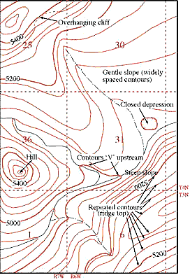

Slide 5
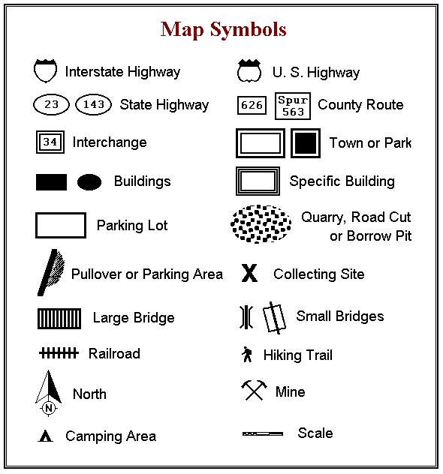

Slide 6

Depressions have hatchure lines.

Slide 7
http://www.tasagraphicarts.com/activities/profile.html

Slide 8
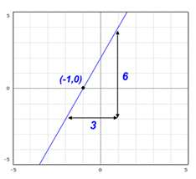
slope

Slide 9
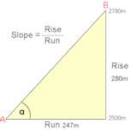
Slope

Slide 10
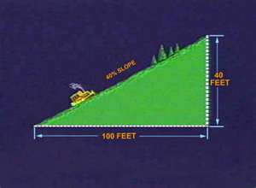
Gradient = slope

Slide 11
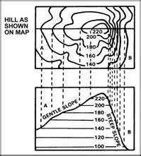
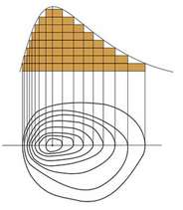

Slide 12
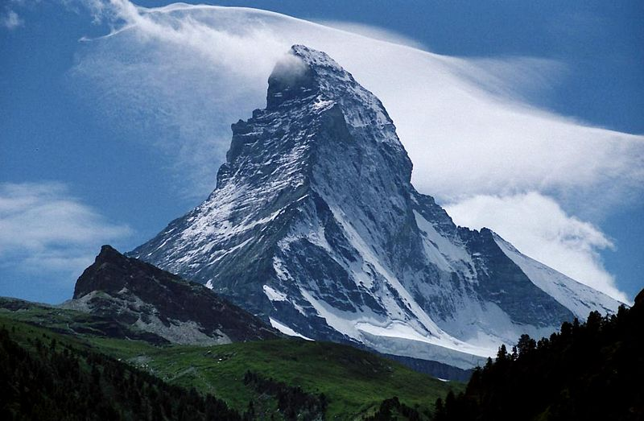
Gradient

Slide 13
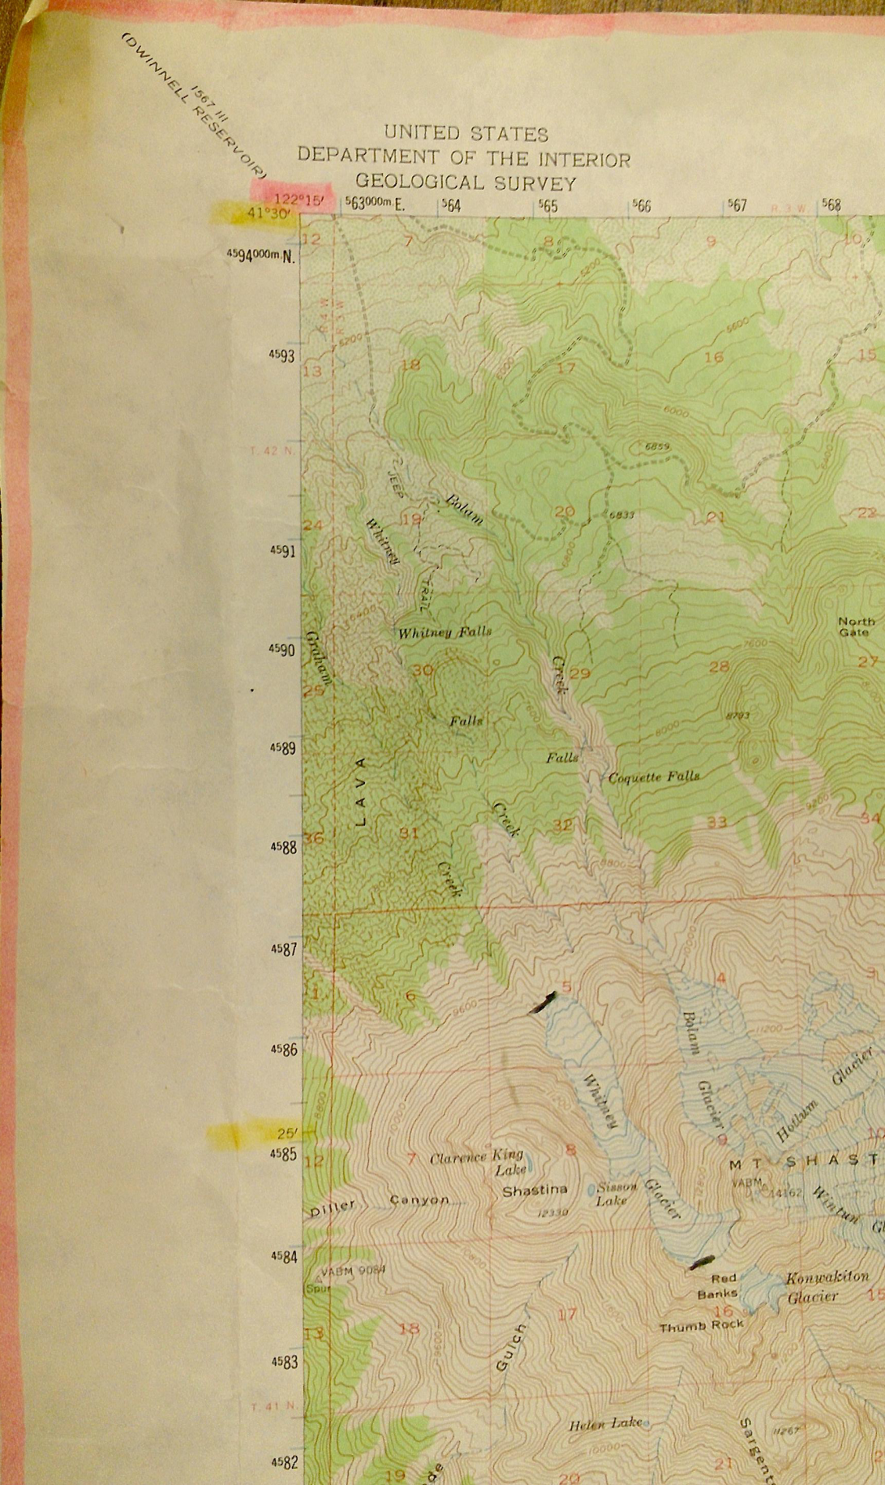
Longitude is in pink. Latitude is in yellow.

Slide 14
