Slide 1
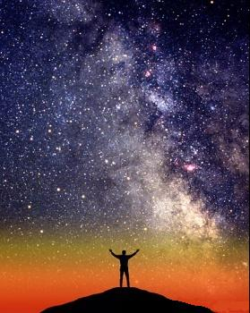
Unit 5 Astronomy

Slide 2
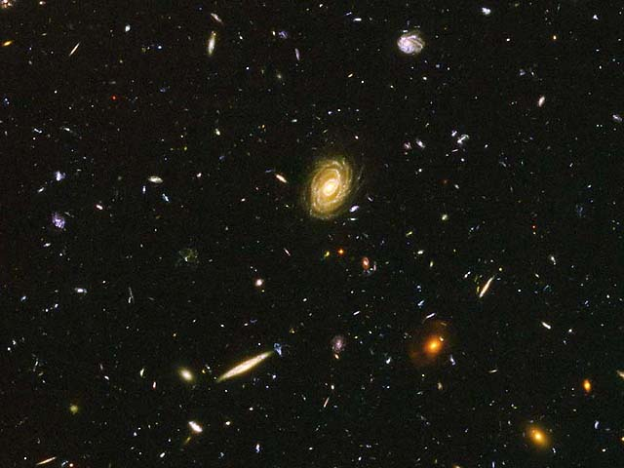
What is everything that exists in every place called?
The Universe

Slide 3
How old is the Universe?
It is at least 14 billion years old.
14,000,000,000

Slide 4
What is the name of the theory that says that the Universe started from a small area that exploded and is still moving outward?

Slide 5
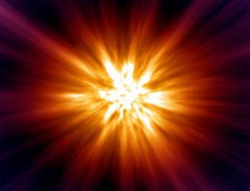
The Big Bang Theory

Slide 6
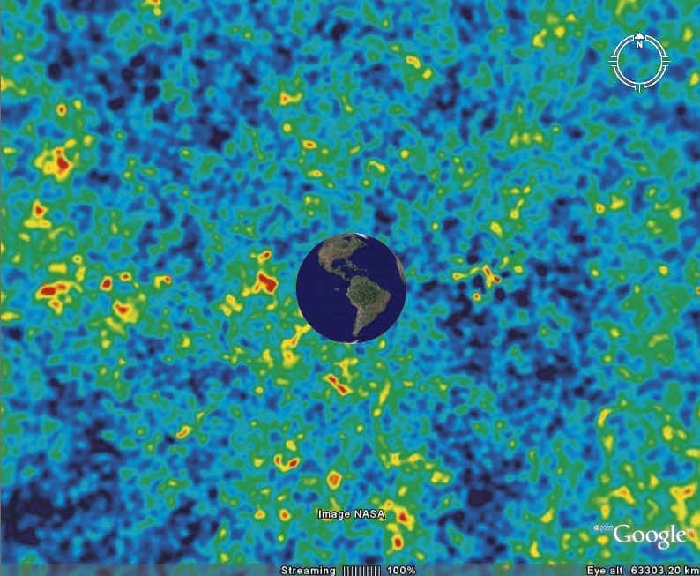
What are 2 evidences of the Big Bang Theory?
1. Microwave energy comes from explosions and we can see this energy in the universe through telescopes.

Slide 7
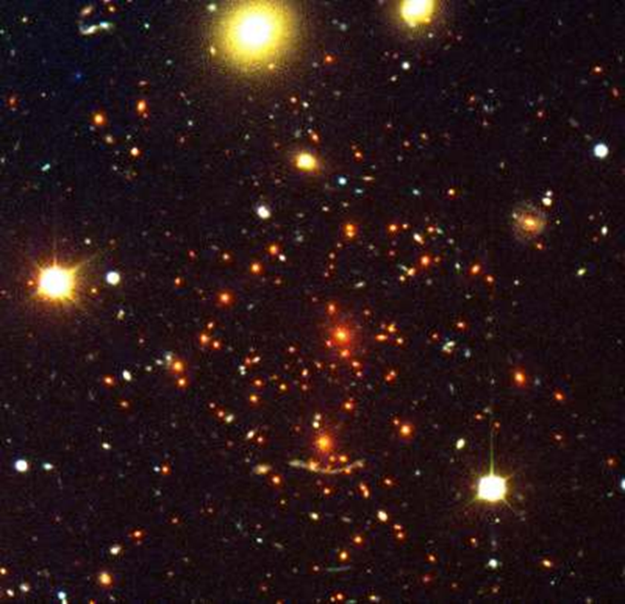
2. We can see a Red-Shift in color of parts of the universe.

Slide 8
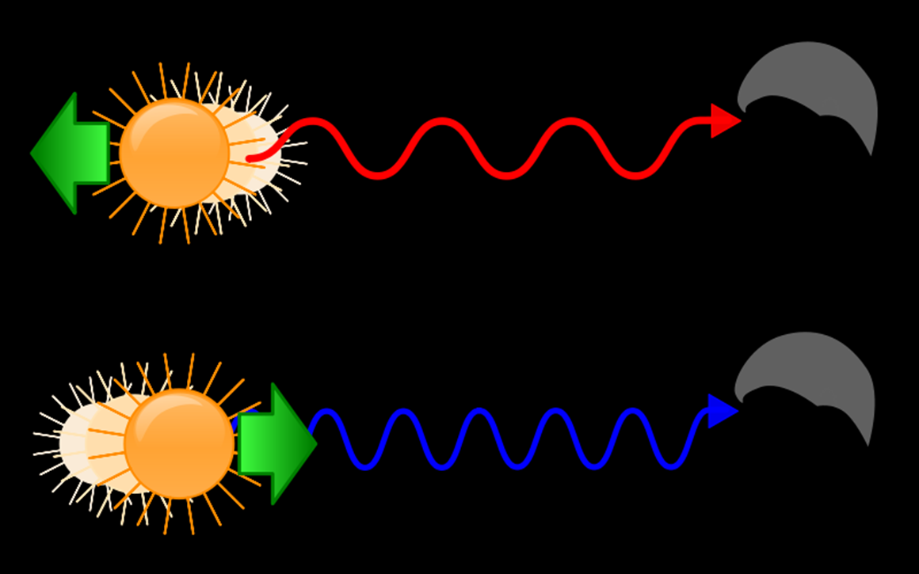
What is the name of that effect that explains why the red-shift happens?
Doppler
Effect

Slide 9
Collections of billions of stars, gas, and dust that are held together by gravity are called:

Slide 10
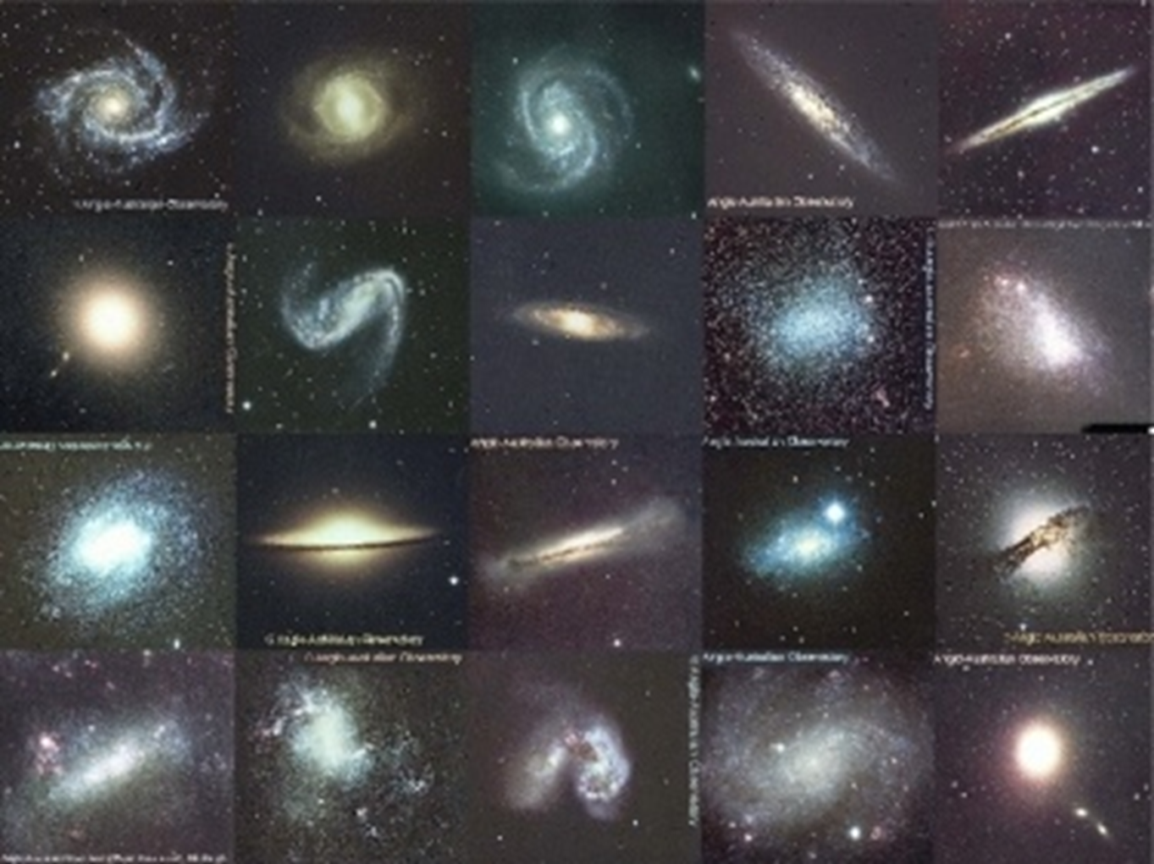
Galaxies

Slide 11
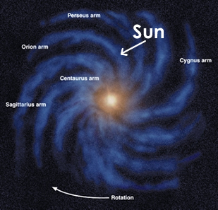
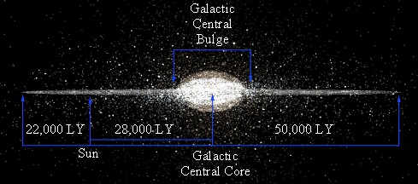
Which galaxy is our solar system in?
Milky Way Galaxy

Slide 12
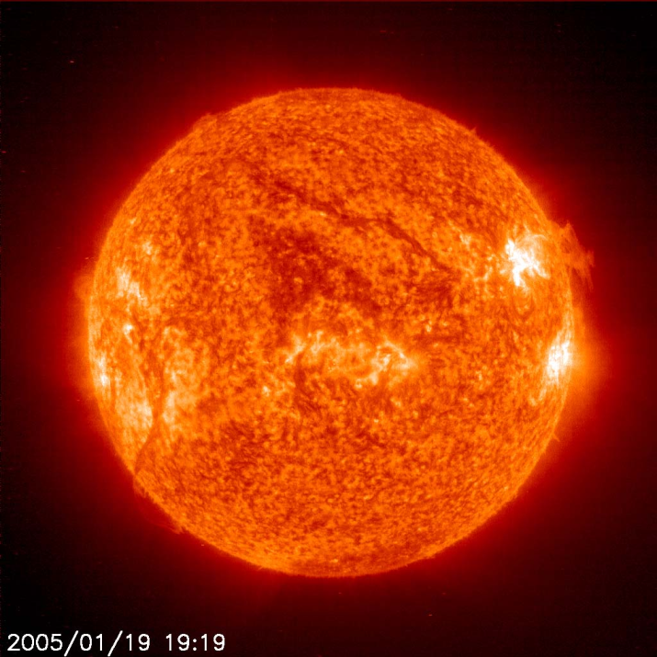
What is a star?
A large ball of gas that is held together by gravity that produces energy and shines.

Slide 13
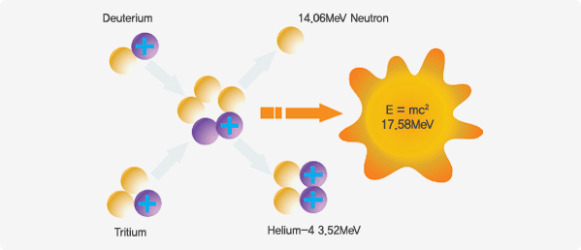
Nuclear Fusion in the sun changes Hydrogen into _?
Helium

Slide 14
What does luminosity mean?
How bright a star is compared to the sun.

Slide 15
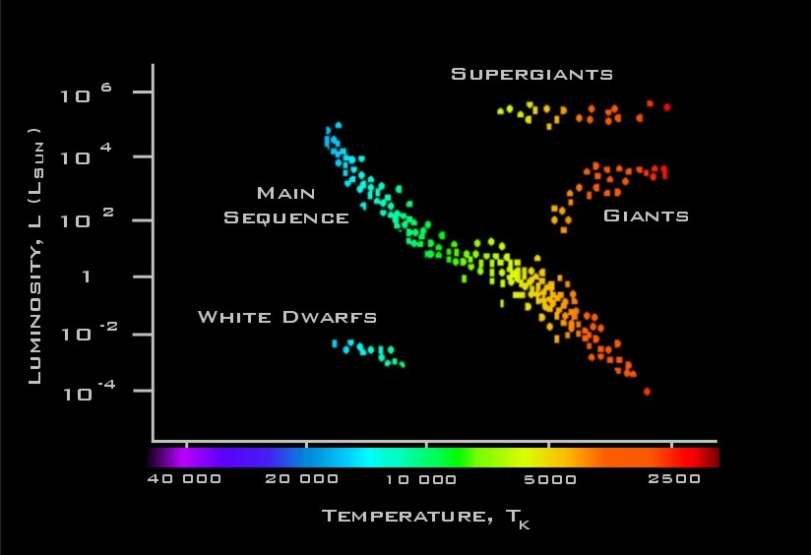
The H-R Chart

Slide 16
What are Main-Sequence Stars?
Stars that are average in size.
90% of stars are Main-Sequence
size
temp
blue

Slide 17
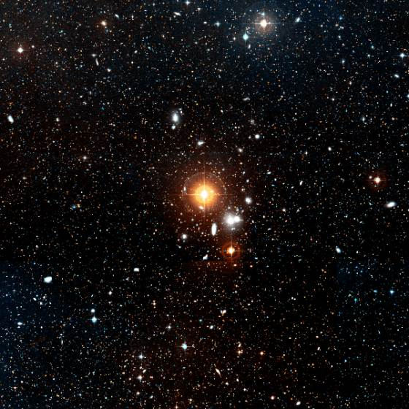
What is a GIANT star?
Really big rare stars that are in their dying stage.
Can usually see these in night sky because they are so big.
They can be any color.
Notes:
The bright orange star at the centre of the picture is HR4162 - a fifth magnitude red giant star 480 light years away.

Slide 18
What is the name of stars that are super BIG, very bright and sometimes explode into events called SuperNovas?
Super Giant Stars

Slide 19
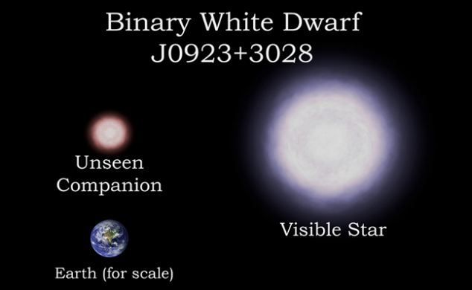
What is a white Dwarf?
Stars that have burnt most of the hydrogen.
The last shining phase of an average star.
Hot on surface but not bright.
Can be any color.

Slide 20
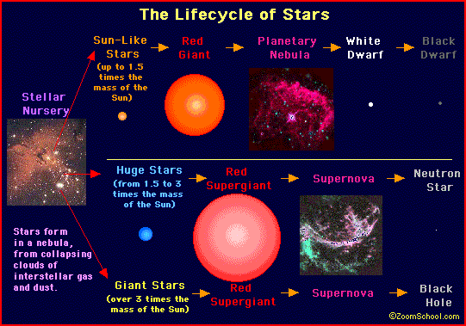
Are Stars Alive?

Slide 21
Extreme gravity fields that allow no light to escape are called:

Slide 22
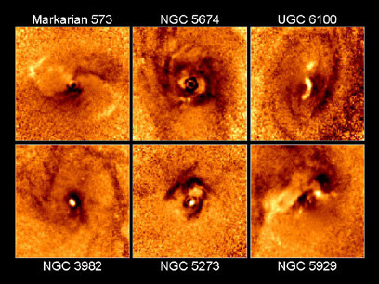
Black Holes

Slide 23
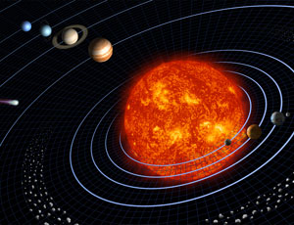
The sun and all the objects that orbit the sun is called:
The solar system

Slide 24
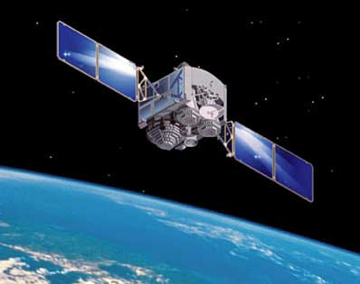
Any object that revolves around another object is called?
A satellite
Notes:
Image of a defense satellite communications systems from the United States Armed Forces library

Slide 25
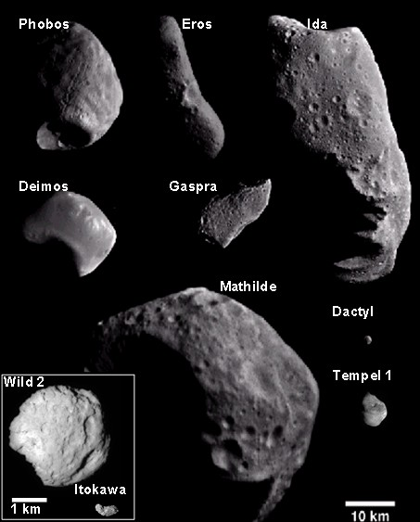
What are asteroids?
Solid, rocky or metallic irregularly shaped bodies that orbit the sun.

Slide 26
Between which two planets is the asteroid belt located in our solar system?
Mars and Jupiter
It separates the inner planets and the outer planets.

Slide 27
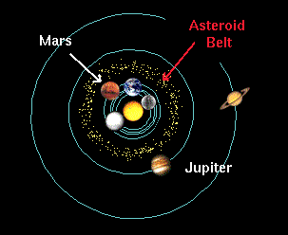

Slide 28
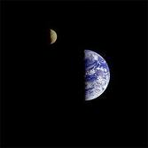
What is the name of the Earth’s natural satellite?
Moon
A body that revolves around a planet or an asteroid.
There are many moons in our solar system – most belong to the outer planets.

Slide 29
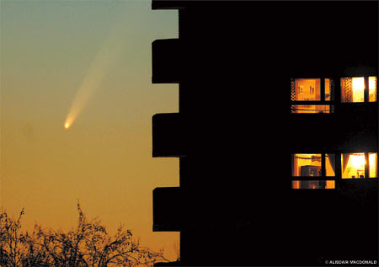
What are solid and made up of frozen gases that orbit the sun?
Comets
Notes:
Comet McNaught shines brightly in the twilight over Chelsea
Read more: http://www.dailymail.co.uk/news/article-428123/Just-passing-best-comet-32-years.html#ixzz17FrnbbTe

Slide 30
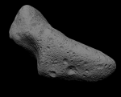
Very small rocky objects that orbit the sun are called:
Metoroids

Slide 31
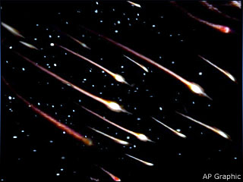
Meteors are what they are called when they enter our atmosphere.

Slide 32
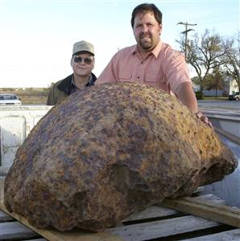
Meteorites are meteors that hit the ground.
Notes:
Guy finds this in his field in Kansas. Thought to be 20 myo

Slide 33
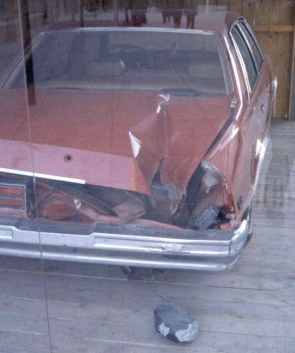
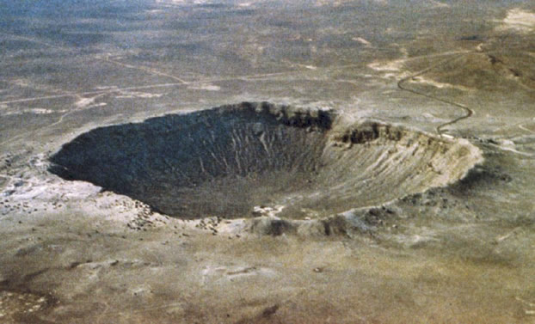
What can meteorites cause on Earth?
Impact Craters

Slide 34
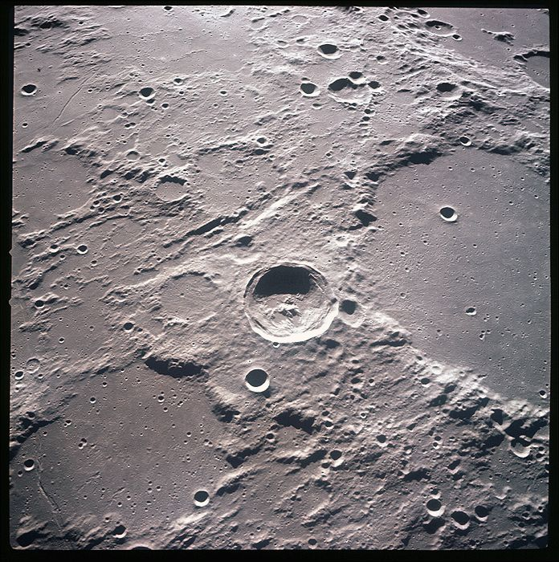
You can see impact craters on the moon too.

Slide 35
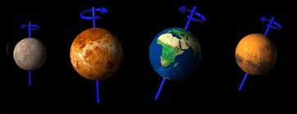
Planets that are close to the sun are called:
Inner Planets
Also Terrestrial Planets
Because they are like Earth
Small in diameter
Rocky
Dense
Have few moons
Planets include: Mercury, Venus, Earth, and Mars

Slide 36
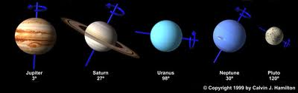
Planets that are far away from the sun are called:
Outer Planets
Also called Jovian Planets because they are like Jupiter.
The are large, gaseous, less dense, and have many moons.
Jovian planets include: Jupiter, Saturn, Uranus, and Neptune.

Slide 37
What is the relationship between the distance from the sun and the time for one revolution?
The farther a planet is from the sun, the longer the time to revolve around the sun. (direct relationship)

Slide 38
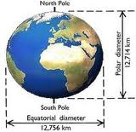
What does equatorial diameter mean?
How wide a planet is around it’s equator.

Slide 39
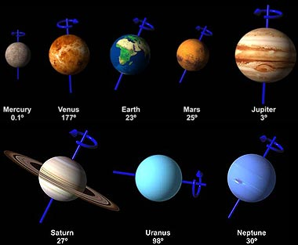
What does the period of rotation mean?
The time it takes to rotate (spin) once.
It is the length of one day.

Slide 40
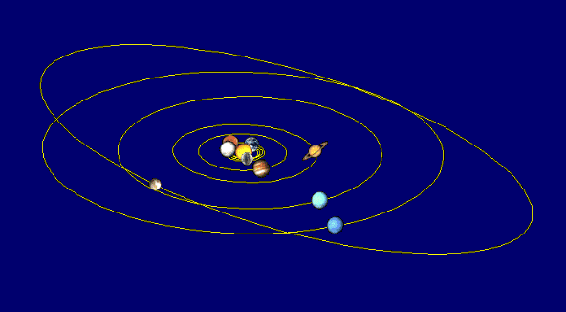
What does the period of revolution mean?
The time it takes to revolve (orbit) around another object.
It is the length of a year.

Slide 41
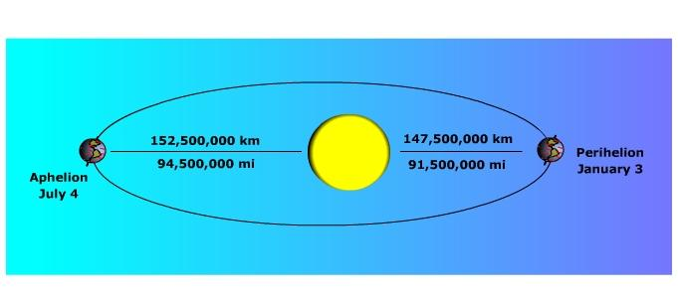
What shape is a planet’s orbit?
An ellipse. (oval)

Slide 42
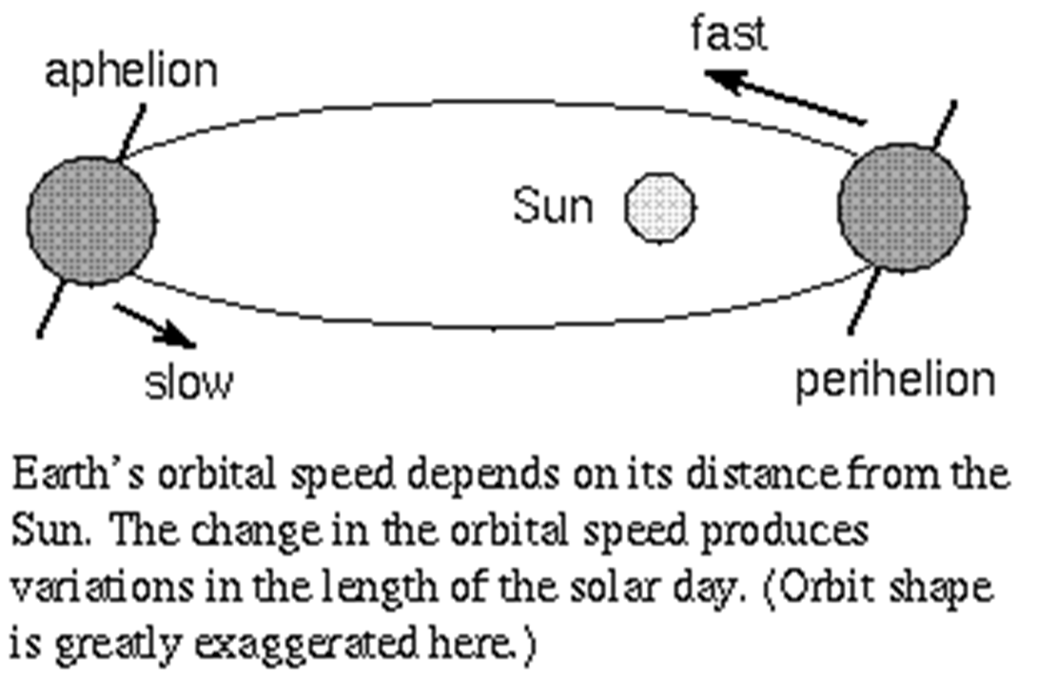
How fast a planet travels in it’s orbit is called:
Orbital Velocity
It increases when the planet is near it’s sun.
It decreases when the planet is far from it’s sun.

Slide 43
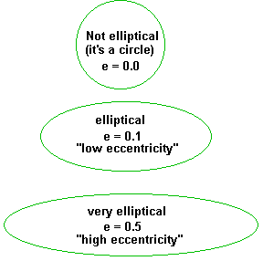
The calculation of how oval an orbit is – is called:
Eccentricity
0 = round
1 = line

Slide 44
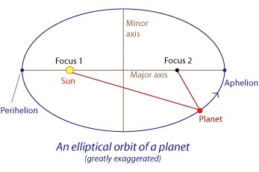
There are two _____ in middle of an orbit.
Foci – plural for focus.
The sun is at one foci.
Nothing is at the other foci

Slide 45
What is the major axis?
The length from one side of the oval to the other side.

Slide 46
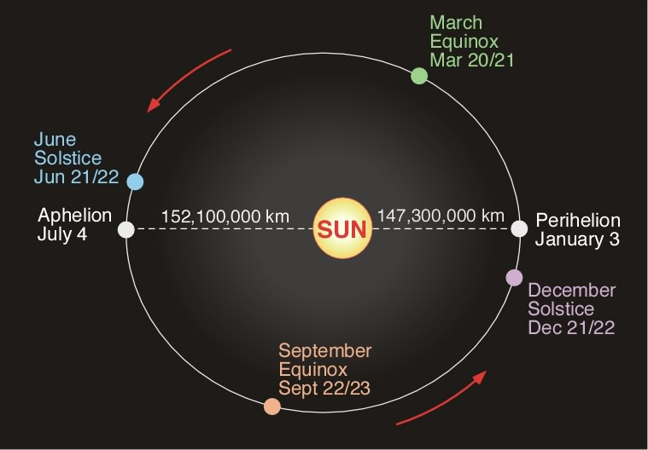
In which season is the Earth closest to the Sun?
Winter
It’s called Perihelion.

Slide 47
Why is it cold if the Earth is closer to the Sun?
1. It isn’t that much closer, relatively speaking.
2. It is winter in the Northern Hemisphere because the Northern Hemisphere happens to be tipped away from the Sun at that time.

Slide 48


Slide 49
In which season is the Earth farthest from the Sun?
Summer
It is called aphelion

