Slide 1
Weather Variables

Slide 2
Describing Weather
What is weather?
Short term condition of the atmosphere
Includes the changes that occur within the atmosphere and troposphere
These changes are mostly caused by unequal heating by solar radiation (sunlight) of the Earth’s landmasses, oceans, and atmosphere.

Slide 3
Atmospheric Variables/Meteorologists
Atmospheric Variables – the characteristics of the atmosphere that change
Temperature
Pressure
Dew Point
Humidity
Wind
Meteorologists – (scientists that study weather) make field charts of these variables and then can make predictions (forecasts).

Slide 4

Atmospheric Variables
Air Temperature – a measure of heat energy
More heat energy = greater temperature
The amount of heat energy emitted from the sun is fairly constant but the amount that reaches the Earth varies because of:
The # of hours of sunlight per day
Summer= more hours= hot
Winter = less hours = colder
The angle at which solar radiation strikes the Earth
Straight on = hotter
Angle = cooler
What is the main source of heat energy for our atmosphere?

Slide 5
Atmospheric Variables Continued
3. The type of surface that absorbs solar radiation.
Dark, rough surfaces (land) absorbs faster = warmer
Light-colored, smooth surfaces (oceans) absorbs slower = cooler.
4. The amount of cloud cover.
Solar radiation is reflected, refracted, or absorbed.
More cloud cover during the day = cooler.
More cloud cover at night = warmer.

Slide 6

Temperature Continued
Continuous temperature readings are made with a thermograph.
Temperature is measured with a thermometer.
Why does seasonal temperature change?
Revolution – the way that the Earth revolves around the sun
Tilt – the way the Earth is positioned on its axis
Why does air temperature change throughout the day?
Because the Earth rotates

Slide 7
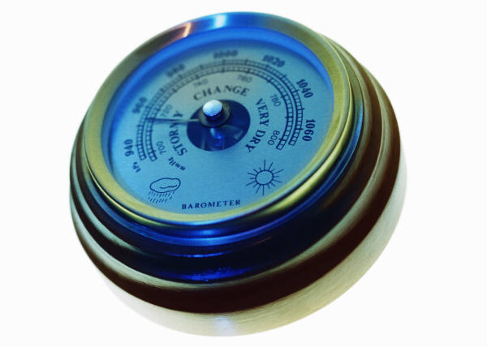
Air Pressure
Air pressure – the pressure exerted by the gases in our atmosphere
Air is a mixture of gases.
A gas contains many tiny individual molecules that are far apart and moving rapidly.
Why doesn’t our atmosphere float off into space???
Gravity
You can NOT sense changes in air pressure but a barometer can.
Two types of Barometers:
Mercury barometer – air pushes down on mercury then the mercury will rise up in a tube.
Aneroid barometer – no air, the can has a spring scale. As the air pressure pushes against it the spring records how much pressure.

Slide 8

Air Pressure Continued
One atmosphere = the average pressure at sea level = 1013.2
In general, when the barometric pressure is rising, fair weather is moving in.
When the barometric pressure is falling stormy weather is approaching.
Air pressure gradient controls the velocity (speed) of the wind.
The higher the gradient (closer the lines) the great the wind velocity.

Slide 9

Humidity
Humidity – the amount of moisture in the air.
Water vapor – water in the form of a gas; it is odorless and colorless.
Two ways to express humidity:
Absolute Humidity – the # of grams of water vapor in 1 cubic meter of air. This is rarely measured.
Relative Humidity – the ratio of the water vapor actually in the air compared to the maximum amount of water vapor that the air can hold at that temperature. (The air is holding ___% of the water vapor that it can hold).
Why is water vapor important?
Makes clouds and precipitation

Slide 10
Humidity Continued
Warm air can hold more water vapor.
Cold air can hold less water vapor.
Dew Point – is the temperature at which the water vapor in the air fills to capacity and will begin to condense (Change from a gas to a liquid)
100% relative humidity = rain or fog
0% relative humidity = desert
Relative humidity can be calculated by using a sling psychrometer.
Wet Bulb – measures evaporation temperature
Dry Bulb – measures air temperature

Slide 11
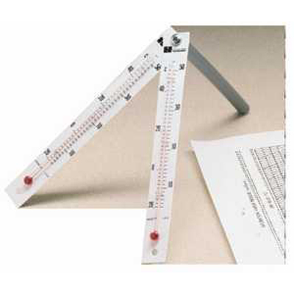
How to calculate relative humidity?
Spin your sling psychrometer above your head for 20 seconds.
Find the wet bulb reading. Record.
Find the dry bulb reading. Record.
Using the relative humidity table on page 12 of your reference table, you can calculate the relative humidity.
If you have a dry bulb of 22°C and a wet bulb of 28°C, what is the relative humidity?

Slide 12
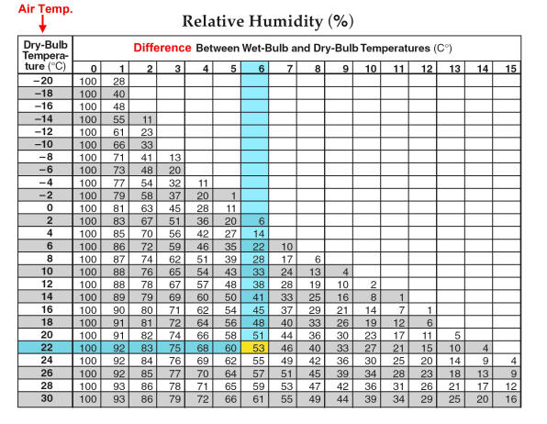

Slide 13
You try!
Calculate the relative humidity in the classroom!

Slide 14
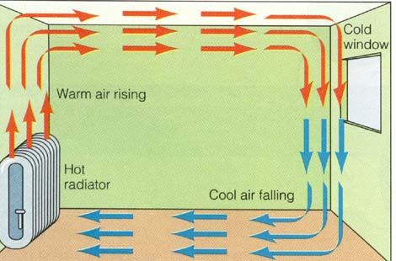
Air Movements
Why does air move in the atmosphere?
Hot air rises because its less dense, cold air sinks because it is more dense

Slide 15


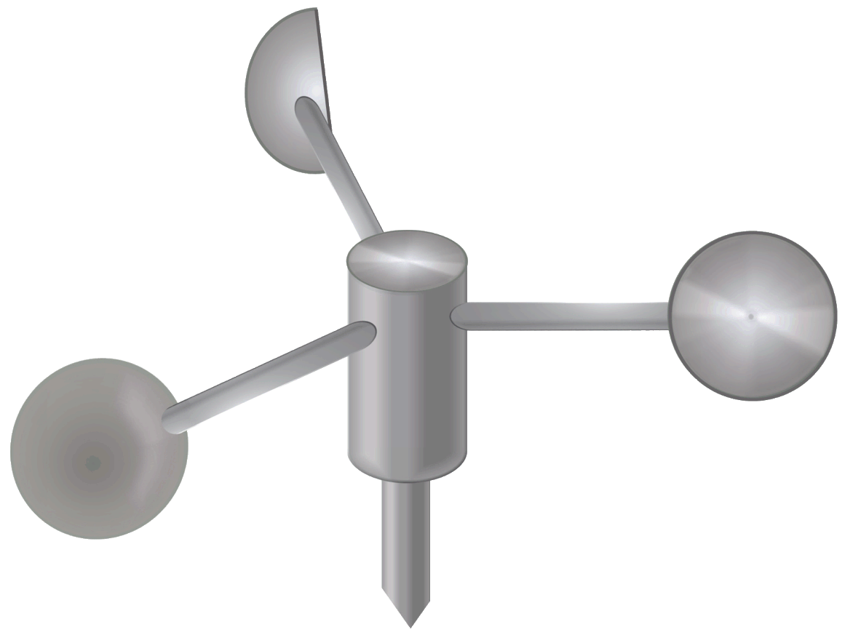
Air Currents
Air currents – are vertical movements of air.
Wind – horizontal movements of air.
Described by both air direction and speed.
A wind is named for the direction from which is blows.
Wind Vane – a pointer that shows the direction of wind.
Anemometer – an instrument that measures wind speed.

Slide 16
Atmospheric Transparency
All of the gases in our atmosphere are transparent (see through)
What types of substances might block our view in the air?
Dust
Ash
Smoke
Salt
Aerosols (droplets of liquid)
Visibility – the horizontal distance through which the eye can distinguish objects in miles.
Cloud Cover – the fraction of the sky that is blocked by the clouds.

Slide 17
