Slide 1
Unit 4 Climate
Part 2
Factors affecting water movement

Slide 2
What factors affect the movement of water?
Slope
Degree of saturation
Porosity
Permeability
Capillarity
Vegetation
Land use

Slide 3
Slope
Slope is how steep the land is.
The steeper the slope of the land, less water will be able to infiltrate the soil, more water will run off the land.
Steeper slope= more runoff, less infiltration
Gentle slope= more infiltration, less runoff
Which hill will have more run-off?
Which hill will have more infiltration?
Run off
infiltration

Slide 4
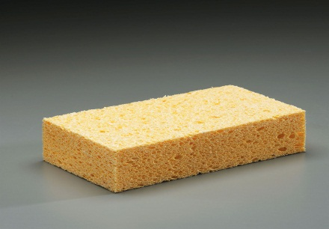

Degree of saturation
Saturation is how full of water the land or soil is.
The fuller or more saturated the land is the less the amount of infiltration.
More saturated = less infiltration and more runoff
Less saturated= more infiltration and less runoff
Which sponge will allow for more runoff?
Which sponge will allow for more infiltration
runoff
infiltration

Slide 5
Porosity
Porosity is the amount of open spaces ( pores or cracks) a sample of a material has.
The greater the porosity, the greater the infiltration.
More pores= more water being able to infiltrate and less water running off
Less pores= less water being able to infiltrate and more water running off
Shape- well rounded particles have a greater porosity then angular particles
Packing- the more closely packed the particles are the lower the porosity
Sorting- if all the particles in a samples are the same size they are said to be sorted. The more sorted the sample the greater the porosity.
Which of the following samples of rocks will allow for the greatest porosity
Great porosity
Less porosity

Slide 6
Permeability
Permeability is the ability of a material to allow water to flow through.
This depends on:
- the shape of the pores
- how well they are connect
- is the rocks are cemented together
- how well the particles are sorted
Impermeable means that water cannot flow through

Slide 7
Capillarity
Capillarity is the attractive force between water molecules and the soil or rock surrounding it.
This force works up against gravity.
The smaller the soil or rock particle the greater the capillarity.
http://youtu.be/Ea3_9Gg-Kro

Slide 8
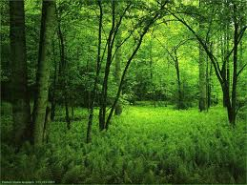
Vegetation
Vegetation is plants, shrubs, tress and grasses growing on the ground.
The more vegetation there is the greater the infiltration.
Which will have more infiltration and why?
More because there is more vegetation
Less because there is less vegetation

Slide 9
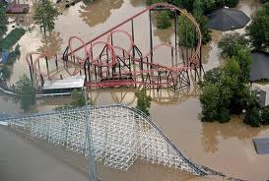
Land use
Land use is how the land is used by people.
Roads, parking lots and buildings cover the ground and water can not infiltrate causing more runoff.
more paved parking lots= more runoff
less paved parking lots= less runoff
more vegetation= more infiltration

Slide 10
Runoff
Surface runoff can occur when:
- it is raining faster then the ground can absorb
- the ground is saturated
- the slope of the hill is too steep to allow for water to infiltrate
- the ground is frozen
Most runoff will eventually flow into a stream
The greater the runoff, the greater the amount of stream discharge
Stream discharge is the amount of water flowing in a stream

Slide 11
Flooding
Flooding occurs when:
a stream overflows its normal channel
when the rate of precipitation exceeds the rate of infiltration
there is a storm surge
Costal storms
Rising sea levels
Sinking lands
What do you do in case of a flood?
Move to higher ground

