Slide 1
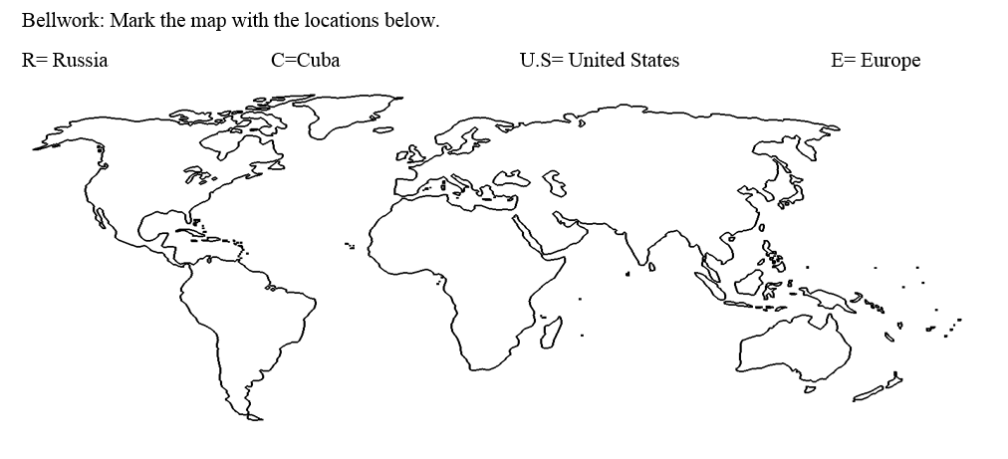
Bellwork:

Slide 2
Learning Target: I can examine a timeline of events and a current event on the relationship between the United States and Russia, Mexico and Cuba in order to explain how U.S. foreign policy has changed over time.
Language Target: I can summarize an example of U.S. foreign policy with Russia, Mexico, and Cuba by using transitional phrases to list details.
This is an example of foreign policy because…
One decision made by the U.S. government was…
Another action taken by the current administration was…

Slide 3
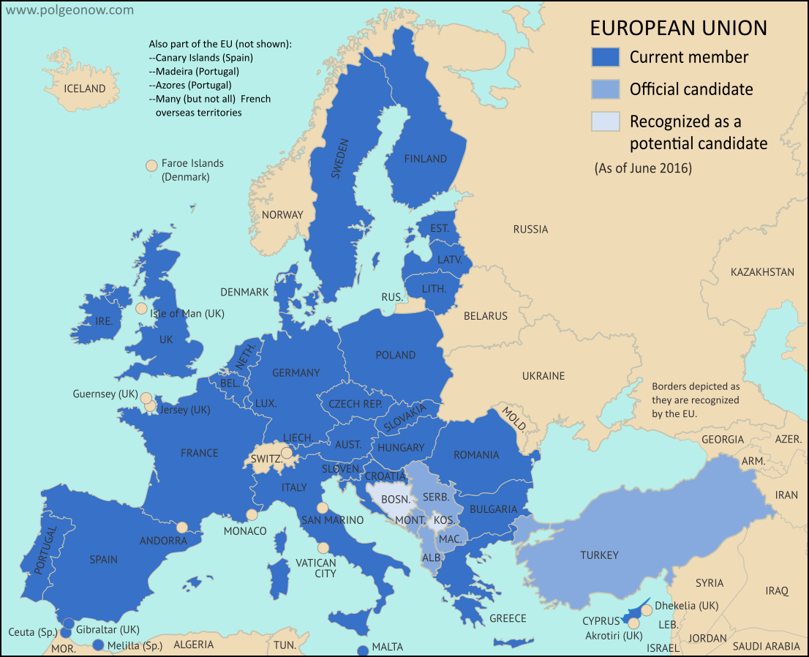
U.S Relations with the European Union
Relations between the US and the European Union (EU) are the bilateral (joint) relations between that country and the supranational (multinational) organization.
The US and EU have been interacting for more than sixty years. US-EU relations officially started in 1953. The two parties share a good relationship which is strengthened by cooperation on trade, military defense and shared values. There are 28 members of the E.U that include Italy, Germany, France and the United Kingdom.

Slide 4
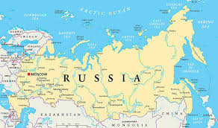
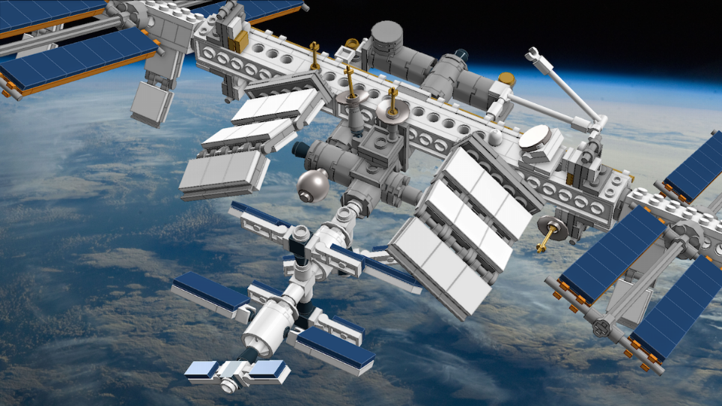
U.S Relations with Russia
Year | Topic | Explanation
1991 | USSR's End
2000 | Space Cooperation Continues
2003 | Iraq War Dispute
The Soviet Union dissolved, ending communist rule. The Soviet Union changes its name back to Russia and becomes more democratic.
Russians and Americans occupy the jointly built International Space Station for the first time.
Russia strongly opposes the 2nd American-led invasion of Iraq.

Slide 5
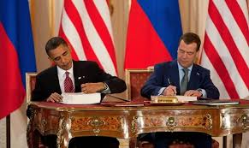
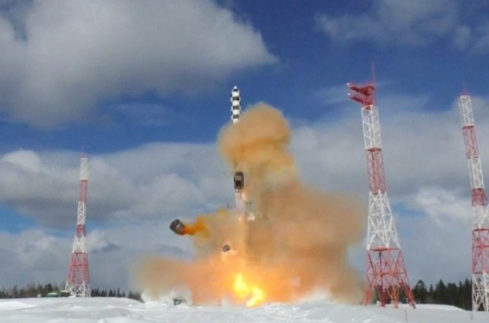
U.S Relations with Russia
2010 | New START Agreement
2014 | Russian Missile Testing
President Obama and Russian President Medvedev sign a new Strategic Arms Reduction Treaty to cut and limit the number of long-range nuclear weapons held by each side.
The U.S. government states Russia violated the 1987 Intermediate-Range Nuclear Forces Treaty by testing a prohibited medium-range ground-launched cruise missile.

Slide 6
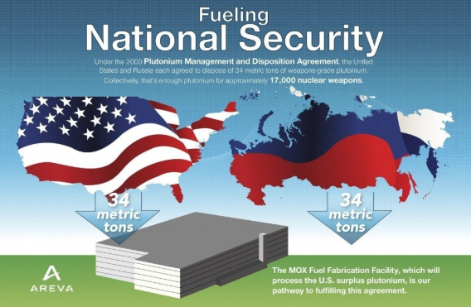
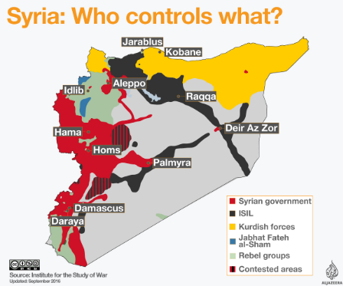
U.S Relations with Russia
2014 | U.S. Imposes Sanctions on Russia
2016 | Disagreement Over the Syrian Civil War
The U.S. government imposed sanctions for Russia's activity in the Ukraine. The U.S. passed the Ukraine Freedom Support Act, aimed at cutting off the Russian government from Western financing and technology while also providing $350 million in arms and military equipment to Ukraine.
Negotiations over Syria were suspended by the U.S in October 2016, after an offensive by Syrian and Russian troops. Russian President Putin signed a decree that suspended the 2000 Plutonium Management and Disposition Agreement with the U.S. because the U.S did not meet their obligations.

Slide 7
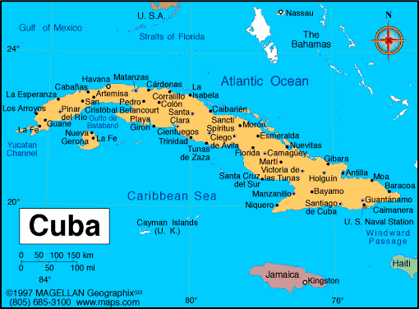
U.S Relations with Cuba
Year | Explanation
1959
1963
1977
Fidel Castro overthrows President Batista and establishes a revolutionary socialist state. The US gradually implements trade restrictions. Cuba leans on the Soviet Union to compensate.
Kennedy prohibits US citizens from traveling to or making financial transactions with Cuba. The embargo (ban on trade) devastates the Cuban economy over the course of the next 50 years.
President Jimmy Carter allows the US travel restrictions to expire.

Slide 8
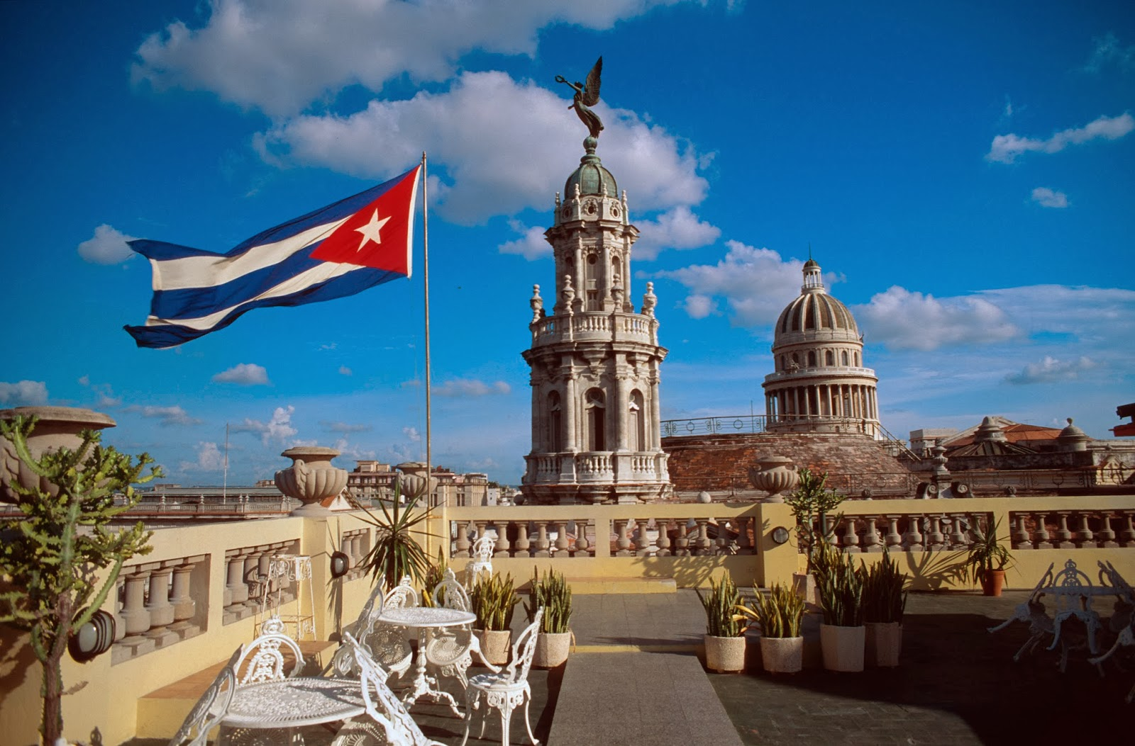
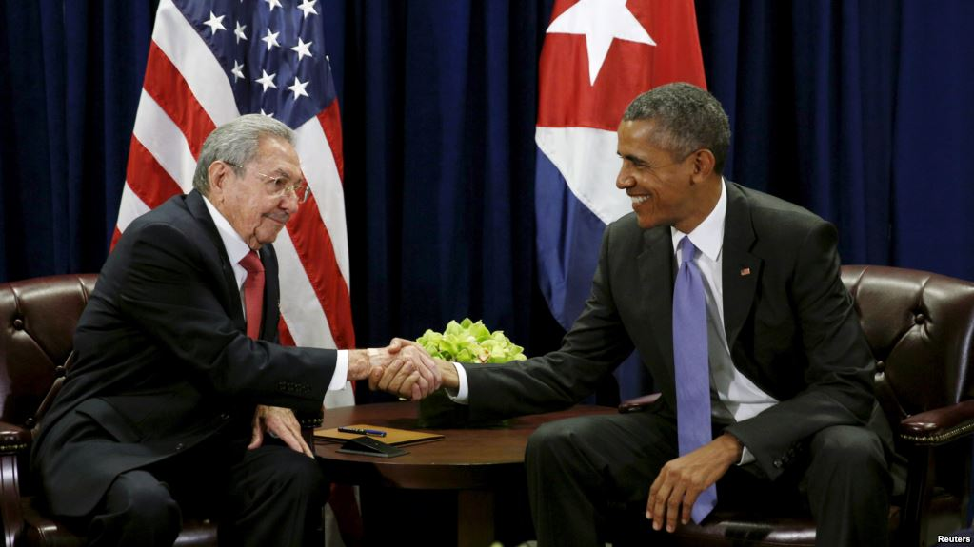
President Reagan re-establishes the travel ban and tightens trade sanctions against Cuba.
1982
2009
2011
2015
2016
President Barack Obama lifts all restrictions on family travel and remittances to Cuba. He eases general travel restrictions, allowing for religious or educational trips to Cuba.
Obama further eases restrictions, allowing non-family remittances and US airports to license charter flights to and from Cuba.
Cuba is removed from the US State Department’s list of state sponsors of terrorism. Obama had called for the removal days after meeting with Raúl Castro in what was the first meeting in more than 50 years.
Obama signs a directive easing trade restrictions on Cuban rum and cigars. These steps were taken to normalize US and Cuban relations.

Slide 9
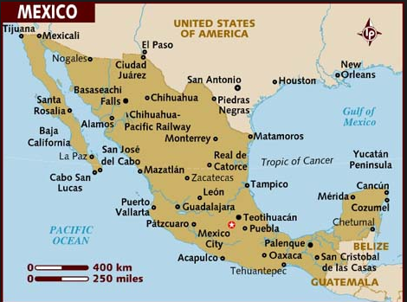
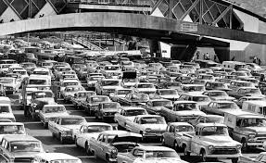
U.S Relations with Mexico
Year | Topic | Explanation
1969 | War on Drugs
1973 | War on Drugs
1969, U.S. President Nixon declares a “war on drugs” and the U.S launches an aggressive search-and-seizure operation on the U.S.-Mexico border.
The United States creates the Drug Enforcement Administration (DEA) to stop drugs coming into the nation.

Slide 10
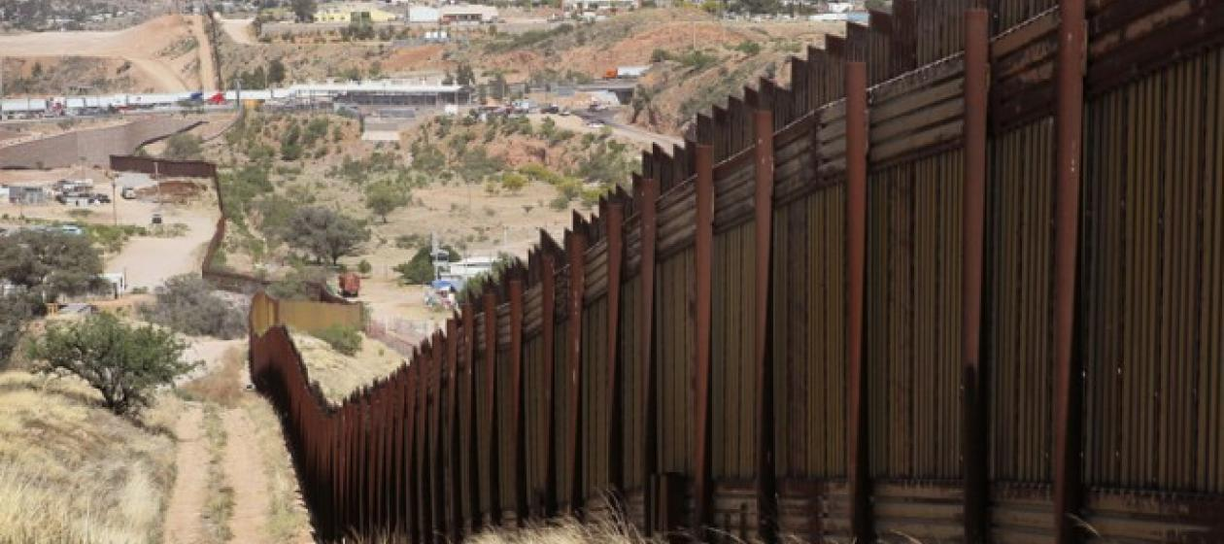
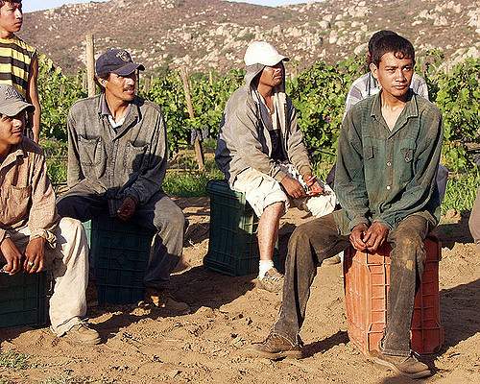
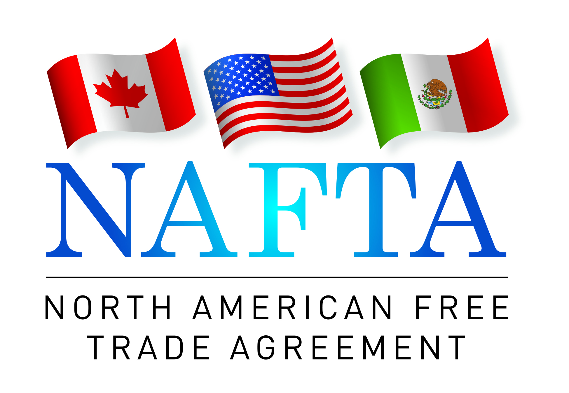
1976 | Immigration
1986 | Immigration
1992 | Trade
U.S. concern over unauthorized immigrants grows. U.S. President Carter explores options to revise U.S. immigration policy, including improving border security and offering amnesty (forgiveness) to undocumented immigrants.
Widespread unemployment in Mexico pushes Mexican migrants to cross the border in search of work. The U.S passes the Immigration Reform and Control Act, which seeks to crack down on undocumented immigration by sanctioning employers who hire unauthorized immigrants.
North American Free Trade Agreement (NAFTA) established a free-trade zone in North America. It was signed in 1992 by Canada, Mexico, and the U.S. NAFTA immediately lifted tariffs on the majority of goods.

Slide 11
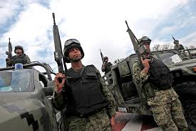
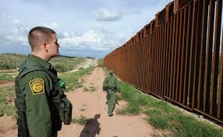
2004 | Border Protection
2018 | Border Dispute
Following the September 11, 2001, terrorist attacks, U.S. border security intensifies. The Department of Homeland Security is created, reorganizing the INS as Immigration and Customs Enforcement (ICE).
President Trump is in conflict with Mexican leaders. Trump is demanding that Mexico finances (pay) the boarder wall between the US and Mexico. He is also pledging to tear up the North American Free Trade Agreement and promising to deport millions of Mexicans who crossed the border illegally.

Slide 12
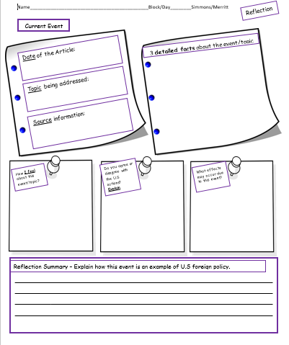
Close Read Current Event Activity
View video (comments/questions)
Fill in Date, Topic, & Source
Read and annotate
Fill in Current Event Graphic Organizer
Closure: Reflection Summary
http://www.bbc.com/news/world-asia-43500299

