Slide 1
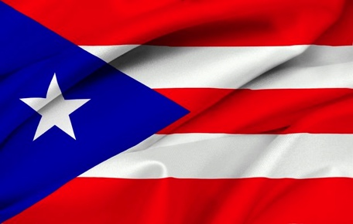
Puerto Rico
Angel J. Carreras Aponte

Slide 2
Where’s Puerto Rico?
Puerto Rico is an island that is located between the Caribbean Sea and the Atlantic Ocean.
It is a territory of the United States. The capital is San Juan. The population is over 3.600.000 people.
The ational language is Spanish
Notes:
Insert a map of your country.

Slide 3
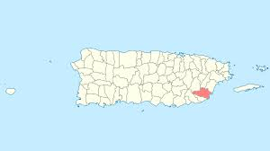
My Hometown
Yabucoa is a municipality in Puerto Rico, located in the southeastern region, north of Maunabo; south of San Lorenzo, Las Piedras and Humacao; and east of Patillas. Yabucoa is spread over 9 wards and Yabucoa Pueblo.

Slide 4
The Geography of Puerto Rico
From East to West, the island is only about 110 miles long.
Puerto Rico is a mountainous island.
The main mountain range is called La Cordillera Central.
Notes:
Insert a picture of one of the geographic features of your country.

Slide 5
What is the weather like?
Tropical/Caribbean climate.
In January, it’s usually around 73°F.
July is usually around 81°F.
Notes:
Insert a picture illustrating a season in your country.

Slide 6
What is the natural environment like?
El Yunque:
A magnificent tropical rainforest.
The only rainforest of the United States.
More than 200 inches of rain each year.
Many exotic animals and plants within El Yunque.
Notes:
Insert a picture of an animal and/or plant found in your country.

Slide 7
A quick history…….
Columbus’ arrival | 1st Spanish Settlement | Warfare | Citizenship | Governing | Currently
Nov 9, 1493 | Aug 8, 1508 | July 5, 1898 | 1917 | 1947 | Jan 2, 2013
Columbus arrived on Puerto Rico during his 2nd voyage. | First Spanish Settlement, Caparra governed by Juan Ponce de Leon. | The US invaded Puerto Rico during the Spanish-American War. | US Congress votes to make all Puerto Ricans US citizens. | US grants Puerto Rico the right elect their own governor. | Governor Alejandro García Padilla was sworn in as the 11th governor. (4 year term)
The indigenous population was called “Los Taínos”.
Notes:
Add key points in the history of your country to the timeline.

Slide 8
The Culture of Puerto Rico
A very diverse culture.
A mixed population ranging from:
Africans
Spaniards
Taínos
Americans
Asian
Official Languages are English & Spanish.
Notes:
Insert a picture illustrating a custom or tradition.

Slide 9
The traditional candy OR snack:
Pasta de guayaba
Popularly known as “guava paste”
Notes:
Insert a picture of the head leader of your country.

Slide 10
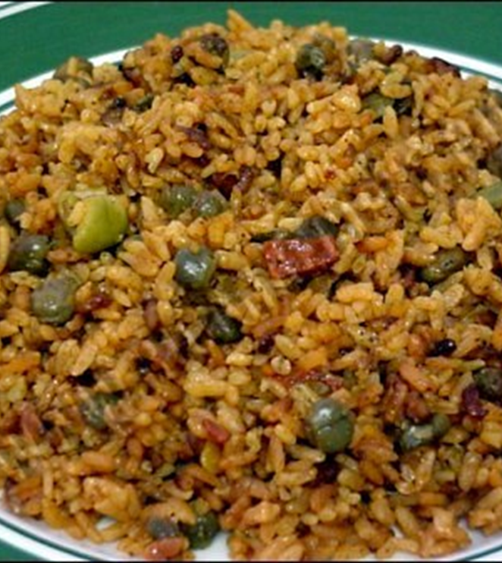
Most Traditional Food
Los Pasteles
Tamales made with green plantains or “yautías” (a vegetable similar to the potatoe) and meat.
Arroz con gandules
Gandules are also known as Pigeon Peas.
Rice with pigeon peas

Slide 11
Coffee
Coffee is a popular drink after a snack or a meal.
A huge export of coffee is from Puerto Rico.

Slide 12
The Largest Radio Telescope
El Observatorio de Arecibo
You will find the biggest radio telescope in the world in Arecibo, Puerto Rico.
Dish is 20 acres & a sinkhole the size of 13 football fields.
Used to study planets, comets, asteroids, galaxies, and more.
Notes:
Insert a picture that illustrates some part of your country’s economy.

Slide 13
Salsa
Salsa is dance music with Afro-Cuban influences that is very popular in Puerto Rico and the rest of Latin America.
(On the image: Mark Antony)
Notes:
Insert a picture of one of the points of interest for your country.

Slide 14
Sports
El béisbol
Baseball is the most popular sport in Puerto Rico.
(Yadiel Molina y Carlos Belran)

Slide 15
El Morro, San Juan
El Morro:
A Spanish Fortress built during the Spanish control of Puerto Rico.
Located in San Juan.

Slide 16
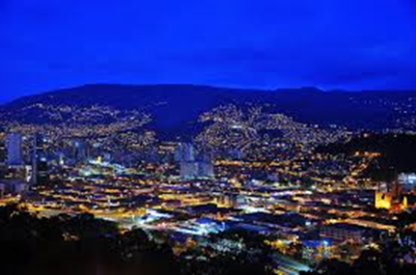
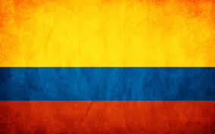
The place were I want to travel some day is Medellin, Colombia
Medellín, officially the Municipality of Medellín, is the second-largest city in Colombia and the capital of the department of Antioquia. It is located in Aburrá Valley, a central region of the Andes Mountains in South America.

