Slide 1
Authentic Chinese Food
Nan Zhang

Slide 2
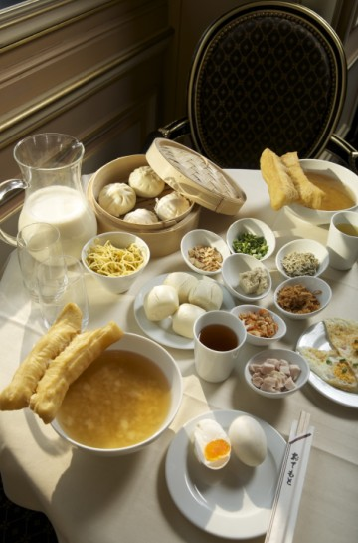
Breakfast
Many options:
Soymilk/milk
Fried bread stick
Rice porridge
Eggs
Pickled side dishes
Steamed buns

Slide 3
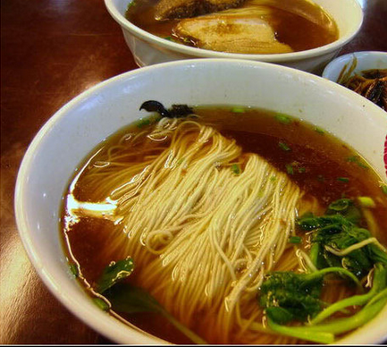
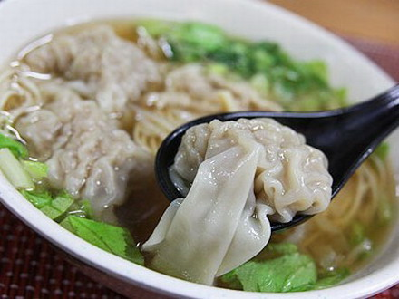
Breakfast (cont.)
Other Options:
Noodles
Wonton

Slide 4
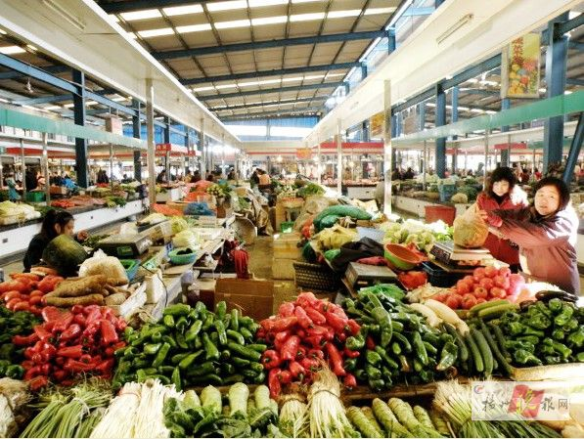
Traditional Chinese Food Market

Slide 5
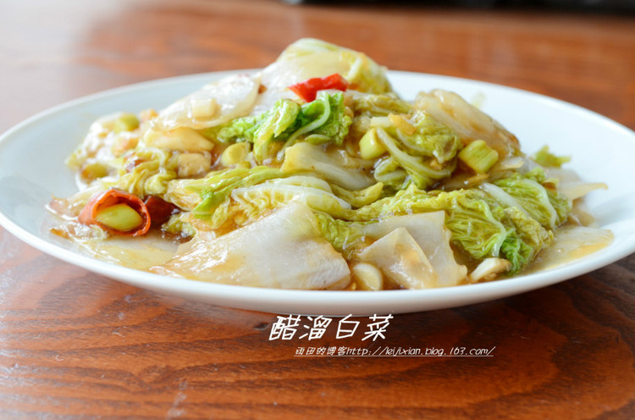
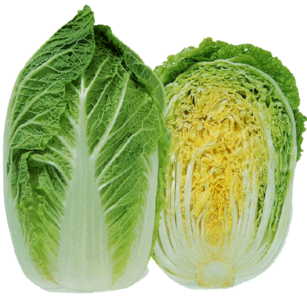
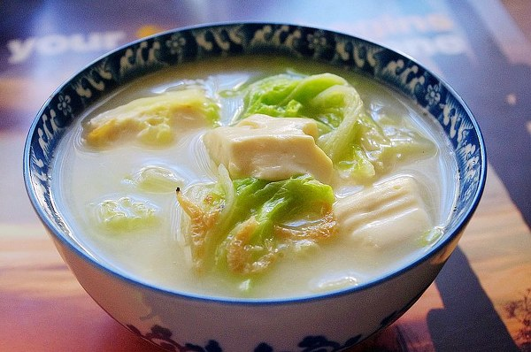
Popular Vegetables
Chinese cabbage
Sautéed with dry chili and rice vinegar
Cabbage soup with tofu

Slide 6
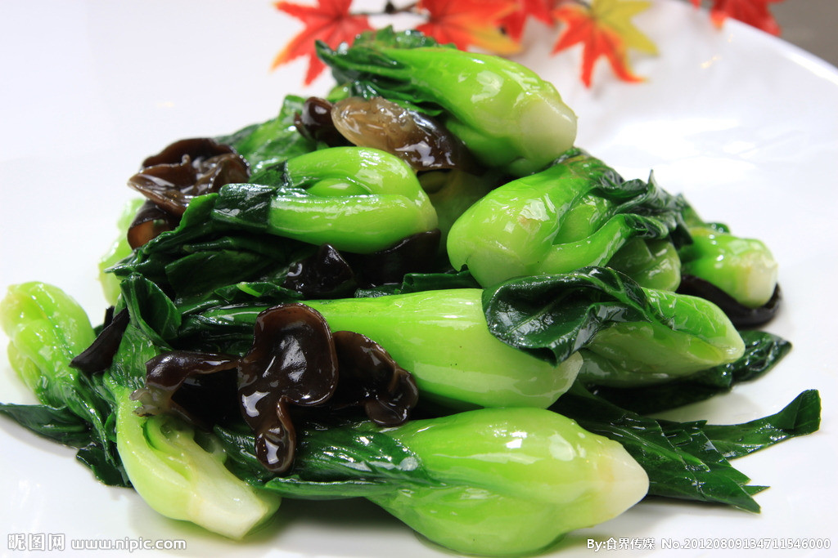
Popular Vegetables (cont.)
Bok Chow
Stir fry with mushrooms or wood ears, seasoned with salt.

Slide 7
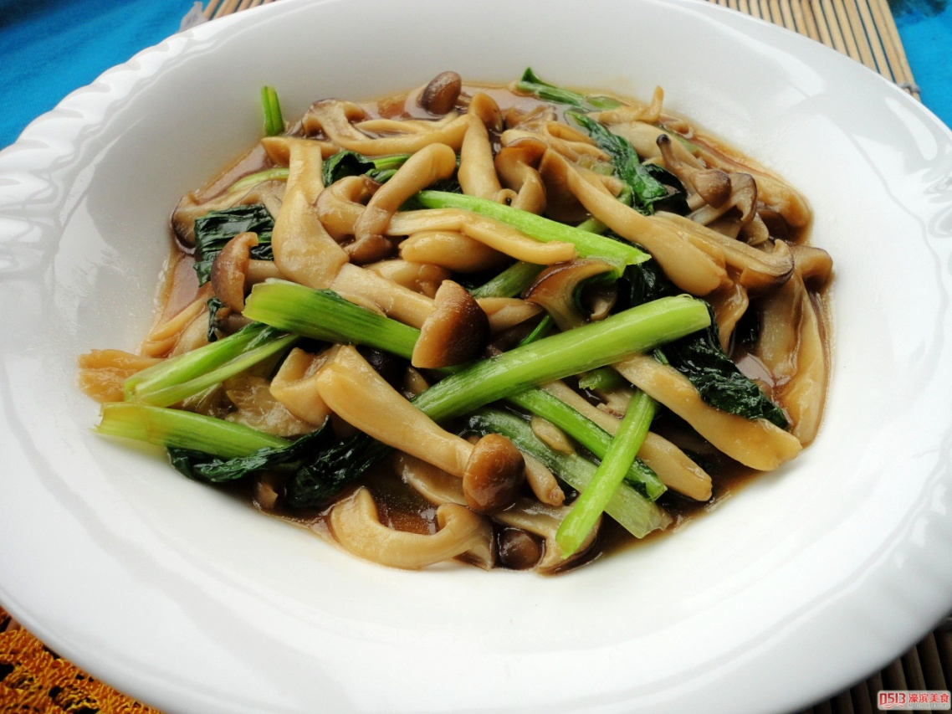
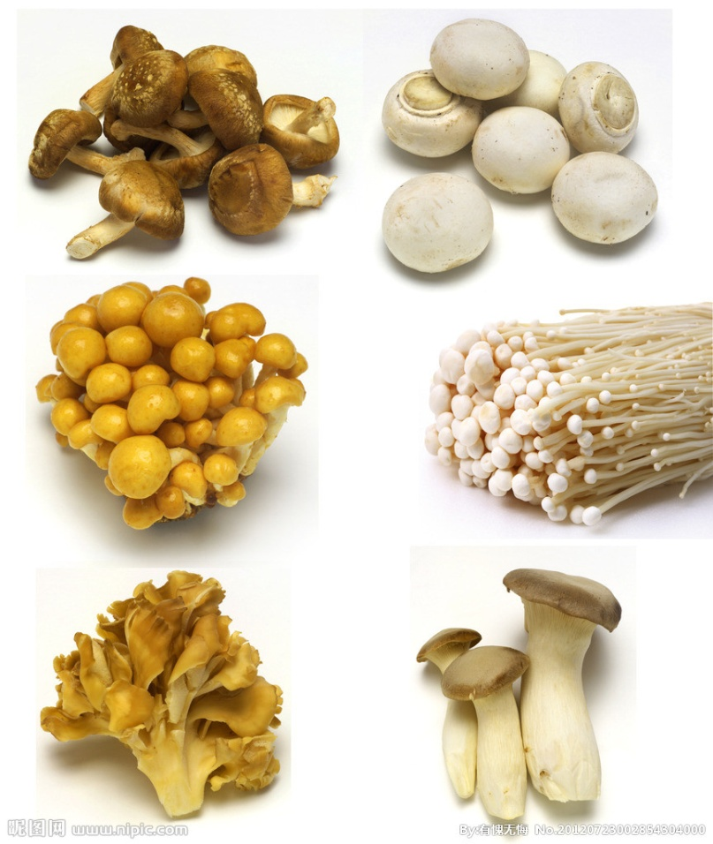
Popular Vegetables (cont.)
Varieties of Mushrooms
Sautéed mushrooms
Also used in soups and dumpling fillings

Slide 8
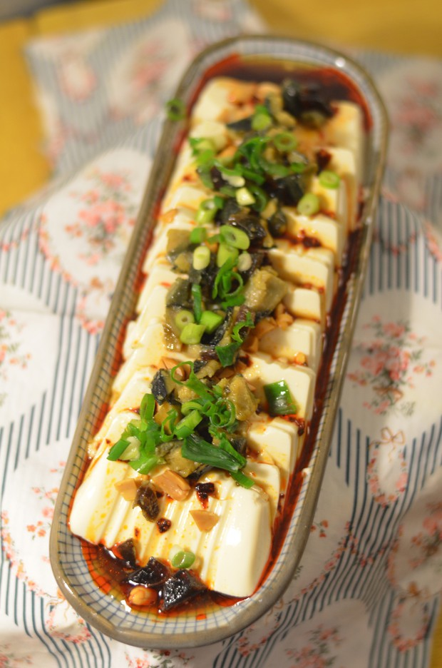
Popular Vegetables (cont.)
Tofu
Side dish, eat raw with pickled eggs, seasoned with soy sauce, chili oil and green onion

Slide 9
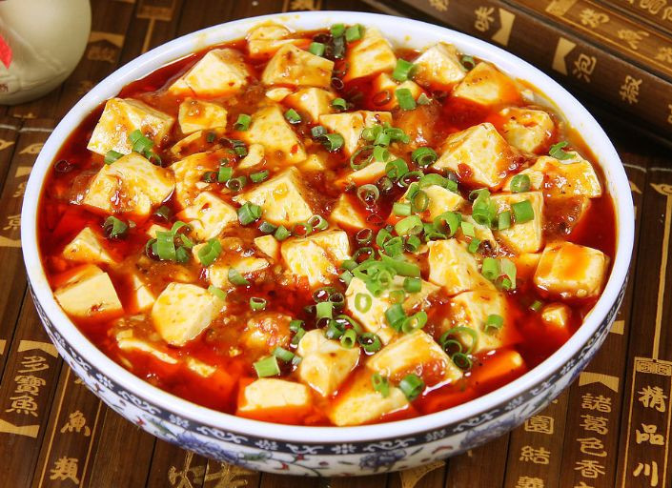
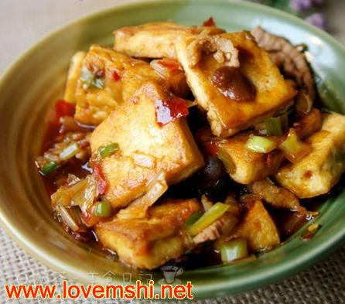
Tofu (Cont.)
Spicy Tofu with minced pork and chopped green onions
Deep fried tofu with black bean sauce

Slide 10
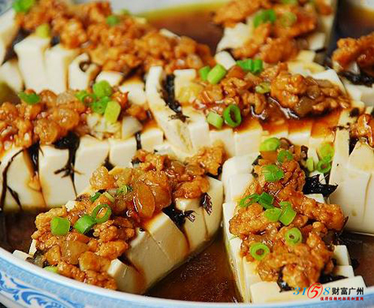
Tofu (Cont.)
Steamed Tofu with minced pork
Tofu Soup

Slide 11
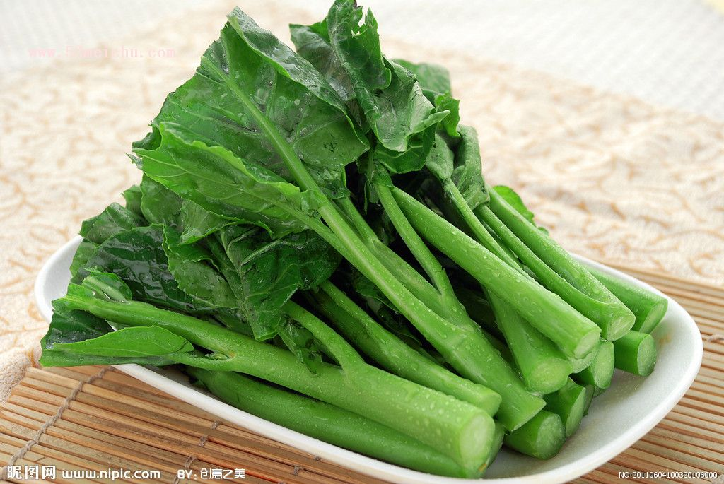
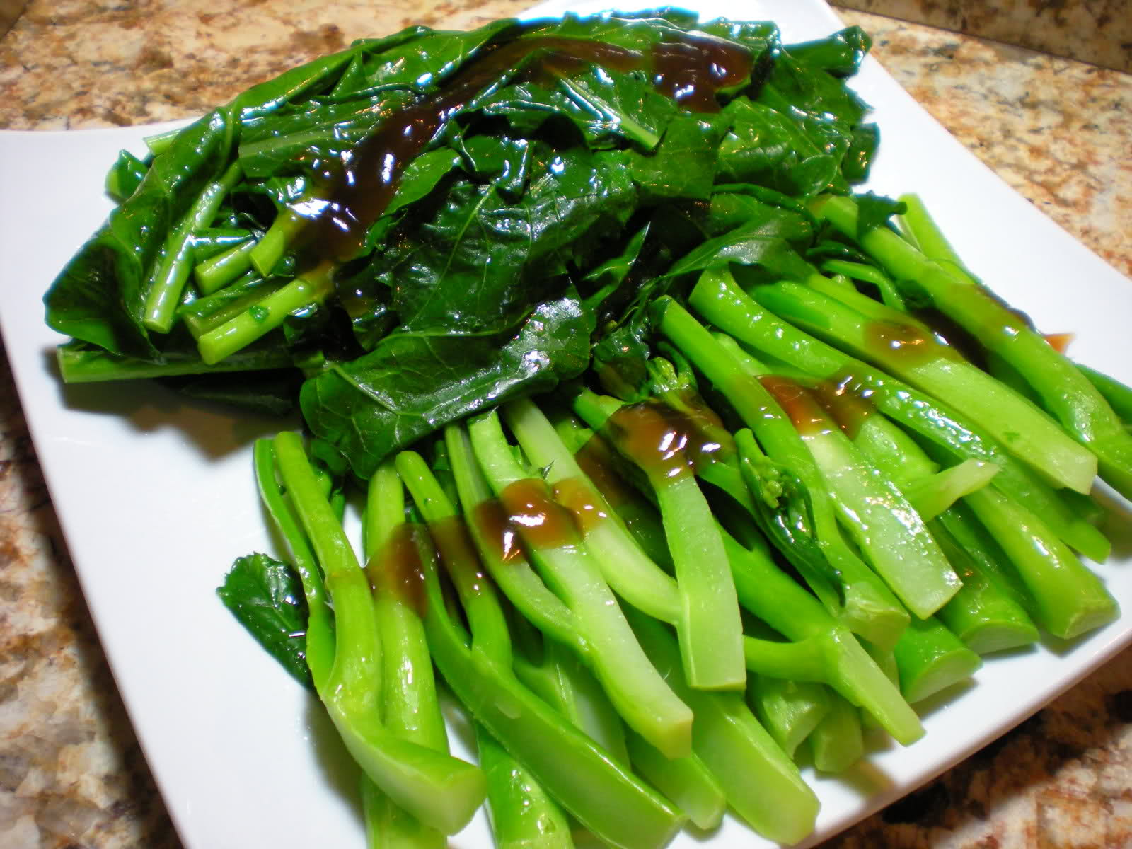
Popular Vegetables (cont.)
Chinese Broccoli
Sautéed with oyster sauce

Slide 12
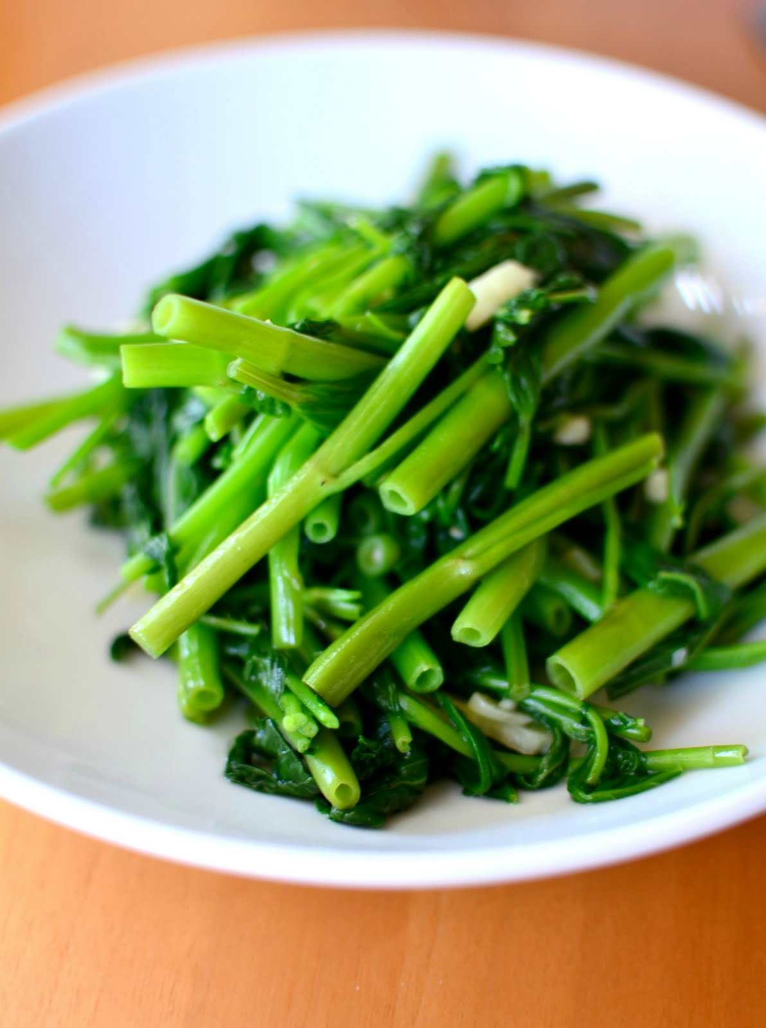
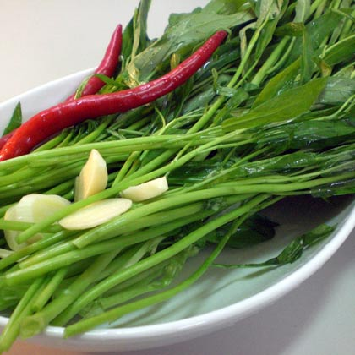
Popular Vegetables
Water Spinach
Sautéed water spinach with garlic

Slide 13
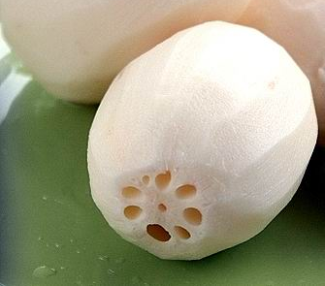
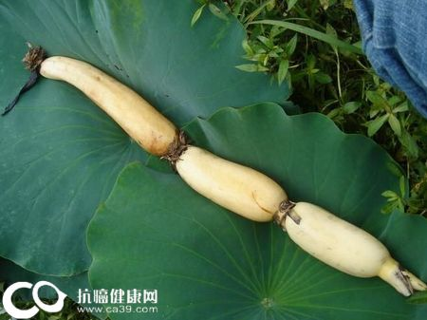
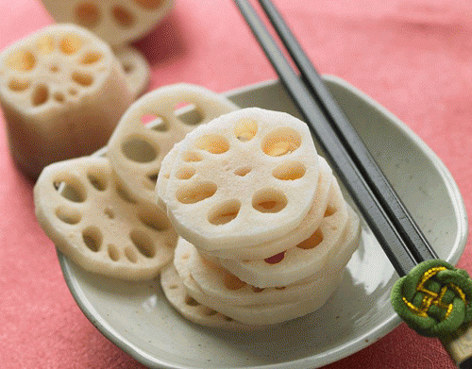
Popular Vegetables (Cont.)
Lotus roots
Peeled
Sliced

Slide 14
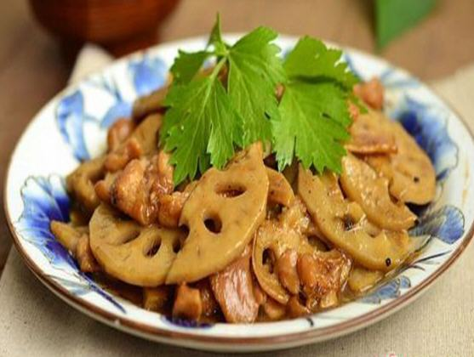
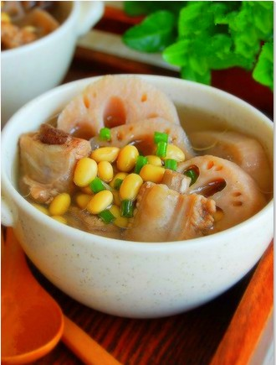
Lotus Roots
Lotus roots and pork chop soup
Sautéed

Slide 15
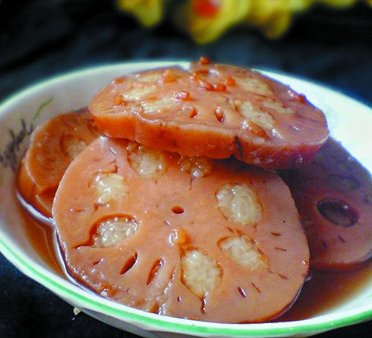
Lotus Roots Appetizer
Filled with sticky rice and steamed/boiled with sugar and
sugar candy
Eat cold or hot

Slide 16
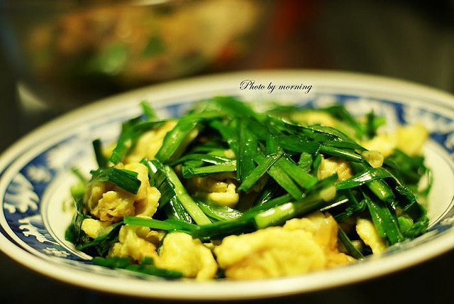
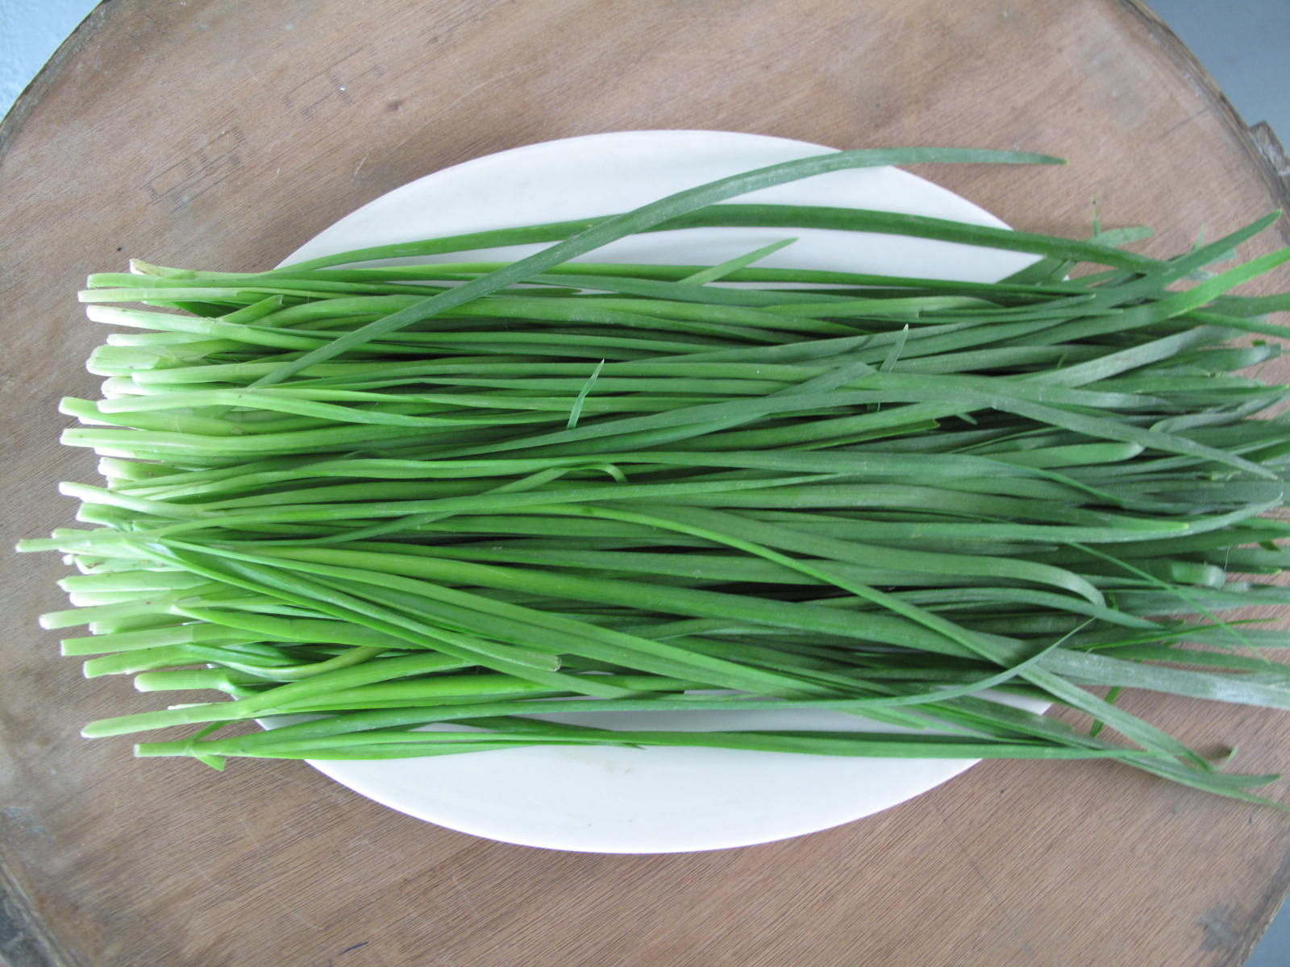
Popular Vegetables (cont.)
Chinese Chives
Stir fry with eggs, seasoned with salt

Slide 17
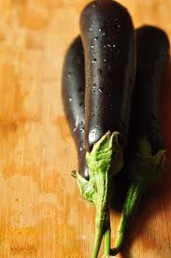
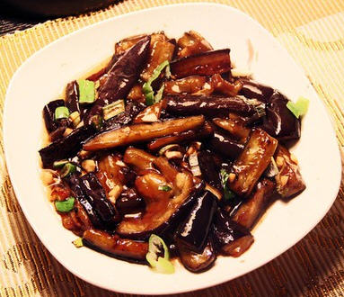
Popular Vegetables (cont.)
Chinese Eggplant
Sautéed eggplant with garlic and black bean sauce

Slide 18
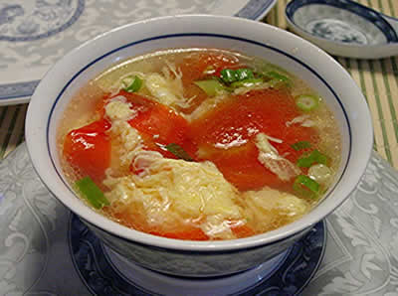
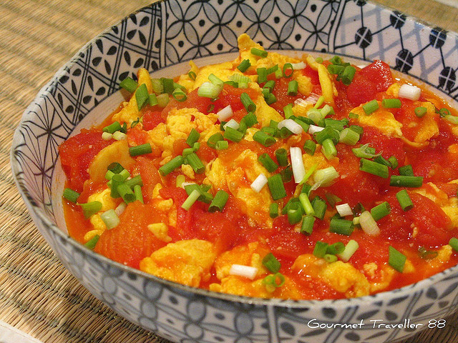
Popular Vegetables (cont.)
Tomatoes
Egg stirred with tomatoes, seasoned
with salt, sugar and green onion
Egg drop soup with tomatoes

Slide 19
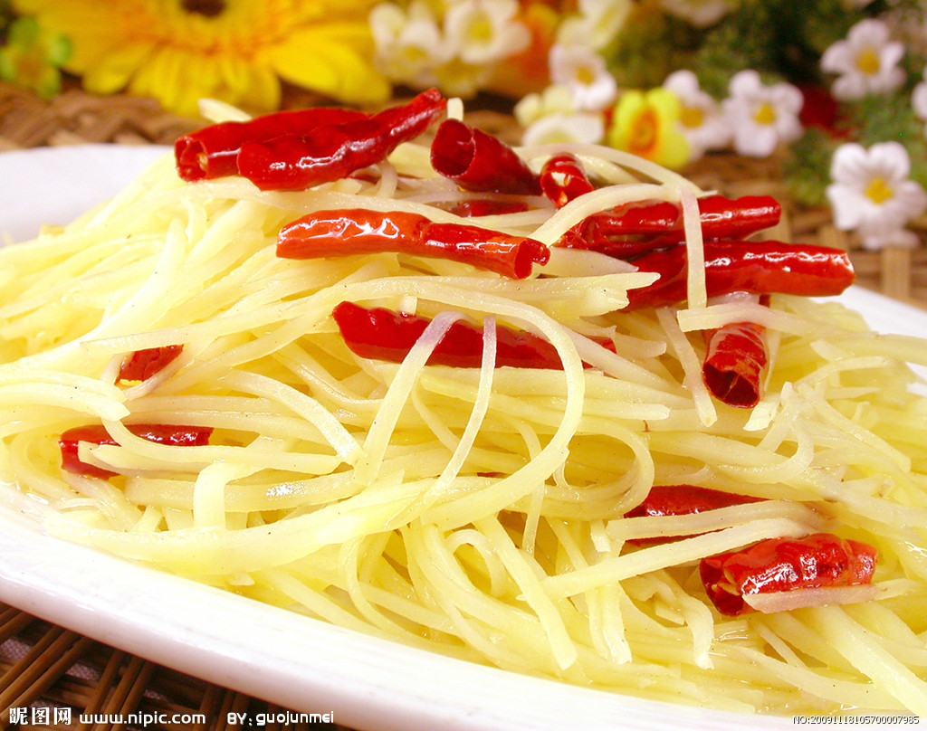
Popular Vegetables (Cont.)
Potatoes
Vinegar flavor spicy potato shreds with dry chili

Slide 20
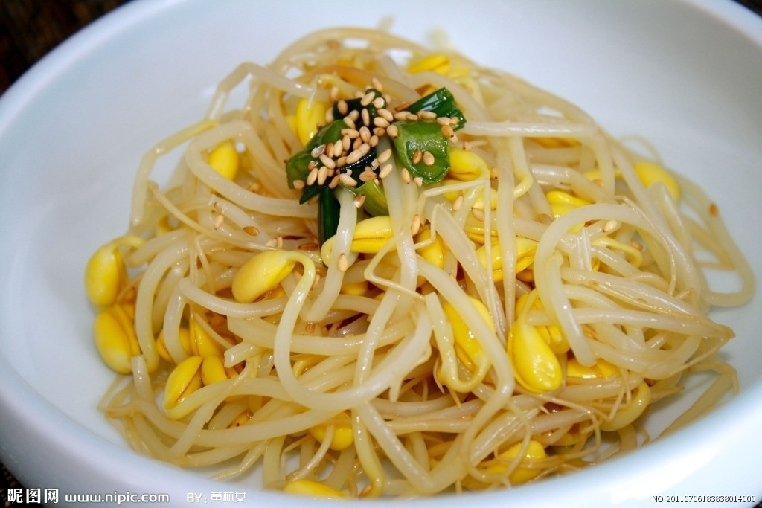
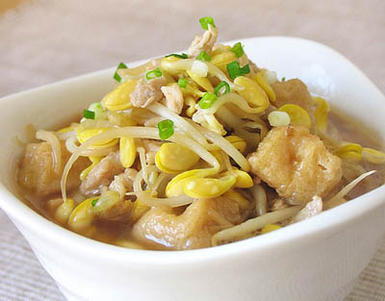
Popular Vegetables (Cont.)
Sprouts
Stir fried sprouts vinegar flavor
Sprouts soup with deep fried tofu

Slide 21
Vegetable Seasoning
Garlic
Salt
Sugar (optional)
Oyster sauce (optional)
Vinegar (optional)

Slide 22
Meat Seasoning
Garlic
Ginger
Green onion
Rice wine
Soy sauce
Salt
Spice

Slide 23
Fish Seasoning
Garlic
Ginger
Green onion
Rice wine
Rice vinegar
Salt
Sugar
Spice

Slide 24
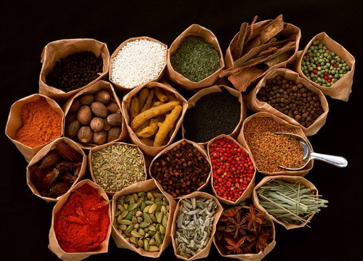
Spice

Slide 25
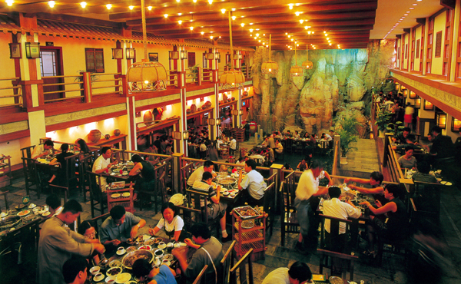
Hotpot
Traditionally, Chinese people eat hotpot during winter when it gets really cold.
Nowadays, any season
We LOVE hotpot!!

Slide 26
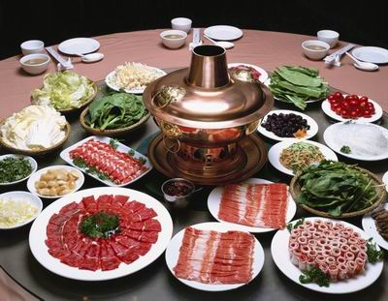
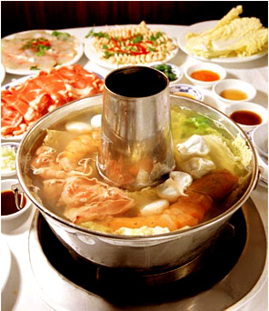
Hotpot (Cont.)
Traditionally, hotpot looks like this.
Wait till the soup is boiling, and add meat and vegetables to the pot, after
boiling for a few minutes, meat and vegetables are ready to eat.

Slide 27
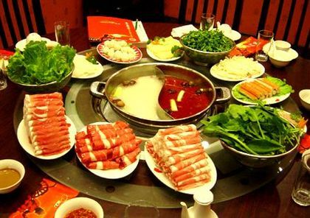
Hotpot (Cont.)
Nowadays, most of the hotpots offer two flavors within one pot, spicy and not spicy

Slide 28
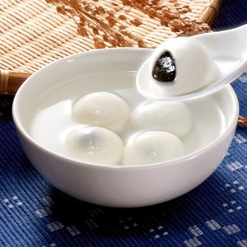
Tangyuan (Sweet Soup Balls)
Tangyuan is part of people’s life in the southern part of China. People eat it for breakfast and sometimes as a quick dinner or dissert.
Tastes sweet.
Made of sticky rice with
sweet flavored fillings
(black sesame or
red beans)

Slide 29
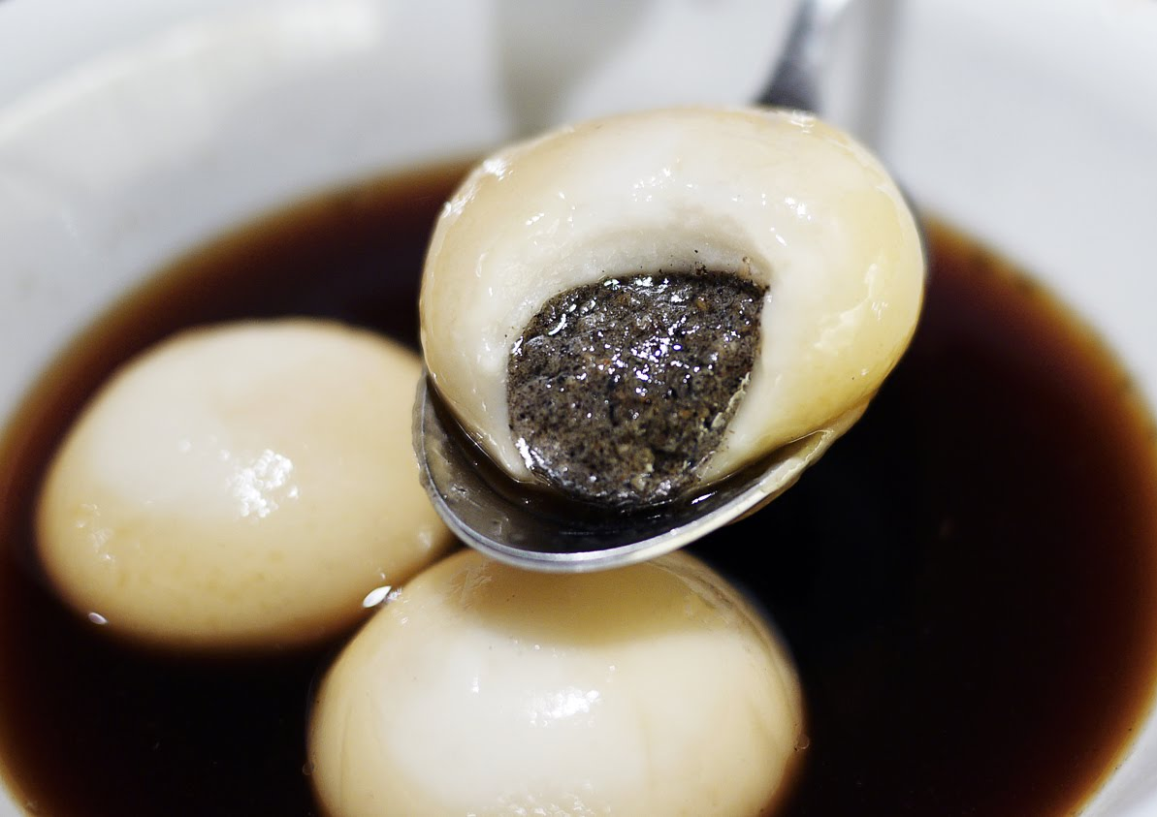
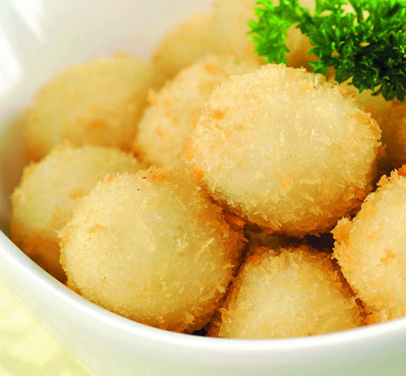
Tangyuan (Sweet Soup Balls)
Eat in soup
Deep fry

Slide 30
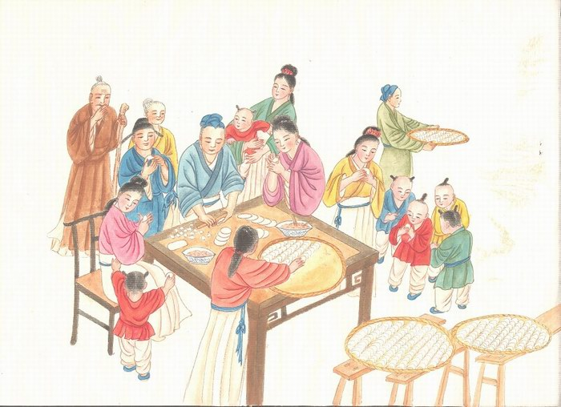
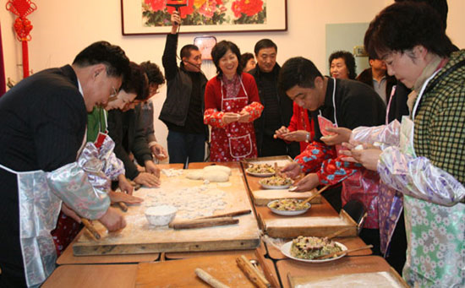
Dumplings
Chinese people eat dumplings on family gatherings and important cultural holidays, especially on Chinese New Year.
Dumpling is on Chinese people’s dinner table from ancient time to recent history and till today.

Slide 31
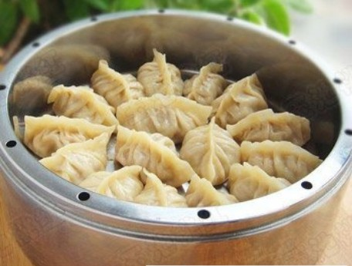
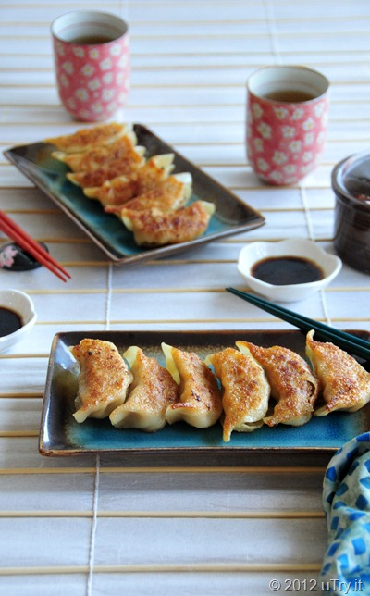
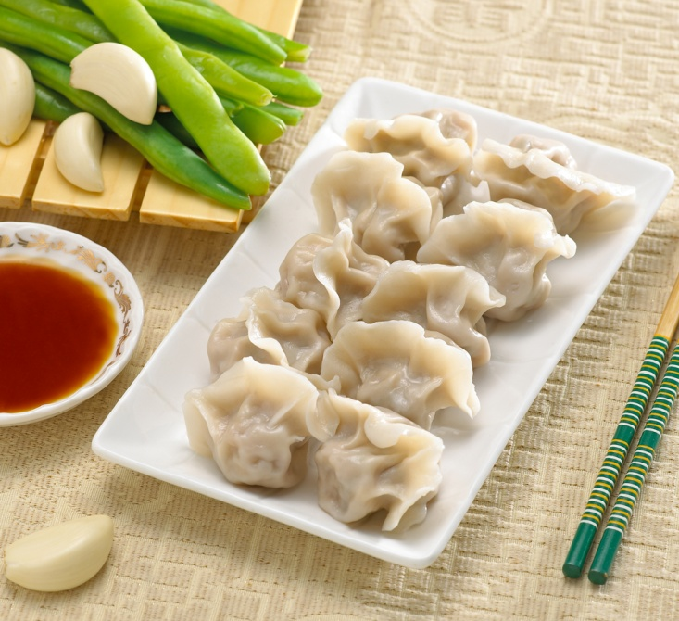
Ways to eat dumplings
People eat dumplings with sauce. Soy sauce, vinegar, chili paste, and chili oil are the most common sauces.
Boiled
Steamed
Fried

Slide 32
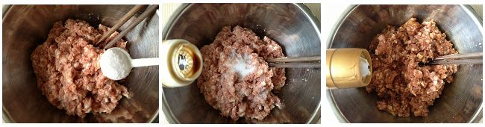
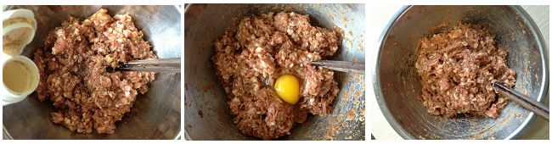
How to make dumplings
Fillings
Add salt, oil, soy sauce, rice wine, Sichuan pepper powder and one egg to grounded pork, beef, lamb or chicken
2) Mix everything together

Slide 33
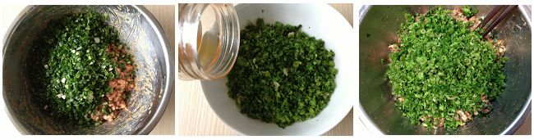
Making dumplings
3) Add chopped garlic, ginger and green onions to the meat mixture
4) Add vegetables (cabbages, celeries, green peppers, carrots, mushrooms, or chives) to the mixtures
5) Mixture everything all together

Slide 34
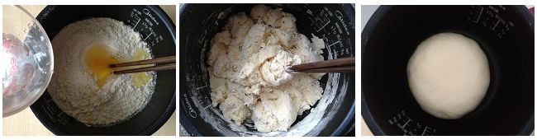

Making dumplings
Making dough
1) Add room temperature water and one egg to the flour; mix everything together till you get a dough
2) Cut the dough into four pieces, and turn each piece into a long shape

Slide 35


Making dumplings
Making dumpling wrappers
Cut the stick shape dough into small pieces
Roll each piece thin till the wrapper reaches a round shape and big enough for the fillings

Slide 36

Making dumplings
Making dumplings as the pictures show

Slide 37

Yeah!!! You Did it!!

Slide 38

Boiling dumplings
Put dumplings into the boiling waiter, cover the lid and let the dumpling cooked until the water is boiling; add a bowel of cold water to the pot and let it cook until the water is boiling for the third time, taste the dumplings, if it is not cooked yet, add more cold water and cook till water is boiling.

Slide 39

Ready to eat!!

