Slide 1
Addressing Rigor
RCSD Mathematics Department

Slide 2
What is Rigor? http://daggett.com/rrr.html
Rigor/Relevance Framework® The Rigor/Relevance Framework is a tool developed by staff of the International Center for Leadership in Education to examine curriculum, instruction, and assessment. The Rigor/Relevance Framework is based on two dimensions of higher standards and student achievement. First, there is the Knowledge Taxonomy, a continuum based on the six levels of Bloom's Taxonomy, which describes the increasingly complex ways in which we think. The low end involves acquiring knowledge and being able to recall or locate that knowledge. The high end labels the more complex ways in which individuals use knowledge, such as taking several pieces of knowledge and combining them in both logical and creative ways. The second continuum, known as the Application Model, is one of action. Its five levels describe putting knowledge to use. While the low end is knowledge acquired for its own sake, the high end signifies use of that knowledge to solve complex real-world problems and to create unique projects, designs, and other works for use in real-world situations. The Rigor/Relevance Framework has four quadrants. Each is labeled with a term that characterizes the learning or student performance at that level.
The Rigor/Relevance Framework is easy to understand. With its simple, straightforward structure, it can serve as a bridge between school and the community. It offers a common language with which to express the notion of a more rigorous and relevant curriculum. The Rigor/Relevance Framework is versatile; it can be used in the development of instruction and assessment. Likewise, teachers can use it to measure their progress in adding rigor and relevance to instruction and to select appropriate instructional strategies to meet learner needs and higher achievement goals. More About the Rigor/Relevance Framework

Slide 3
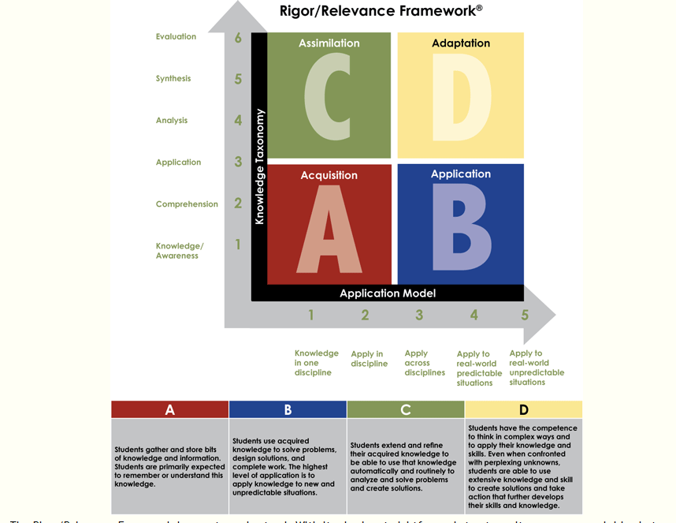

Slide 4
Grade 5 A

Slide 5
Grade 6 B
Elementary School: Elaine bought 6 lb 4 ounces of EVOO cooking oil for $16.80. The container leaked and she lost some of the oil. She quickly sold the remaining oil to George, at a per-ounce price 3/7 higher than she paid for. Altogether, she made a profit of $3.60. What percentage of the oil was lost in the leak?

Slide 6
Geometry D

Slide 7
Grade 4 C
Without using a calculator or equivalent fractions, determine which fraction is larger, or if they are equal. Explain your reasoning.
$\frac{37}{40}$ or $\frac{25}{28}$

Slide 8
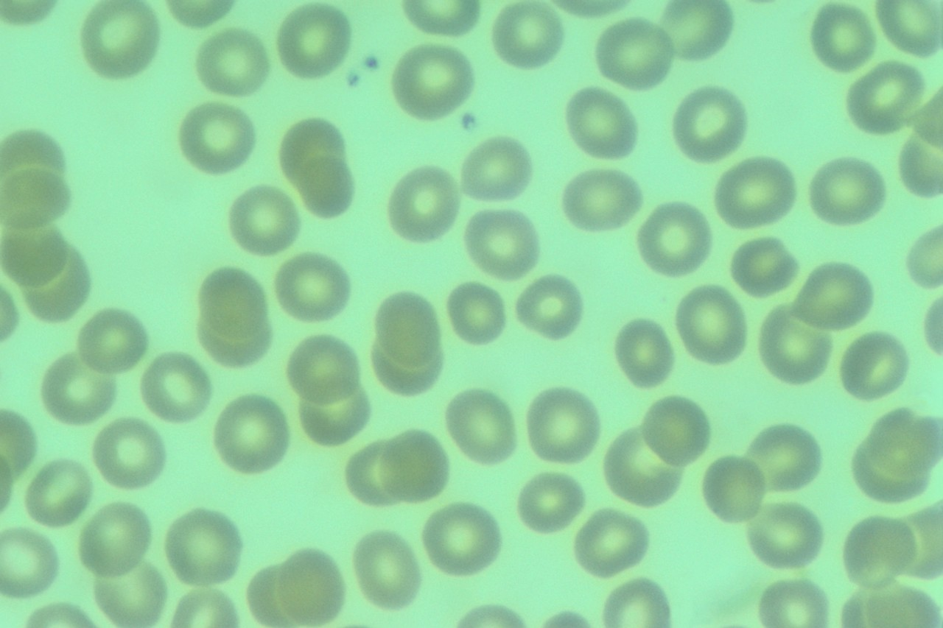
Where would you place this question?
About how many cells are in the human body?
You can assume that a cell is a sphere with radius 10⁻³ cm and that the density of a cell is approximately the density of water which is 1g/cm³.

Slide 9
Where would you place this question?
Your heart pumps about 5 quarts of blood through its chambers every 60 seconds. How many seconds will it take your heart to pump 1 quart of blood? How much blood will pump in 300 seconds?

Slide 10
Where would you place this question?
Use the distributive property to help you find 7 x 12.
Decompose one of the factors into easier numbers to multiply.
Shade in each array. Draw a line between the two arrays.
Write the facts represented by each new array.
Total the products of the 2 arrays for the product of the original fact.

Slide 11
Grade 7 http://www.p12.nysed.gov/assessment/common-core-sample-questions/
13. Grade 7:
While on vacation, a group can rent bicycles and scooters by the week. They get a reduced rental rate if they rent 5 bicycles for every 2 scooters rented. The reduced rate per bicycle is $15.50 per week and the reduced rate per scooter is $160 per week. The sales tax on each rental is 12%.
The group has $1600 available to spend on bicycle and scooter rentals. What is the greatest number of bicycles and the greatest number of scooters the group can rent if the ratio of bicycles to scooters is 5:2?

Slide 12
Addressing Rigor Protocol
Round 1
-use a difficult task (a task with several steps to address more than one standard)
-rigor (three legged stool-fluency, deep understanding, application)
-do the task (teacher does task first)
-share multiple solutions with colleagues
-identify concepts (content emphasis)
-map concepts to standards
-identify math practices
- identify potential student misconceptions and plan on how to address them
-identify potential student strengths
-share rubric(state)

Slide 13
Addressing Rigor Protocol
Round 2
-share task with students
-score work using rubric
-identify and confirm student misconceptions
-identify and confirm student strengths
-identify action steps

Slide 14
Addressing Rigor Protocol
Round 3
-share rubric with students
-discuss solutions
-allow students time to identify action steps to improve response
-allow students to revise work
-students report their work

Slide 15
Testing Guides http://engageny.org/resource/test-guides-for-english-language-arts-and-mathematics

Slide 16
Questions

