Slide 1
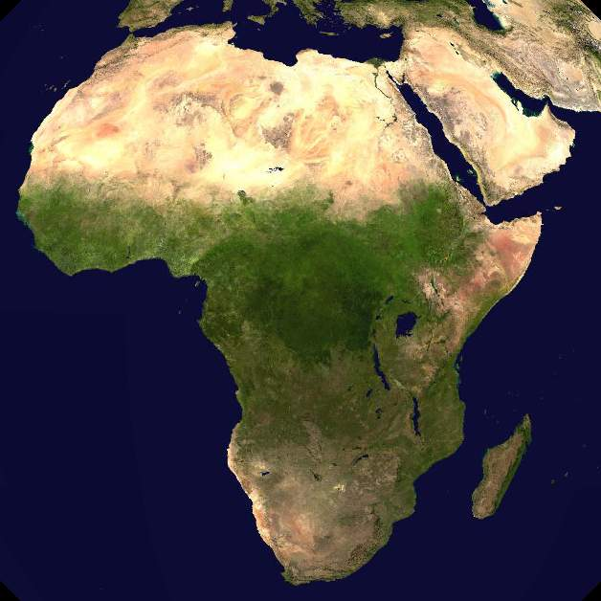
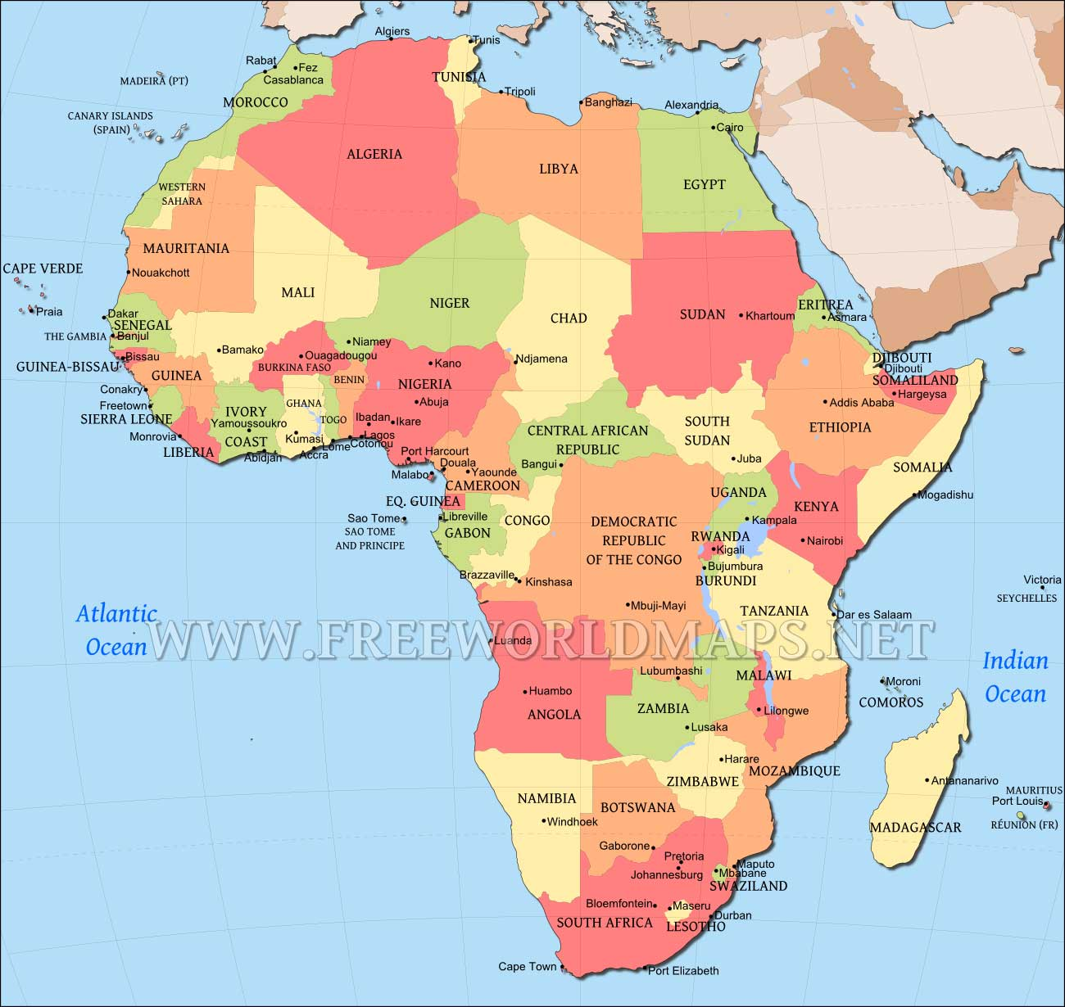
Post WWII Africa
Colonialism to Chaos

Slide 2
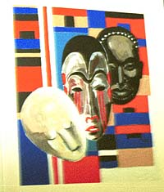
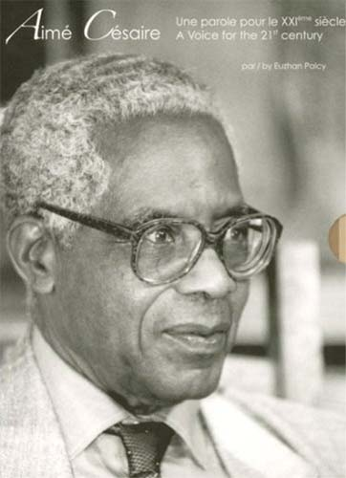
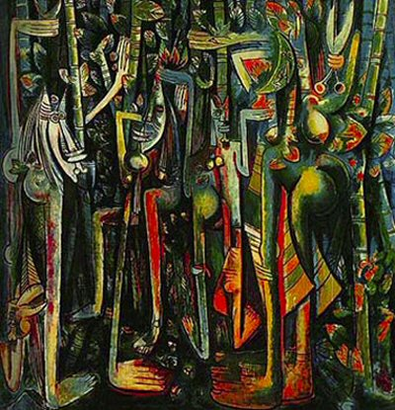
Rebirth of Cultural Identity
Negritude Movement- starts in the Caribbean as a carry over from the Harlem Renaissance & fosters the development of African studies
Celebrates African heritage & culture through the French language

Slide 3
Colonies to Countries
Weak Economy—dependent on single cash crops or resources
Weak Educational System—uneducated citizens incapable of supporting democracy
Colonial Borders—reflected European interests not cultural boundaries
All of these problems lead to instability

Slide 4
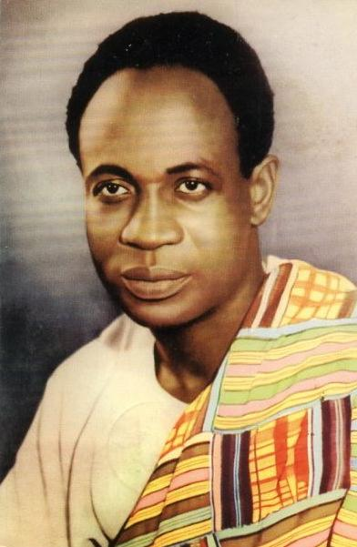

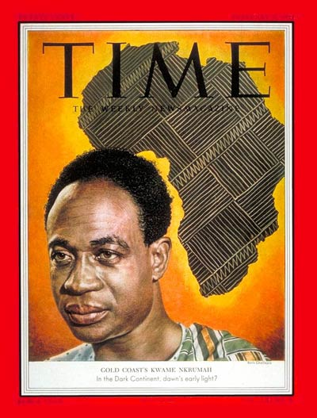
Ghana
Kwame Nkrumah led a relatively non-violent independence movement
Achieved independence in 1957
Wanted to unite all of Africa

Slide 5

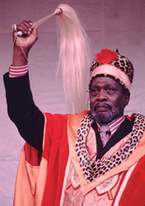
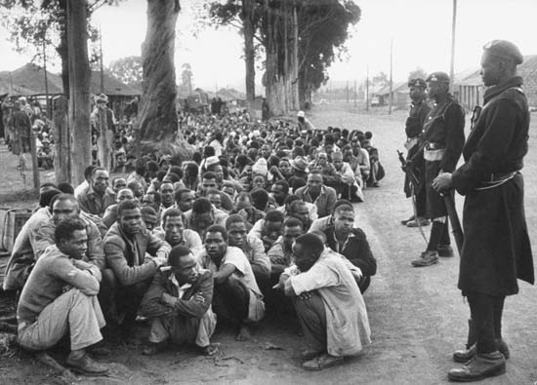
Kenya
Jomo Kenyatta & Mau Mau led the fight for independence
Mau Mau was a nationalist/terrorist group
Jomo Kenyatta was imprisoned by the British
First president of independent Kenya in 1963

Slide 6

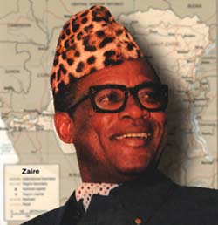


Congo/Zaire
Achieved independence in 1960
General Mobutu seized power from 1960-65
Mobutu was “elected” president in 1965 and established a totalitarian government
Mobutu ruled until 1997
U.S. supported Mobutu because he was not a communist, he fled in 1997
The country is still fighting a civil war, current estimates are 45,000 people die each month

Slide 7

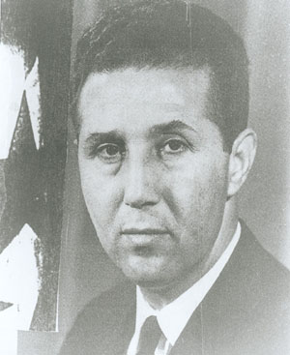
Algeria
Ahmed Ben Bella leader of the Algerian Liberation Front (ALF) & 1st President
Gained independence from France in 1962
Nationalist movement led to a fundamentalist Islamic movement (France is Christian)
Economic problems (high unemployment & inflation) after independence allowed the religious movement to continue

Slide 8
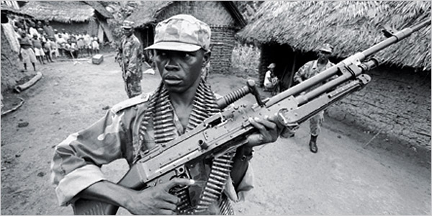

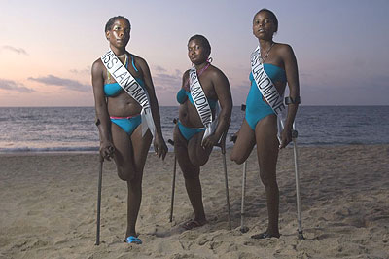
Angola
Gained independence from Portugal in 1975 after 25 years of war
Endured a civil war from 1975-2002, communist v. anti-communists (Cold War)
Vast mineral deposits & petroleum reserves but has a low life expectancy & high infant mortality rate
2008 elections were not open or fair

Slide 9

Nigeria
Gained independence from Britain in 1960
A series of military coups & ethnic rivalries in the 1960s led to a civil war
Nigeria joined OPEC in the 1970s & enjoyed an economic boom with the oil income
There have been several more coups during the 1980s & 90s
They have had peaceful transfers of power since 1999, but Islamic fundamentalists terrorize the country today

Slide 10

Rwanda
Rwanda was ruled by Belgium after WWI, the Tutsis (15%) were favored over the Hutus (85%) during this time
During the 1959 revolution the Hutus forced 300, 000 Tutsis out of the country, including the Tutsi king
General Habyarimana ruled as a totalitarian dictator from 1973 until his assassination in April 1994
A Tutsi led rebel group began a civil war in 1993
Between April & July 1994 over 800,000 Tutsis & moderate Hutus were slaughtered with machetes

Slide 11

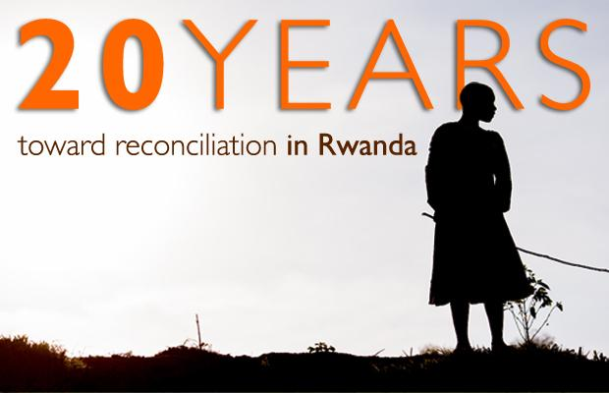
Aftermath of Genocide
The Rwandan government adopted a new constitution that follows a policy of “unity & reconciliation”
Adult males are only 20% of the population
42,000 homes are headed by children, some as young as 9 years old
There are 350,000 orphans, many due to the spread of HIV/AIDS during the rapes committed with the genocide

Slide 12
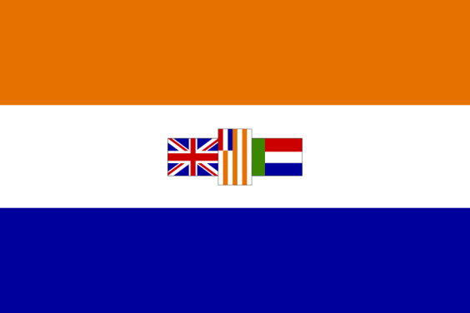

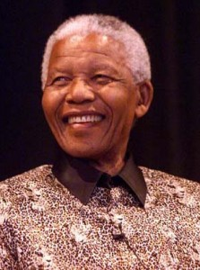
South Africa
Gained independence from Britain in 1931
The white minority controlled the government & denied basic rights to the black majority
Instituted Apartheid (extreme segregation) in 1948
The African National Congress (ANC) used violent & non-violent methods to achieve equality
Many ANC leaders were imprisoned including Nelson Mandela

Slide 13
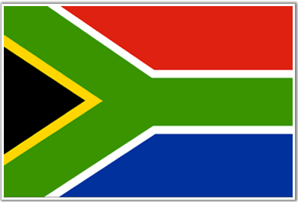
South Africa cont’d
Increasing protests & world pressure during the 1990s forced the white minority government to give up power
A new constitution was written & free open elections were held in 1994
Nelson Mandela was elected the 1st president of Post-Apartheid South Africa
South Africa currently faces severe economic problems and an AIDS epidemic

Slide 14

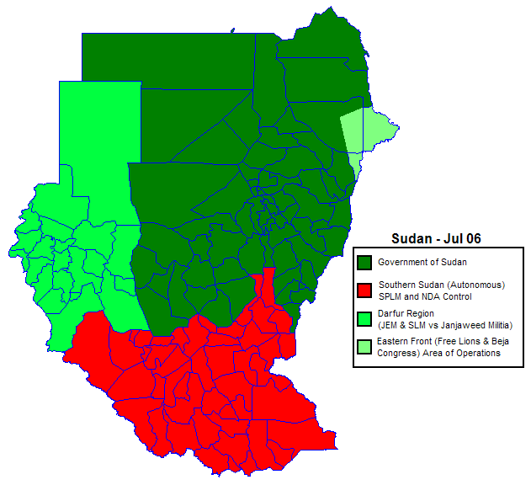
Sudan
Sudan achieved independence from Britain & Egypt in 1956
The 1st Civil War between the Muslim North & the Christian South lasted from 1955-1972
The 2nd Civil War began in 1983 and ended in 2004
The Darfur region began rebelling in the 1970s, the conflict was defined as genocide in 2004

Slide 15

Sudan cont’d
South Sudanese Independence Referendum was held in January 2011
The people overwhelmingly chose to become an independent nation
South Sudan will be a republic
Salva Kiir Mayardit is the first elected president of South Sudan

Slide 16
Summary
Colonialism created the problems Africa faces today
Current borders do not reflect cultural boundaries
Natural resources were exploited without developing an infrastructure
Weak educational systems did not prepare the population for independence

