Slide 1
Russian and Chinese Empire-Building [1450-1750]
AP World History Notes
Chapter 14

Slide 2
Making the Russian Empire
Russian state centered on the city of Moscow
Conquered a number of neighboring Russian-speaking cities
Continued to expand south and east of Moscow
Brought together a wide variety of different peoples and cultures

Slide 3
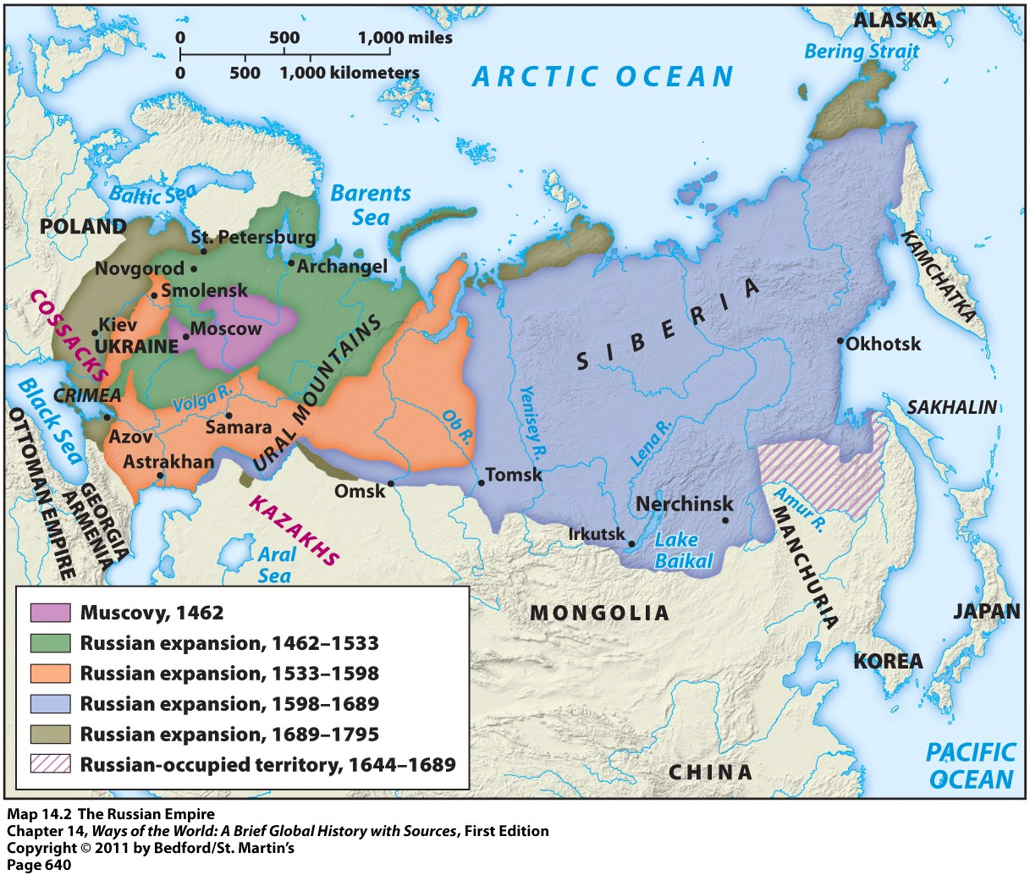
Making the Russian Empire

Slide 4
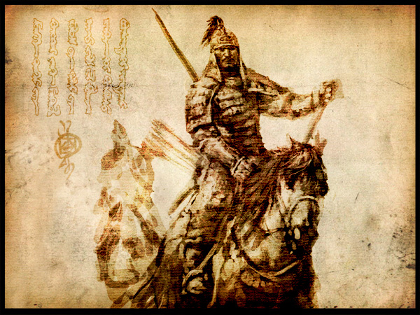
Motivations for Russian Expansion
Motivation #1 = security from the nomadic pastoral peoples
Lived in the grasslands south and east of the Russian heartland
Russians = afraid one of these groups will rise to power like the Mongols
These nomads frequently raided Russia’s neighbors and sold many of them into slavery

Slide 5
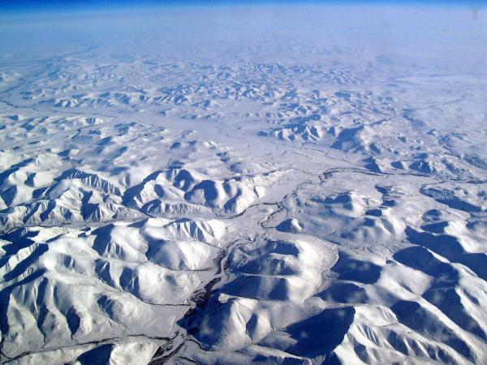
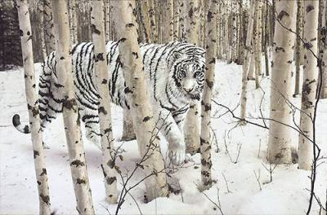
Motivations for Russian Expansion
Motivation #2 = Pelts of fur-bearing animals
To the east across the vast expanse of Siberia
Very valuable and in-demand item
Nickname = “soft gold”

Slide 6
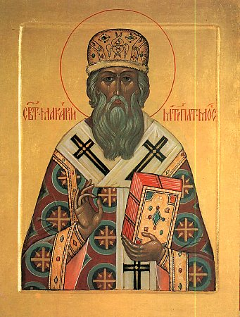
Russian Point of View
To Russians, their empire meant:
Defending the Russian frontiers
Enhancing the power of the Russian state
Bringing Christianity, civilization, and enlightenment to “savages”

Slide 7
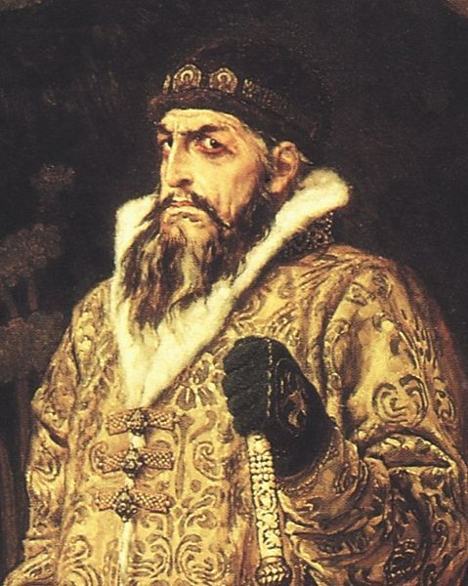
Life in the Russian Empire
Everyone had to swear an oath of allegiance to the grand tsar
Everyone had to pay yasak = tribute paid in cash or valuable goods
New diseases accompanied Russian conquest → ex: smallpox and measles
People felt the pressure to convert to Christianity
Tax breaks, tribute exemptions, and the promise of land if they did
Ivan the Terrible
Tsar of Russia (1533-1584)

Slide 8
Life in the Russian Empire
Huge influx of Russian settlers to conquered territories within the empire
Began to outnumber the native peoples
Ex: By 1720 = population of Siberia = 70% Russian and 30% native Siberian

Slide 9
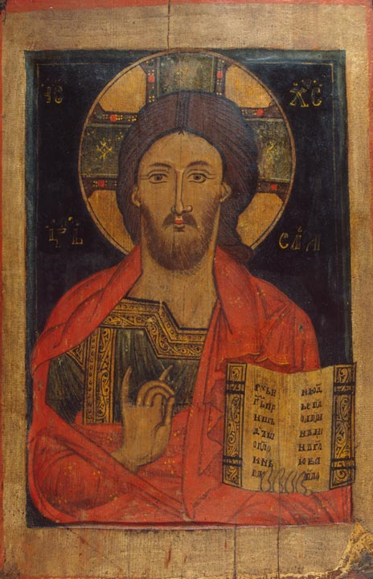
Life in the Russian Empire
Native peoples were “Russified” = adopted the Russian language and culture, converted to Christianity, gave up their traditional hunting & gathering lifestyle, etc.

Slide 10
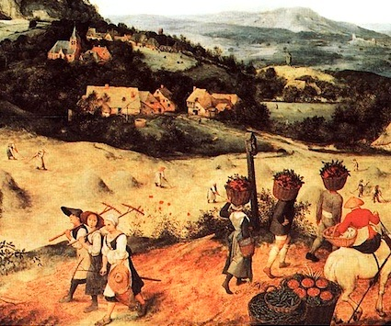
Impact on the Environment
Loss of hunting ground and pasturelands to Russian agricultural settlers
Result = native peoples became dependent on Russian markets for crops and luxury goods

Slide 11
The Russian Empire
By the 18th century = Russia became one of the great powers of Europe
Power stemmed from wealth found in: rich agricultural lands, valuable furs, and mineral deposits
Russia became a highly militarized state as well
Russian Empire stayed intact until the collapse of the Soviet Union in 1991

Slide 12
The Russian Empire
Established a tradition of autocratic government with a powerful monarchy
Belief = only a strong ruler could hold together such a large empire with such a diverse population
Ruled by monarchies until the early 1900s
Peter the Great
Reign: 1682 - 1725

Slide 13
Russian Empire vs. those of other Western European Countries
Russian Empire
Other Europeans
Acquired territories next to them that they had been in contact with for a long time
Acquired territories at the same time that a Russian state was taking shape
“Russia was an empire.”
Acquired territories far away from them that they didn’t know about until 1492
Acquired overseas empires AFTER establishing themselves as solid European states
“The British had an empire.”

Slide 14
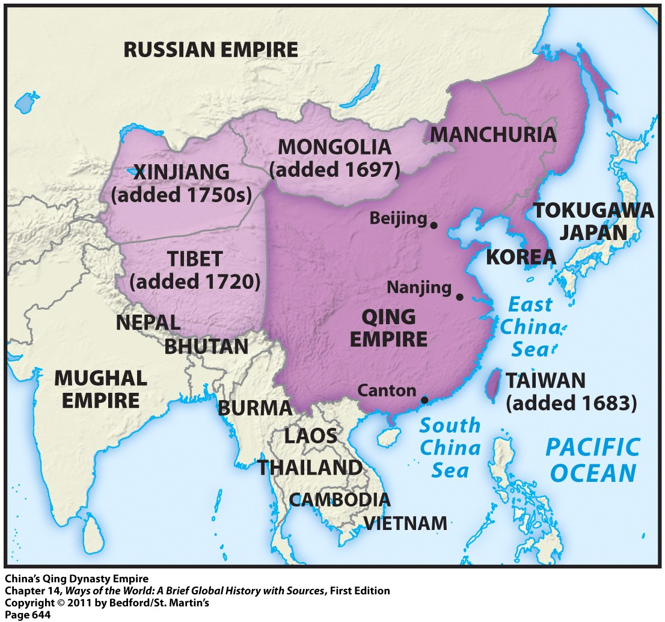
Making China an Empire
Done by the Qing (aka Manchu) Dynasty
Ruled from 1644 to 1912
Foreigners → invaders from Manchuria
Enlarged the size of China and incorporated a lot of non-Chinese peoples as they expanded to the north and west

Slide 15
Qing Rulers: Cultural Elements
Maintained
Adopted
Ethnic distinctiveness → forbade intermarriage between themselves and native Chinese
Chinese language
Confucian teachings
Chinese government techniques

Slide 16
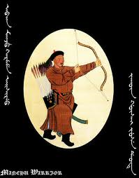
Making China an Empire: Motivations
Major motivation = security concerns
To China = expansion was viewed as a defensive necessity
Result = Qing dynasty China undertook an 80-year military effort (1680-1760) to bring together surrounding regions under Chinese control

Slide 17
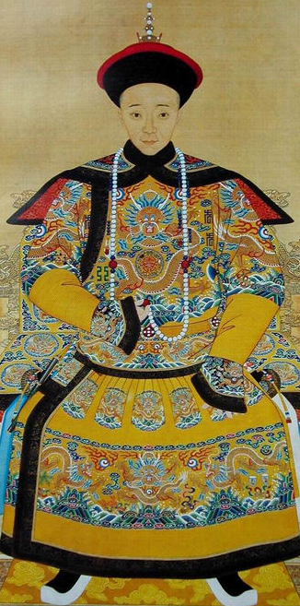
Life in the Chinese Empire
In general the Qing rulers:
Showed respect for other cultures
Did not force people to assimilate to Chinese culture
Chinese settlers did not flood the other regions of the empire
Yizhu = 8th Emperor of the Qing (Manchu) Dynasty

