Slide 1
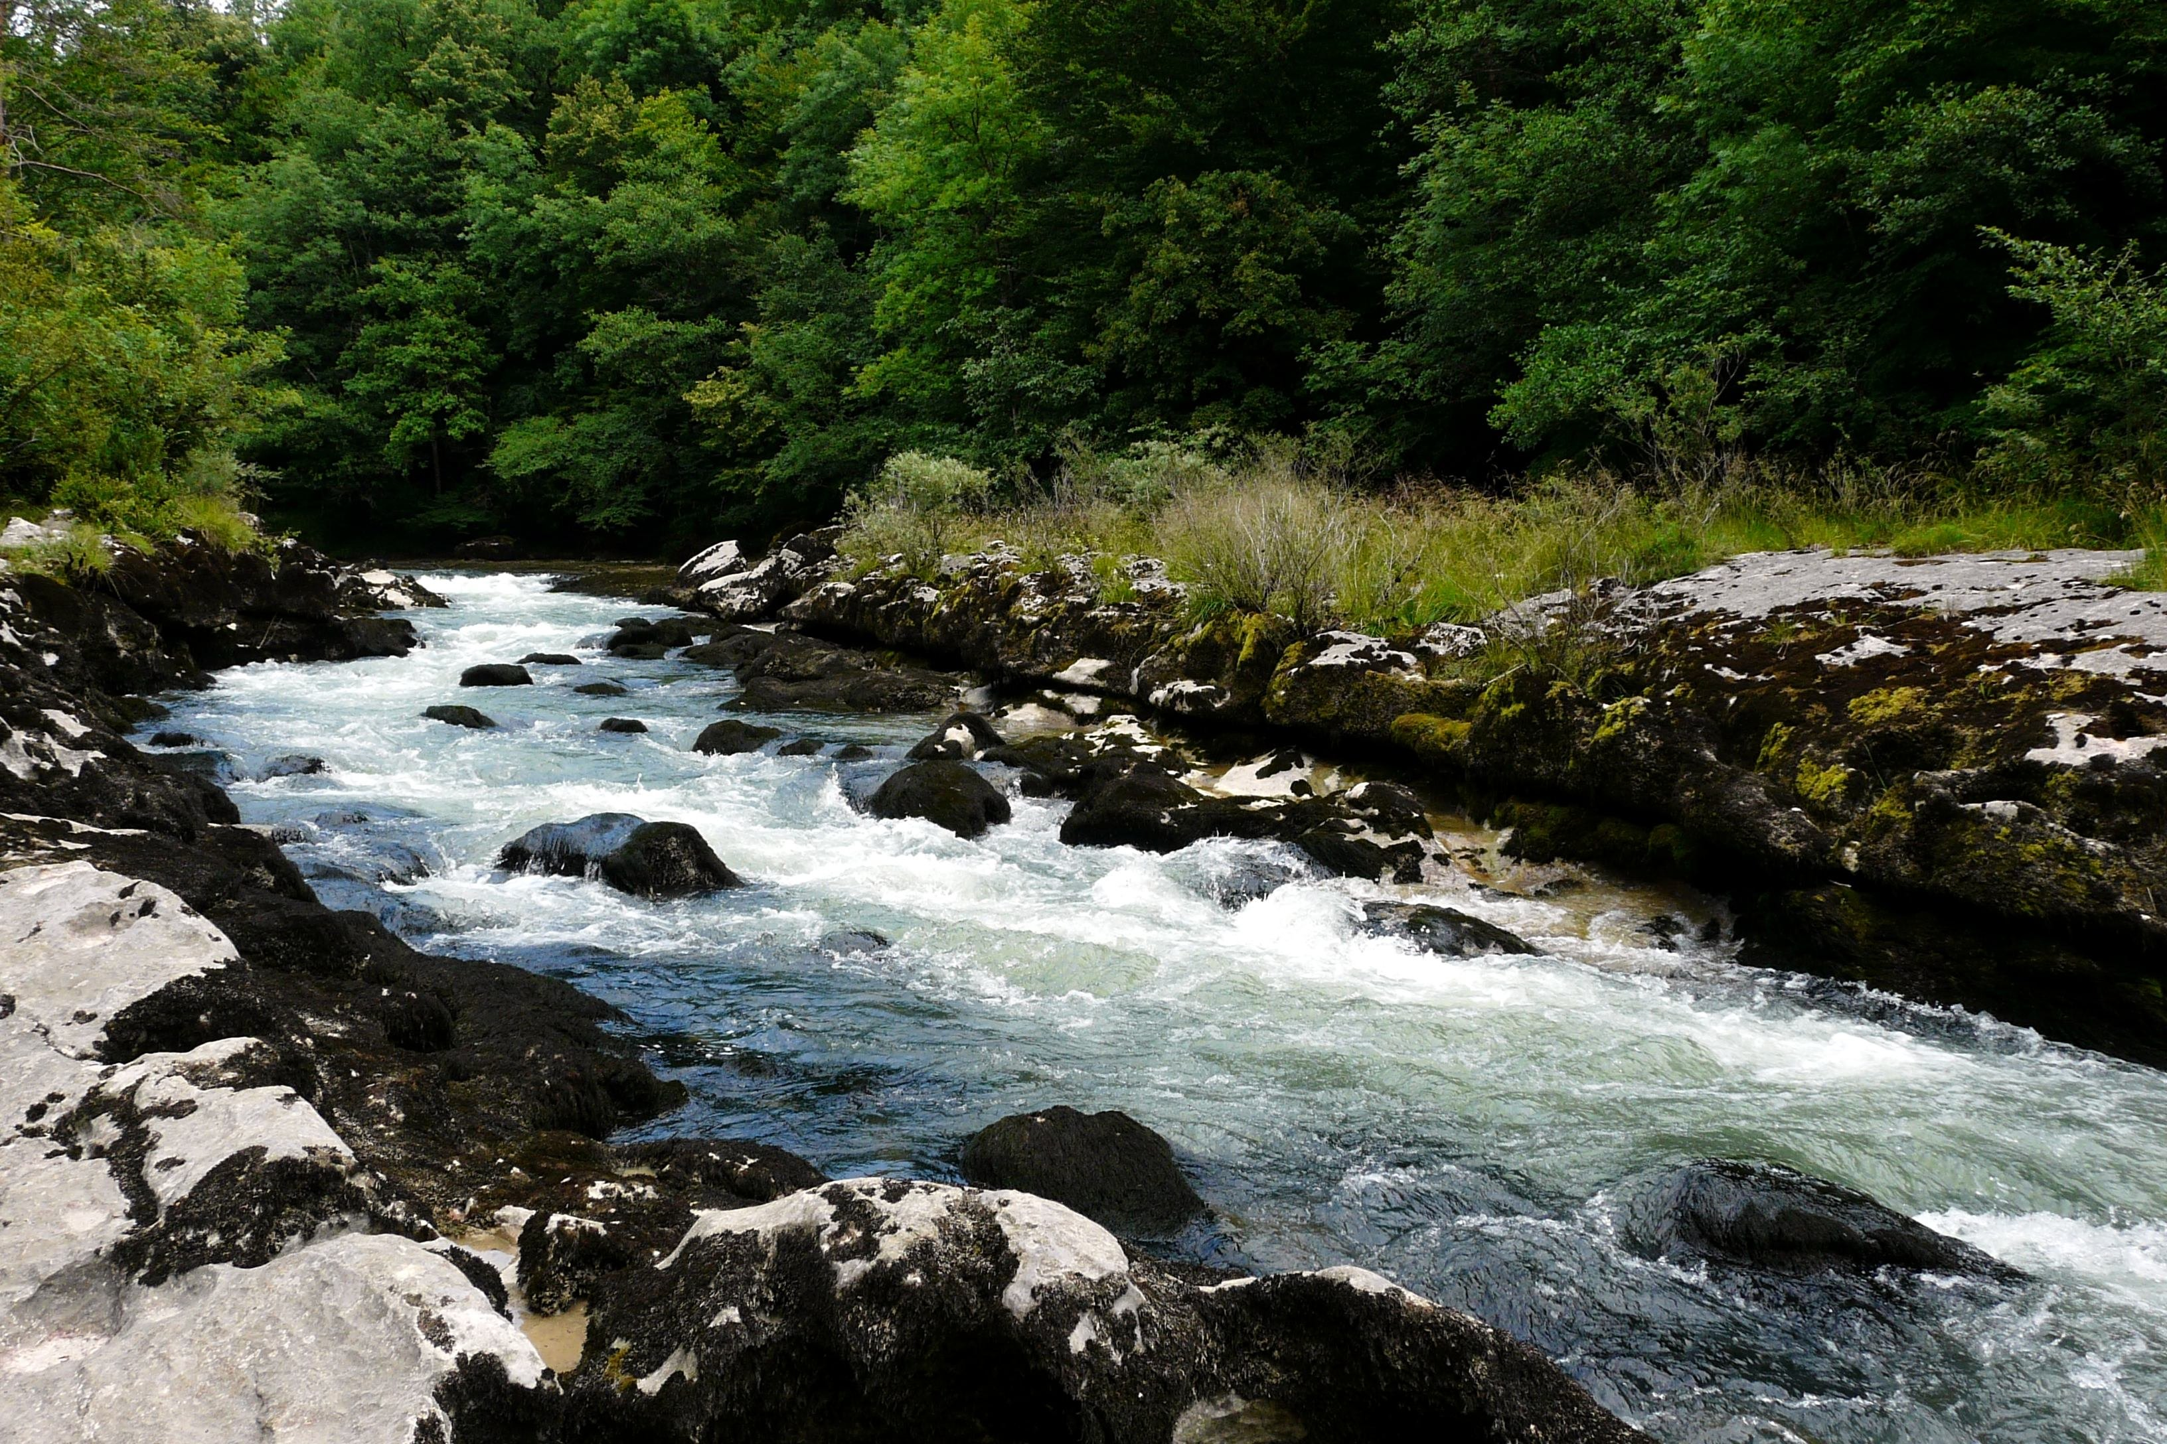
Environmental Engineer
Career Demand, Salary, and Education
Academy of Engineering

Slide 2
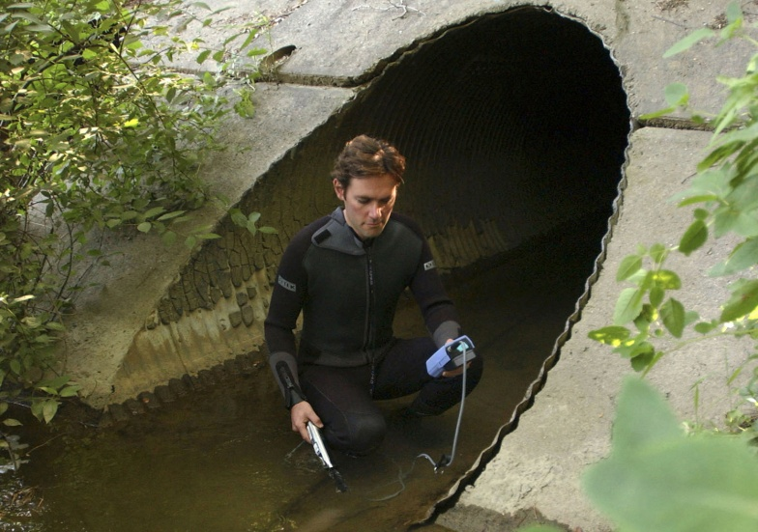
Demand for Environmental Engineers
-This field has taken off since the Clean Water Act (CWA) and Clean Air Act (CAA)
-Nearly 55,000 people hold jobs in environmental engineering, mostly in urban industrial settings
-There are current job postings in Rochester

Slide 3
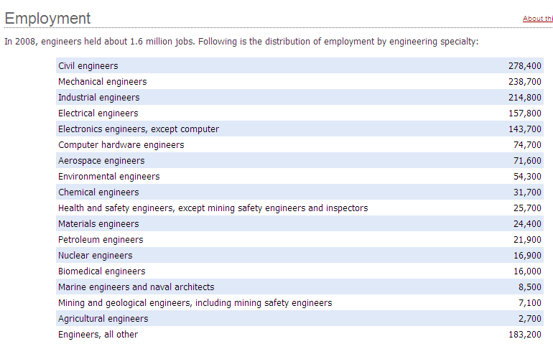

Slide 4
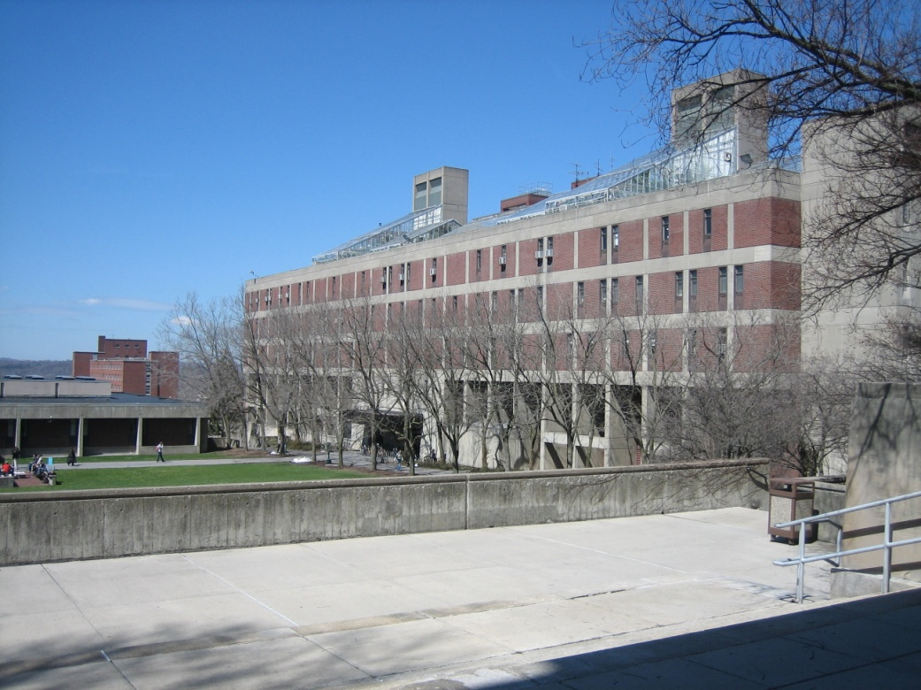
Education
-Many New York State colleges and universities offer environmental engineering, including:
-SUNY Environmental Science and Forestry
-University at Buffalo
-NY Institute of Technology

Slide 5
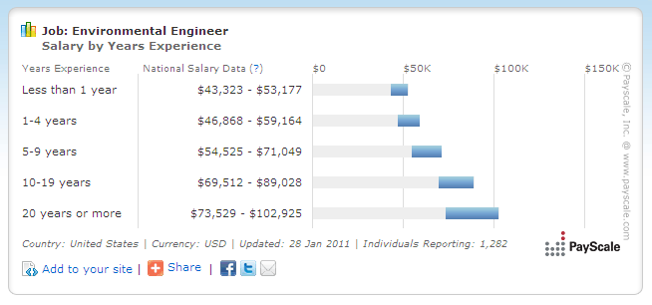
Salary
-Average Salary is between $50k and $75k
-Salary will steadily increase up to $100k or more with experience

Slide 6
Sources:
Bureau of Labor Statistics. (2010). Occupational outlook handbook, 2010-2011 edition.
Retrieved from: http://www.bls.gov/oco/ocos027.htm
Construction Weblinks. (2010). Colleges, universities, and libraries: environmental engineering.
Retrieved from: http://www.constructionweblinks.com/
Organizations/Colleges_and_Universities/Graduate_Programs__C
olleges__U/Environmental/environmental__graduate_program.html
PayScale. (2011). Salary snapshot for environmental engineer jobs. Retrieved from:
http://www.payscale.com/research/US/Job=Environmental_Engineer/Salary

