Slide 1
Agenda
Have out Nixon reflection writing to check
Gerald Ford notes and video clips
Jimmy Carter notes and video clips
Iran Hostage Crisis reading & questions
Daily Reflection Writing

Slide 2
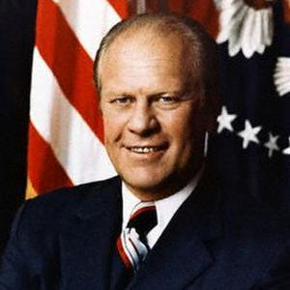
Gerald Ford

Slide 3
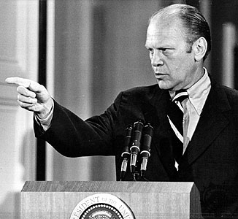
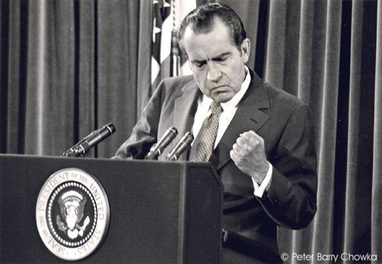
1974 - Ford Pardons Nixon
Pardoned Nixon for any crimes committed while in office
  Pardon = official forgiveness
Ford hoped to heal the nation, but his move further divided the country
  Some believed he had cut a deal with Nixon. Ford denied the allegation.
Notes:
Left picture - link

Slide 4
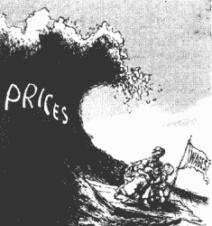

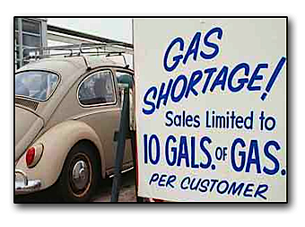
1974 - Economic Troubles
Inflation and unemployment were high
  Inflation = rising prices on goods
Ford tried to fix it by cutting spending and encouraging America to be less dependent on foreign nations for goods and oil
  “Here is what we must do, what each and every one of you can do: To help increase food and lower prices, grow more and waste less; to help save scarce fuel in the energy crisis, drive less, heat less.”
Notes:
Left picture - link

Slide 5
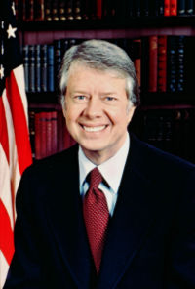
Jimmy Carter

Slide 6
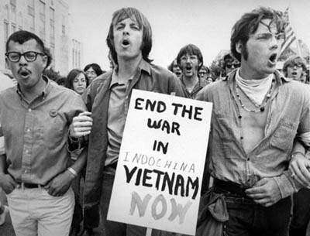
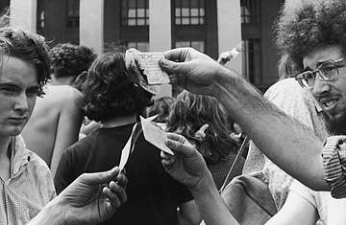
Draft Dodgers
Carter offered a full pardon to everyone who had avoided the Vietnam War
  Some people saw this as an apology for an unjust war
  Others saw it as disrespectful to the men who did serve
Notes:
Left picture – Link

Slide 7
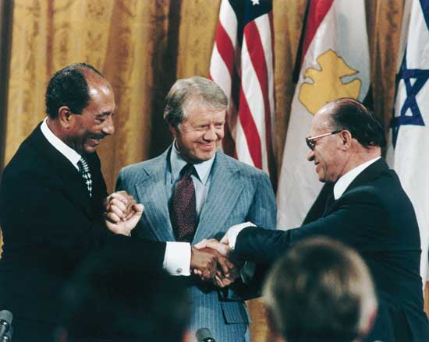
1978 - Camp David Accords
A series of meetings between the leaders of Egypt and Israel
Intended to bring peace to the Middle East
Established an alliance between Israel, Egypt, and the U.S.
Notes:
Picture - linked

Slide 8
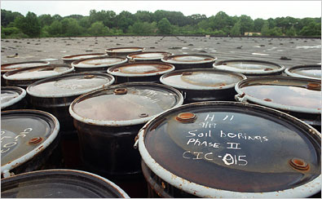
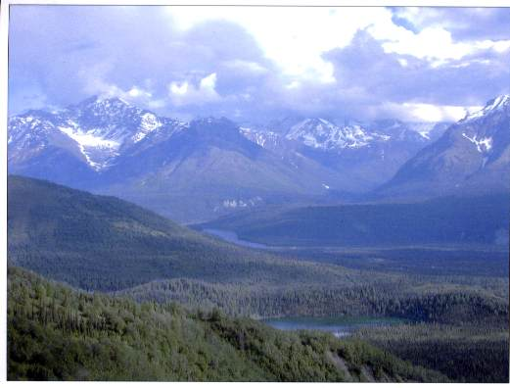
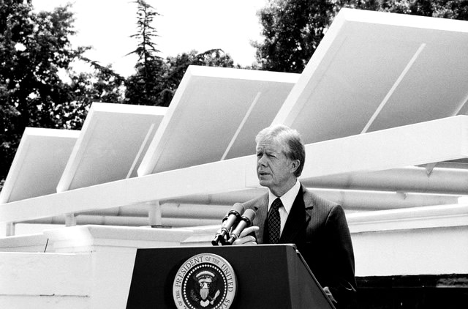
Environmental Protection
Created programs to clean up toxic waste dumps around the country
Installed solar panels on the White House roof
Created the protected wilderness areas in Alaska

Slide 9
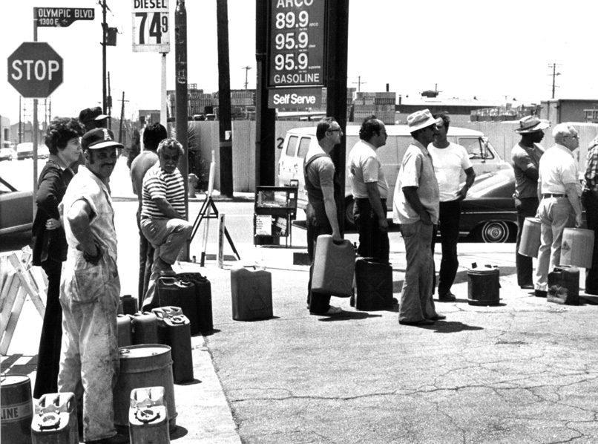
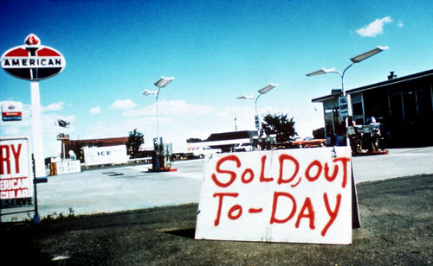
1979 - Oil Crisis
OPEC (Organization of Petroleum Exporting Countries) cut off America’s oil supply
Gas and heating prices went up
America experienced an “energy crisis”
Notes:
Right picture - link

Slide 10
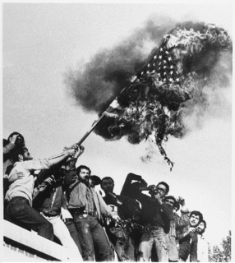
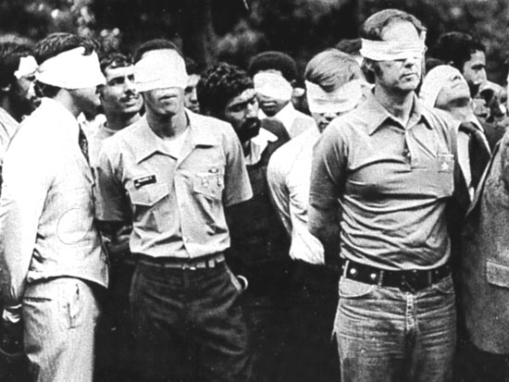
1980 - Iran Hostage Crisis
Iranian militants stormed the US Embassy in Tehran as protest against US influence in Iranian affairs
52 Americans were held hostage in Iran for over a year
Notes:
Right picture - link

Slide 11

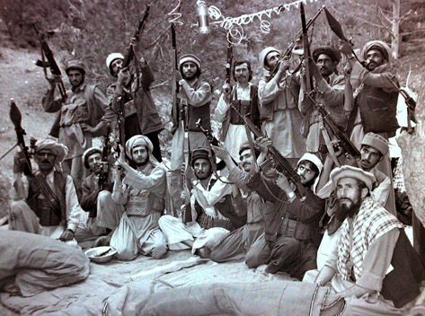
1980 - Olympic Boycott
Russians invaded Afghanistan
In protest, Carter decided America will not participate in the Moscow Olympics
Only American boycott in Olympic history

