Slide 1
Early Reform Movements
1830-1900

Slide 2
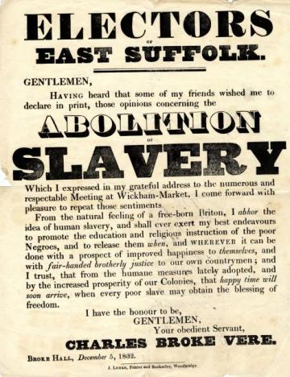
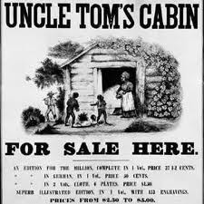
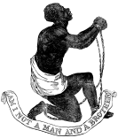
Abolition Movement
Wanted to end slavery
Wanted to free current slaves and end future enslavement
Many believed it was morally wrong and violated human rights

Slide 3
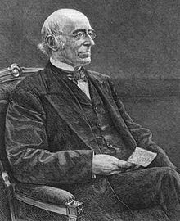
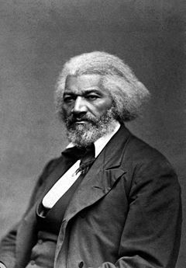
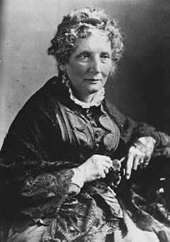
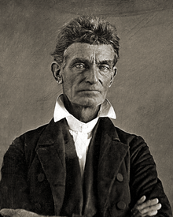
Abolitionists
Started Amer. Anti-Slavery Society
Wrote “The Liberator”
Wrote about his slave experiences
Published “The North Star”
William Lloyd Garrison
Frederick Douglass
Wrote “Uncle Tom’s Cabin
Supported Underground Railroad
Led raid at Harper’s Ferry
Tried to prevent capture of slaves
Harriet Beecher Stowe
John Brown
Notes:
William Lloyd Garrison –founded American Anti-Slavery Society; founded anti-slavery newspaper “the Liberator”; demanded “immediate emancipation”
Frederick Douglass – former slave; wrote books about his experiences as a slave; published “The North Star” anti-slavery paper; met with Abraham Lincoln about treatment of black soldiers during Civil War; buried in Mount Hope Cemetary in Rochester
Harriet Beecher Stowe – wrote “Uncle Tom’s Cabin”, supported Underground Railroad
John Brown – worked to prevent slaves’ capture after Fugitive Slave Act was passed; led anti-slavery massacre during “Bleeding Kansas”; led raid on Harper’s Ferry in attempt to start armed slave revolt – was later tried for treason and hung.

Slide 4
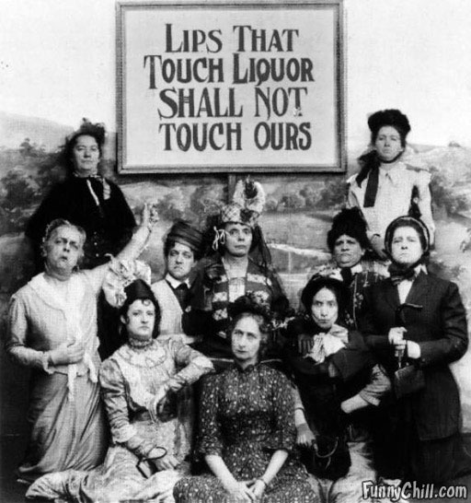
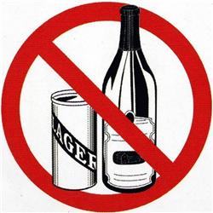
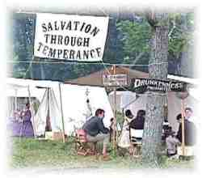
Temperance Movement
Wanted to make alcohol illegal
Believed alcohol hurt people physically and mentally
Blamed alcohol for the breakup of families
Thought that poverty was caused by alcohol

Slide 5
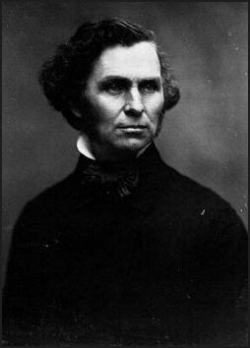
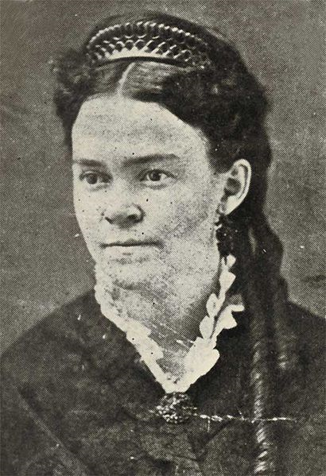
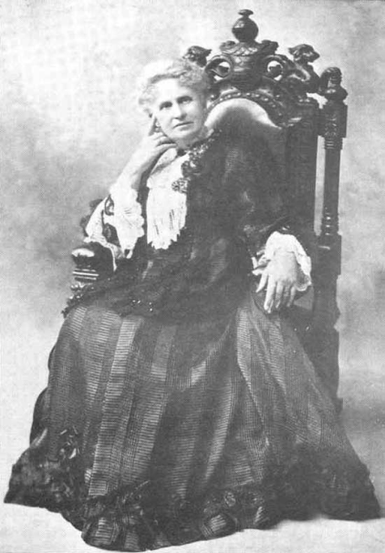
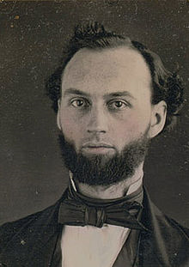
Temperance Leaders
Mayor of Portland, ME
Passed law making Maine a dry state
Support through vandalism
Attacked bars w a hatchet
Neal S. Dow
“Napoleon of Temperance”
Carrie Nation
Mary Hunt
Henry Cogswell
Cold drinking water = no desire for alcohol
Built drinking fountains across US
Women’s Christian Temperance Union
Schoolbooks should teach about abstinence and prohibition
Notes:
Neal Dow – mayor of Portland, Maine; helped pass one of the first laws in the nation making Maine a dry state
Carrie Nation – known for her support of the movement through vandalism – she would enter places that served alcohol and attack the bar with a hatchet
Henry Cogswell – originally a dentist; believed that if people had access to cold drinking water, they wouldn’t want to drink alcohol; wanted to build one public drinking fountain for every 100 saloons across the US (5 still stand; 7 were torn down – including ones in Rochester and Buffalo)
Mary Hunt – Superintendent of the Women’s Christian Temperance Union; wanted laws passed that would ensure that textbooks teach every school child about abstinence and alcohol prohibition

Slide 6
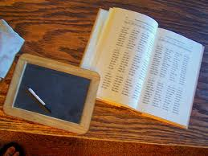
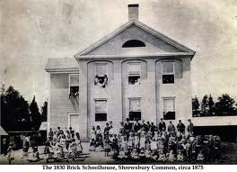
Educational Reform
Wanted free, public education for all
Fought for specialized schools for students with disabilities

Slide 7
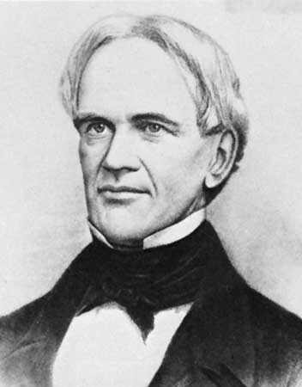
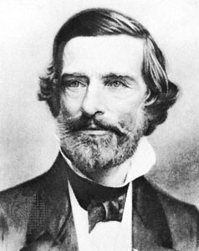
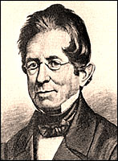
Important educational reformers
<-- Free public education across the country
Dr. Samuel Gridley Howe
Thomas Gallaudet
Horace Mann
<-- School for the blind
School for the deaf →
Notes:
Horace Mann – fought for free public education across country (it was only in NE)
Dr. Samuel Gridley Howe – started a school for the blind in Boston, MA
Thomas Gallaudet – Started school for the Deaf in Hartford, CT

Slide 8
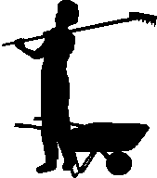
Muckrakers
Journalists who exposed corruption in business and politics
Helped the public see what was going on so that people would fight for change

Slide 9
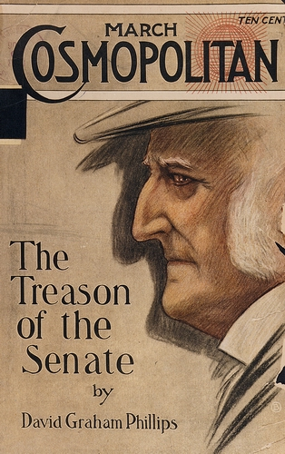
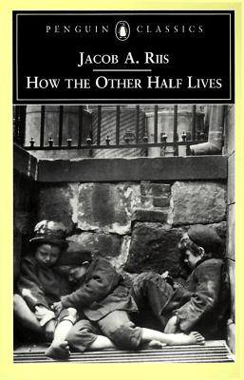
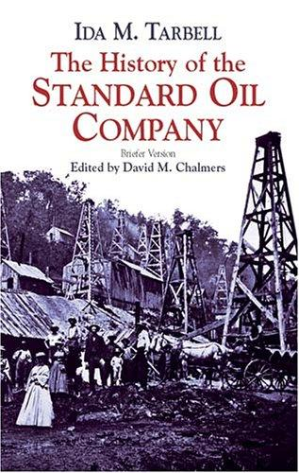
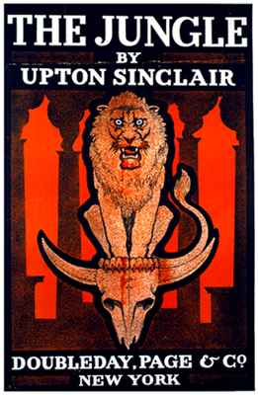
Important Muckraker Publications
US Senate was corrupt →
Immigrants lived in bad conditions →
<-- Shady business by Rockefeller
<-- Meatpacking industry was gross
Notes:
The Jungle by Upton Sinclair – exposed the unsanitary conditions of the meatpacking industry in the US. Led to passage of Meat Inspection Act and Pure Food & Drug Act.
Treason of the Senate by David Graham Phillips – exposed corruption in the US Senate. Led to 17th Amendment (direct election of US Senators).
History of the Standard Oil Company by Ida Tarbell – exposed the shady business practices of John D. Rockefeller’s Standard Oil Company
How the Other Half Lives by Jocob Riis – described the poor living conditions of immigrants in NYC slums

