Slide 1
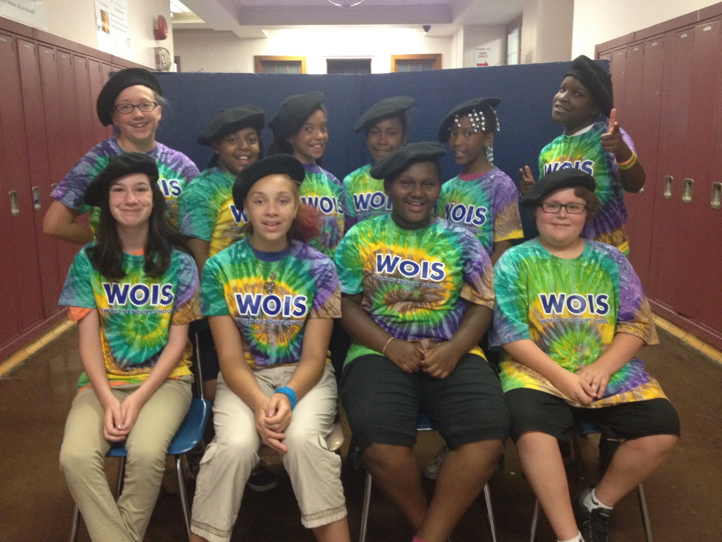
The Poets at Heart Crew
June 18th, 2014

Slide 2
IF YOU SHOW A TEEN CARIBOU THE NORTHERN LIGHTS
By Arabella Ashford
OMG!!! It’s the amazing Northern Lights!!
EEEEEE!! They are so shiny!!
I'm gonna go say hi!!
I hope it hears me!
“Um, hi!! I'm Bella the Caribou...Um, bye!!”
That was awesome!
I think it went well!
Its beautiful!
SOOOO colorful!!!
It has purple, and crisp white, and royal blue, and yellow.
And its BRIGHT!
Its SOOO BRIGHT!
Brighter than anything I've EVER seen before!
OH NO!!
Where did it go?!
The wild dancing lights are GONE!!
Oh well...

Slide 3
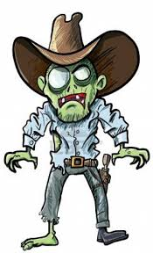
THE END OF THE WORLD
By Arabella Ashford
Apple eating apes attack antelopes.
Badgers! Banging on the big door with huge hammers.
Can't help but be terrified.
DANGER!! DANGER!!
End is near...the end is near...
Find my family...
Getting tired, a little too tired...
Help! Help!
Idiots are cluelessly walking among zombies!
Just stay calm...
KEEP CALM!!!
Leave me be cannibals! Leave me be! MOMMA! I found you!!!
Now let's go find Carlie.
OMG! Where is she?
Pineapple picking possums named Penelope pretend to be pigs.
Questions...
Remember that this is all going to be ok...
Sorry, I lied! Zoo animals in the streets.
The zoo keepers are horrible at their jobs.
Unusual green, slimy goop...
Very sticky...
Wet and disgusting!
X-ray vision suddenly takes over.
YOU! HEY YOU! I need some help!
ZOMBIE!!!!!!RUN!!!!!!

Slide 4
The Turkey
By Arabella Ashford
Tom the tiny turkey
Watched the tall farmer
On that horrible Thanksgiving Day.
As the farmer approached,
Tom attempted to run until the farmer grabbed him by the neck and…
Gave him a HUGE hug!!!!!

Slide 5
THE FAST TRAIN
By Harrison Davis
I boarded a train that was the fastest in the world!
When I sat down in my seat,
an attendant came over to me
and asked me if I had life insurance!
When the train started moving,
5 seat belts automatically strapped onto me!
The train went so fast that
the skin on my face flapped around my head!
A sign in front of me said, “Reaching Medium Speed”!
The train gathered speed as I looked out my window
and saw we had gone so fast,
all I could see was streaks of green and light blue!
My vision turned blurry and suddenly
BOOM!!!
We were at the train station.
I got out of the train and went into the closest bathroom.
I looked in the mirror and realized
I got a free facelift!!!

Slide 6
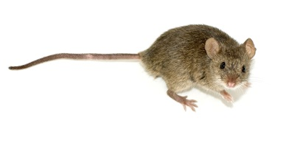
The lurking predator stalks its gray, tiny prey.
the game gradually goes backwards,
as it begins to twitch with fear.
The orange tabby’s tail ticks to and fro with impatience.
It jumps and SNAP!
The cat walks away with a mouse in its jaws.
By Harrison Davis

Slide 7
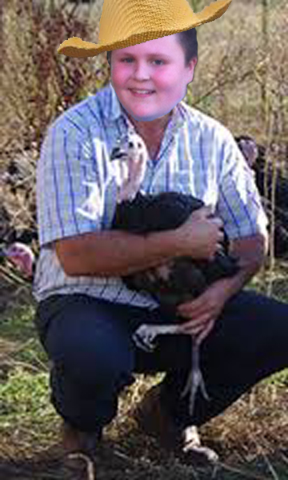
MY TURKEY LIFE
By Harrison Davis
I was trotting along the barn's perimeter,
While thinking about Thanksgiving.
I hoped my parents would stay safe this November,
And they would not become the un-living.
My friends told me that Farmer Brown
Took five turkeys, no matter the size.
He would tell those unlucky turkeys they would be alright
But everything he told them would be nothing but pure lies.
He would take a pot of boiling water
And one by one he dropped them in.
And by our turkey religion
Harming a turkey is considered a sin.
He would pluck their magnificent feathers
And put those turkeys in the oven to bake.
You know what?
It’s just too much for me to take!
I heard some footsteps following me
And as I turned around
Farmer Brown's hands curled around my head
And suddenly I could not hear a single sound.
My chest swelled up.
And my heart began to race.
I moved my head so I could s
ee Farmer Brown
And I could not believe the mischievous smile on his face.

Slide 8
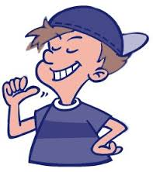
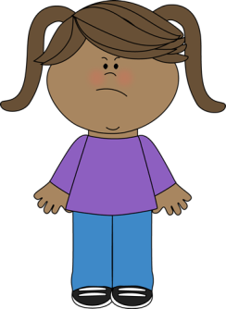
Boys are Annoying!
By Aaniyah Simmons
Boys are so annoying!
For starters, they make farting noises
and laugh about it – Ewwwwwww!
Then, they burp
and don’t use any manners.
On a scale from 1-10,
I am at 2 and when I get to 10,
I am gonna die.
Oh where were we…
Oh yes, and boys
always be calling you names -
Just breathe Aaniyah, breathe!
They always have competitions
Just give it a rest!
They compete for whose shoes look better.
Give it a BREAK!
And I’m now at 5
so soon I’m gonna blow!
They drill you all the time.
They act crazy.
They think they’re handsome.
Does anyone have a bag?
They touch you all the time!
Just leave me alone please.
But no, they keep talking to you -
OH GOD I’M FEELING DIZZY!

Slide 9
WHAT DID I DO?
By Aaniyah Simmons
What did I do to deserve this?
Here are all the things I did today:
1. Punched Skye in the face,
2. Kicked Selah in the gut,
3. Called Harrison bad words,
4. Told Melanie that she coughs like a goat,
5. Gave Janihya 1,000 dollars (which I stole out of the bank),
6. Made Arabella cry,
7. Inspired Maya to love to drill people,
8. Hung Kasim's pants from the ceiling,
9. Pushed Katie out the window,
10. Told Ms. Martin she was the best teacher in the world.
But they sent me to jail anyways.
lucky I got out, but in my defense
what did I do?
You all asked, “Why you do this?”
but not Maya,
she said, “Thank you.”

Slide 10
OPPOSITE RAINBOW
By Aaniyah Simmons
Red is for Miss Martin's red water bottle that she got red paint ALL over,
Orange is for the orangutan that Janihya tickled. Or not.
Yellow is for the sun that Skye stole and went to jail for.
Green is for the Mountain Dew that Kasim took and got in school suspension for,
Blue is for the sea water that Harrison drank and is now banned from drinking ever again.
Purple is for the flowers that Arabella ate and now has to stay in her house on house arrest.
Pink is for when I took the pink pen and got a round of applause for the pretty poem I wrote.

Slide 11
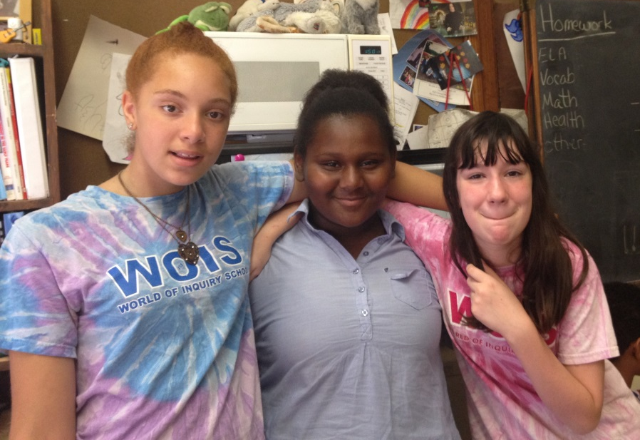
IRREPLACEABLE
By Selah Jackson
My friend and I, we're super close
it's always cute, and never gross!
This may seem weird, and somewhat twisted -
but we were enemies and our friendship fixed it!
And that just shows that with some heart,
magically a friendship can start.
And that friend became...
Irreplaceable!

Slide 12
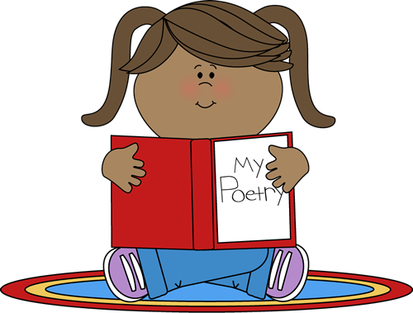
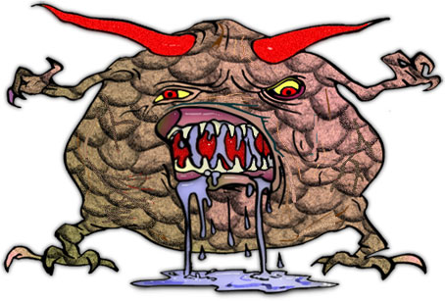
POETRY!
By Selah Jackson
Poetry is like reading a book;
quiet and calm and peaceful,
Poetry is like visiting a new country-
seeing beautiful sights and exploring new things.
Poetry is a huge monster standing right behind you,
drooling on your shoulder.
Poetry is as shiny as a shimmering jewel
sitting in the sun’s beams shining on Earth.
Poetry is my parents; kind, thoughtful,
And always caring about me!!!

Slide 13
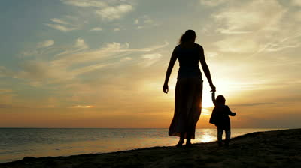
YOU ARE MINE!!!
By Selah Jackson
Ever since birth I've been by your side
I love you to death, and till death do we part
I promise nothing will tear us apart
and if the time comes when we descend
I swear I will fight for you till the end
for you and I are one
for I am the one you came from
and with that you are mine

Slide 14
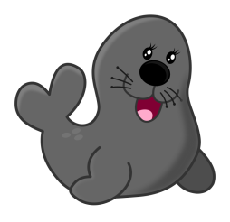
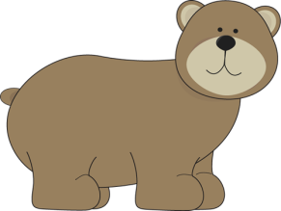
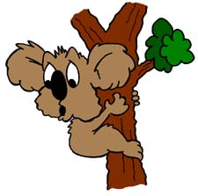
My Poetry Club Friends
By Katie Schall
I am a kooky kangaroo eating candy koalas.
Selah is a sassy sea lion swimming in a salty sea.
Bella is a brutal bear…RAWR goes her beastly bark.
Harrison is a happy horse hiking the Himalayas
Aaniyah is an awesome ant annoying other animals.
Maya is a marvelous mongoose mingling with monkeys.
Daja is a dancing dandelion declaring her decision.
Janiah is a jumping jaguar joining juggling jelly fish.
Skye is a singing salmon sassing Selah.
Ms. Martin is a mighty moose muttering malarkey.
Kasim is a kooky koala cooking kangaroos… wait what?
They are all my frothy friends, frolicking in forget-me-nots.
I am grateful to have them.

Slide 15
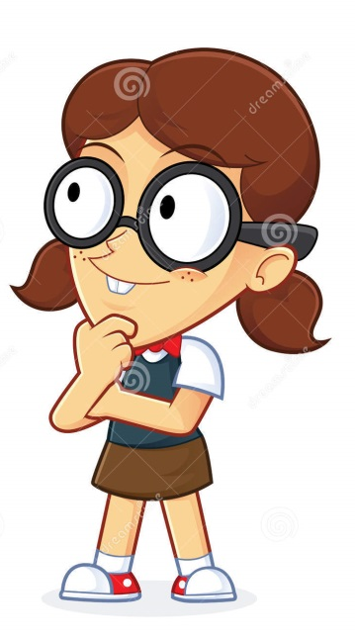
Children
By Katie Schall
What if crazy children took over the world?
That would be super awesome!
What if Arabella became president?
We would probably have even more freedom to be crazy!
What if I became principal?
We would have better lunches.
What if Harrison became an amazing software developer?
We would have much better technology!
What if Selah became an author?
The books would be gross, but awesome!
What if Maya became a Mayan Princess?
Ms. Martin would worship her!
What if I ran out of “What if’s”?
OH NOOOOOOO!

Slide 16
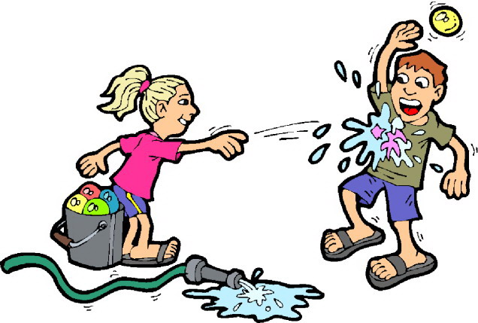
My Prank
By Katie Schall
Tip-toe…tip-toe…goes my sneaking…. Shhhhhhh.
Drip…Drip goes the hot water balloons in the bucket.
Tick….Tock..goes the awaiting clock…waiting for ‘them’,
Whisper…Whisper….goes the victims. Shhhhhh.
SPLASH! BOOM! Goes the balloons falling on my friends’ heads!
Pitter patter goes their running feet. Pitter patter, SPLASH!
I got my revenge. MWUAHAHAHAHAHA!!!!! *Cough Cough*

Slide 17
The Fruit Colors of the Rainbow!
By Skye Ellison
Red is the skin of a sour apple
Orange is the juice that pours out of an orange
Yellow is the peel of your banana
Green is the juicy grapes fresh from a vine
Blue is the tangy blueberries you eat
Purple is the plum you pick off of trees
The colors of fruit in the rainbow!

Slide 18
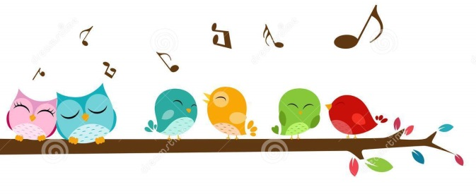
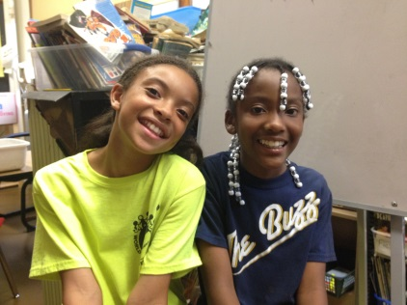
POETRY IS...
by Skye Ellison
Poetry is holding & cuddling a bundle of love.
Poetry is bright blue eyes looking at me!
Poetry is beautiful singing birds in the trees.
Poetry is ice cream that's covered with chocolate fudge spilling over the top.
Poetry is a colorful rainbow flowing through the sky.
Poetry is a beautiful girl named Skye giggling with her little brother, Elijah!
Poetry is a sweet little sister Janihya,
Poetry is a funny girl Nazaria, who makes me laugh all the time,
Poetry my caring family, who love me!
Poetry is you!

Slide 19
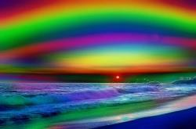
The flowers in the flowing garden
so pretty in the yard
make me think of the rainbow in the sky
when the rain pours down.
The bold wonderful colors make me
think of the glowing sunset
Roses are my favorite flowers.
By Skye Ellison

Slide 20
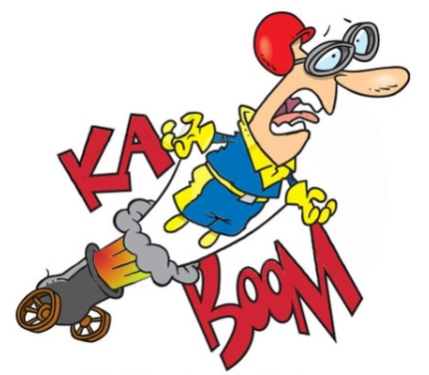
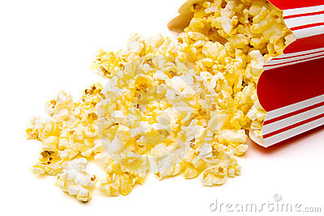
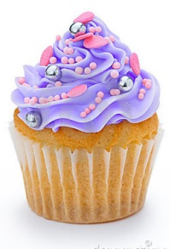
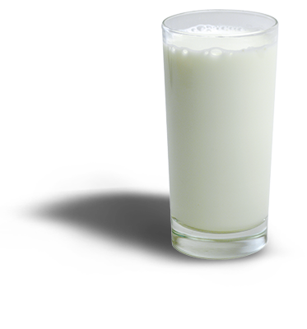
Poetry
by Kasim O’Meally
Poetry is a sweet vanilla cupcake, - Sugar!
Poetry is stinky, soggy milk ready to decay – Yuck!
Poetry is an avalanche of buttery popcorn - Yummy! Yummy!
Poetry is dancing with dragons old-school style - Whika, whika, fresh!
Poetry is a stuntman doing his job really, really well - Cool!

Slide 21
TECHNOLOGY IS AWESOME
By Kasim O'Meally
Taking science to the next level – tech = interesting future
Everything is fast like light speed
Cool games are the boss, thanks to conventions
Happy music like “Happy”
New ways to fascinate mankind
Odd errors – I know right
Loaded streaming including Netflix
OMG hoverbikes!
Google - Addicting
Yahoo – Says it all!
Innovating - innovative
So awesome - very
Apple – crank it up!
Windows – woo hoo
Entertainment
Super -games
Oh My Gosh, free apps
Marvelous Microsoft – computer kings
Everest heights

Slide 22
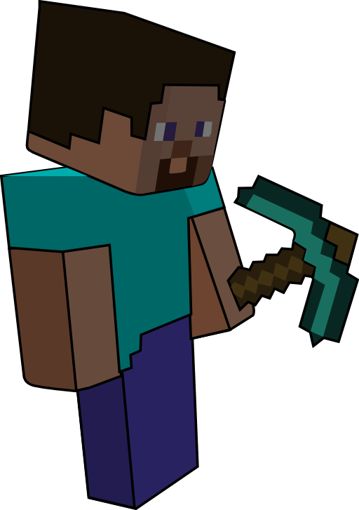
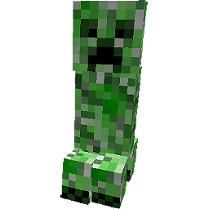
REVENGE ON CREEPERS!!
By Kasim O'Meally
Everyone who plays Minecraft hates creepers,
the scary monster acts like a reaper,
now, I have a solution
an awesome solution.
Read this and it'll change your life.
Craft a bow so it will shoot like a pro.
Turn up! Turn up!
Enchant your old diamond sword.
and it will attack like a dragon!
Then, get the peeper creeper. Woo hoo!
If there are more mobs, run and block with your sword,
Run for your life!
Especially if they're furious skeletons,
now you can kill creepers like you mean it.

Slide 23
WASHING MACHINE
By Maya Waller
Thoughts
Feelings Life
Schoolwork
Style Looks
Questions
Who do I want to be?
Where will I end up?
Dreams
Good and Bad
Friends
Come and Go
Parents Siblings
Its collapsing
Its all whirling around me
It repeats and repeats
But never stops
What is it like to be grown up?
What is this?
Its like a washing machine
Inside my head

Slide 24
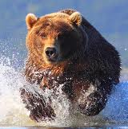
CHARGING PEACEFULLY
By Maya Waller
Splash, Splash!
Splashing crystal white
and royal blue water
drip, drop
Damp, muddled fur,
soaked, shaggy paws
Charging through
the crisp droplets of water
Dark, beady eyes staring me down
Yet with a curious look in them
Big black nostrils sniffing me out
Charging at me like he wants me deceased
but gracefully he's coming
Charging peacefully.

Slide 25
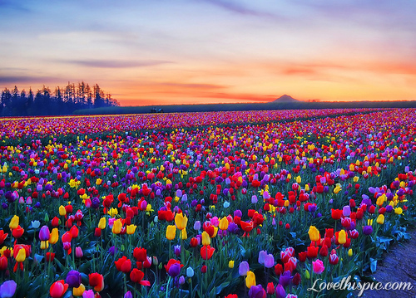
Tulips
By Maya Waller
Red, purple, orange,
pink, white, and tie dye
many, many, many, many different colors.
They all stand so tall -
they are a river of colors
coming together to stand for their rights.
So common, yet so special.
You can get tied up in their still lives
Just being how they want to be.
The rows and rows are almost one
but each one is unique.

Slide 26
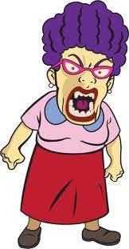
How to Make Your Teacher Mad
By Daja Weathers
First, make clock noises during math,
Tick tock tick tock
Then, break her favorite teacher’s mug,
I mean smash it, SMASH IT!!
Also, tap your pencil on your desk,
But blame it on your best friend,
Then throw spitballs at your teacher,
Then scream, “I’M A BOSS!” in library.

Slide 27
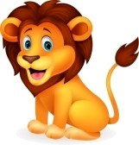
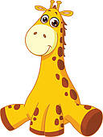
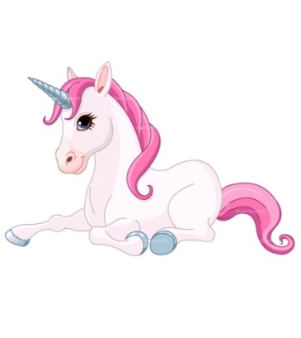
How to Convince my Mom to get a Giraffe
By Daja Weathers
First, I will clean up my room,
Then buy her a spectacular gift
I will sprinkle a pinch of love on top
Next, let it melt until
her heart heats up
If it still does not work
I'll ask for a loving lion
If that still does not work
I'll ask for a unique unicorn
Add a little bit of begging, and begging,
and begging, and begging some more.
Then you might just end up with a
gigantic giraffe in your back yard!

Slide 28
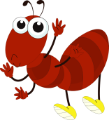
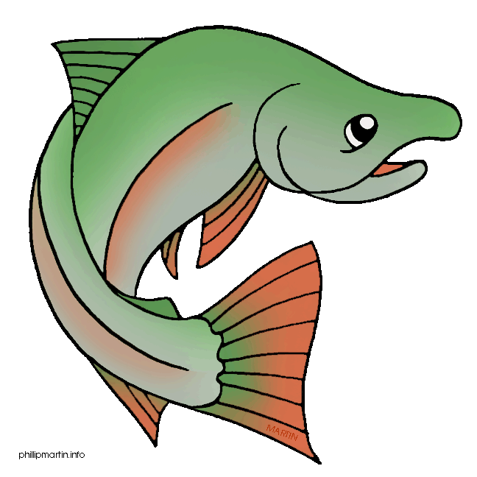
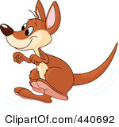
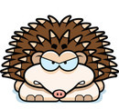
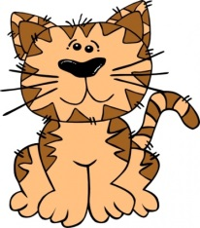
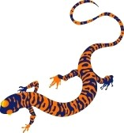
What if…
By Daja Weathers
What if Arabella turns into an ant?
I would smash her!
What if Ms. Martin turned into Mountain Dew?
I would gulp her down!
What if Selah turned into a slimy salmon?
I would feed her to the sea lions!
What if Katie turned into a kangaroo?
I would have a hopping contest I would obviously win, BOO YA!
What if Harrison turned into a mean hairy hedgehog?
I wouldn’t mess with him!
What if Kasim turned into a cuddly cute kitten?
I would introduce him to the neighbor’s dog.
What if Maya turned into a muskrat?
I would feed her to Katie the Kangaroo.
What if Skye turned into a salamander?
I would drop her and run!

Slide 29
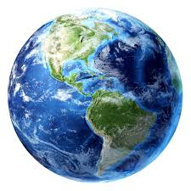
EARTH
by Janihya Thornton
Earth is so beautiful.
It’s special to me,
I wish I owned it.
It is turquoise and green.
And every color in between,
The water is amazing,
The land is awesome.
That's the wonderful world.

Slide 30
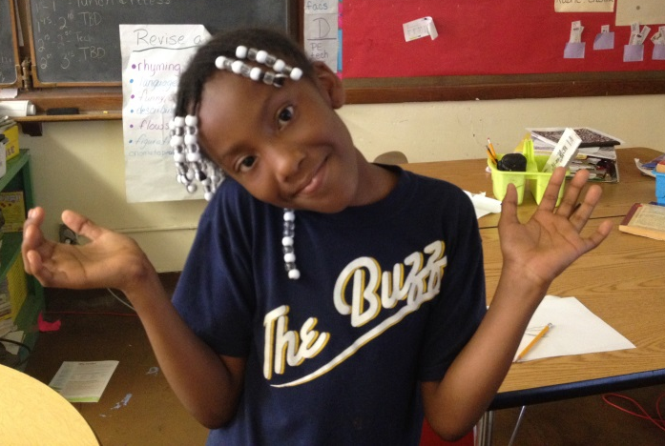
I Didn't Do Anything
by Janihya Thorton
I didn't do anything majorly wrong.
This is what I did:
1. I yelled at Miss Martin, and told her to get out of the room,
2. Made Aaniyah famous,
3. Punched Skye softly in the face.
4. Told Selah to “Shut up!”
5. Put pizza on Melanie's face,
6. Blamed a fart on Katie even though it was the dog,
7. I walked on the red carpet in fancy clothing,
8. Sent my teachers to the dumpster for 10 weeks,
9. Threw goo in Arabella’s face,
10. Kicked Kasim in the nose, and his nose only bled for two straight days,
I don't understand why I am in detention or why they call me bad.

Slide 31
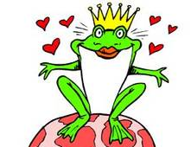
What if’s…
By Janihya Thornton
What if I lived in a mansion?
What if Aaniyah lost her two and got fours?
What if Skye turned into jelly and I ate her with whipped cream?
What if I gave Ms. Martin an empty Mountain Dew because I drank it?
What if my mom was a little girl again?
What if Troyrod had big lips and kissed Gabby the princess on the lips?
What if Aaniyah and I were queens in real life?
What if the “What if’s” were gone?

Slide 32
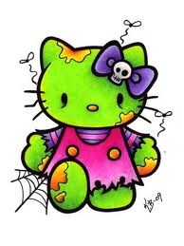
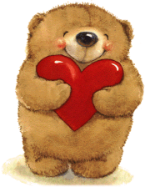
A Special Thank You to…
Our Families
Mrs. Connie Ashford
Mrs. Mary Ellen West
Mrs. Webster
Mrs. Ricci
Ms. Martin
Mrs. Robertson

