Slide 1
Classroom vs. Office Managed Behaviors

Slide 2
Classroom vs. Office Managed Behaviors
  School #33 faculty concluded which types of behaviors are to be managed by a teacher’s classroom system and which behaviors should be sent to the office.
A rubric was developed to create a standardized method of managing student behavior.
  The rubric is displayed as an escalating scale of problem behaviors.

Slide 3
Classroom vs. Office Managed Behaviors
In order to monitor progress of our universal system, we need to have accurate data collection.
  We will be now be able to examine office discipline referral rates and patterns to ask:
    How often are problem behavior events occurring?
    Where are they happening?
    What types of problem behaviors?
    When are the problems occurring?
    Who is contributing?

Slide 4
How was the rubric developed?
Professional Development (Winter 2011)- At a PD held in the winter of last year, the staff was split into small groups. Each group produced a T-chart listing behaviors they believed should be handled by the teacher and which behaviors should be handled by administration.
The SWPBS committee compiled all of these charts and developed the Classroom vs. Office Managed Behaviors Rubric.

Slide 5
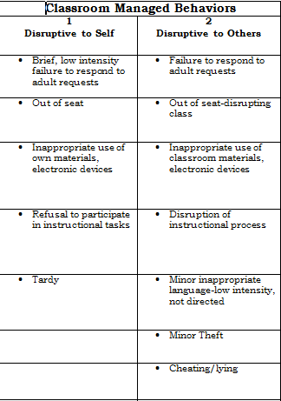
Classroom Managed
Level 1 & Level 2
Level 1 & 2 Offenses should be handled by a teacher’s classroom management system.
Your classroom system explicitly provides necessary classroom procedures, rules, expectations, consequences, and rewards that help students become more self-directed in their behavior.

Slide 6
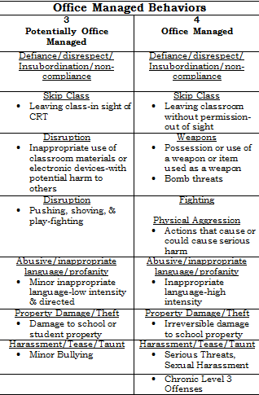
Office Managed Behaviors
Level 3 & 4
Potentially Office Managed
These behaviors are more severe and may

